Slide 1
Diabetes
Leading contributing Factors
Lesley Conn, Katrina Brown, Triston Cavaness and Juliet Hamilton

Slide 2
Title and Content Layout with List
Add your first bullet point here
Add your second bullet point here
Add your third bullet point here

Slide 3
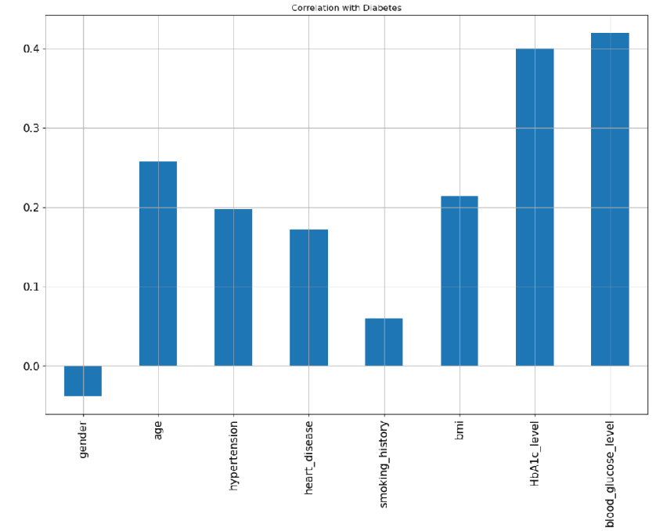
Correlation with Diabetes
The Kaggle data examined gender, age, hypertension, heart disease, smoking history, BMI, HBA1C levels, and glucose levels.

Slide 4
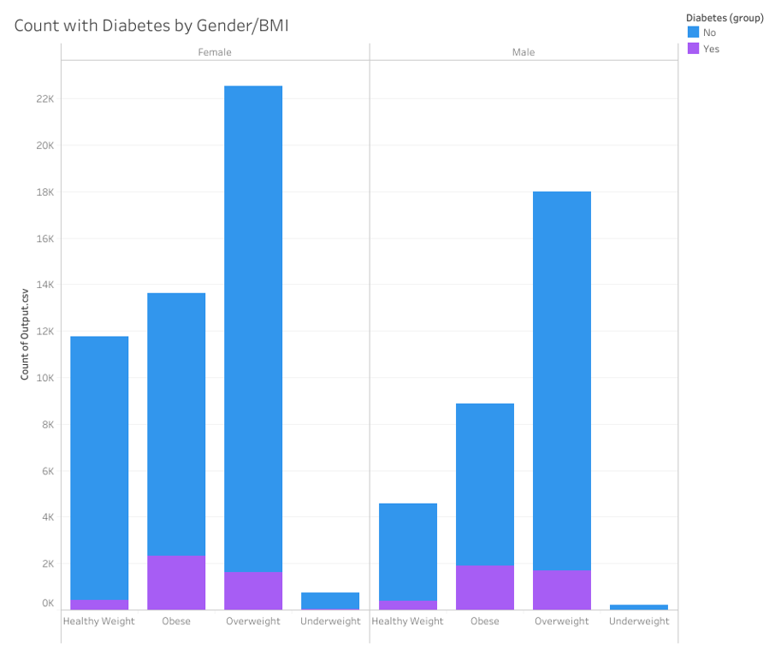
Analysis of Diabetics and Weight Levels
Women have higher levels of obese and overweight patients.
This analysis drove us to look at details in both men and women and also combined group.

Slide 5
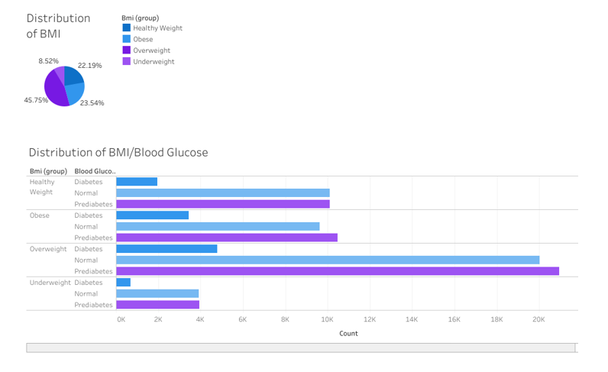
Distribution of Key Measurements
Distribution of BMI
23.5% are Obese
45.75% are overweight
Distribution of BMI/Blood Glucose
Overweight group has largest group with 4.7k (10% of group)
Obese group has 3.5k people(15% of group)
Obese group has higher percentage of people that are Diabetic

Slide 6
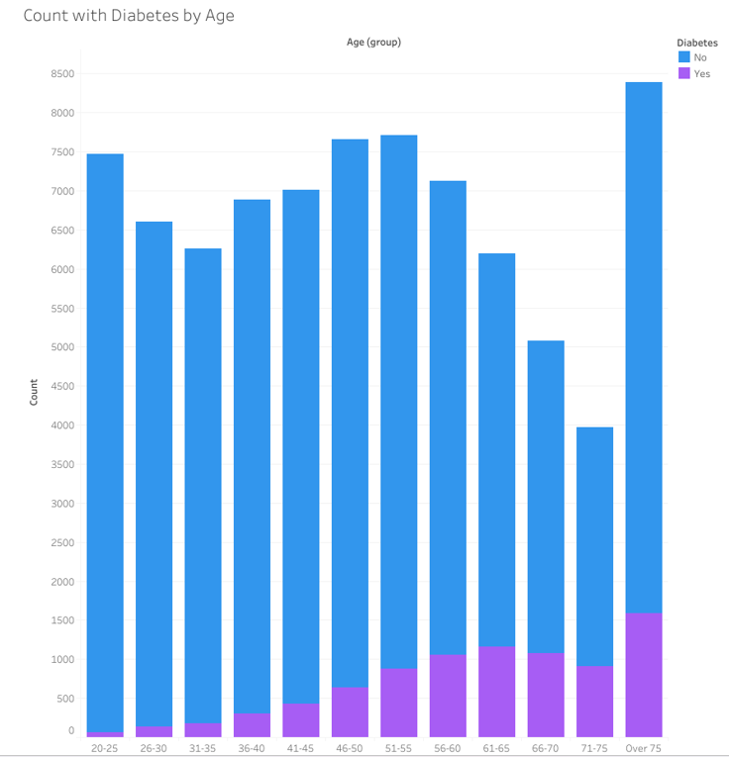
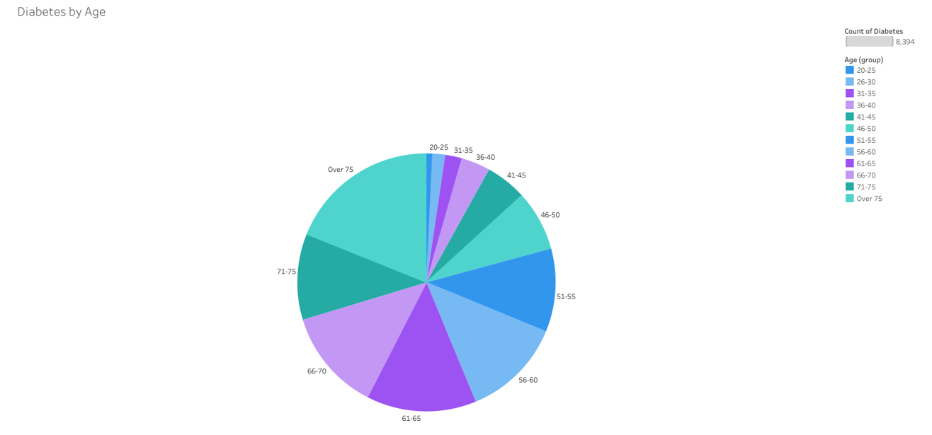
Analysis Age Distribution of patients with Diabetes
Diabetes increases with age. Key age point based on data begins at age 50.
79.2% of Diabetic group comes from ages 51 and older
Over 75 years is largest group with 18.9% of total group.

Slide 7
Add a Slide Title - 2

Slide 8
Add a Slide Title - 3

Slide 9
Fast Facts on Diabetes
Diabetes
Total: 38.4 million people have diabetes (11.6% of the US population)
Diagnosed: 29.7 million people, including 29.4 million adults
Undiagnosed: 8.7 million people (22.8% of adults are undiagnosed)
Prediabetes
Total: 97.6 million people aged 18 years or older have prediabetes (38.0% of the adult US population)
65 years or older: 27.2 million people aged 65 years or older (48.8%) have prediabetes
Risk Factors for Diabetes-Related Complications
- Smoking
- Overweight and Obesity
- Physical Inactivity
- A1C
- High Blood Pressure
- High Cholesterol
Preventing Diabetes-Related Complications
- Usual Source for Diabetes Care
- Physical Activity
- Weight Management
- Statin Treatment
- A1C, Blood Pressure, Cholesterol, and Smoking (ABCs)

Slide 10
Add a Slide Title - 5

