Slide 1

Text Analysis with R for Social Science Research
Project Mosaic Workshop
Date 10/6/2016
Ryan Wesslen, Computing & Informatics
rwesslen@uncc.edu

Slide 2

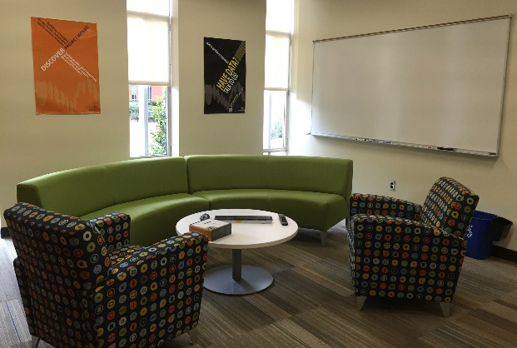
Project Mosaic
Project Mosaic: What do we do?
Build research methods capability in social sciences
Facilitate research across social science disciplines
Promote social science research
Project Mosaic Services
Social sciences research incubator
Facilitate connections
Bring people together to exchange ideas and pursue external funding
Information sharing on research funding opportunities
Consulting
Free to UNC Charlotte faculty, staff and graduate students
Workshops
Open to entire campus community
Provides cutting-edge tools for research and a forum for researchers to network within campus

Slide 3
Workshop Agenda
Overview of Text Analysis
Federalist Papers
Case 1: Text pre-processing & exploratory analysis
Case 2: Disputed authorship problem
Ridge Regression
Case 3: Exploring topics in the papers
Topic Modeling (LDA)

Slide 4
Learning Objectives
Level | Background | Learning Objective
Beginner | No background in R or text analysis | Learn text terminology and high level of text analysis approaches (e.g. pre-processing, classification, topic modeling)
Intermediate | Familiar with either R or text mining (not both) | Ability to rerun code independently and learn the associated R packages (quanteda, topicmodels) functionality.
Advanced | Proficient in both R and text analysis | Ability to customize code and answer advanced section questions at the end of each case.

Slide 5
Workshop materials
All workshop materials can be found here:
www.github.com/wesslen/federalist-papers-workshop

Slide 6
Introduction to Text Analysis

Slide 7
Why analyze text?
Growing
Interesting
Untapped

Slide 8
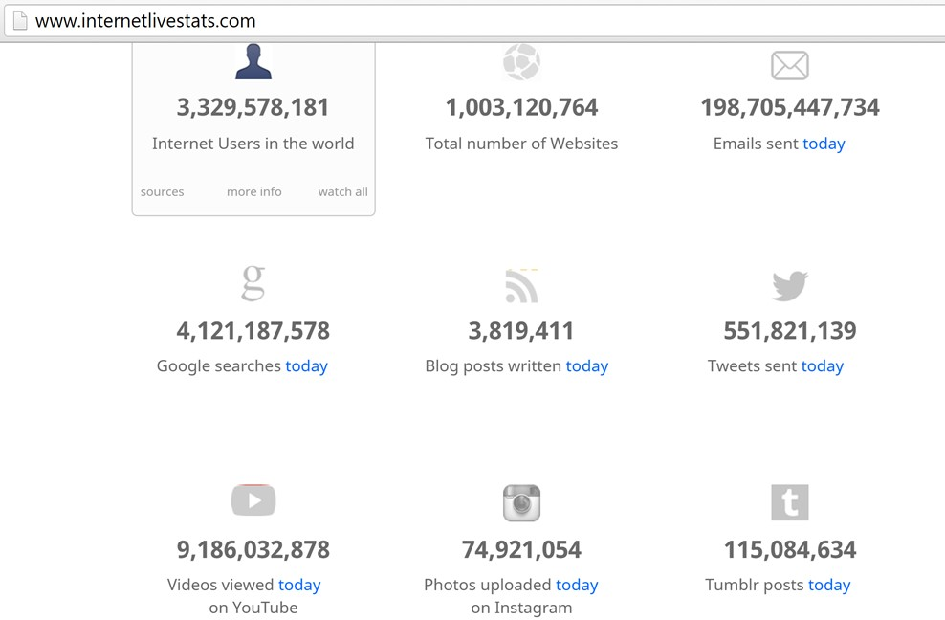
Big Data: Internetlivestats.com

Slide 9




Language Technology
making good progress
Sentiment analysis
still really hard
mostly solved
Best roast chicken in San Francisco!
Question answering (QA)
The waiter ignored us for 20 minutes.
Spam detection (Classification)
Coreference resolution
Q. How effective is ibuprofen in reducing fever in patients with acute febrile illness?
✓
Let’s go to Agra!
✗
Carter told Mubarak he shouldn’t run again.
Paraphrase
Buy V1AGRA …
Word sense disambiguation (WSD)
XYZ acquired ABC yesterday
Part-of-speech (POS) tagging
I need new batteries for my mouse.
ABC has been taken over by XYZ
ADJ ADJ NOUN VERB ADV
Parsing
Summarization
Colorless green ideas sleep furiously.
The Dow Jones is up
Economy is good
I can see Alcatraz from the window!
The S&P500 jumped
Named entity recognition (NER)
Machine translation (MT)
Housing prices rose
PERSON ORG LOC
第13届上海国际电影节开幕…
Dialog
Where is Citizen Kane playing in SF?
Einstein met with UN officials in Princeton
The 13th Shanghai International Film Festival…
Information extraction (IE)
Castro Theatre at 7:30. Do you want a ticket?
You’re invited to our dinner party, Friday May 27 at 8:30
Party May 27 add
Source: Dan Jurafsky

Slide 10
Why else is text analysis difficult?
non-standard English
segmentation issues
idioms
Great job @justinbieber! Were SOO PROUD of what youve accomplished! U taught us 2 #neversaynever & you yourself should never give up either♥
dark horse
get cold feet
lose face
throw in the towel
the New York-New Haven Railroad
the New York-New Haven Railroad
neologisms
sarcasm
tricky entity names
unfriend
Retweet
bromance
A: I love Justin Bieber. Do you like him to?
B: Yeah. Sure. I absolutely love him.
Where is A Bug’s Life playing …
Let It Be was recorded …
… a mutation on the for gene …
Source: Dan Jurafsky (modified)

Slide 11
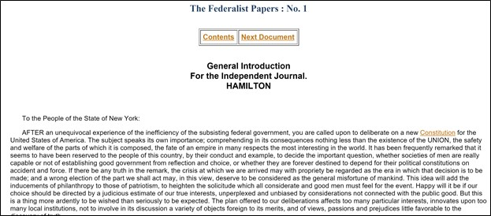
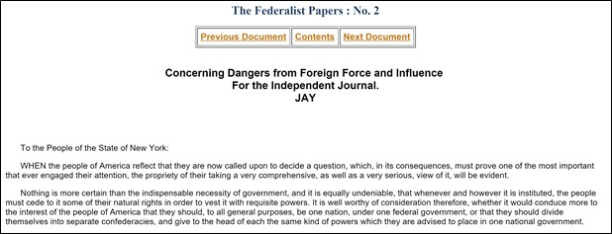
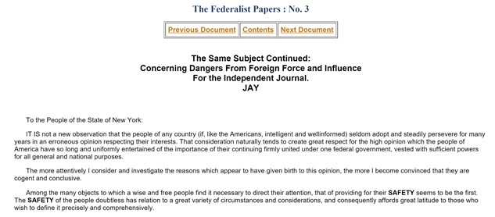
Basic Text Terminology
Corpus
Term
Document

Slide 12
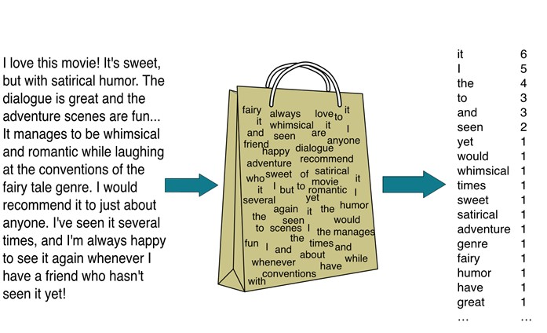
“Bag of Words” Approach
Source: Chris Manning
Simplest way to quantify text
Counts the term count per document
Document-Term Matrix
Ignores word order
N-grams (uni-,bi-,tri-, etc)
Good at classification
Like Spam Filter
Bad at semantic meaning

Slide 13
Preprocessing
Tokenize
Clean
Stem
Filter
Tokenization
Cleaning: Lower case, white space, punctuation
Stemming and/or Lemmatization
Filter: remove stop words

Slide 14
Case 1: Preprocessing & Exploratory Analysis
Intro to text analysis in R

Slide 15
Text Analysis with the Quanteda Package
We will use the R quanteda package:
https://cran.r-project.org/web/packages/quanteda/vignettes/quickstart.html

Slide 16
Case 1: Preprocessing
The exercise can be found on the github site:
https://github.com/wesslen/Federalist-Papers-Workshop/blob/master/part1/preprocessing-01.Rmd

Slide 17
Case 2: Disputed Authorship Problem
Supervised Learning

Slide 18


Alexander Hamilton

Slide 19
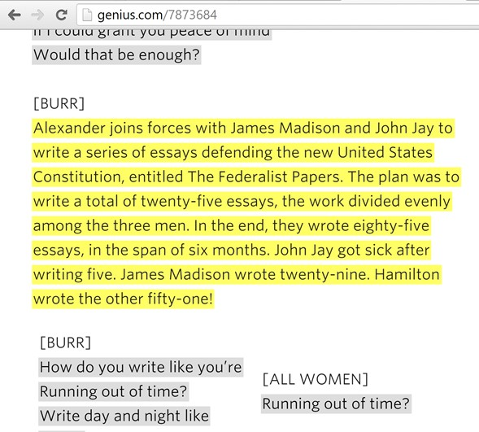
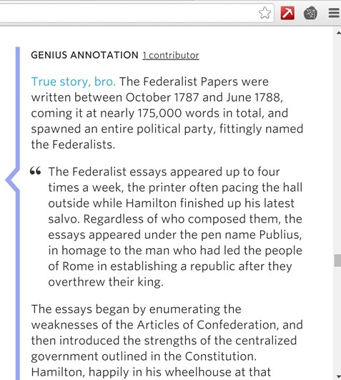
Genius.com’s “Non-Stop” Lyrics
Notes:
Set the bedrock for the united states government… if you want to know the original structure of the us government, this is your document.

Slide 20
Federalist Paper setup
Not so true story, bro (about how many papers each wrote)
Reality: the authorship of twelve papers is disputed
Hamilton claimed authorship before he was killed; Madison disputed those claims eight years later.
Adair (1944), Moesteller & Wallace (1963), Fung (2003), Collins et al (2004)
In this case, our goal is to build a binary supervised algorithm on the known authored papers.
The y variable is authorship (1 = Hamilton, 0 = Madison) and the x variables are the word counts.
We will then apply the model to the disputed papers to predict their authorship.

Slide 21
Text Analysis Methodologies
Text Analysis
Natural Language Processing
Bag-of-Words (Statistical-based)
Supervised
Unsupervised
Overgeneralization for illustrative purposes
SVM, Naïve Bayes, Regression

Slide 22
Predictive Models: Classification
Classification models predict class labels.
Class labels = categories
For example, binary (yes or no), ordinal (high, medium, low) or nominal (dog, cat, kangaroo)
Classification models use supervised algorithms as the class labels (“y variables”) are known (observed).
Determining the disputed Federalist papers is a binary classification problem as the author of the disputed papers is one of two authors: Hamilton or Madison.

Slide 23
Types of Classification Models
There are many different models (algorithms) that can be used for classification problems.
Examples: Naïve Bayes, Decision Tree, Support Vector Machine, Neural Networks
We are going to use Ridge Regression.

Slide 24
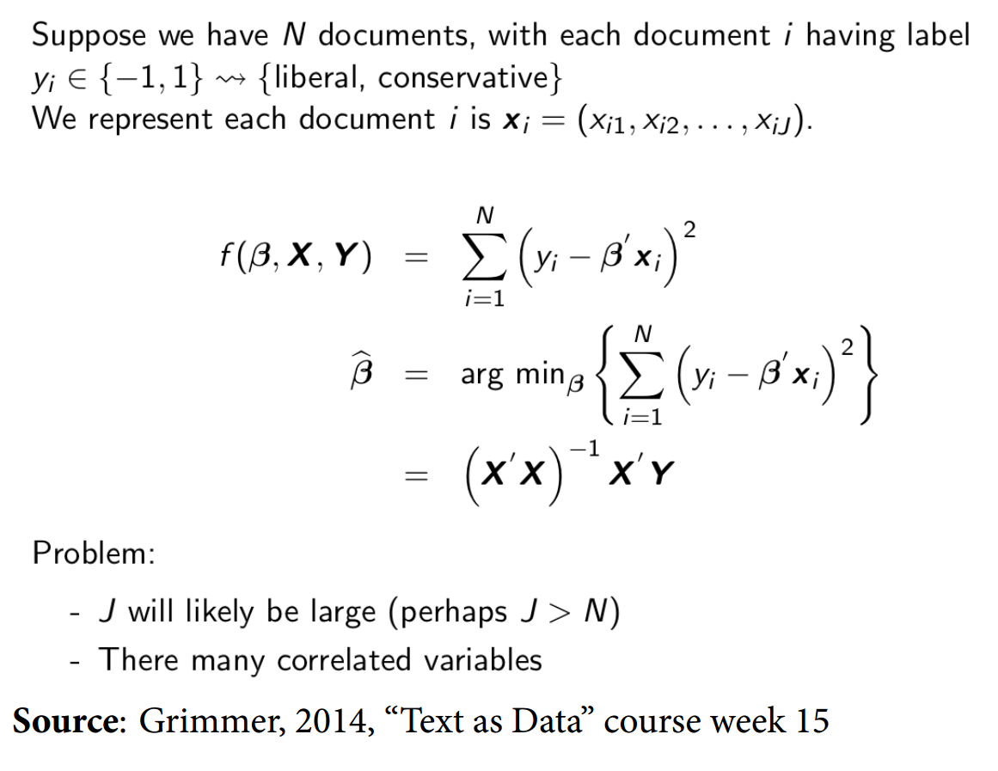
Ridge Regression

Slide 25
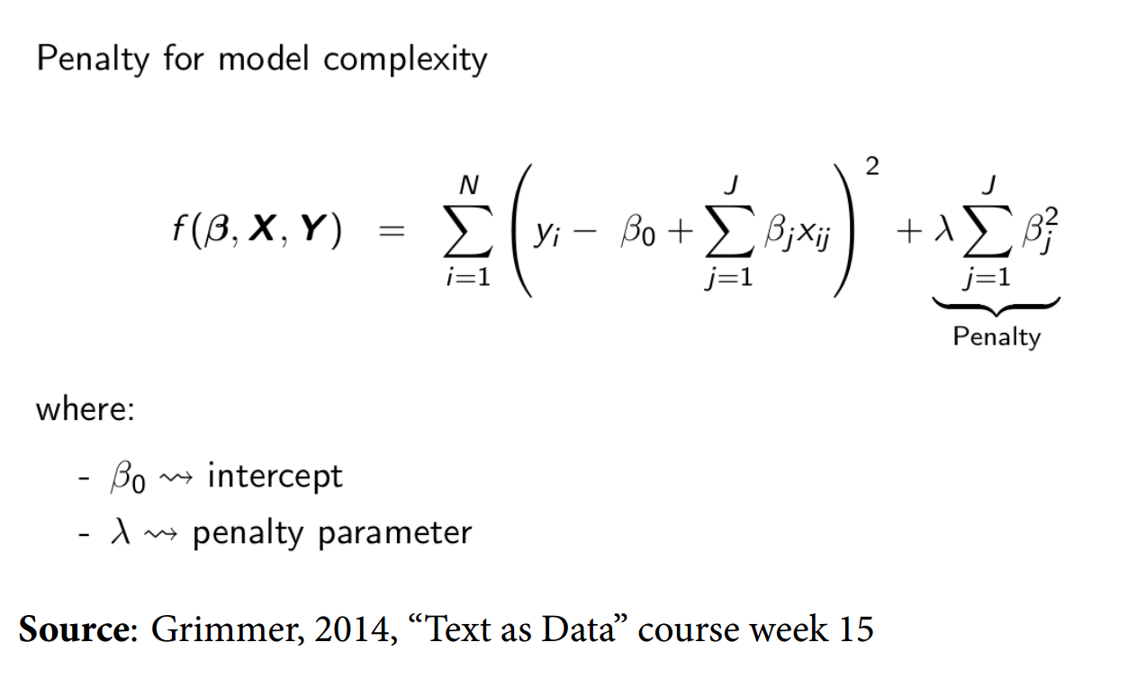
Ridge Regression

Slide 26
Ridge Regression
Ridge regression is based on regression framework but with regularization parameters.
Regularization = add in penalty for the number of X variables
Regularization is performed to reduce overfitting given the large number of X variables (words).
StackExchange on why Ridge Regression works well for text classification
StackExchange on Interpretation of Ridge Regression

Slide 27
Ridge Regression
Pro:
Prevents overfitting with many features (x variables)
Interpretable coefficients (compared to Naïve Bayes or SVM)
Con:
Decision of the lambda value (need of cross-validation)
Abandons unbiased estimator
A more thorough (statistical) overview of Ridge Regression

Slide 28
Cross-Validation
Intuition:
Create K training and test sets (“folds”) within training set.
For each k in K, run classifier and estimate performance in test set within fold.
Pick value of λ (regularization parameter) that gives better performance
Train classifier with full dataset and compute performance on test set
Why? Avoids overfitting
Source: Pablo Barberá

Slide 29
Case 2: Disputed Authorship Problem
The exercise can be found on the github site:
https://github.com/wesslen/Federalist-Papers-Workshop/blob/master/part2/supervised-02.Rmd

Slide 30
Case 3: Topic Modeling (LDA)
Unsupervised Learning

Slide 31
Text Analysis Methodologies
Text Analysis
Natural Language Processing
Bag-of-Words (Statistical-based)
Supervised
Unsupervised
Overgeneralization for illustrative purposes
SVM, Naïve Bayes, Regression
Topic Modeling

Slide 32
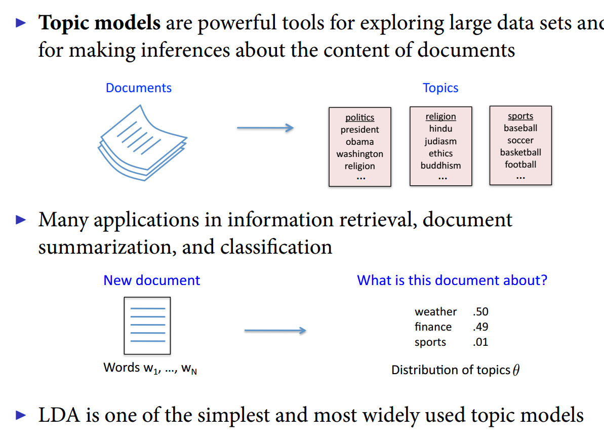
Topic Models
Source: Pablo Barberá

Slide 33
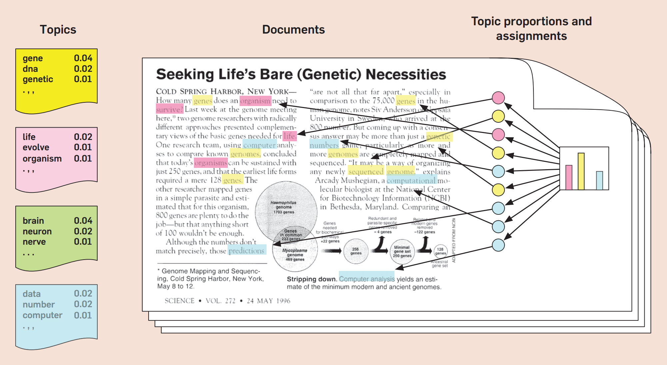
Latent Dirichlet Allocation (LDA)
David Blei’s “Probabilistic Topic Models” (2012)

Slide 34
topicmodels package in R
We’ll focus on a hands on introduction.
For more detailed documentation, see: https://cran.r-project.org/web/packages/topicmodels/vignettes/topicmodels.pdf
Also, we’ll try to run LDAVis package:
Sample: https://gallery.shinyapps.io/LDAelife/

Slide 35
Case 3: Topic Modeling
The exercise can be found on the github site:
https://github.com/wesslen/Federalist-Papers-Workshop/blob/master/part3/topicmodeling-03.Rmd

Slide 36
Learning Objectives
Level | Background | Learning Objective
Beginner | No background in R or text analysis | Learn text terminology and high level of text analysis approaches (e.g. pre-processing, classification, topic modeling)
Intermediate | Familiar with either R or text mining (not both) | Ability to rerun code independently and learn the quanteda package basic functions.
Advanced | Proficient in both R and text analysis | Ability to customize code and answer advanced section questions at the end of each case.

Slide 37
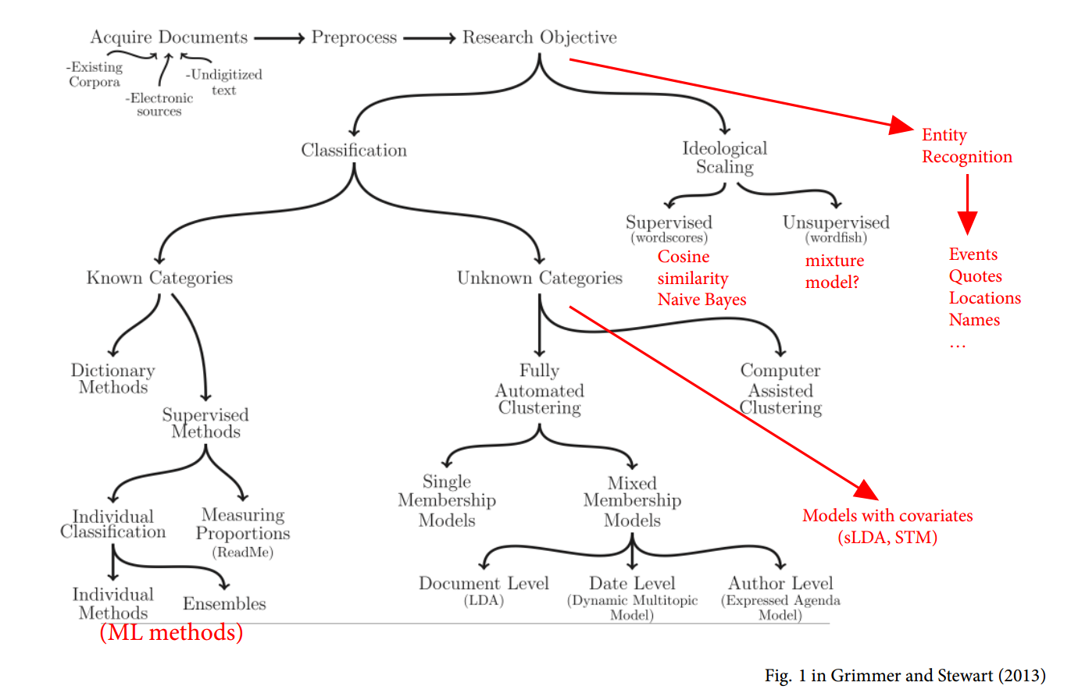
Automated Text Analysis Methods
Source: Pablo Barberá

Slide 38
Resources for Social Science Text Analysis
Quanteda package vignette
https://cran.r-project.org/web/packages/quanteda/vignettes/quickstart.html
Justin Grimmer’s Text as Data Course
http://stanford.edu/~jgrimmer/Text14/
Topicmodels package vignette
https://cran.r-project.org/web/packages/topicmodels/vignettes/topicmodels.pdf
Stm package vignette for Structural Topic Modeling
https://cran.r-project.org/web/packages/stm/vignettes/stmVignette.pdf

Slide 39
More About Services
Research Incubator
Affiliates Program
Faculty Affiliates are hand picked for their research expertise
Our affiliates leverage the core functionality and expertise of Project Mosaic
Seed Grants Program
Geared towards the formation of new teams of researchers in the social, behavior and economic sciences
Aim is to pursue external funding
Consulting
Project Mosaic offers three types of consulting:
Software-centric
Dissertation/thesis assistance
Research collaboration
Workshops
Our workshops fulfill a commitment to enhance data literacy and analytical capabilities of UNC Charlotte researchers
Make an appointment on our website!
Find workshops online on our Events List.

Slide 40



Contact Project Mosaic
Jean-Claude Thill is the director of Project Mosaic. A broadly trained geographer, he is a ‘Knight’ Distinguished Professor of Public Policy at UNC Charlotte.
Contact Jean-Claude:
Email: Jean-Claude.Thill@uncc.edu
Phone: 704-687-5931 ext. 75909
Leonora is the Administrative Support for Project Mosaic. She manages our not-so-massive paperwork, coordinates meetings and assists with administrative functions.
Contact Leonora:
Email: projectmosaic@uncc.edu
Phone: 704-687-5931
Visit our website!
Projectmosaic.uncc.edu

Slide 41
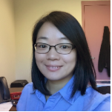

Additional Resources: Consultants
Shaoyu Li is the head consultant in the Center of Statistics and Applied Mathematics Consulting Center (CSAMC) and works with Project Mosaic to coordinate consulting requests for statistical and mathematical expertise.
Contact Shaoyu:
Email: shaoyu.li@uncc.edu
Kailas Venkitasubramanian is a research methodologist and manages the consulting service and the workshop program of Project Mosaic. Kailas is experienced in a variety of applied statistical techniques and works fluently on multiple software platforms.
Contact Kailas:
Email: kvenkita@uncc.edu
Notes:
https://projectmosaic.uncc.edu/make-a-consulting-appointment/

Slide 42
Questions?

