Slide 1
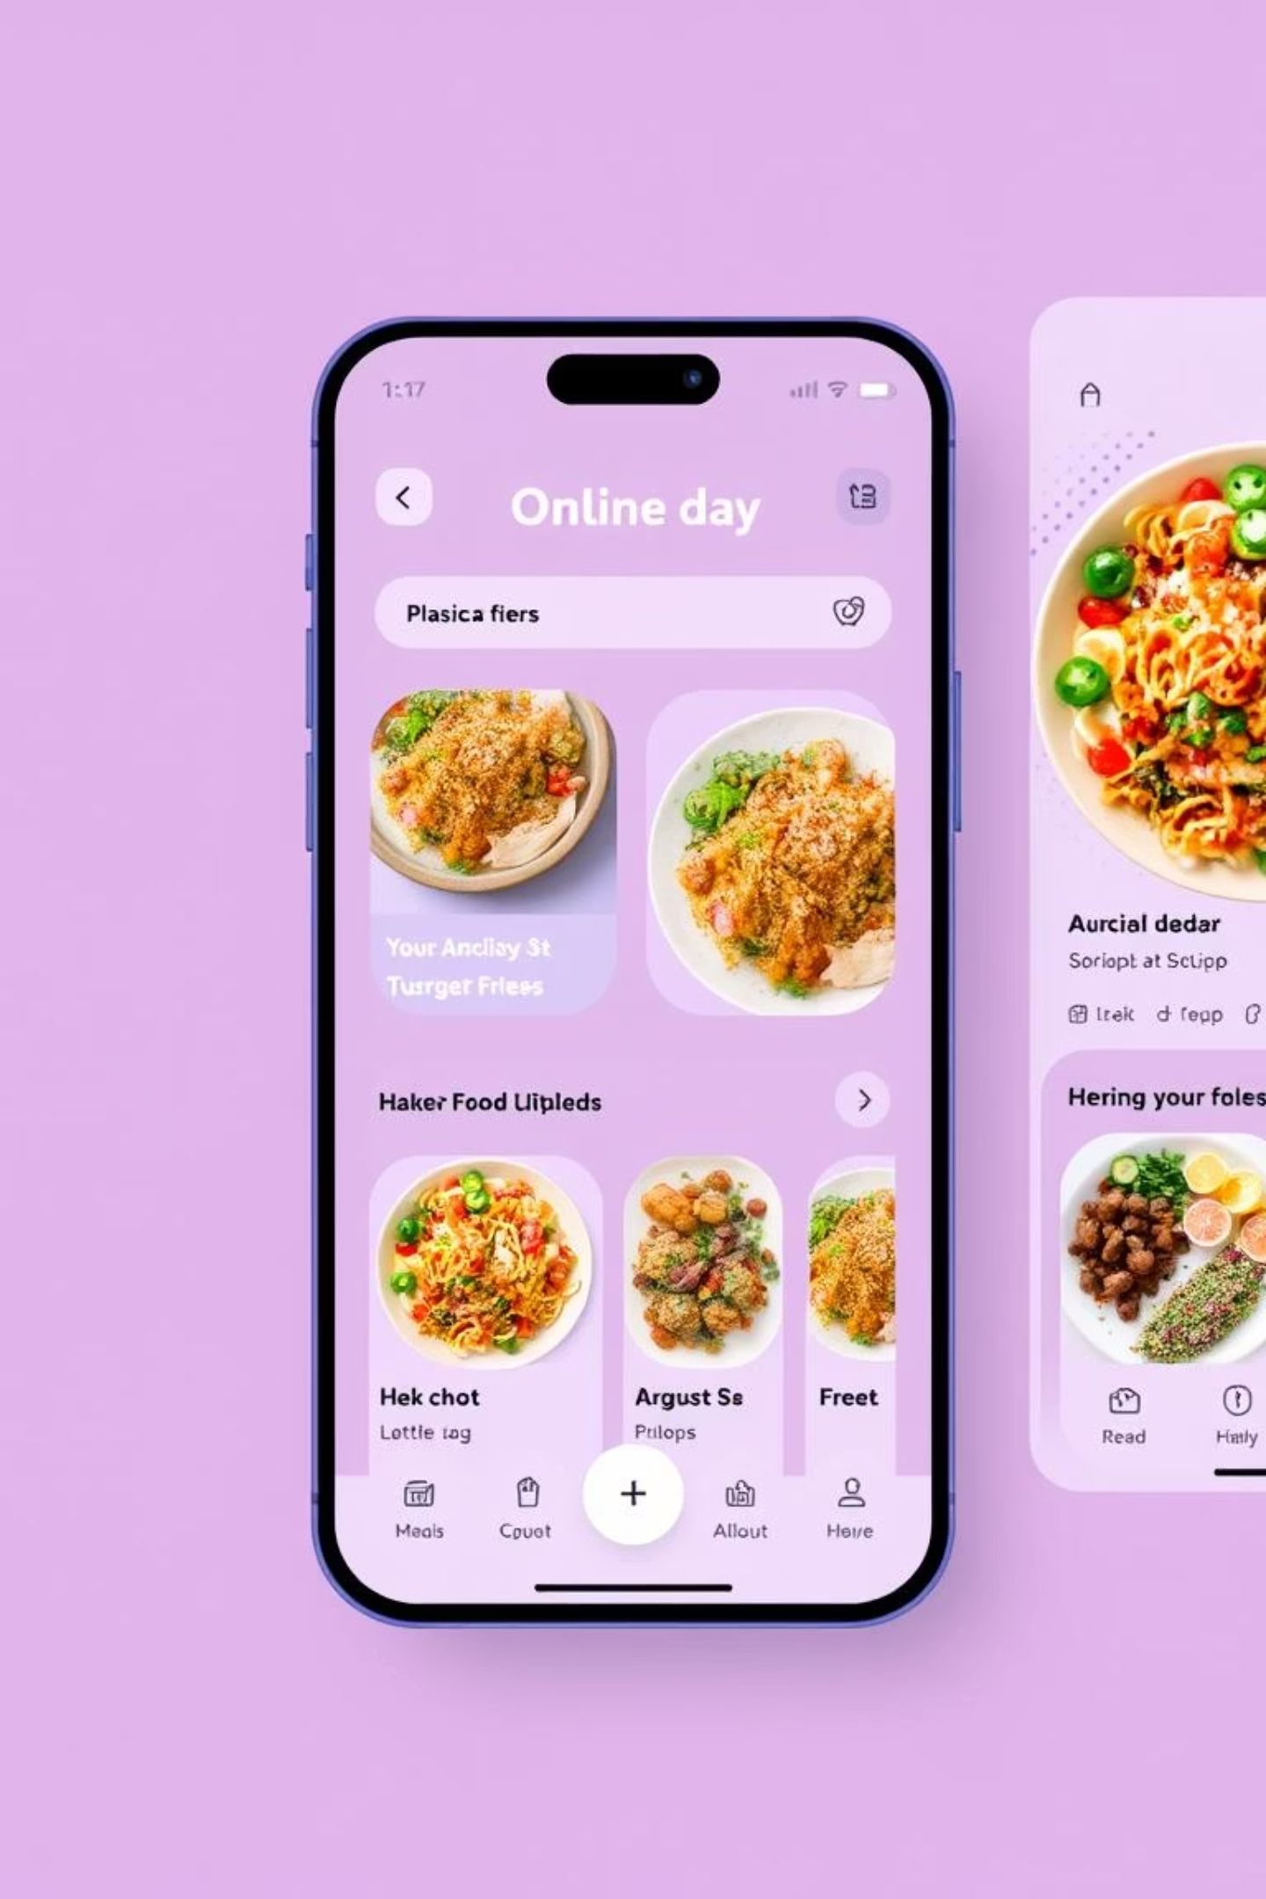

Developing an Online Food Ordering System
This presentation outlines the development of our Online Food Ordering System, a comprehensive web application designed to streamline the food ordering process for users and simplify menu management for administrators.
Developed by: Harini, Prasanna, Uma Nandini, Haleema, Swathi, Lakshmi Kala, Sri Lakshmi, Chandini.

Slide 2
Project Overview
Our Online Food Ordering System is a full-stack application enabling users to browse food items, manage a shopping cart, apply filters, and place orders. It also features a secure login/signup system and a robust admin panel for comprehensive menu management.
1
2
3
User-Centric Experience
Admin Control ( CLI )
Register & Login
Intuitive browsing, cart management, and seamless order placement.
Efficient tools for menu updates and operational oversight.
Robust login and registration features for user accounts.

Slide 3
Technology Stack
Frontend
Backend
HTML: Structure and content of web pages.
Java: Core business logic and API development.
CSS: Styling and visual presentation.
SparkJava: Lightweight web framework for routing.
JavaScript: Interactive elements and dynamic content updates.
Maven: Project build automation and dependency management.
Our choice of technologies provided a robust and scalable foundation for the application, balancing performance with ease of development.

Slide 4





Core Modules
User Module
Admin Module
Menu Module
User registration, login, menu viewing, filtering, and order placement with cart functionality.
Backend menu management, including adding, removing, and updating food items.
Displays food items with images, names, and prices using interactive cards.
Cart & Order
Filter/Sort
Functionality to add items to cart, confirm orders, and send data via JavaScript fetch() POST calls.
Dropdown for sorting items by price (Low to High / High to Low), implemented with JavaScript.

Slide 5
Frontend-Backend Integration & Data Management
Seamless Communication
Data Structures & Algorithms
SparkJava: Utilized for efficient backend routing and endpoint exposure (e.g., /login, /order, /menu).
ArrayList: Used extensively for dynamic storage of menu items, cart contents, and order details.
JavaScript fetch(): Enabled asynchronous communication between frontend and backend.
Sorting Algorithms: Applied Quick Sort or Merge Sort for efficient price-based menu sorting.
CORS Handling: Properly configured in SparkJava to ensure secure and smooth cross-origin requests.
Java Collections: Leveraged various Java collections and applied sorting/searching logic as needed for optimal data handling.

Slide 6
Project Flow: A User's Journey
Home Page
Display of available food items, with options for user login or registration.
Login/Register
Secure validation of user credentials or creation of new accounts.
User Dashboard
Access to the full menu, cart management, and the ability to place orders.
Admin Panel
Exclusive access for administrators to add, modify, or delete food items from the menu.
Order Confirmed Page
Confirmation and summary displayed to the user after a successful order placement.

Slide 7
Challenges and Solutions
Frontend-Backend Connection
CORS Handling
Professional UI Design
Implementing Cross-Origin Resource Sharing (CORS) correctly in SparkJava was crucial to enable secure communication across domains.
Designing an intuitive and aesthetically pleasing user interface that mimics professional food ordering applications demanded significant effort in CSS and layout.
Establishing seamless data flow between the HTML/CSS frontend and the SparkJava backend proved challenging, requiring careful endpoint configuration.
Overcoming these challenges significantly enhanced our understanding of full-stack development and practical problem-solving.

Slide 8
Conclusion & Key Learnings
This project provided invaluable hands-on experience in building a real-world web application from the ground up.
Java Backend Mastery
Seamless Integration
Deepened understanding of Java for robust server-side logic and API development.
Gained expertise in connecting frontend technologies (HTML/CSS) with a Java backend.
Web Application Logic
Problem-Solving
Applied core web development principles to implement features like user authentication, cart management, and RESTful APIs.
Developed critical skills in debugging and resolving complex technical challenges, particularly with CORS and data flow.
We are proud of the functional and user-friendly system we developed.

Slide 9

Thank You !

