Slide 1


Predicting Traffic Speed on a
Road Network
Project 4: Traffic Flow Prediction and Signal Control
Phase 1: Machine Learning
Team T072, Section C
Rudraksh Sharma
Anshuman Mehta
Vridhi Chaudhary
Bineet Keshari
Kavya Katal

Slide 2



The Problem
Traffic spreads fast. We forecast to stay ahead.
Traffic jams start on one road
and spread to nearby roads
Goal: predict the speed at every road sensor 15, 30 and 60 minutes ahead
Phase 1: one machine-learning
model per sensor
Phase 2: a graph model that also
looks at neighbouring roads
Any traffic signal control is only simulated, never on real roads

Slide 3

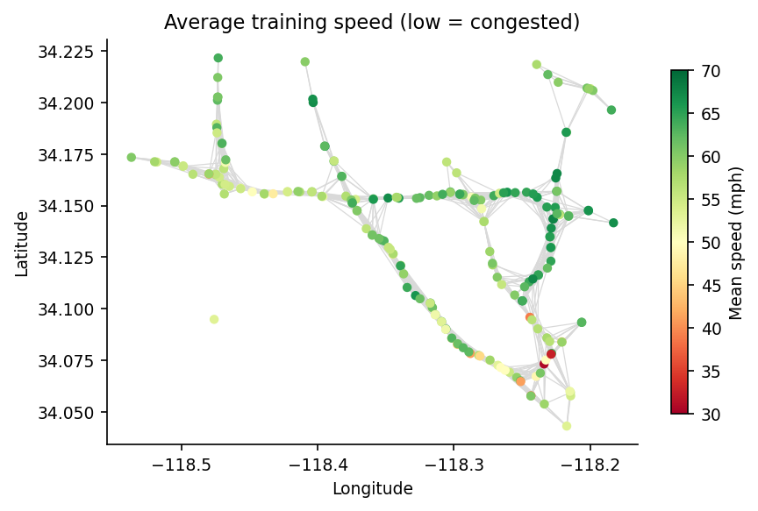

The Data and
How We Checked It
METR-LA: 207 speed sensors on Los Angeles highways
One reading every 5 minutes, March to June 2012 (34,272 time steps)
We checked the size, the 5-minute gaps
and the sensor order
Our rebuilt road map matches the published one
The data has speed only, no vehicle counts

Slide 4



Cleaning the Data
and Building Features
of readings are missing; 0 mph means the sensor was off, so we ignore it
38
8.1%
Split by time: first 70% to train,
next 10% to tune, last 20% to test
features per sensor
Never a random split, so the
model cannot peek at the future
Last 12 speeds
15 and 30 minute averages
Time of day and day of week
written as circles (sin and cos)
Missing flags

Slide 5



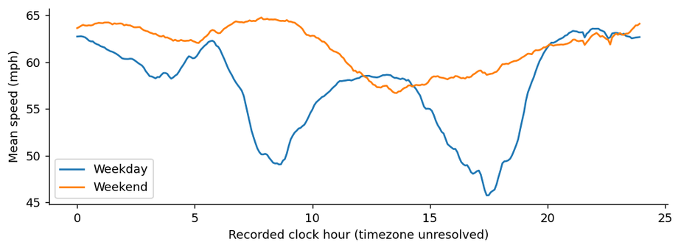


What the Data Shows
Weekdays see major slowdowns
around 8–9 am and around 5:30 pm
Weekends do not have
a morning rush
Some days the whole network is offline and some sensors are offline for days
Downtown roads are the slowest
on average

Slide 6

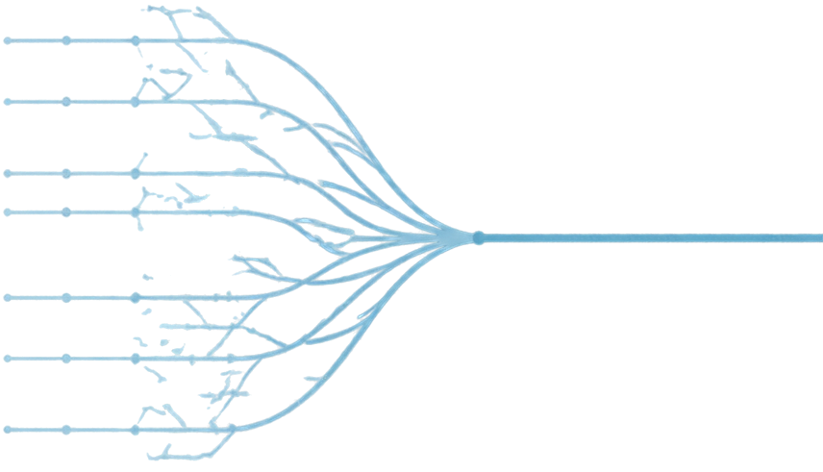
Simple Baselines and Random Forest
Starting points and the first learned model.
Persistence: speed will stay the same as now
Historical average: the usual speed for
this time of the week
Random Forest: many decision trees
vote on the answer
One forest per sensor predicts all 12
future steps at once
Makes the fewest very big mistakes

Slide 7



XGBoost and
How We Measure Error
Trees built one after another,
each fixing the last one's mistakes
One model per sensor and per future step
Settings chosen on the tuning data only, never the test data
MAE
Average error in mph
RMSE
Punishes big misses more
MAPE
Error as a percentage
Lower error is better; these are errors, not accuracy percentages.

Slide 8







Results
Test-period average error (MAE, mph)
15 MINUTES AHEAD
30 MINUTES AHEAD
60 MINUTES AHEAD
Persistence
3.48
4.17
5.32
Historical average
4.19
4.19
4.19
Random Forest
2.97
3.42
3.90
XGBoost
2.92
3.38
3.87
XGBoost is best on average error,
16% to 27% better than persistence
Random Forest has the fewest very big misses
Both learned models beat both simple baselines at every horizon

Slide 9

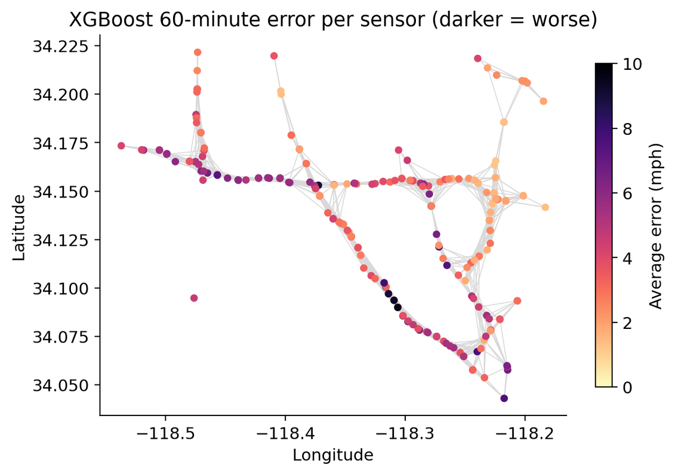




Where the Models Still Fail
Rush-hour errors are about twice the normal errors
At 60 minutes in rush hour,
Random Forest beats XGBoost (5.95 vs 6.31 mph)
The biggest errors
sit together on the same roads
A sensor's own past cannot warn it about a jam starting on a nearby road

Slide 10



Next Steps and Thank You
Build a graph attention network on
the same road map, with the same splits and 1-hour history
Check if it helps most at rush hour
and on the worst roads
Optionally, test a signal-timing
idea in a simulator only
Thank you. Questions?

