Slide 1


Slide 2





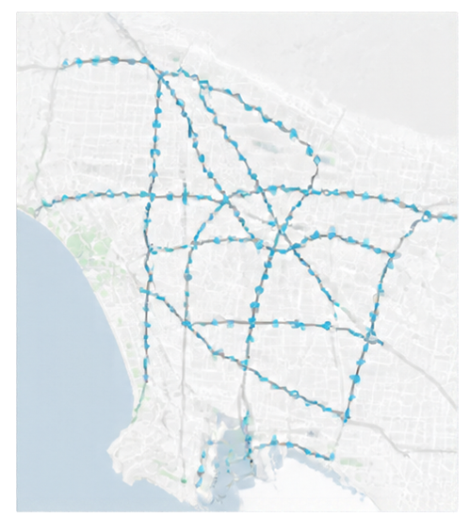





METR-LA Dataset & EDA
Data overview and exploratory insights
Sensor geography
207
Average speed profile
sensors
weekday
weekend
80
34,272
60
timestamps
pads areane
40
5-minute
cadence
20
0
March 1–June 27 2012
00:00
06:00
12:00
18:00
24:00
data period
time of day
8.11%
Missingness insights
Missingness occurs in contiguous blocks
missing values under
Aligned with sensor downtime periods
benchmark zero/NaN convention
Graph validated for integrity but not used by trained models

Slide 3




















Causal Preprocessing & 38 Features
From past readings to predictive features
Past 12
readings
Detect
missing
Forward-fill within history
Extract
features
History window
from the same sensor
Identify gaps
within history
Fill only using
available past values
Convert history
into predictors
Leading missing values are set to the sensor training median. Future targets remain untouched.
12
12
9
5
Lag features
Missing flags
Statistical / change
Calendar features
Historical speed
values from the past
Indicators showing where data was absent
Aggregates and change metrics from history
Time-based context
from calendar signals
Total features:
38
No standardization, PCA or feature selection ablation.

Slide 4















Four Forecasting Methods
Traditional machine learning approaches for traffic speed prediction
PERSISTENCE
HISTORICAL AVERAGE
RANDOM FOREST
XGBOOST
M0
M1
M3
M4
repeats latest
valid reading
uses training
time-of-week
target slot
207 multioutput forests
selected 48 trees
depth 12
2,484 direct sensor×horizon
regressors
selected 140 trees
depth 3
key configuration
approach
approach
key configuration
140 trees
maximum depth 3
learning rate 0.06
absoluteerror objective
uses most recent
observed speed
averages past values for
same time-of-week
48 trees
maximum depth 12
six
validation mean absolute error (MAE)
3.829
3.881
3.824
3.413
pilot sensors
VS
VS
Random Forest
Historical Average
XGBoost
Historical Average

Slide 5


















05 — Chronological Experiment & Evaluation
Data split timeline and evaluation approach
Training
Tuning validation
Second validation
Test
23,963
1,701
1,702
6,850
forecast origins
forecast origins
forecast origins
forecast origins
Same observed targets used for scoring
Purge last 11 forecast origins
MAE
RMSE
MAPE
at earlier boundaries to avoid future-label overlap
mean absolute error
root mean squared error
mean absolute percentage error
Test inspected previously
results are exploratory, not a pristine holdout

Slide 6






Results
MAE and RMSE across forecast horizons and models
MAE (mph)
RMSE (mph)
27.2%
Model
15 min
30 min
60 min
15 min
30 min
60 min
lower 60 min MAE
with XGBoost vs
persistence
Persistence
3.482
4.173
5.321
5.214
6.178
7.645
Historical average
4.187
4.187
4.187
6.021
6.021
6.021
Best RMSE
Random Forest
2.972
3.423
3.896
3.982
4.615
5.487
random forest has the lowest pooled RMSE at all three horizons
XGBoost
2.920
3.376
3.874
4.046
4.701
5.592
results are exploratory and for comparison only

Slide 7








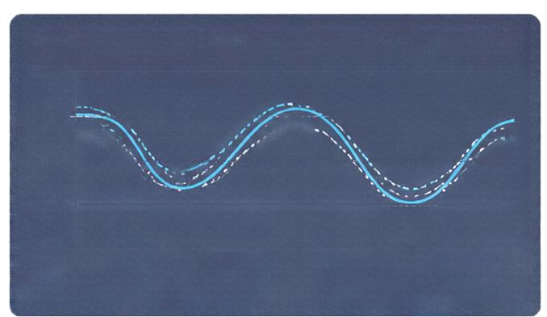





07 — Rush Hour & Error Analysis
Mean Absolute Error (mph)
Prediction example (Illustrative only)
Random Forest
XGBoost
60-MINUTE
PEAK
5.954
6.308
Observed speed
XGB prediction
RF prediction
80
mph
mph
60
Random Forest
XGBoost
(RdW)peaks
3.379
3.261
40
60-MINUTE
OFF-PEAK
20
mph
mph
0
206/207
00:00
06:00
12:00
18:00
24:00
sensors where XGB beats persistence at 60 minutes
time of day
Longer forecasts increase prediction difficulty
Sensor 717488
June 5 2012
Sudden congestion shifts add to forecasting error

Slide 8











Conclusions, Limitations & Phase 2
What we established
Limitations
Next steps
Validated speed-only 207-sensor pipeline with 38 causal features
Exposed test
Controlled graph-aware GAT experiments
Limited tuning
No-neighbour controls
XGB 3.874 mph 60-min MAE
Speed-only
LWR needs extra flow density assumptions
No neighbour inputs
RF stronger RMSE
and peak MAE
Unresolved timezone
Any control experiment simulated only
3.874
60-min MAE with XGB
mph
Thank you / Questions

