Slide 1
Saving Your Credit Score: Analysis of Small Business Loans
By Stephanie, Morgan, Marisol, Katalina
Notes:
Consultants, who help small businesses grow. (They will guide from an initial idea to the point to qualify for a small business loan and be successful enough to not default on it.

Slide 2
Kaggle:
Should This Loan be Approved or
Denied?
Dataset Size
27 Columns
Rows: 899164 Columns: 27
A large and rich dataset from the U.S. Small Business Administration (SBA)
SBA loans from 1970-2014
Name of business, bank, state, gross amount, term, approval date, default date...

Slide 3
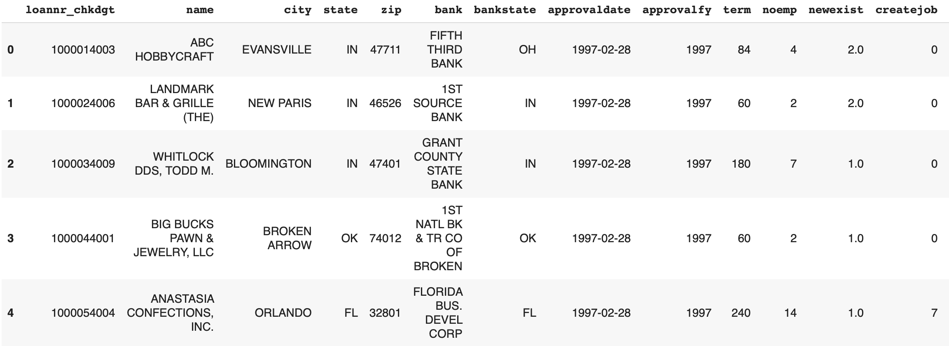
Data Set

Slide 4
Goals
What factors tend to cause a loan to be defaulted on.
Create a model to predict which approved loan applications will default on their loan.
Hi, I have a small business. How can I get a loan and not default on it?

Slide 5
What is SBA ?
Requirements and Tips
The Small Business Administration
Provides support to small businesses and entrepreneurs.
Connects businesses with lenders to help grow their business.
Requirements
Must be a legally operating business in the USA.
Cannot be funded by another lender.
Deciding factors
How you get your income
Business location
Business size
New or existing

Slide 6
How to get a loan?
Personal
Credit Score
Interview with the banks
Personal Record
Business
Existing or New
Bank
Industry
Loan Terms
Loan Amounts

Slide 7
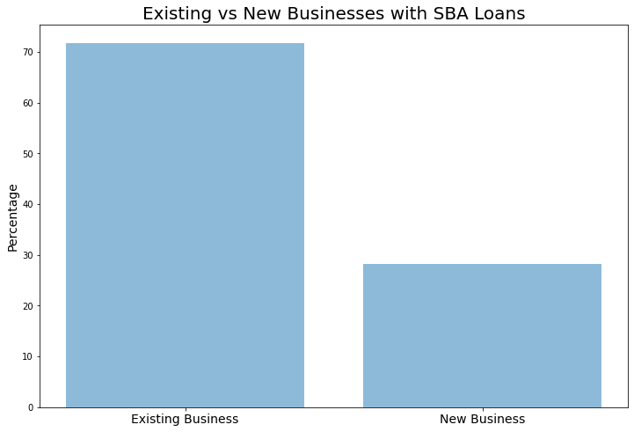
Between 1970 and 2014 70% of loans were given to Existing businesses

Slide 8
Factors that play a role in defaultness
Identified 5 factors from the SBA website as well as Business.org
Analyzed 15 different features
Our findings are consistent with these sites
Features
Industry
Year
Loan Term
Loan Amount
Bank
Notes:
Why these factors influence defaultness

Slide 9
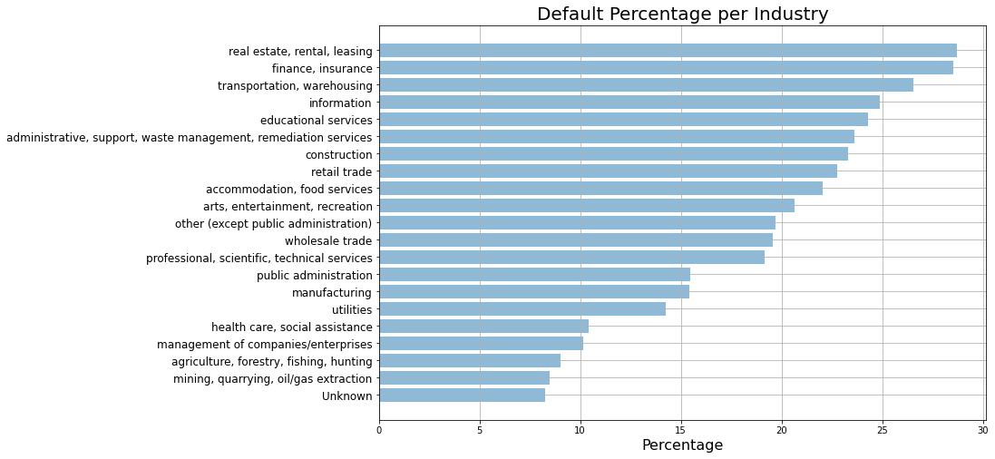

Slide 10
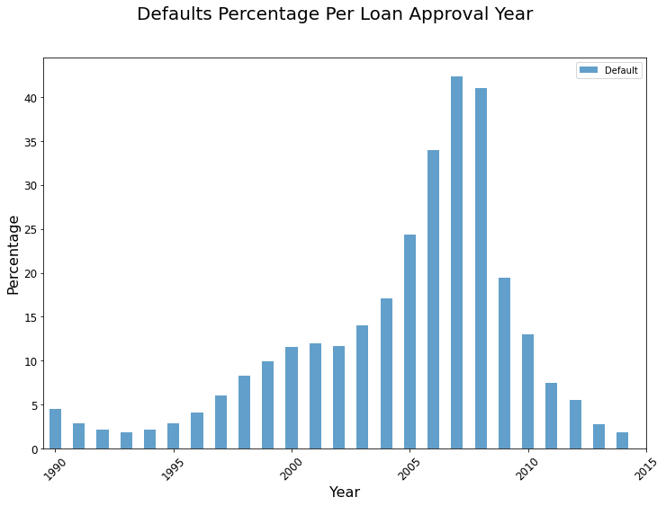

Slide 11
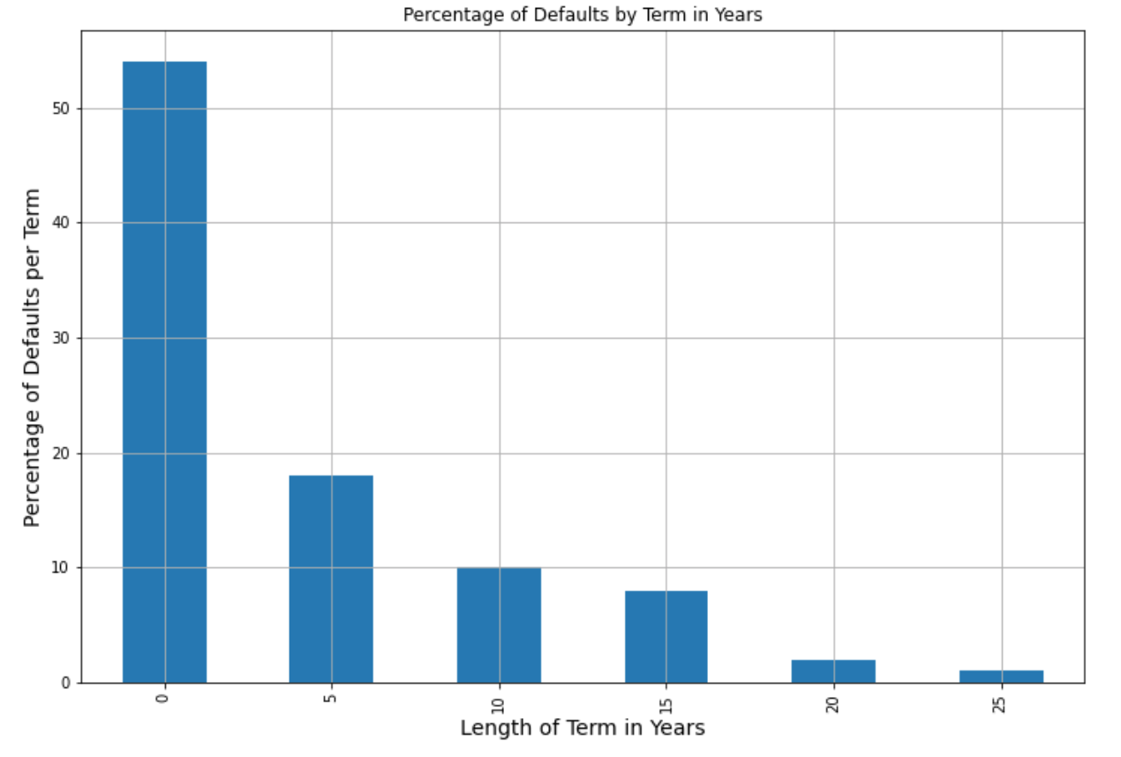
54% of loans with terms less than 2.5 years defaulted
Only 1% of loans with terms of about 25 years defaulted
Notes:
While determining this, we came to the conclusion that the reason larger term, amount loans didn’t default as much is because of trust. The small term, amount loans aren’t risky. The banks hand them out so much more often and don’t care as much about these as less than $50,000 isn’t much to a lender. This is the opposite for the larger term, amount loans. These are extremely risky loans for the banks. Thus they must be super confident in the businesses they loan to and have almost a guarantee they will not default. Our recommendation is that if you are offered a long term loan to take it because it most likely means that the bank has trust in you.

Slide 12
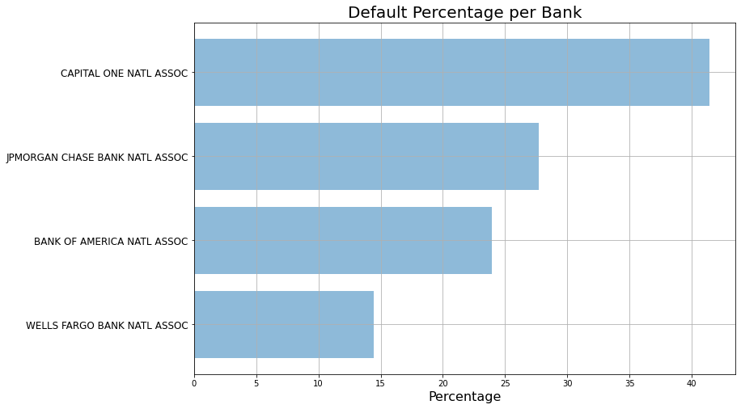
Average term was 5.5 years
Average term was 10 years
Notes:
We also found the average term Capital One was 66 months and Well Fargo was 119 months, This is consistent with what we found earlier. The longer the term the more likely you are to not default. We recommend if you are going to use a big bank to secure a loan to go with Wells Fargo.

Slide 13
Model (XGBoost)
Decision tree-based model
Decision trees can capture non-linearity in data
In XGBoost, multiple decision trees are built subsequently (called “boosting”)
Builds current decision tree based on where previous decision tree did poorly

Slide 14
Model (XGBoost)
Predicts whether a loan will default or not based on the SBA Loan dataset from 1970-2014
Model will help US economy come out of the recession by making sure loans given out won’t default
90% precision on predicting defaulted loans

Slide 15
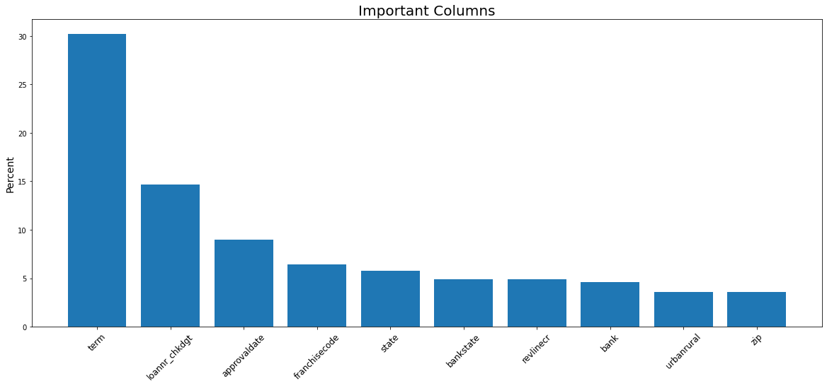
The SBA website, our analysis, and our model found 3 similar contributing factors

Slide 16
In summary, if you’re looking to get a loan:
Be aware that some industries are riskier than others
The current pandemic can increase your likelihood of defaulting
Go for a longer term loan (ideally 20-25 years) if possible
Wells Fargo is the safest bet out of popular banks

Slide 17

$200,000
20,000
$400,000,000
Average loan amount given by the SBA
Average amount of SBA loans given yearly
Saved using our model

Slide 18

THANKS!
Any questions?

