Slide 1
IITU Lockdown impact on Air quality in Hubei province in China
Abutalip Kudaibergen
May 2020

Slide 2

Hubei Province Climate Data
Xiaogan
Jingzhou
Huanggang
Xianning
Suizhou
Enshitujiazumiaozu
NO2
Wuhan
Huangshi
Shiyan
Yichang
Xiangfan
Ezhou
Jingmen
CO
O3
PM
SO2
01.01.20 – 23.01.20
01.03.20 – 23.03.20

Slide 3
Hypothesis
H0: Air quality parameters didn’t change
H1: Lockdown affected air quality parameters

Slide 4
Hypothesis
H0: Air quality parameters didn’t change
H1: Lockdown affected air quality parameters
T-Test. The paired sample t-test, sometimes called the dependent sample t-test, is a statistical procedure used to determine whether the mean difference between two sets of observations is zero.
An “F Test” is a catch-all term for any test that uses the F-distribution. In most cases, when people talk about the F-Test, what they are actually talking about is The F-Test to Compare Two Variances.

Slide 5
AQI, CO, NO2
AQI(Air quality index)-information on the quality and composition of atmospheric air

Slide 6
O3, SO2
Ozone is a gas composed of three atoms of oxygen

Slide 7
PM10, PM2.5
Particulate matter (PM10) are particles of any substances that are less than 10 or 2.5 micrometres diameter

Slide 8
Tests results ( Province )
AQ
CO
Statistic | Parameter | p.value | conf.int | difference_in_means | alternative
10.73326 | 298 | 6.14E-23 | 20.5175245973929, 29.7305811339732 | 25.12405 | two.sided
Statistic | Parameter | p.value | conf.int | difference_in_means | alternative
3.292711 | 298 | 0.001112 | 0.027680877897919, 0.109922204639548 | 0.068802 | two.sided
Statistic | Parameter | p.value | conf.int | ratio_of_variances | alternative
2.739022 | 298 | 0 | 2.18167022550511, 3.43876157413385 | 2.739022 | two.sided
Statistic | Parameter | p.value | conf.int | difference_in_means | alternative
2.132323 | 298 | 1.08E-10 | 1.69842518425159, 2.6770678684004 | 2.1323232 | two.sided

Slide 9
NO2
O3
Statistic | Parameter | p.value | conf.int | difference_in_means | alternative
26.39887 | 298 | 5.37E-80 | 15.20350063484298, 17.6528415260972 | 16.42818 | two.sided
Statistic | Parameter | p.value | conf.int | difference_in_means | alternative
-37.3261 | 298 | 2.3E-114 | 41.798312795391, - 37.6115604375346 | -39.7049 | two.sided
Statistic | Parameter | p.value | conf.int | difference_in_means | alternative
2.359449 | 298 | 3.01E-13 | 1.87933449561262,2.96221820003096 | 2.359449 | two.sided
Statistic | Parameter | p.value | conf.int | difference_in_means | alternative
3.909843 | 298 | 0 | 3.11424580800671, 4.90869274915345 | 3.909843 | two.sided
PM2.5
PM10
Statistic | Parameter | p.value | conf.int | difference_in_means | alternative
12.84341 | 298 | 2.39E-30 | 21.0449149754564, 28.661233765863 | 24.85307 | two.sided
Statistic | Parameter | p.value | conf.int | difference_in_means | alternative
0.298182 | 298 | 3.62E-24 | 0.2375058600871449, 0.37435814805173 | 0.298182 | two.sided
Statistic | Parameter | p.value | conf.int | difference_in_means | alternative
3.909843 | 298 | 0 | 3.11424580800671, 4.90869274915345 | 3.909843 | two.sided
Statistic | Parameter | p.value | conf.int | difference_in_means | alternative
0.143739 | 298 | 3.92E-55 | 0.114490170870637, 0.180460087690298 | 0.143739 | two.sided

Slide 10
City | Statistic | Parameter | p.value | conf.int | difference_in_means | alternative
Wuhan | 3.1655589347075 | 22 | 0.00448086779026482 | 9.05759084303166, 43.4709587919253 | 26.2642748174785 | two.sided
Huangshi | 2.11680005803816 | 22 | 0.0458211740193349 | 0.232665418381203, 22.7135588379117 | 11.4731121281465 | two.sided
Shiyan | 2.37095683591039 | 22 | 0.0269222063473498 | 2.22788376602307, 33.3325662721158 | 17.7802250190694 | two.sided
Yichang | 3.94020735626695 | 22 | 0.000697722177169502 | 24.1164424401788, 77.7128863164955 | 50.9146643783371 | two.sided
Xiangfan | 4.66336998765408 | 22 | 0.000119393611474296 | 27.368922788276, 71.2073003783362 | 49.2881115833061 | two.sided
Ezhou | 2.71672920264359 | 22 | 0.0125962293268528 | 4.03211282194799, 30.0475453154905 | 17.0398290687192 | two.sided
Jingmen | 4.65854210389143 | 22 | 0.000120807091506302 | 24.9719663620403, 65.0457148921349 | 45.0088406270876 | two.sided
Xiaogan | 3.2938868997644 | 22 | 0.00330971267354053 | 8.8890476760422, 39.1096174650715 | 23.9993325705568 | two.sided
Jingzhou | 4.68956538011744 | 22 | 0.000112009246444095 | 15.1925915479107, 39.2837327694991 | 27.2381621587049 | two.sided
Huanggang | 2.17839263225006 | 22 | 0.0403740140924228 | 0.673776559940108, 27.4118723449308 | 14.0428244524354 | two.sided
Xianning | 4.06890354288595 | 22 | 0.000509851568315821 | 9.83796594681722, 30.291480693499 | 20.0647233201581 | two.sided
Suizhou | 4.04622102167156 | 22 | 0.000538859120092958 | 13.6729950630704, 42.4265992785147 | 28.0497971707926 | two.sided
Enshitujiazumiaozu | -0.57735361440229 | 22 | 0.569562654092984 | -20.8993053758562, 11.7968852940311 | -4.55121004091256 | two.sided
SO2
Statistic | Parameter | p.value | conf.int | difference_in_means | alternative
0.508507 | 298 | 7.55E-09 | 0.405032935910604, 0.638415320512308 | 0.508507 | two.sided
Statistic | Parameter | p.value | conf.int | difference_in_means | alternative
-6.60539 | 298 | 1.82E-10 | -2.06128931275621, -1.11497774589072 | -1.58813 | two.sided

Slide 11
Conclusion
After checking tests result for every city and whole province we may conclude that most of them are statistically significant enough to reject null hypothesis.
Overall, air quality has improved.

Slide 12
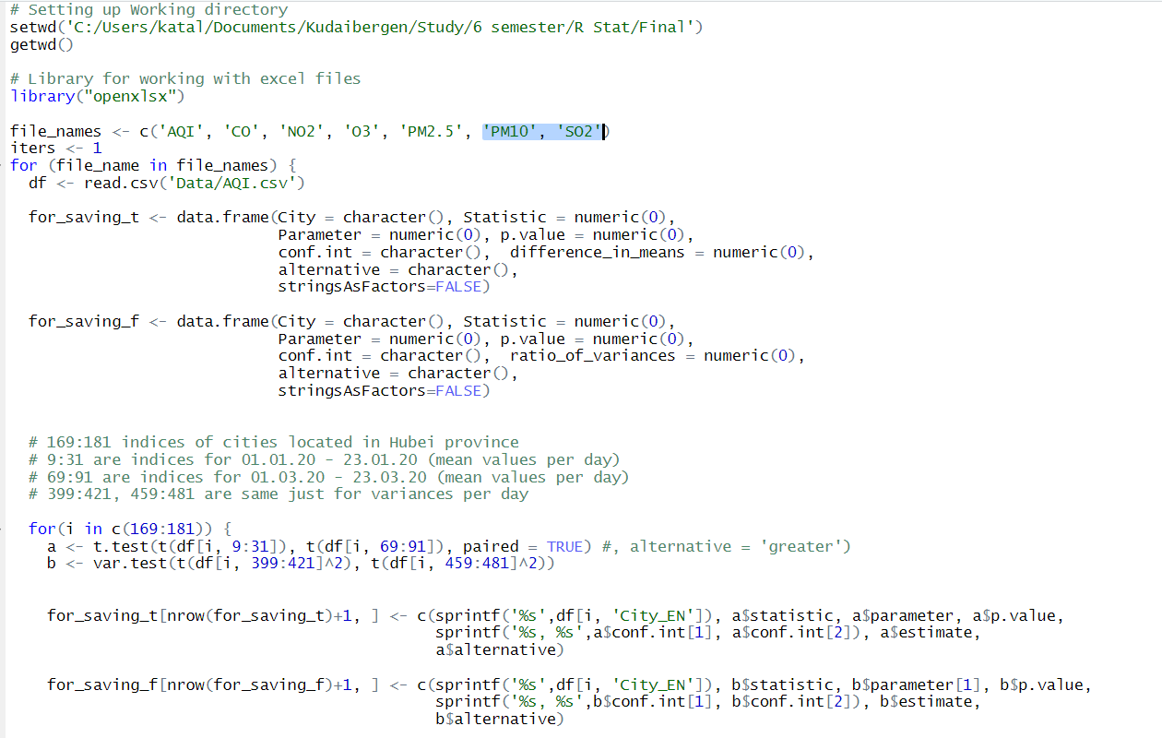
Attachment

Slide 13
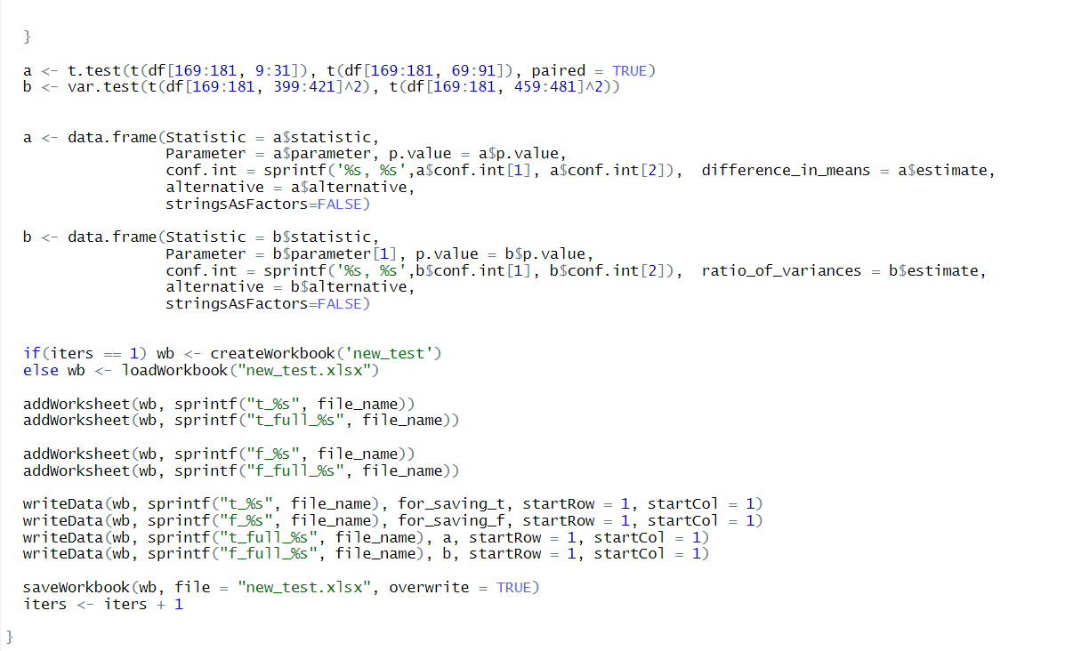

Slide 14
References
Data
https://dataverse.harvard.edu/dataset.xhtml?persistentId=doi:10.7910/DVN/XETLSS
https://www.epa.gov/co-pollution/basic-information-about-carbon-monoxide-co-outdoor-air-pollution
NO2 - Nitrogen Dioxide
https://www.epa.gov/no2-pollution
O3 - Ground-level ozone
https://www.environment.gov.au/protection/publications/factsheet-ground-level-ozone-o3
PM2.5 - Fine Particles
https://www.health.ny.gov/environmental/indoors/air/pmq_a.htm
PM10 - Particular matter
http://www.npi.gov.au/resource/particulate-matter-pm10-and-pm25
SO2 - Sulfur Dioxide
https://www.epa.gov/so2-pollution
Lockdown
https://en.wikipedia.org/wiki/COVID-19_pandemic_lockdown_in_Hubei
Pollution indicators
https://en.wikipedia.org/wiki/Air_quality_index
R
https://statistics.berkeley.edu/computing/r-t-tests
http://www.sthda.com/english/wiki/f-test-compare-two-variances-in-r
https://rcompanion.org/rcompanion/d_09.html

Slide 15
THANK YOU FOR YOUR ATTENTION!

