Slide 1

Portfolio BI Case Study
Katarina Knezevic
July, 2022.

Slide 2
Scenario 1
Technology stack
Programming language C#
Visual Studio 2022
.Net/.Net Core, Entity Framework
Microsoft SQL Server Management Studio (T-SQL)
Microsoft Excel
GitHub
Pricing data resources
https://www.investing.com
https://markets.financialcontent.com

Slide 3
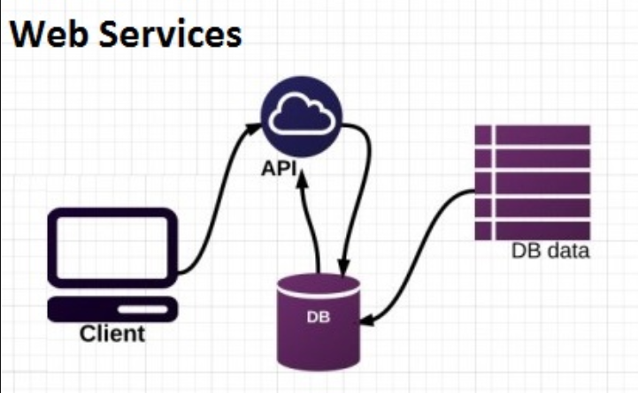
Scenario 1
Code organization
Stored procedures
PortfolioBi.PricingDataAnalysis.Bll.WebApi
Data Access layer - Client.Db
Business logic layer - Bll
Web api
PortfolioBi.PricingDataAnalysis.Bll.MyConsoleApp
Web api layer - Client.WebApi
Business logic layer – Client.Bll
Console application
Layer organization
Model – type declaration
Base - interface
Implementation - definition

Slide 4
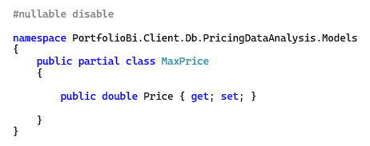
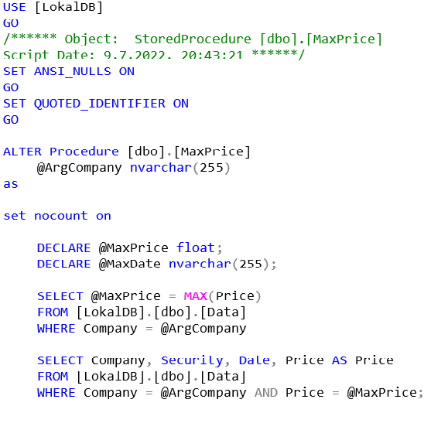
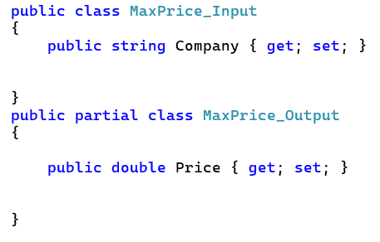
Scenario 1
Example – max price
Client.Db Model
Stored procedure
Bll Model

Slide 5
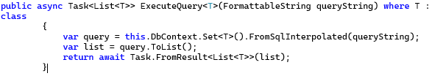
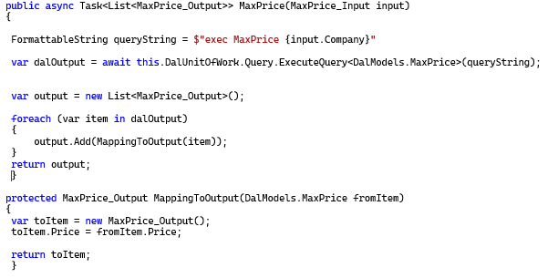
Scenario 1
DAL EntityFramework method
WebApi Bll

Slide 6
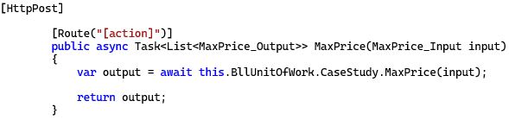
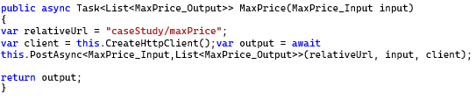
Scenario 1
WebApi
Console app

Slide 7
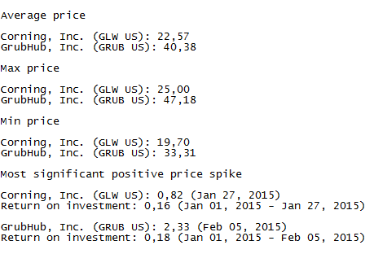
Scenario 1
Max
= Local Max
Max

Slide 8
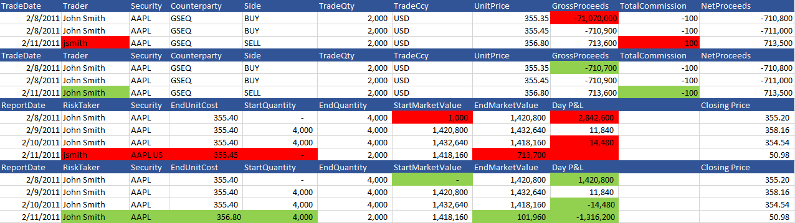
Scenario 2
Trades data
Unique signature
Gross Proceeds - total amount of cash received
GrossProceeds = TradeQuantity * UnitPrice
Net Proceeds - amounts received by the seller after deducting all costs and expenses from the gross proceeds
NetProceeds = GrossProceeds - TotalCommission
Incorrect
Corrected
Holdings data
Unique signature
Same Security
End Unit Cost - average Unit Price (Trades data tabel)
Start Quantity - End Quantity of previous day
End Market Value
EndMarketValue = ClosingPrice * EndQuantity
Day P&L - the amount of money made or lost on from last night's close to the current mark
Day P&L = EndMarketValue - StartMarketValue

Slide 9
Thank you for your attention!

