Slide 1
Capstone Project
Memory Management Strategies in Compiler Design
by
J. Meenakshi (192211324)
K. Bhavitha (192211338)
S. Bhuvaneswari (192211813)

Slide 2
ABSTRACT:
Efficient memory management is crucial for program performance and resource utilization.
This work proposes a data-driven approach for optimizing memory management in compiler design
We leverage machine learning to automatically assess program characteristics and predict the performance impact of different strategies.
This enables the recommendation of the optimal strategy based on performance goals and resource constraints.
This data-driven approach holds the potential to revolutionize compiler design by enabling the selection of optimal memory management strategies for various program types, leading to significant advancements in program performance, development efficiency, and resource utilization.
it also aims to improve program performance, enhance development efficiency, and mitigate memory-related issues.

Slide 3
INTRODUCTION:
Memory management is a crucial aspect of compiler design responsible for allocating and deallocating memory efficiently during program execution.
Different strategies achieve this based on the data's lifetime, access patterns, and size.
Memory management significantly impacts a program's performance, correctness, and resource utilization.
Efficient allocation minimizes fragmentation, prevents memory leaks, and optimizes memory access times.
Efficient memory management directly impacts a program's performance.
Choosing the right strategy can significantly reduce memory access overhead, fragmentation, and cache misses, leading to faster execution speeds.
Memory is a finite and valuable resource, especially in resource-constrained environments.
Optimizing memory usage through effective strategies can prevent memory leaks, crashes, and system instability.

Slide 4
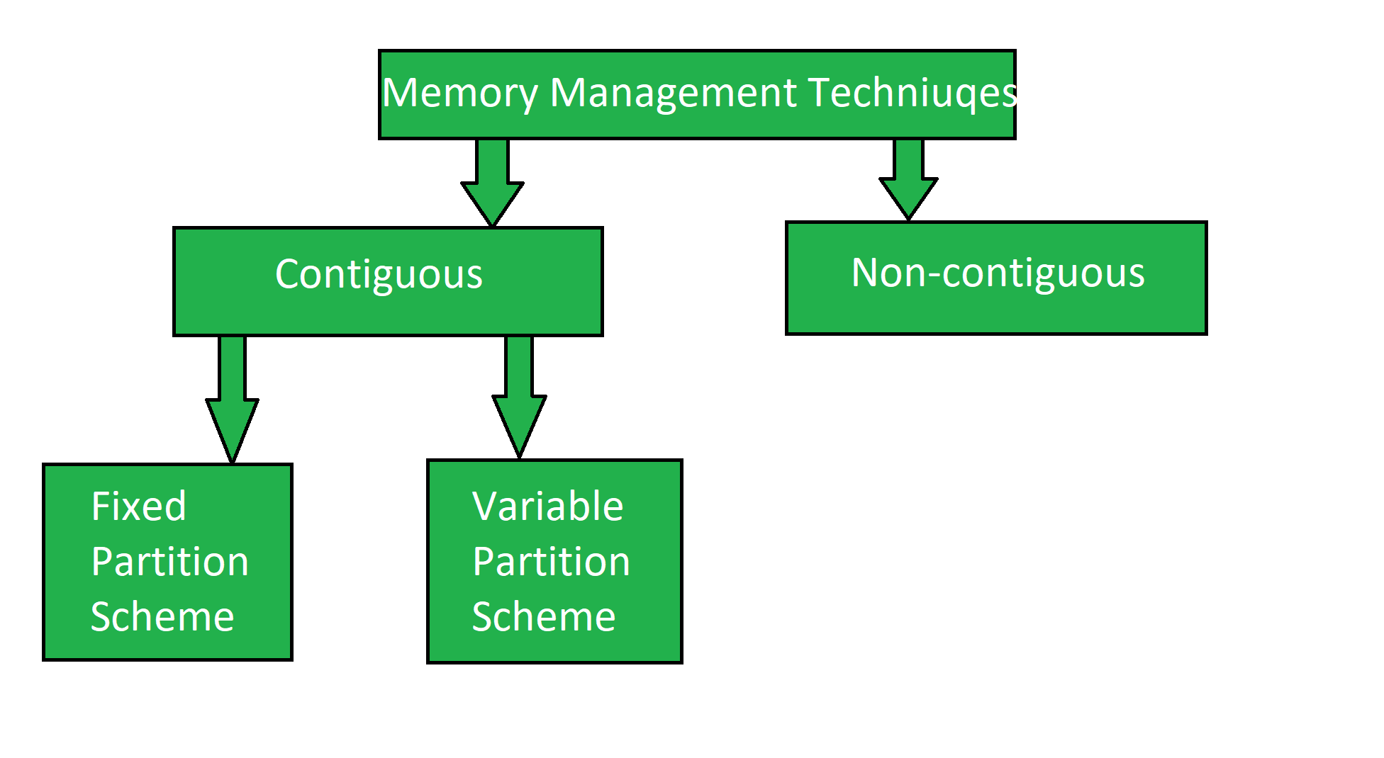

Slide 5
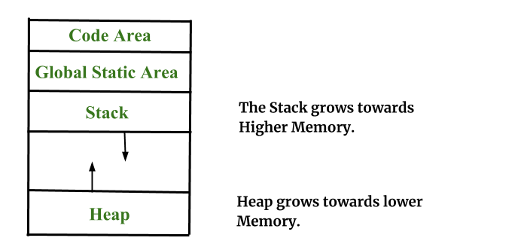
OBJECTIVES:
Compiler designers face the challenge of selecting the most suitable memory management strategy like static, stack, heap, hybrid for different program types and functionalities.
Choosing the optimal memory management strategy for a specific program remains a complex task, often requiring manual analysis and experimentation.
This can negatively impact user experience, resource utilization, and overall program reliability.
This approach should leverage data analysis and machine learning techniques to Automatically assess program characteristics, Predict the performance impact and recommend the optimal strategy.

Slide 6
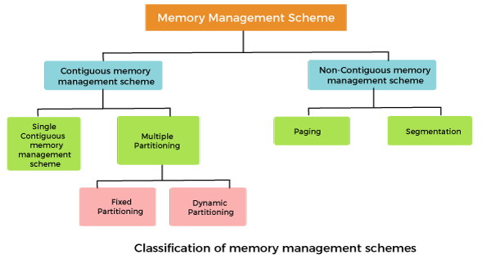
PROJECT SCOPE:
This design employs feature engineering to capture program characteristics relevant to memory usage patterns.
The strategy selection module, informed by predictions and program requirements, recommends the optimal approach.
The Random Forest Model predicts the performance impact of each memory management strategy.
On working with modular design Each component is independent, facilitating development, testing, and maintenance.
Utilization of open- source libraries like scikit-learn for feature engineering and Random Forest implementation.

Slide 7
PROBLEM STATEMENT:
Compiler designers face the challenge of selecting the most suitable memory management strategy like static, stack, heap, hybrid for different program types and functionalities.
Each strategy offers distinct advantages and disadvantages in terms of efficiency, flexibility, and memory usage.
Suboptimal memory management choices can lead to significant performance drawbacks, including increased execution time, excessive memory consumption, and potential memory leaks.
Choosing the optimal memory management strategy for a specific program remains a complex task, often requiring manual analysis and experimentation. This can be time-consuming and error-prone, especially for complex programs with diverse memory requirements.
There is no systematic approach for optimizing memory management strategies in compiler design, This approach should leverage data analysis and machine learning techniques to Automatically assess program characteristics, Predict the performance impact and recommend the optimal strategy.

Slide 8
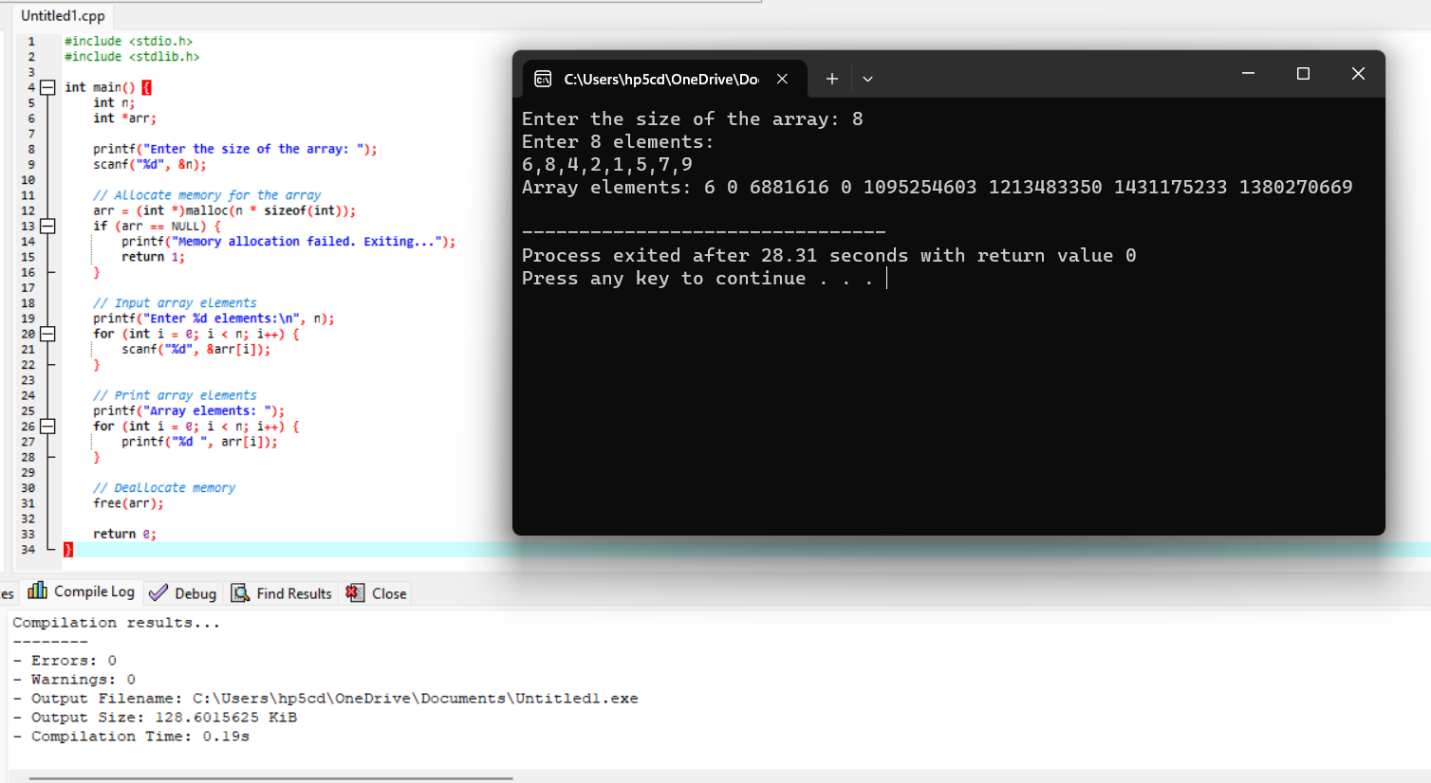
VISUALIZE CODE:

Slide 9
Proposed Design work
KEY COMPONENTS : This design employs feature engineering to capture program characteristics relevant to memory usage patterns. The Random Forest model, predicts performance impact of different strategies for a new program.
FUNCTIONALITY : The Feature Engineering Module extracts features from the input program. The extracted features are used to train the Random Forest Model. For a new program, the features are extracted and fed into the trained model.
ARCHITECTURAL DESIGN : On working with modular design Each component is independent, facilitating development, testing, and maintenance. Utilization of open- source libraries like scikit-learn for feature engineering and Random Forest implementation.

Slide 10
UI DESIGN
The UI design for this memory management strategies in compiler design would be to develop a “web-based interface ” as it is accessible from any device with a web browser and it Can be shared easily online.
These elements facilitate user interaction, data processing, and result presentation. The input panel allows users to provide the code for analysis.
The analysis section displays the predicted performance impact of different strategies and visualizes the results for easy comparison.
The recommendation section highlights the optimal strategy and provides justification. Additional options allow users to customize the analysis based on their preferences and constraints.
This web-based interface offers a user-friendly and accessible way to interact with the memory management optimization tool.

Slide 11
Literature review:
S.E. Abdullahi and G.A. Ringwood have gone through a survey of “Garbage collecting the Internet: A survey of distributed garbage collection”, ACM Computing Surveys, on September 1998.
“Memory colouring : a compiler approach for scratchpad memory management” by L Li, L gao on Architectures and Compilation Techniques in 2005
Compiler-directed scratch pad memory hierarchy design and management by Mahmut Kandemir and Alok Choudhary in Proceedings of the 39th Annual 02 in 2002

Slide 12
CONCLUSION:
This project explored the design of a web-based interface for a memory management optimization tool.
The proposed solution utilizes feature engineering and a machine learning model to predict the performance impact of different memory management strategies on a given program.
The UI facilitates user interaction, allowing them to upload source code, view predicted performance metrics, and receive recommendations for the optimal strategy based on their preferences and constraints.
This design offers several potential benefits, including improved developer productivity, informed decision-making regarding memory management, and potentially enhanced program performance.
By continuously improving and expanding its capabilities, this memory management optimization tool has the potential to become a valuable asset for developers and researchers working on memory-intensive applications.

Slide 13


