Slide 1
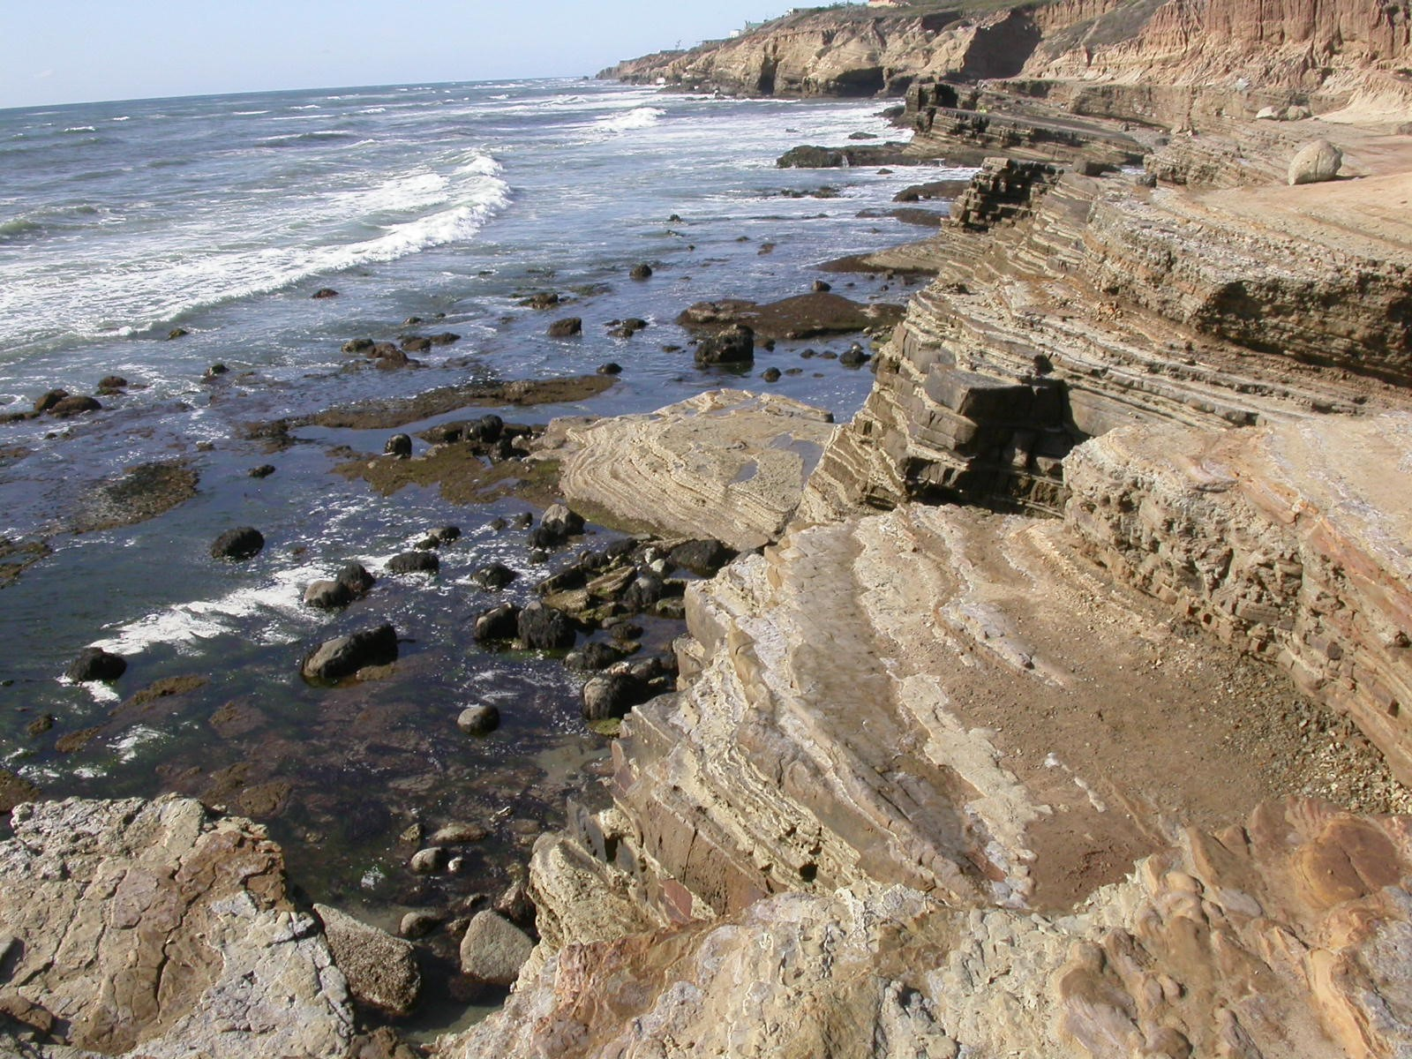
Southern edge of large U in cliffs
North of Z1 boundary
Do not include
ZI
N

Slide 2
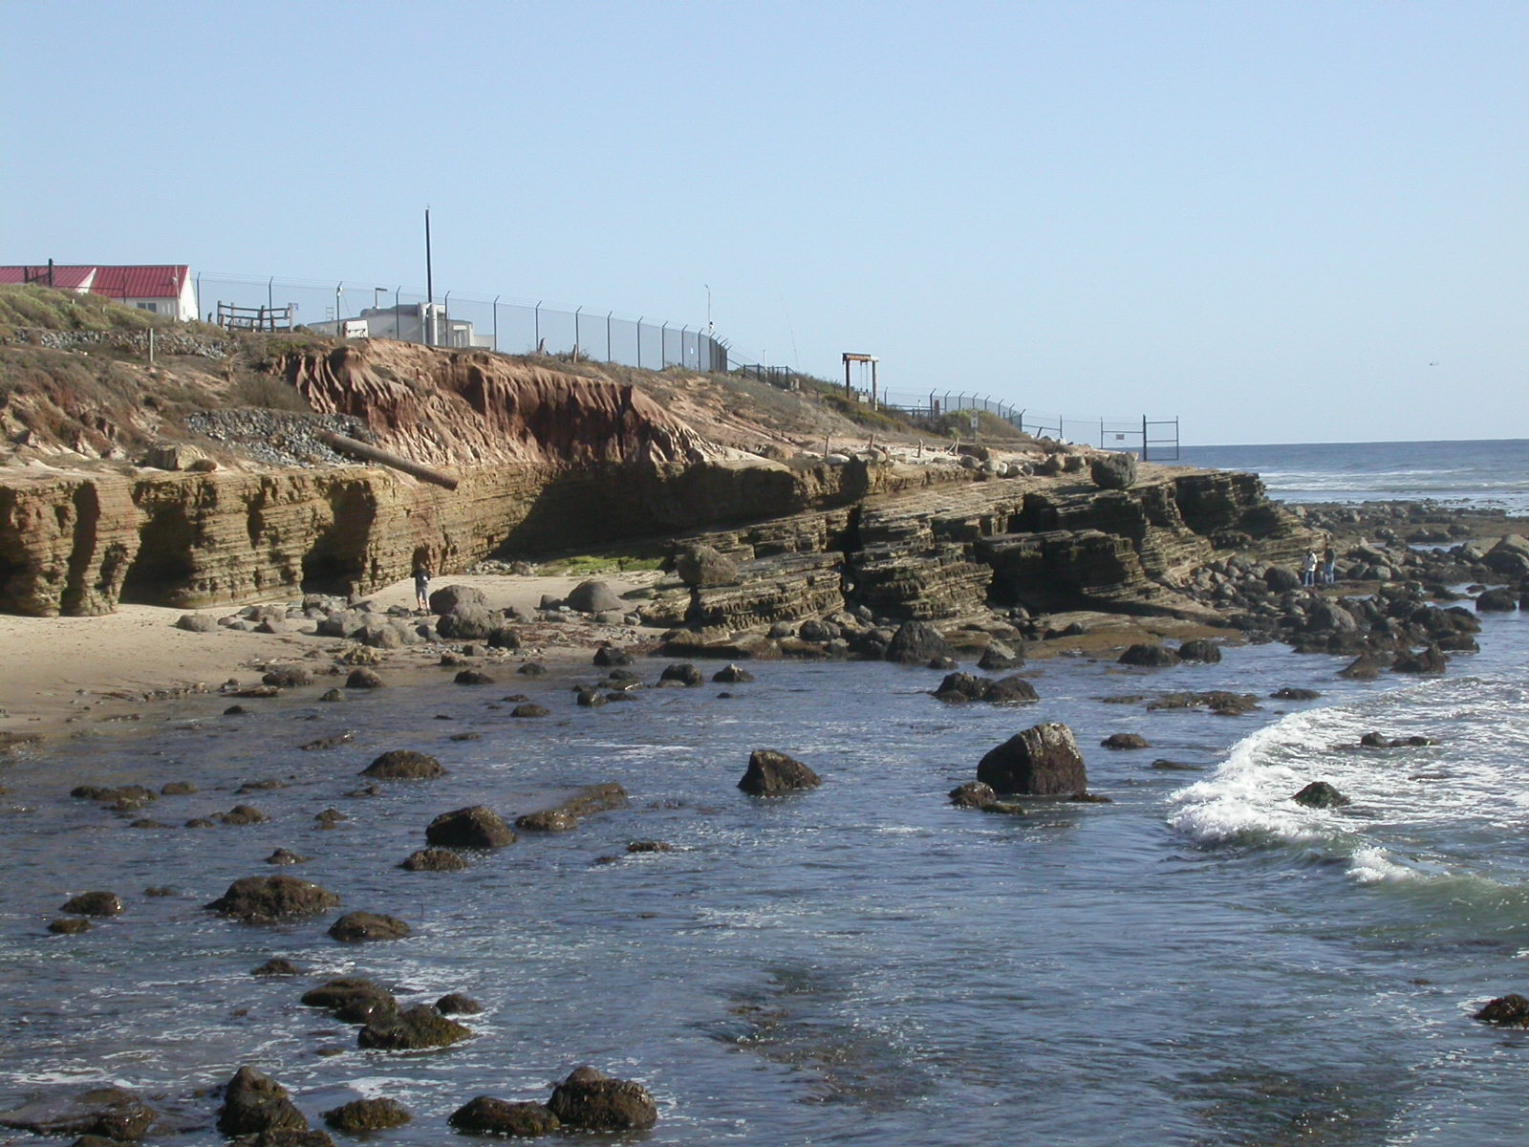
Boundary between ZI and ZII is at the drain-pipe and perpendicular to the cliff edge
ZII
ZI
N

Slide 3
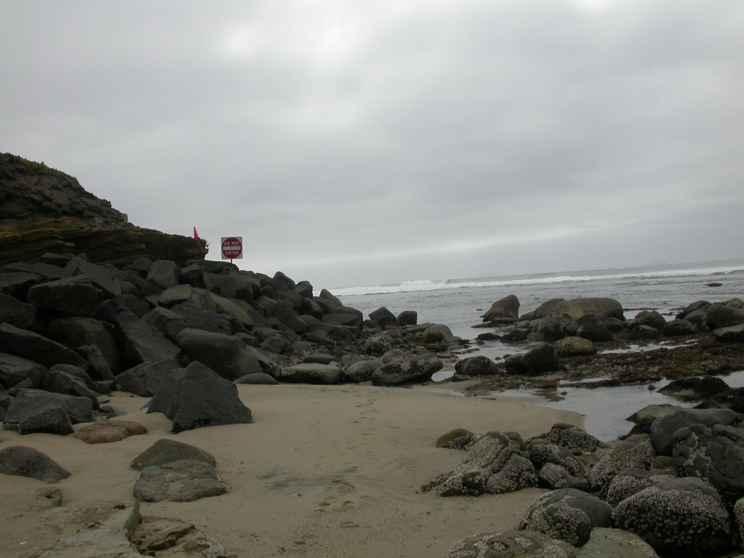
‘Area Closed’ sign marks the boundary between Zone II and Zone III
ZIII
Boundary is perpendicular to cliff edge
N
ZII

Slide 4
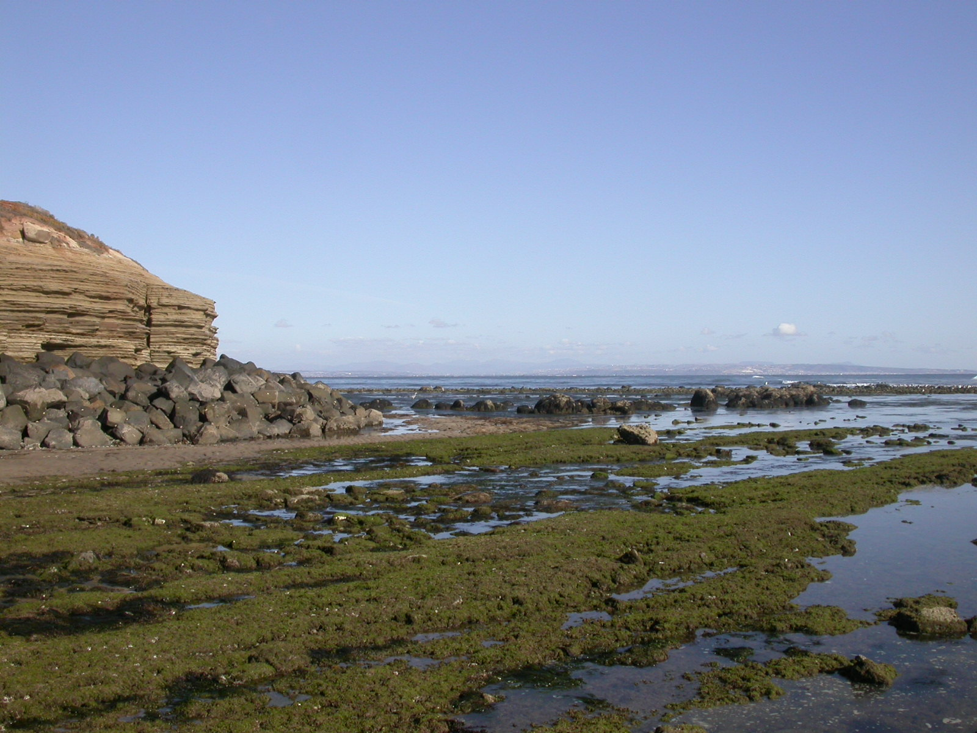
Row of boulders at end of peninsula marks the eastern and southern boundary of ZIII
ZIII
N

