Slide 2

Paper-ID : 190 A Hybrid Deep Learning Approach for Intelligent Intrusion Detection
Name of the Authors : Vasava Khushi, Vekariya Poojal, Patel Yug, Patel Vraj, Sunil Gautam
Affiliation : Nirma University, India

Slide 3
Abstract
Due to the escalation of cyber-attacks, there is a strong demand for intelligent IDS.
This paper presents a hybrid IDS framework that combines PCA + RF + GRU + LSTM using CICIDS2017 dataset.
Results show F1-scores > 0.95 for common attacks, but class imbalance reduces performance on rare attacks like Botnet and Web Attacks.

Slide 4
Introduction
Modern networks (IoT, cloud) are complex and face increasing intrusion threats [14].
Traditional IDS struggle with zero-day attacks; anomaly detection is more effective [13][6].
Deep models (LSTM, GRU) capture temporal traffic patterns, while PCA reduces dimensions [9][11].
This study proposes a two -stage IDS: RF at edge, GRU + LSTM at cloud, tested on CICIDS2017 dataset.

Slide 5
Related Work / Literature Review
LSTM + GRU improve temporal anomaly detection [1].
GRU-LSTM ensembles for IoT networks [5].
Hybrid CNN + ANN + LSTM + GRU models capture spatial + temporal patterns [3].
CNN-based IDS focuses on spatial but lacks temporal analysis.
Limitations of past works: high computation, overfitting, weak on simultaneous attacks.
Our IDS: RF filtering at edge + GRU & LSTM at cloud, scalable and accurate [13][14].

Slide 6
Problem Statement & Objectives
Problem Statement
Detect multiple and rare intrusions in complex networks.
Ensure IDS scalability , speed, and accuracy .
Objectives
Combine classical(RF) and deep learning (GRU, LSTM).
Apply PCA for feature reduction.
Evaluate performance on CICIDS2017 dataset.

Slide 7
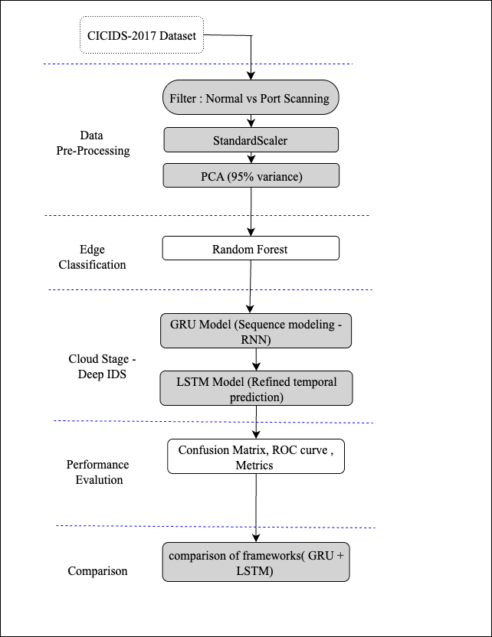
Proposed Methodology
Preprocessing and PCA (retain 95% variance).
Edge Layer: Random Forest for primary filtering.
Cloud Layer: GRU + LSTM for temporal sequence modeling.
Metrics: Accuracy, Precision, Recall, F1-score, ROC-AUC.

Slide 8
Results and Discussion
High detection performance:
DDoS: 99.86% (F1 = 0.9855)
DoS: 99.36% (F1 = 0.9612)
Brute Force: 98.31% (F1 = 0.8499)
Port Scanning: 98.92% (F1 = 0.8692)
Web Attacks: 96.42% (F1 = 0.7575)
Botnet: 95.21% (F1 = 0.7072)

Slide 9
Conclusion and Future Work
Hybrid IDS (PCA + RF + GRU + LSTM) achieved high accuracy and scalability.
Effective in detecting DDoS, DoS, Brute Force attacks.
Performance lower on rare attacks due to class imbalance.
Future Work:
Extend to multi-class classification.

Slide 10
References
Narudkar, M. S., Mahajan, A., & Agarkar, P. (2023). Intrusion Detection for real time Network Dataset using PCA and Random Forest Algorithms.
INTERNATIONAL JOURNAL, 7(9).﻿﻿﻿
Laghrissi, F., Douzi, S., Douzi, K., & Hssina, B. (2021). Intrusion detection systems using long short-term memory (LSTM). Journal of Big Data, 8(1), 65.
﻿﻿﻿Muhuri, P. S., Chatterjee, P., Yuan, X., Roy, K., & Esterline, A. (2020). Koniki, R., Ampapurapu, M. D., & Kollu, P. K. (2022, April). An anomaly based network intrusion detection system using LSTM and GRU. In 2022 International Conference on Electronic Systems and Intelligent Computing (ICES/C) (p.79-84). IEEE
﻿﻿﻿Chintapalli, S. S. N., Singh, S. P., Frnda, J., Divakarachari, P. B., Sarraju, V. L., & Falkowski-Gilski, P. (2024). OOA-modified Bi-LSTM network: An effective intrusion detection framework for IoT systems. Heliyon, 10(8).

Slide 11
References
﻿﻿Selvam, R., & Velliangiri, S. (2024, March). An improving intrusion detection model based on novel CNN technique using recent CIC-IDS datasets. In 2024 International Conference on Distributed Computing and Optimization Techniques (ICDCOT) (pp. 1-6). IEEE.
Al-Kahtani, M. S., Mehmood, Z., Sadad, T., Zada, I., Ali, G., & ElAffendi, M. (2023). Intrusion detection in the Internet of Things using fusion of GRU-LSTM deep learning model. Intelligent Automation & Soft Computing, 37(2), 2279-2290.
﻿﻿﻿Induru, V., & Pushpakumar, R. (2020). Combining LSTM and GRU for efficient intrusion detection and alert correlation in cloud networks. International Journal of Multidisciplinary Research and Growth Evaluation, 1(1), 154-160.
﻿﻿﻿Kilichev, D., Turimov, D., & Kim, W. (2024). Next-generation intrusion detection for iot evcs: Integrating cnn, Istm, and gru models. Mathematics, 12(4), 571.
Alsyaibani, O. M. A., Utami, E., Raharjo, S., & Hartanto, A. D. (2022). Stacked LSTM-GRU model for traffic anomalies detection. Telematika, 15(2), 81-91.
﻿﻿﻿﻿Abdulhammed, R., Musafer, H., Alessa, A., Faezipour, M., & Abuzneid, A. (2019). Features dimensionality reduction approaches for machine learning based network intrusion detection. Electronics, 8(3), 322.

Slide 12
References
﻿﻿﻿﻿Using a long short-term memory recurrent neural network (LSTM-RNN) to classify network attacks. Information, 11(5), 243.
﻿﻿﻿﻿Gautam, S., Henry, A., Zuhair, M., Rashid, M., Javed, A. R., & Maddikunta, P. K.R. (2022). A composite approach of intrusion detection systems: Hybrid RNN and correlation-based feature optimization. Electronics, 11(21), 3529.
﻿﻿﻿﻿Henry, A., Gautam, S., Khanna, S., Rabie, K., Shongwe, T., Bhattacharya, P & Chowdhury, S. (2023). Composition of hybrid deep learning model and feature optimization for intrusion detection system. Sensors, 23(2), 890.
﻿﻿﻿﻿Vaya, D., & Saxena, R. K. (2025). An in-depth comparative analysis of malware detection techniques. In Recent Advances in Sciences, Engineering, Information Technology & Management (pp. 274-283). CRC Press.
﻿﻿﻿﻿Vaya, D., & Saxena, R. K. An In-Depth Comparative Analysis of Malware Classification Techniques. Cybersecurity in Knowledge Management, 151-165.

Slide 13
Thank You

