Slide 1

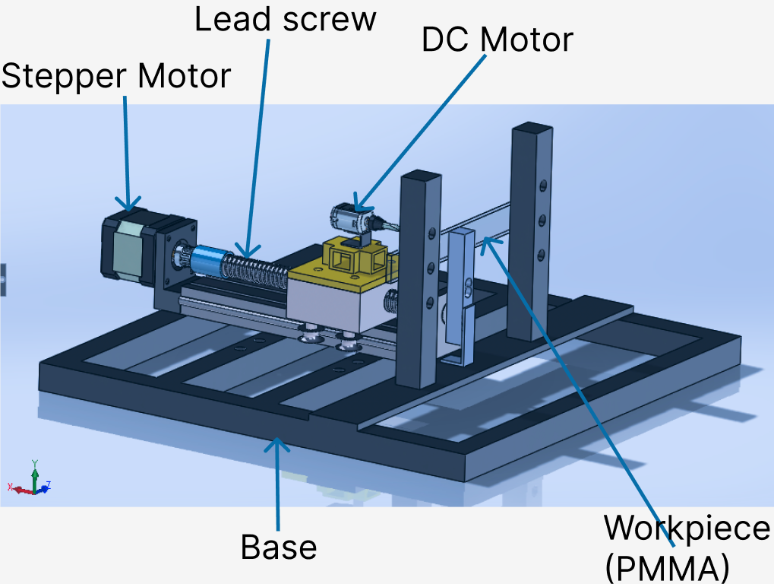
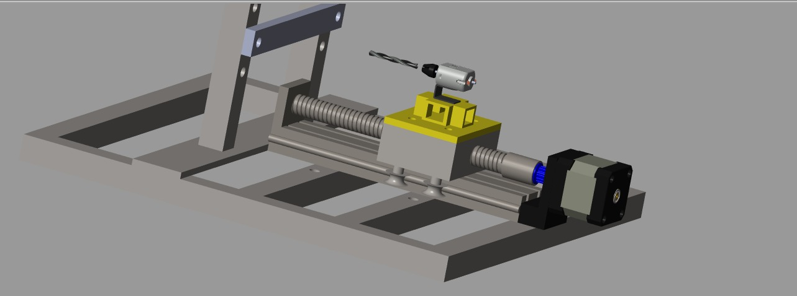
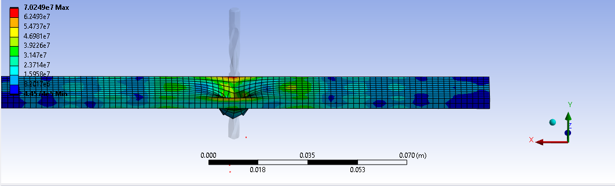
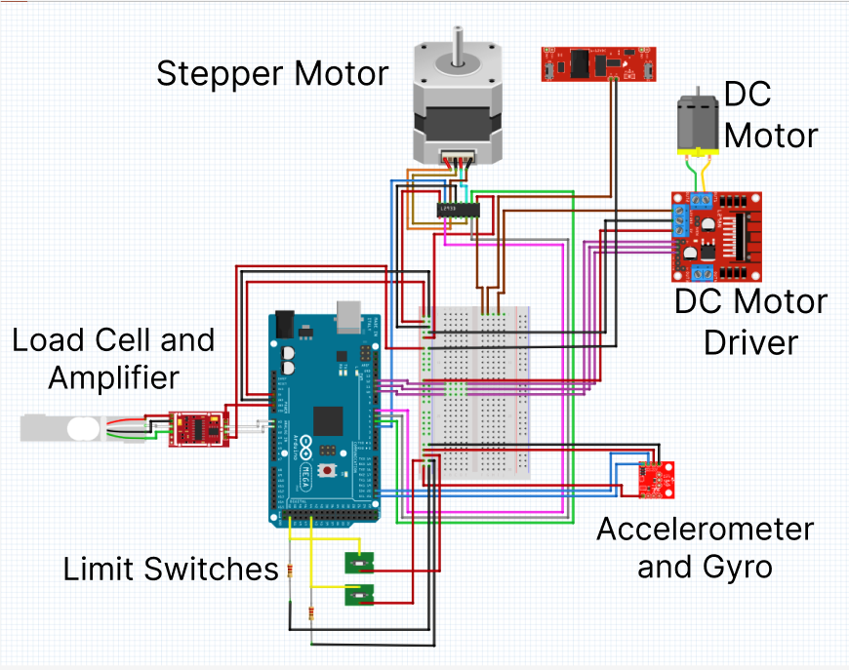
DEVELOPMENT OF AN AUTOMATED
1-AXIS DRILL OF PMMA
GROUP MEMBERS ROLE
Mary Mbaire Mbugua Firmware
Renox Kipkoech ANOVA
Morris Lesinko Matlab
Philip Katiechi Circuitry
Allan Kyalo FEA
Stephen Gitau Circuitry
4th August, 2023
Supervisor:
Dr. Titus Mulembo
INTRODUCTION
ABSTRACT
High-quality drilled holes are required in a lot of industrial and medical applications. It is imperative to design a low-cost and precise drilling machine that can be used and which monitors and mitigates vibrations resulting and forces applied to the workpiece during the drilling operation. This project focuses on the development of a one-axis drill system utilizing a polymer workpiece for improving bone drilling operations in medical applications.
Challenges in the drilling process include unmonitored and unregulated vibrations, chatter, work piece damage and drill bit breakage and misaligned or poor quality holes.
MAIN OBJECTIVE
Development of a precise automated one axis drill.
Specific Objectives
To design 3D model of the physical system
To develop project circuits
To develop firmware.
To carry out experiments
To analyze parameters for vibration mitigation
PROBLEM STATEMENT
In various industrial applications, high-quality drilled holes are essential. The current industrial drilling machines are expensive and lack the required precision for achieving high-quality drilled holes.
METHODOLOGY
1. CAD Design in Solidworks
2. Matlab Simscape
3.Finite element analysis
4. Fritzing
NEXT SEMESTER OBJECTIVES
Carry out experiments to determine best drilling parameters
Carry out statistical analysis of actual drill parameters.
Vibration mitigation for high quality drilled holes.
Run physical model of automated drill.
Monitor drilling parameters in real time.

