Slide 1
Software Engineering Group Project
Use Case Presentation
Authors: Sean Gemmell [seg19], Archie Malvern [arm36]
Version: 0.3
Status: Draft

Slide 2
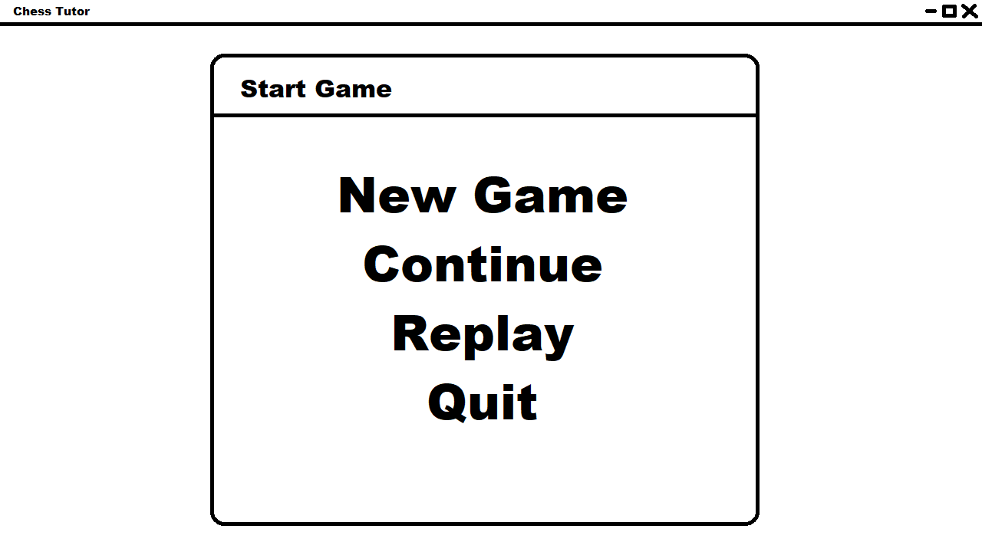
UC-1.1 (Main Menu)
Players can click on an option based on what they want to do. In the case of UC-1.1, the player clicks "New Game".

Slide 3
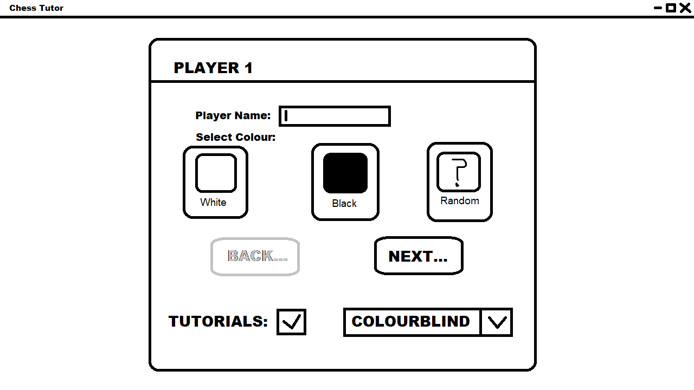
UC-1.1 (Continued)
After the player selects New Game, player 1 enters their name and picks their colour, as well as if they want to have tutorials enabled. The player then clicks Next.
Player 2 then enters their name and the colour not selected by player 1 is automatically selected. Player 2 can click Back if player 1 wants to modify their choices.

Slide 4
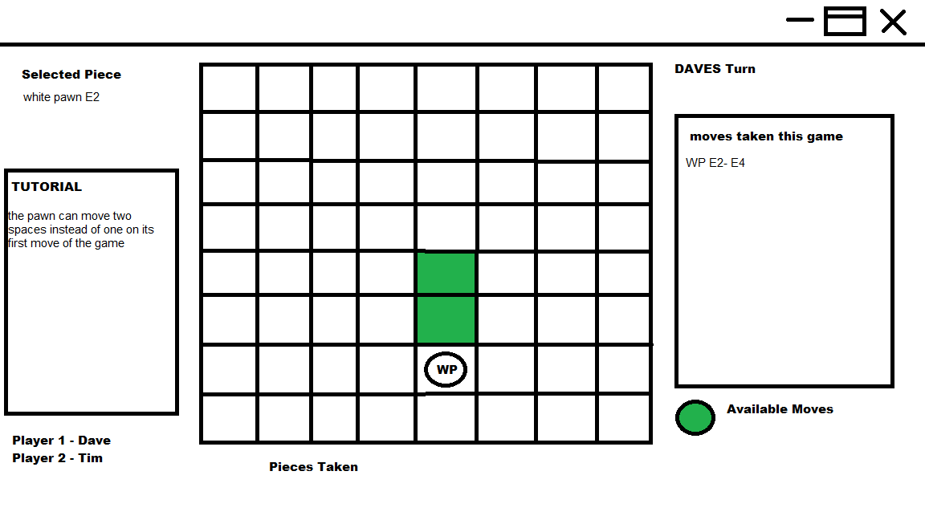
UC-1.2
The player going first will be white as per the rules
The squares that the piece can be moved to will be highlighted in a colour
Player names will be in the corner, along with which players turn it is

Slide 5
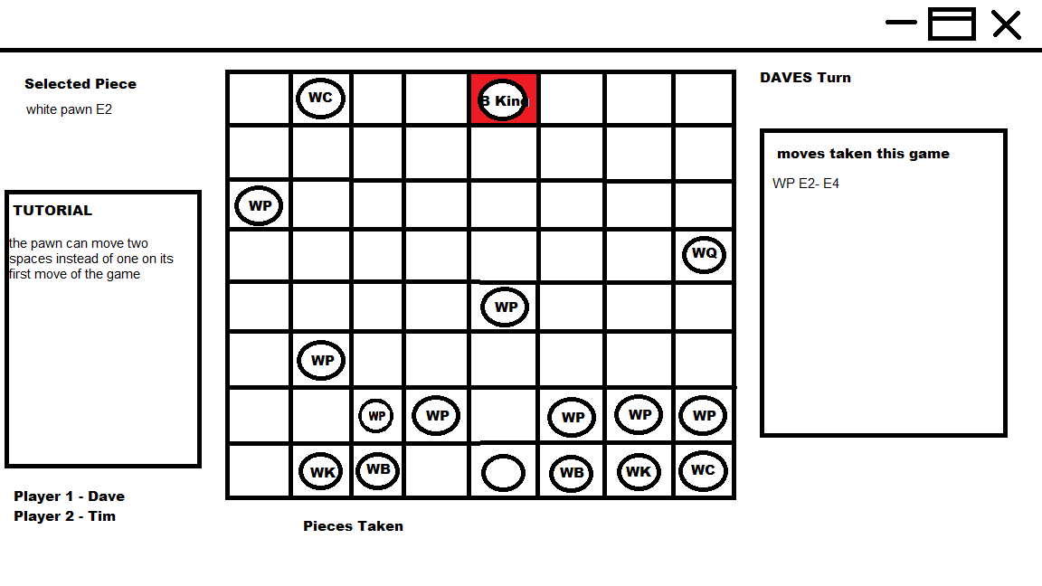
UC-1.2 (check)
When the king is in check the square highlights in red (unless the player has selected colour blind mode)

Slide 6
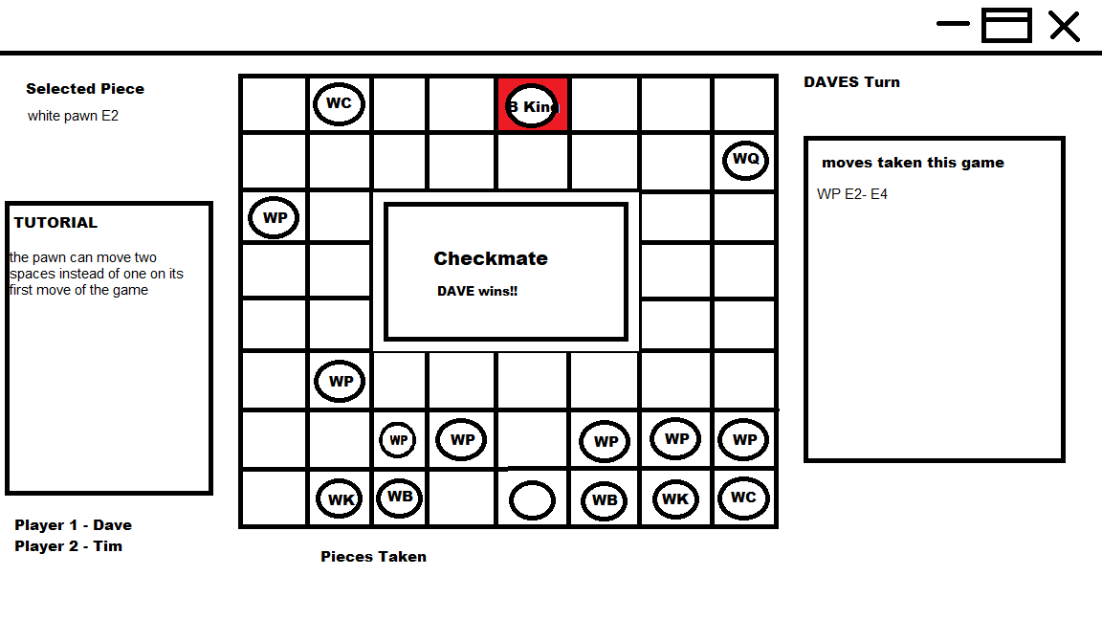
UC-1.2 (Checkmate)
Same as check the square will highlight in red and a pop up will inform the players that the game is over

Slide 7
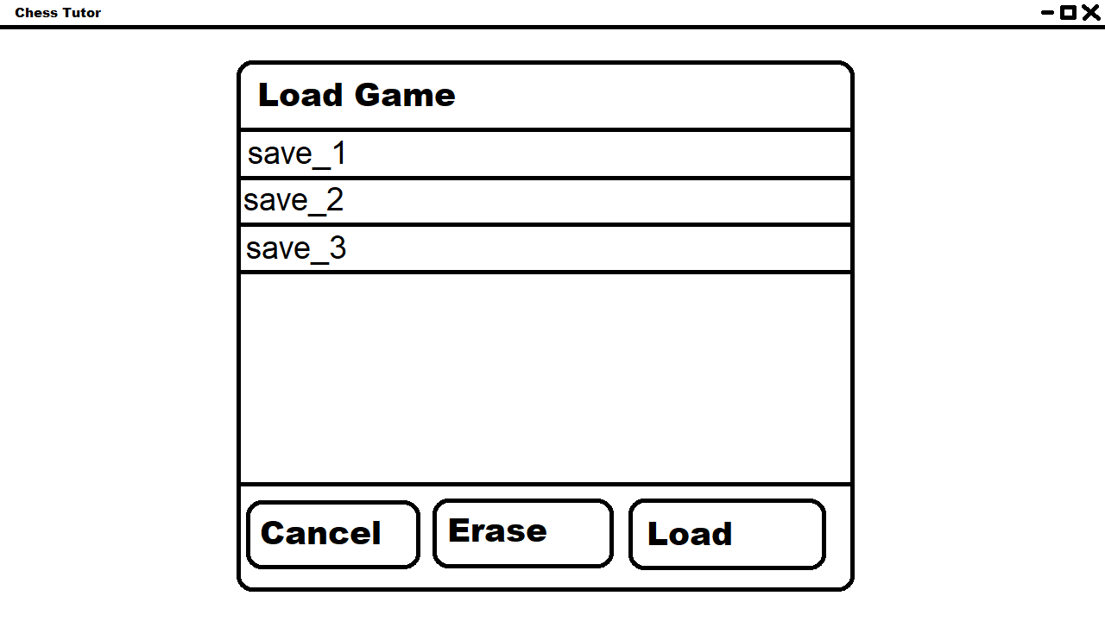
UC-1.3
Player clicks on a save, then load to load it or erase to erase it. The player can also click cancel to exit the dialog back to the main menu.

Slide 8
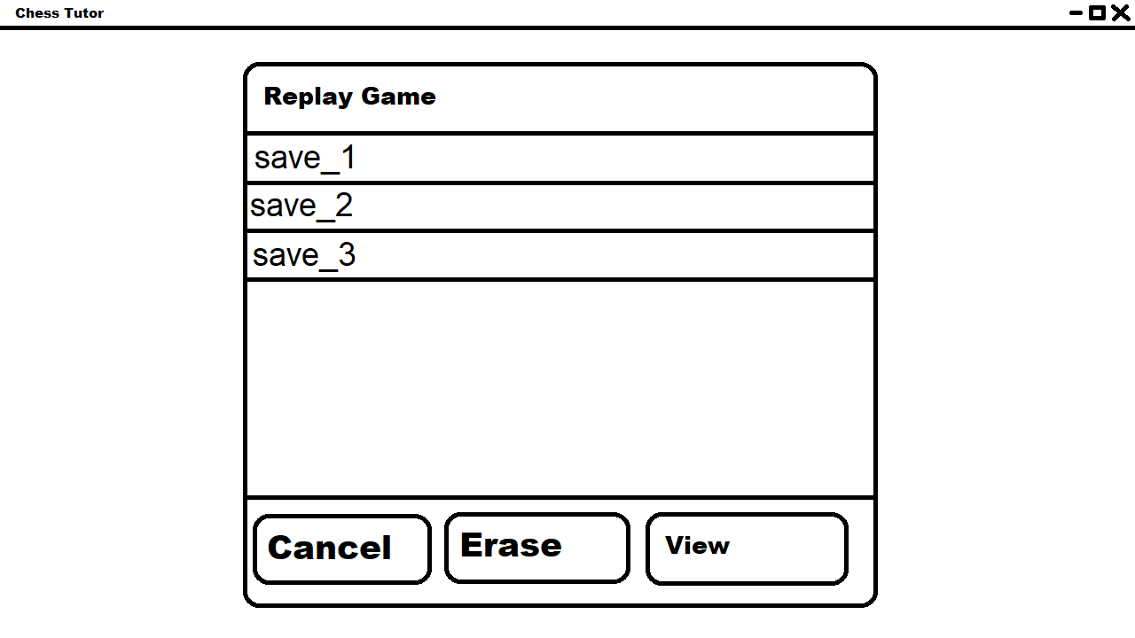
UC-1.4
Clicking the "Replay" button on the main menu loads a menu which allows the player to pick a game and either delete the save or view it.

Slide 9
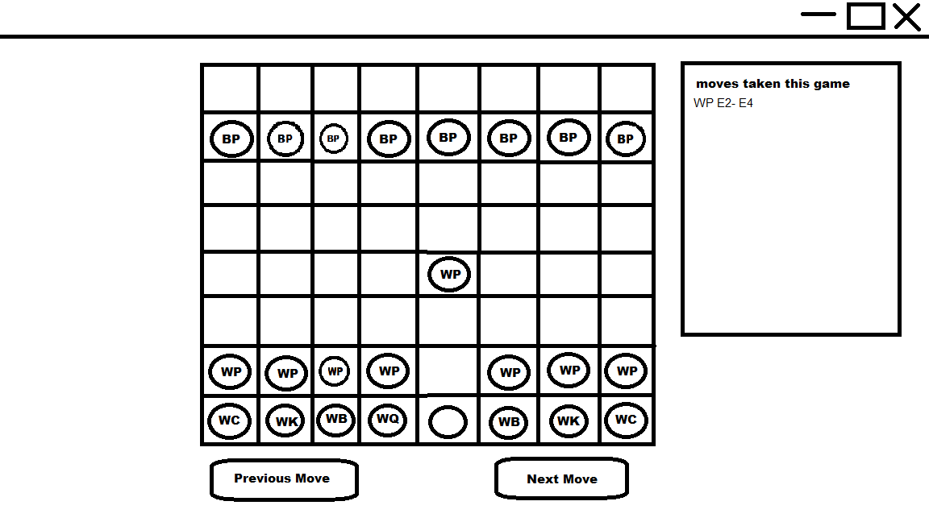
UC-1.4 (Continued)
A bar on the side that will have recorded each move
Button to progress through each move
A button to go to the previous move

Slide 10
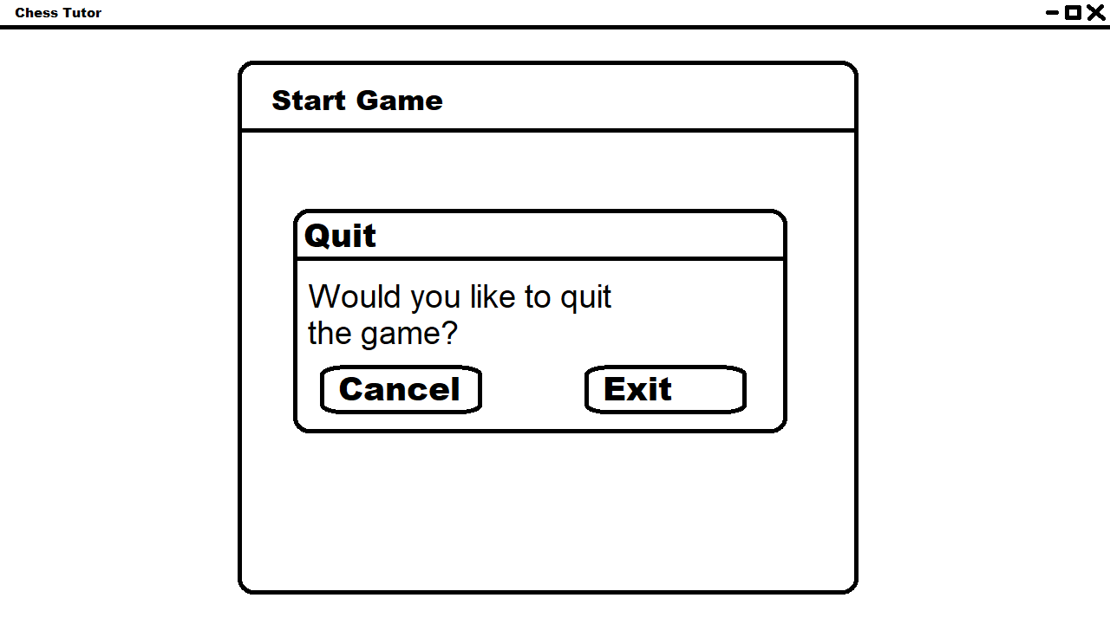
UC-1.5
The player either clicks the red X in the corner or the exit button on the main menu, and a quit dialog appears. The player can either click cancel or exit. Exit ceases operation of the program.

