Slide 1
Software Engineering Group Project
Use Case Presentation Group 18
Authors: Sean Gemmell [seg19], Archie Malvern [arm36]
Config. Ref.: UCPGroup18
Version: 1.0
Status: Release

Slide 2
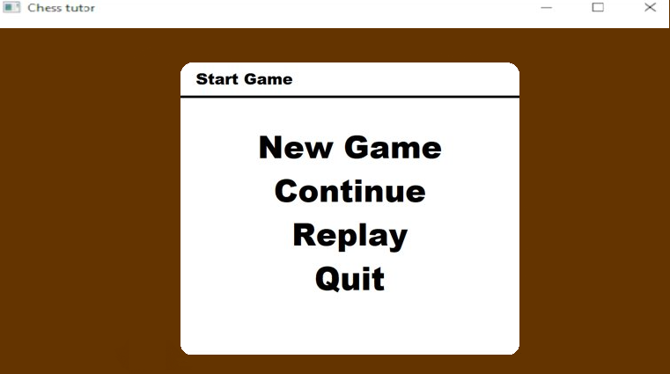
UC-1.1 (Main Menu)
Players can click on an option based on what they want to do. In the case of UC-1.1, the player clicks "New Game".

Slide 3
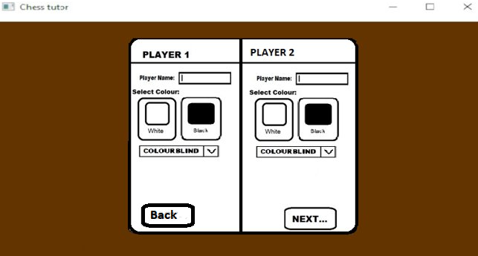
UC-1.1 (Continued)
After the player selects New Game, player 1 enters their name and picks their colour. The player then clicks Next.
Player 2 then enters their name and the colour not selected by player 1 is automatically selected. Player 2 can click Back if player 1 wants to modify their choices.

Slide 4
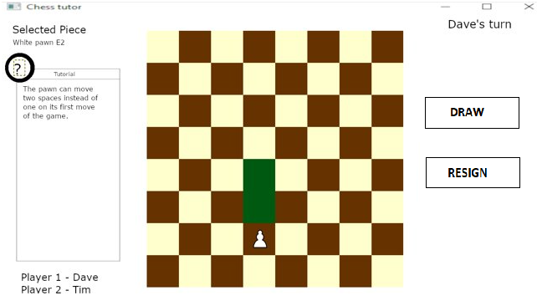
UC-1.2
The player going first will be white as per the rules
The squares that the piece can be moved to will be highlighted in a colour
Player names will be in the corner, along with which players turn it is
During the game, the player can press the question mark bubble and get a brief tutorial on the piece they selected

Slide 5
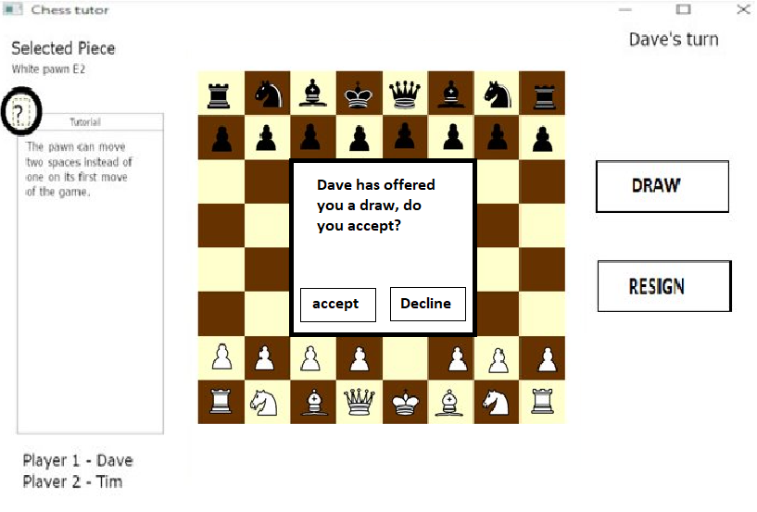
U.C- 1.2
Clicking the draw button will offer the opponent the chance to end the game in a draw

Slide 6
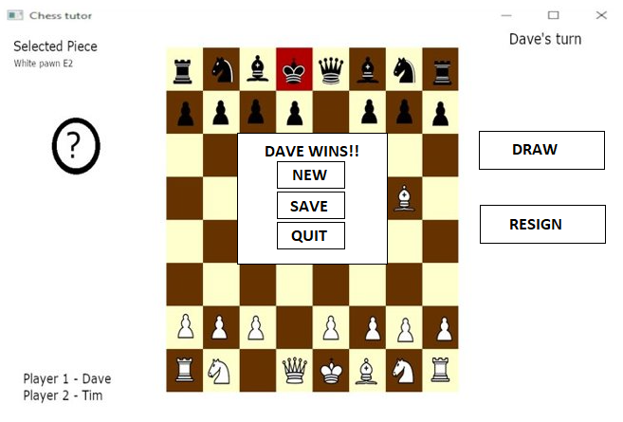
UC-1.2 (Checkmate)
Same as check the square will highlight in red and a pop up will inform the players that the game is over

Slide 7
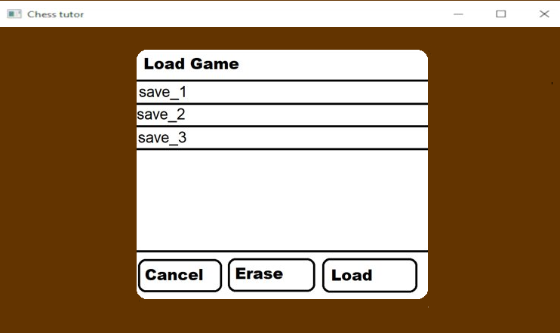
UC-1.3
Player clicks on a save, then load to load it or erase to erase it. The player can also click cancel to exit the dialog back to the main menu.

Slide 8
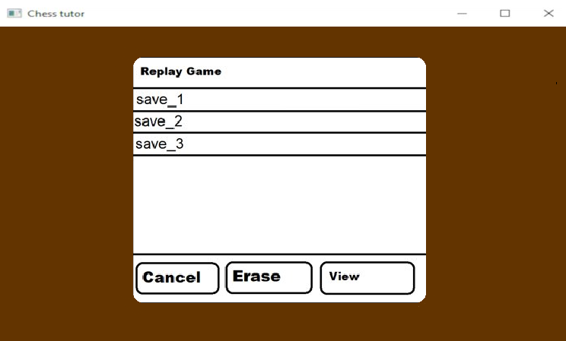
UC-1.4
Clicking the "Replay" button on the main menu loads a menu which allows the player to pick a game and either delete the save or view it.

Slide 9
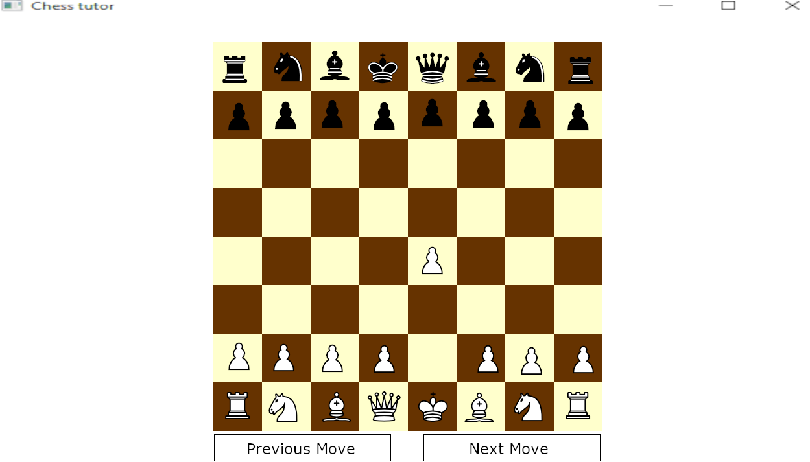
UC-1.4 (Continued)
Button to progress through each move
A button to go to the previous move

Slide 10
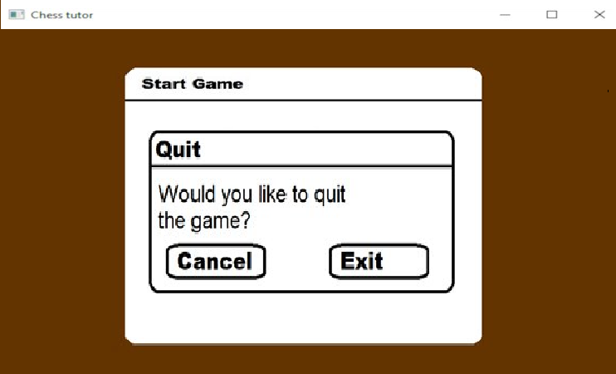
UC-1.5
The player clicks the exit button on the main menu, and a quit dialog appears. The player can either click cancel or exit. Exit ceases operation of the program.

Slide 11
Additional Notes
The board colours are beige and brown.
This is to contrast against the black and white pieces.

