Slide 1
Aviation Accidents Analysis
By Catherine Maina

Slide 2
"Great flights and great investments both start with one thing: a solid runway and a smart plan."

Slide 3
Business Overview
The company is expanding into aviation to diversify portfolio
It’s exploring aircraft for private and commercial use
There is limited knowledge on aircraft safety
Notes:
Overview
The company is expanding into the aviation industry to diversify its portfolio.
Plans involve acquiring aircraft for commercial and private operations.
Internal knowledge on aircraft safety risks is limited.

Slide 4
Project Objectives
Project analyzes accident data to identify low-risk aircraft to purchase
Support data-driven decisions for new aviation division
Notes:
Project Objectives
This project analyzes aviation accident data to:
Identify low-risk aircraft models.
Support data-driven purchasing decisions.
Insights will guide the new aviation division in safe and strategic aircraft investments.

Slide 5
Tools and Technologies used
Python (Pandas, Matplotlib, Seaborn) – Data cleaning, analysis, and visualization
Jupyter Notebook / VS Code – Coding environment
Tableau – Interactive dashboards and charts
Git & GitHub – Version control and collaboration

Slide 6
Data Overview
The data used in this project is from the National Transportation Safety Board (NTSB) who maintain a comprehensive database detailing civil aviation accidents across various territories.

Slide 7
Data Overview
The key features used in this project are;
Coverage Period: 1962 to 2023
Data Scope: Includes over 135,000 accidents and incidents.
Data Fields: Contains information such as aircraft make and model, purpose of flight, number of injuries among others.
Notes:
Key Features:
Coverage Period: Accidents from 1962 to 2023.
Data Scope: Includes over 135,000 accidents and incidents.
Data Fields: Encompasses information on aircraft make, model, weather conditions, purpose of flight, number of injuries and other contributing factors.

Slide 8
Data Cleaning
Data Cleaning Summary;
Dropped columns with excessive missing data
Selected only relevant columns for analysis
Filled missing numeric values with 0, categorical with 'Unknown’
Added a new column for total injuries
Notes:
The following data cleaning steps were taken:
* Columns with too many missing values are dropped.
* Only the relevant columns were chosen for a cleaner analysis
Numerical relevant columns with missing values were replaced with 0
Relevant columns with categorical data with missing values were replaced with 'Unknown’
A new column that combined the total injuries was added

Slide 9
Exploratory Data Analysis
Objective:
To understand key patterns and distributions in the aviation accident dataset.

Slide 10
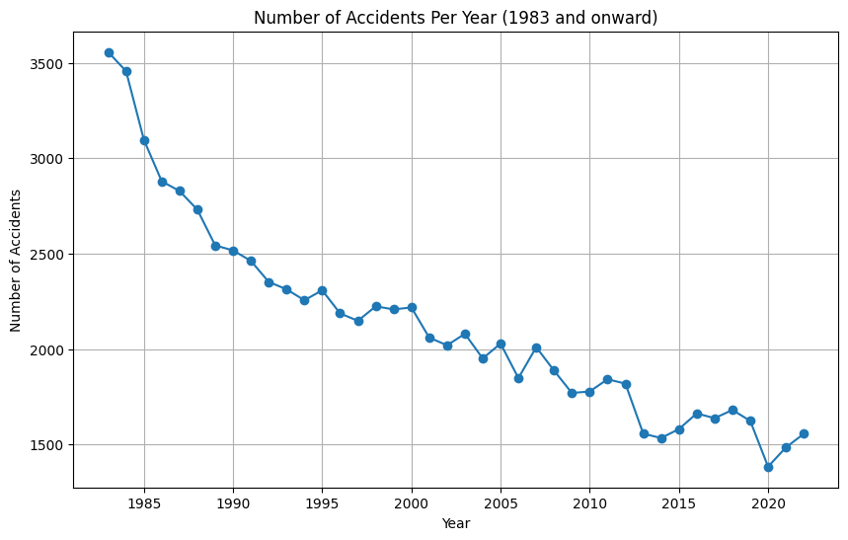
Accident Trends Over Time

Slide 11
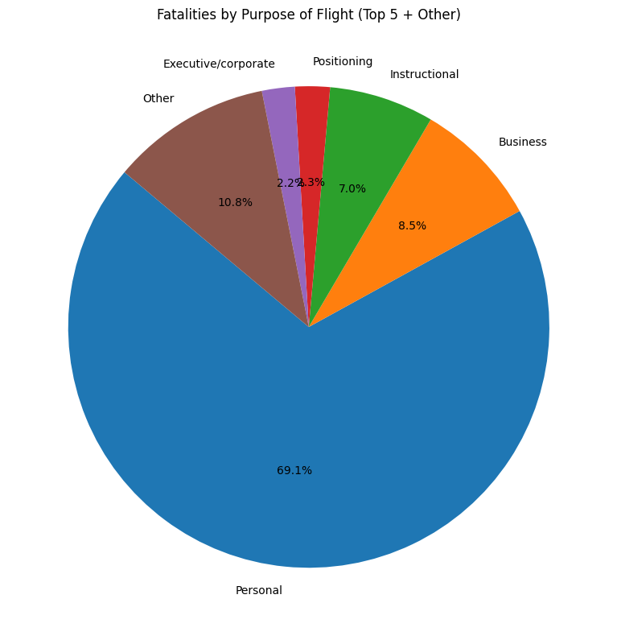
Purpose of Flight vs Fatalities

Slide 12
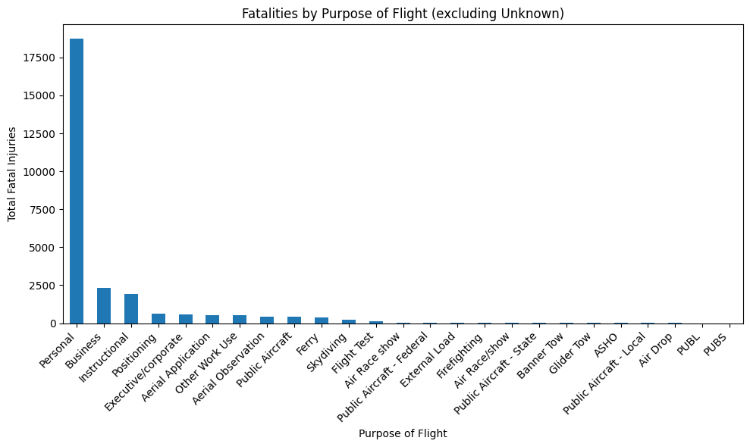
Purpose of Flight vs Fatalities

Slide 13
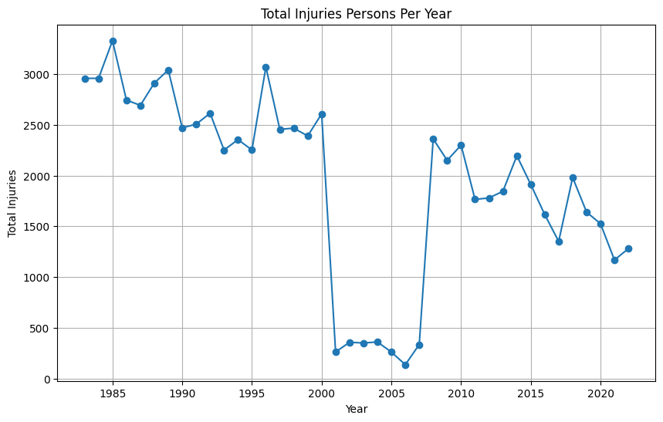
Total Injuries per year

Slide 14
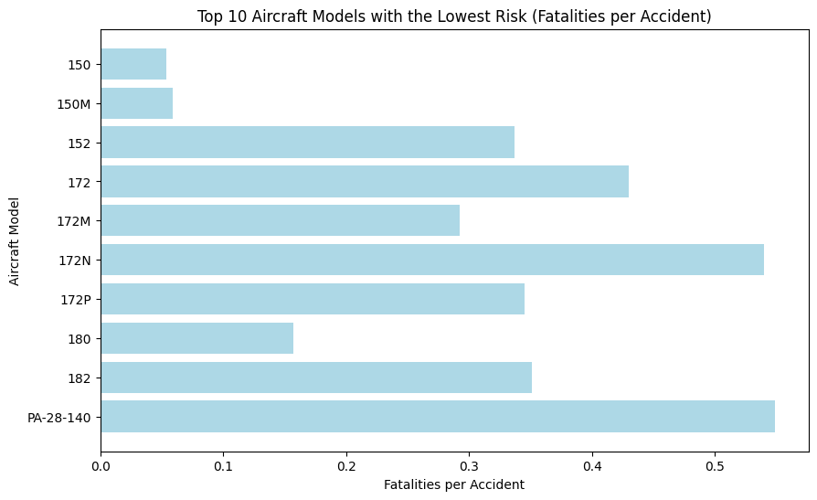
Risk vs Frequently used Models
Notes:
I sorted my data to be based on usage. Based on how often the aircraft were used as well as the number of fatalities reported for those models, the above chart shows the models with the lowest risk. This is shown the Risk vs Frequently used Models slide.

Slide 15
Key Insights
Accident trends – Notable decline over the years
Aircraft models with fewer accidents
Purpose of flight – Commercial has fewer accidents
Notes:
Key Insights;
Accident trends:
Over the years, there has been a notable decline in aviation accidents with occasional peaks and declines.
Purpose of flight:
Flights categorized under Personal or Instructional purposes are associated with a higher number of injury incidents compared to Commercial or Business flights.
Aircraft Models: I sorted my data to be based on usage. Based on how often the aircraft were used as well as the number of fatalities reported for those models, the above chart shows the models with the lowest risk. This is shown the Risk vs Frequently used Models slide.

Slide 16
Business Recommendations
Consider Aircraft with a low Accident rate
Align Investment with Use-Case Insights (Purpose of flight)
Prioritize Aircraft Models with No or Minimal Fatalities
Consider Aircraft that have shown to have the least damage
Notes:
1. Consider Aircraft with a low Accident rate
Aircraft such as the Mooney M-22 and Piper PA-28 as seen in Figure 7, consistently appear in accident data with lower fatality rates per incident, suggesting they are statistically safer and reliable for general aviation or training purposes.
2. Align Investment with Use-Case Insights
Use the Purpose of flight data to guide investment. Flights categorized under "Personal" or "Instructional" showed higher fatality rates compared to commercial operations as shown in Figure 6.Therefore, aircraft with safer outcomes in commercial or charter operations may be preferable if the business strategy is oriented toward such use cases. Avoid High-Risk Models Common in Personal and Instructional Flights.
3. Prioritize Aircraft Models with No or Minimal Fatalities
Aircraft with consistently low or zero fatality rates indicate higher safety and reliability.Aircraft Models such as Cessna 150, Cessna 152M and Cessna 172 showed minimum fatality rates and can be considered.
4. Consider Aircraft that have shown to have the least damage
This shows that the aircraft is generally a safer investment as lower damage can also signify lower injury rates.

Slide 17
Next Steps
Add a total number of flights column for each aircraft.
Analyze manufacturer reliability further
Conduct a Cost-Benefit analysis
Incorporate Updated Data
Perform Risk simulations
Notes:
In the future,
Add a total number of flights column.
Having a column that shows the total number of flights taken for each model of Aircraft in order to get a clearer analysis of the safety of each model.
2. Further Analyze Manufacturer Reliability Combine Make and Model to assess safety records by manufacturer, offering broader investment insights.
3. Conduct Cost-Benefit Analysis Compare operational costs, maintenance history, and acquisition costs for the recommended models.
4. Incorporate Real-Time or Updated Data Use newer accident reports or real-time flight safety databases for a more current risk evaluation.
5. Run Risk Simulations Apply statistical or machine learning models to simulate accident likelihood under various conditions.

Slide 18
Thank you!

