Slide 1

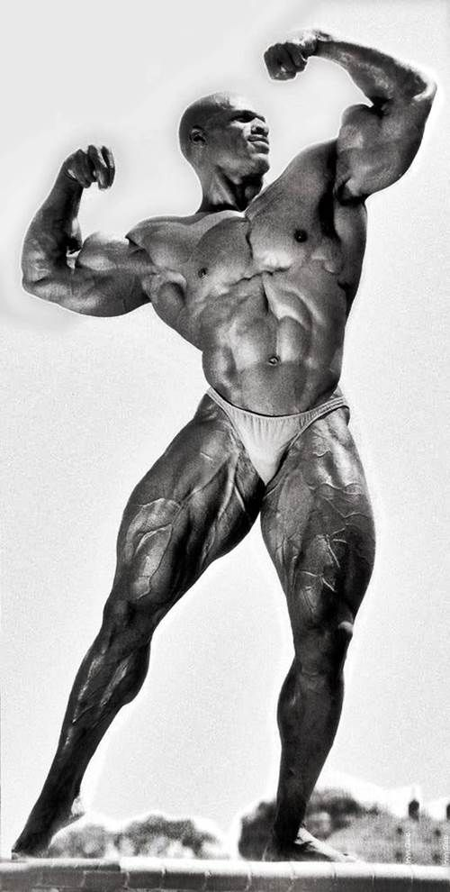
Local Fitness Finder
A FULL-STACK WEBSITE BY TEAM SINISTER TRANQUILITY
Nick Gonzalez
Max Goduco
Kate Remmick
Matt Elmore

Slide 2

The Team
MAX
SD STAFF GOING WTF
NICK
KATE
MATT

Slide 3
Outline

Slide 4
Demonstration

Slide 5
Database Diagram

Slide 6
DAOs & Controllers

Slide 7
Frontend

Slide 8
Lessons Learned

Slide 9
Conclusion

