Slide 1

Predicting Hazardous Asteroids Using Unsupervised Learning Methods

Slide 2
Defining the Problem
Given NASA asteroid data, can I use unsupervised learning techniques to classify asteroids as hazardous or non-hazardous, and therefore screen for hazardous asteroids?

Slide 3
The Dataset
NASA: Asteroids Classification
URL: https://www.kaggle.com/datasets/lovishbansal123/nasa-asteroids-classification/data

Slide 4
The Process
EDA (exploratory data analysis)
PCA (principal component analysis)
Agglomerative Clustering
K-Means
NMF (non-negative matrix factorization)
Comparison of Approaches Used
Recommendation for Practical Applications
Code and slides are available on Github at https://github.com/Kate-Zilla/NASA-asteriod-classification

Slide 5
EDA (exploratory data analysis)
Initial visualizations revealed a large amount of redundancy in the data, most significantly due to measurements replicated in a number of units. Data was therefore cleaned to only one version per type of measurement, reflecting the most readable/appropriate unit for the specific trait measured.
LD vs kilometers, etc
Constant columns were also dropped
Orbiting body = earth
Equinox = J2000
Timestamps were also removed, as they represent when something happened not how it related structurally with the other asteroid features.
Booleans were mapped to integers

Slide 6
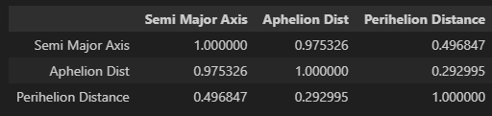
EDA (exploratory data analysis)
Then I had to do some research.
Aphelion Distance, Perihelion Distance, and Semi-Major Axis are all mathematically related, so I created a correlation matrix.
Aphelion Distance and Semi-Major Axis had the strongest correlation, so I dropped Aphelion Dist.

Slide 7
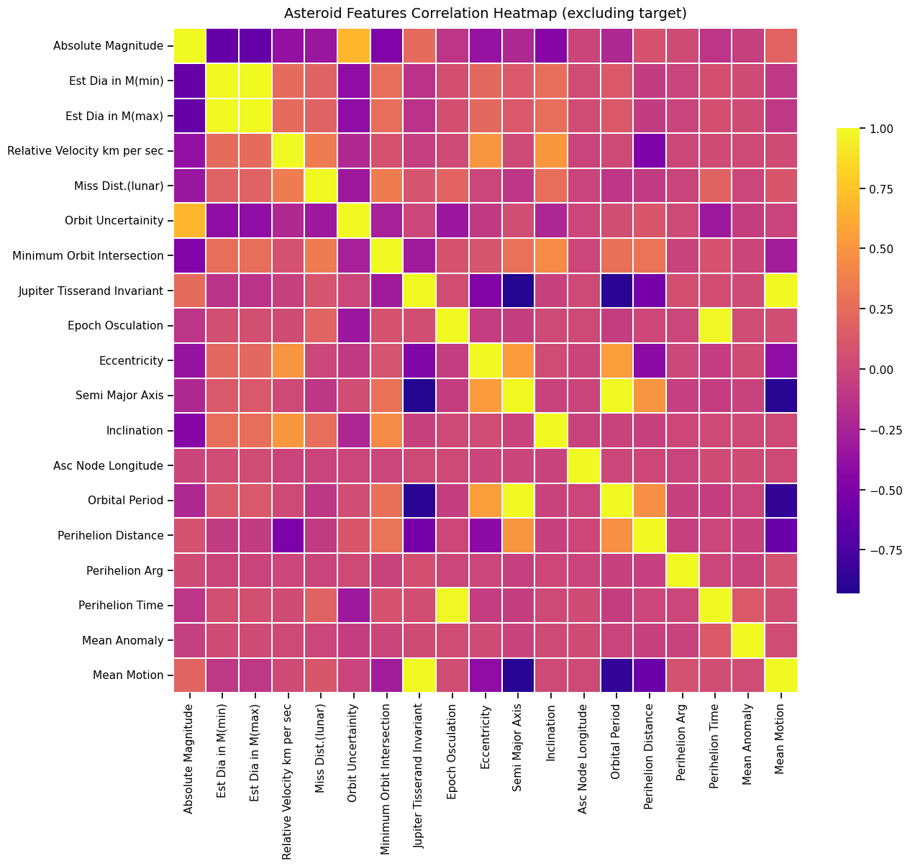
More on the EDA
The heatmap for the subsequent correlation matrix of all features showed the strongest correlations between
Orbital Period & Semi-Major Axis
Epoch Osculation & Perihelion Time
Jupiter Tisserand Invariant & Mean Motion
After some research on Wikipedia & NASA’s website, these relationships can be explained by:
Kepler’s Third Law of Planetary Motion
The Mathematical Definition of Mean Anomaly
The definition of the Tissarand Invariant (aka Parameter)
Therefore, I dropped the following features:
Orbital Period, because it is directly derived from the Semi-Major Axis
Epoch Osculation, because it is linearly related to Perihelion Time
Mean Motion, as it is a mathematical derivative of the Semi-Major Axis, while the Jupiter Tisserand holds a greater depth of information

Slide 8
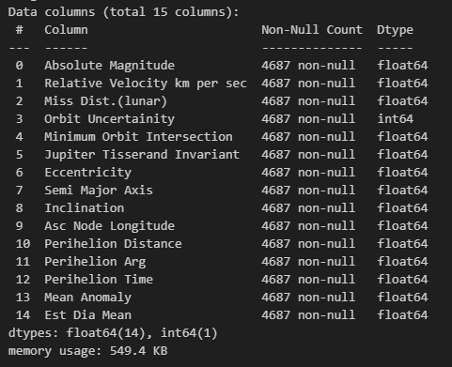
More on the EDA
Finally, there is a high correlation between minimum estimated diameter and maximum estimated diameter for each asteroid. Since the two are calculated using a standard uncertainty based on uncertain albedo in space, I replaced both columns with their mean value as a reasonable approximation.

Slide 9
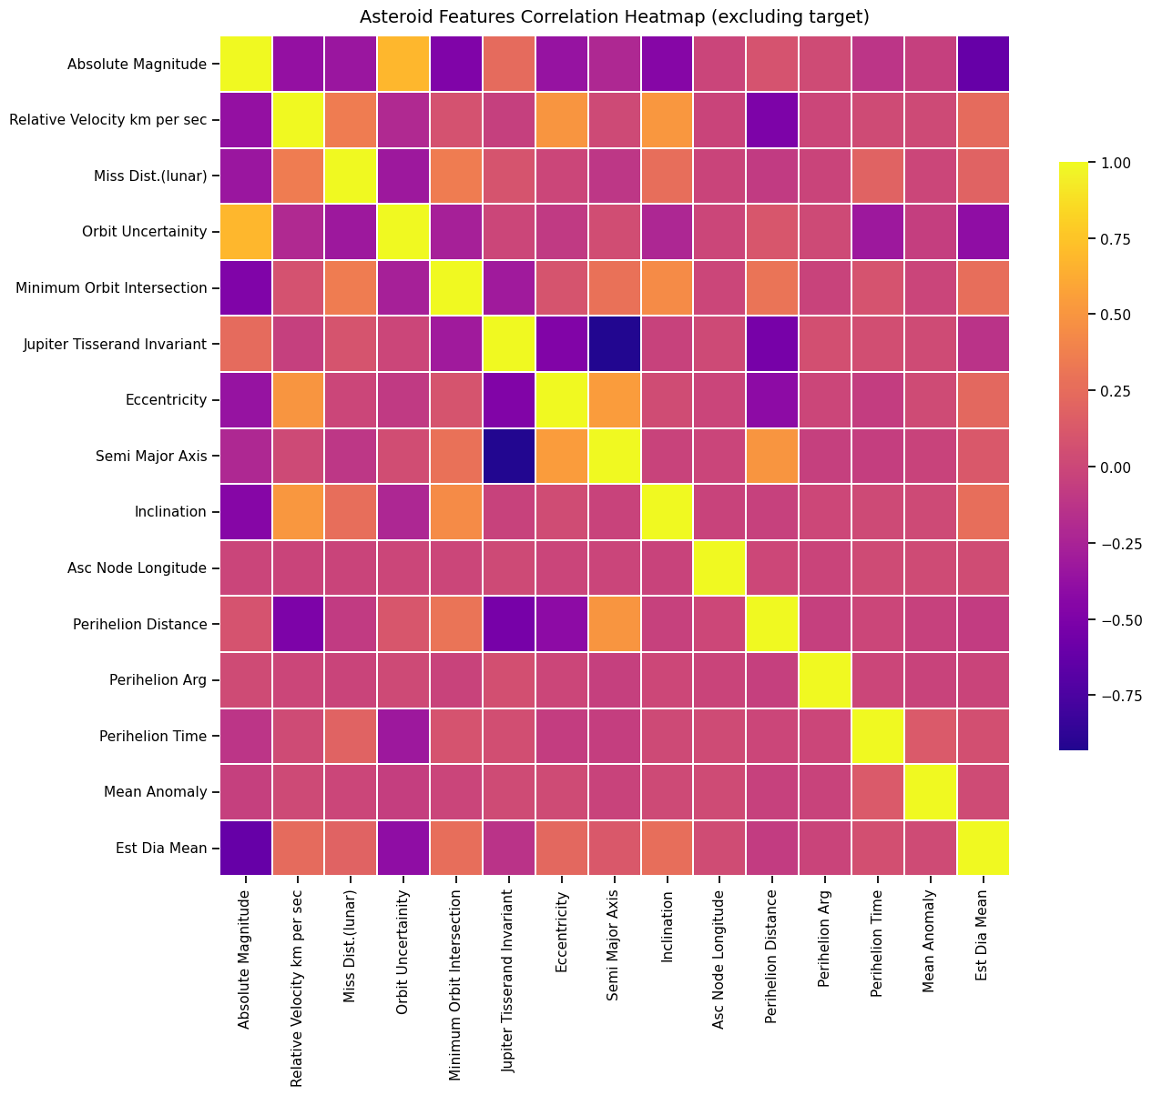
Final Asteroid Features Correlation Heatmap

Slide 10
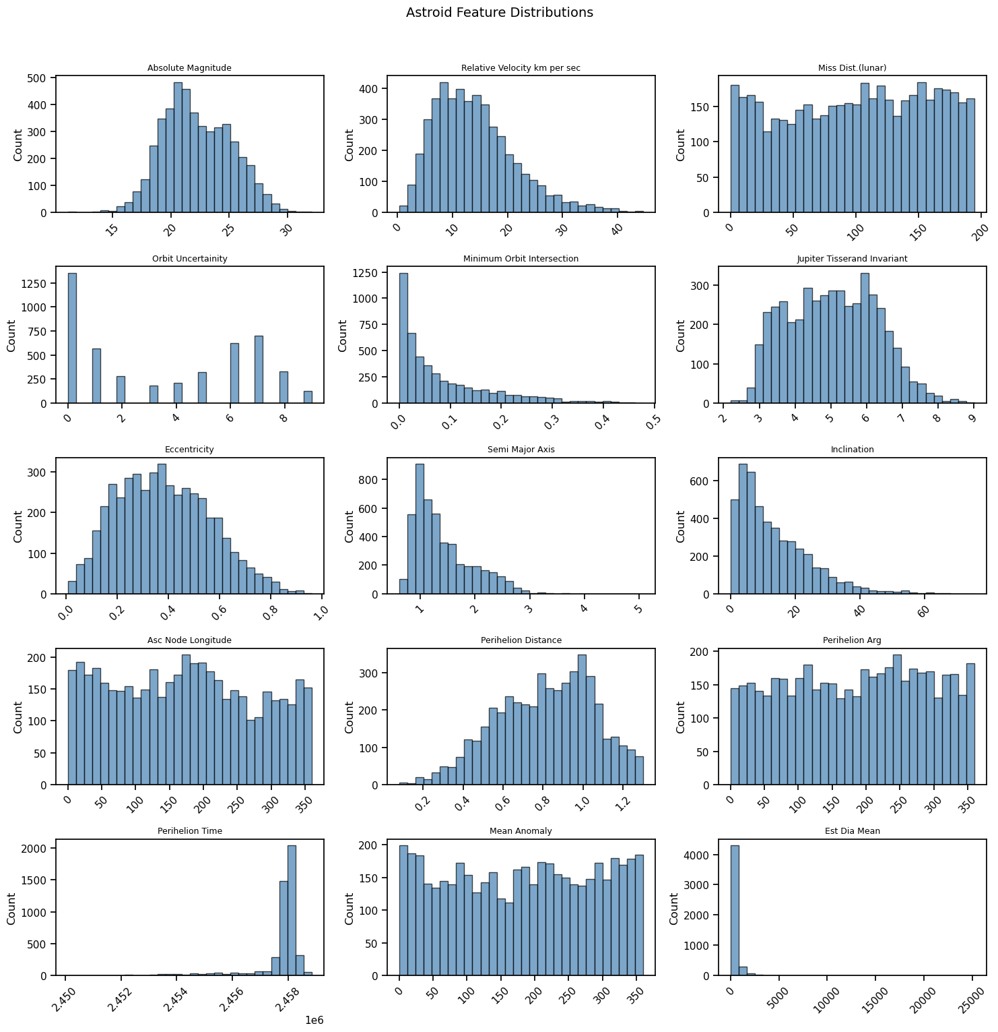
Histograms of Feature Distributions

Slide 11
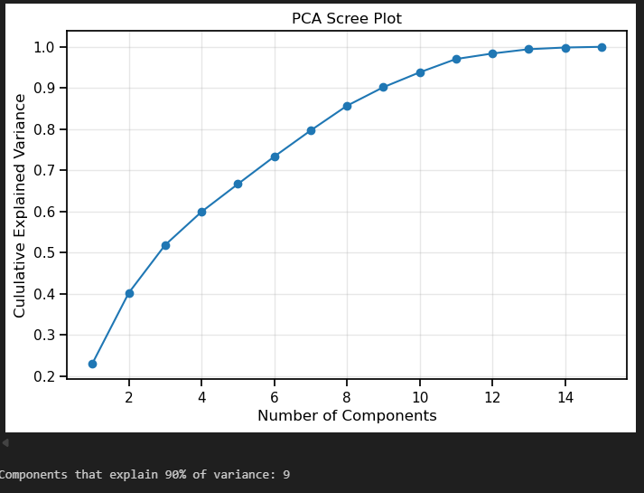
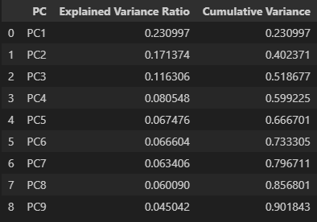
PCA: Principal Component Analysis
Output from my PCA explained variance ratio & Scree Plot showed that 9 components explained 90% of all variance. This allows me to reduce dimensionality to 9.
After projecting onto my top 9 principal components, I created a table showing how each component contributes

Slide 12
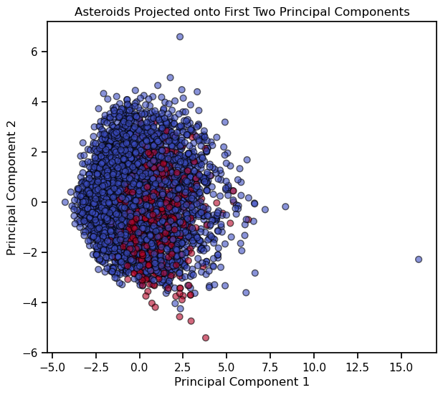
PCA: Principal Component Analysis
As it is tricky to visualize 9 dimensions, but I still wanted a plot to visualize, I plotted the asteroids as projected onto the first two principal components.
Red are hazardous, blue are non-hazardous
While we are not seeing the full picture in only two dimensions, you can already start to see the red points cluster together.

Slide 13
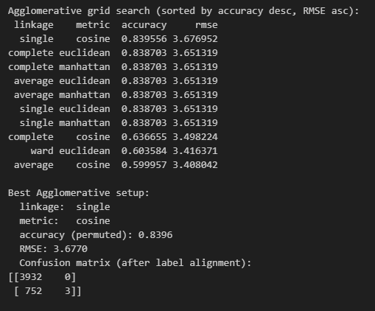
Agglomerative Clustering
Iterated over a variety of linkages & metrics until arriving at the optimal combination, then arrived at results
Best setup = single & cosine
83.96% accuracy
Heavily unbalanced confusion matrix
Could still reasonably represent reality as hazardous asteroids are rare
Notes:
Also of note, single linkage with cosine makes sense to have come out as the top performer in this case, as single linkage is sensitive to pairwise proximity and cosine distance measures angular similarity, capturing directional relationships. Therefore, this setup tends to perform well when clusters differ in direction but have overlapping scales. Likely, this combination captured directional patterns in orbit or velocity features, maybe relative velocity, eccentricity, or inclination.

Slide 14
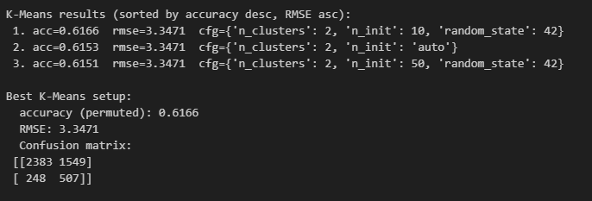
K-Means
Results appear more balanced than Agglomerative approach
Two substantial groups present
RMSE also shows the data to be in tighter clusters
Accuracy is lower
Suggests that hazardousness may not be cleanly separable by linear/spherical clusters

Slide 15
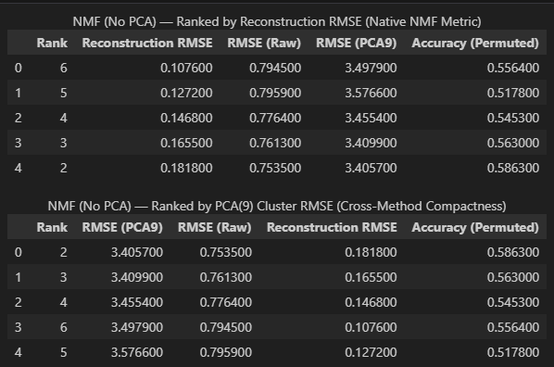
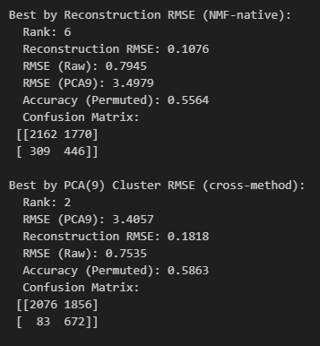
NMF (non-negative matrix factorization)
Notes:
NMF is well suited to the asteroid data because the physical qualities measured are non-negative and can combine additively. Looking at the Reconstruction RMSE (using the original factors before PCA), the error decreased with rank, as expected. When W was clustered into two groups to compare hazardous vs non hazardous, the accuracy was at around 55.6%. I calculated precision, recall, and accuracy from the confusion matrices, and at rank = 6, got precision of ~0.201, recall of ~0.590, and accuracy of ~ 55.6%. This shows that while the higher rank captures teh continuous physical structure well, but "hazardous" is not a distinct cluster inside W; it appears to behave as a *threshold* over several correlated parameters.
For rank = 2, which was the best rank when using the same PC 9 space as prior methods, I calculated precision = ~0.266, recall = ~0.890, and accuracy = ~58.6%. This iteration had a notably high recall. This means that this method is a conservative screen that flags most hazardous asteroids with few misses, but has many false alarms.
Ultimately rank=6 would be useful for faithfully summarizing the population with the lowest reconstruction error, but rank =2 is best for a high-recall triage situation that catches most hazardous asteroids but is slightly less precise and comes with more false positives.

Slide 16
Comparison of Approaches Used
Approach | Accuracy | RMSE on PCA(9) | Remarks
Agglomerative Clustering, Single/cosine | 0.8396 | 3.6770 | Unbalanced clusters
K-Means | 0.6166 | 3.3471 | Tighter, more balanced clusters
NMF, rank = 6 | 0.5564 | 3.4979 | Reconstruction RMSE = 0.1076
NMF, rank = 2 | 0.5863 | 3.4057 | Reconstruction RMSE = 0.1818
Notes:
In this context, Agglomerative Clustering was great for finding chains & outliers and exploratory anomoly hunting. However, it had the worst recall and the worst RMSE. In practice, it would not be particularly useful for indentifying hazardous asteroids.
K-Means, with k=2 had the tightest clusters, lowest RMSE, and gave two substantial balanced groups in a fast and stable manner. It does however miss some hazards and flag many non-hazards.
NMF, with rank = 2, had a very high recall, showing it has the capacity to capture most hazardous asteroids. It is also possible to interpret the physics by inspecting H. It does however have low precision, which can lead to many false alarms. This method would be the best for flagging hazards in cases in which missing the hazard is the worst case outcome.
NMF, with rank = 6, gave the best reconstruction of the data, with lowest recon RMSE. However, it did not have the tightest clusters and recall and precicion were both unexceptional. This method could have utility in scientific interpretation and dimensional summaries; however would not be a practical method for flagging active hazards.
For practical purposes, I would recommend a two step pipeline, first using NMF with rank =2 to screen for hazards, keeping anything predicted as a hazard for step 2, which would be to re-score that subset with K-Means to achieve a tighter cluster distance.

Slide 17
Recommendation for Practical Applications
Two-step pipeline
First, use NMF with rank = 2 to screen for hazards, keeping any asteroid predicted to be “hazard” for step 2
Next, re-score that subset with K-Means to achieve a tighter cluster distance
Simulation example starts on next slide

Slide 18
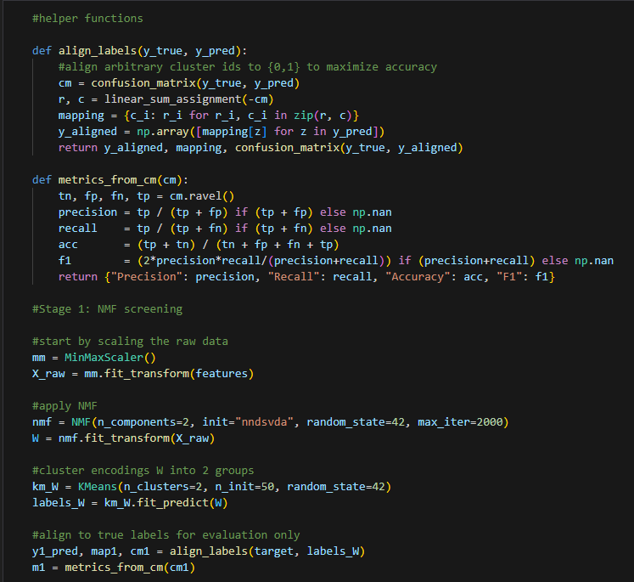
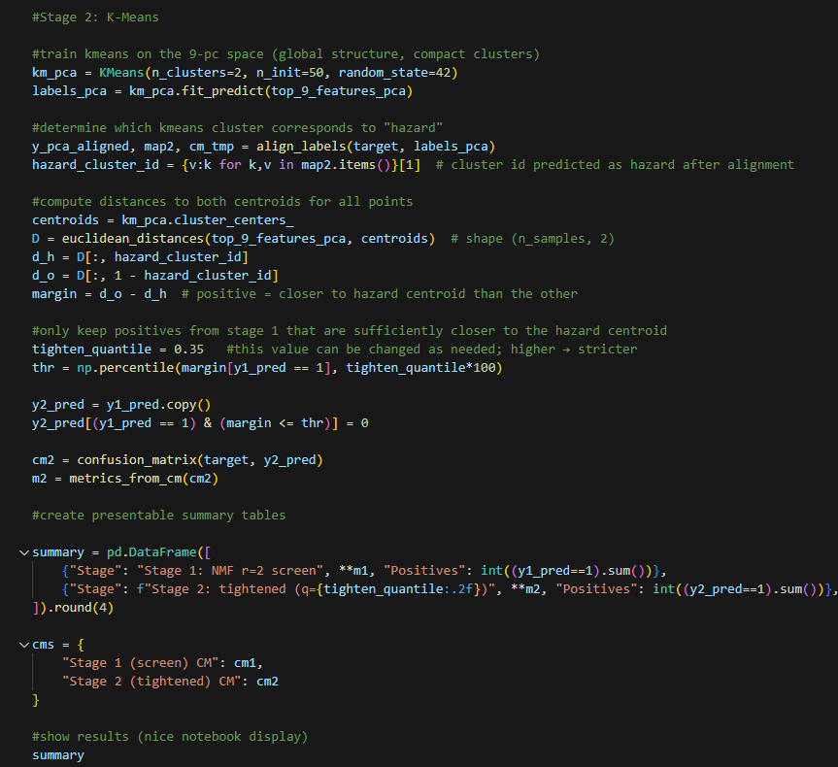

Slide 19

Recommendation for Practical Applications
Stage 1:
Very high recall, catches most hazards
Low precision, many false alarms
Stage 2:
Reduces alerts and boosts overall accuracy
Recall does drop to about 51.8%

Slide 20
References
Bansal, Lovish. “NASA: Asteroids Classification.” Www.kaggle.com, www.kaggle.com/datasets/lovishbansal123/nasa-asteroids-classification.
“Mean Anomaly.” Wikipedia, 1 Dec. 2021, en.wikipedia.org/wiki/Mean_anomaly.
NASA. “Orbits and Kepler’s Laws - NASA Science.” Science.nasa.gov, NASA, 26 June 2008, science.nasa.gov/resource/orbits-and-keplers-laws.
“Tisserand’s Parameter.” Wikipedia, Wikimedia Foundation, 28 Aug. 2025, en.wikipedia.org/wiki/Tisserand%27s_parameter.

