Slide 1

Quickchat
Bill Huang, Yang Zhou, Zhen Gao,
Jeff Zhou, Jianing Lou, Jerry Zhang, Zhengtong Liu

Slide 2

Agenda
Use cases
App design
Demo
Q&A

Slide 3


Use cases

Slide 4
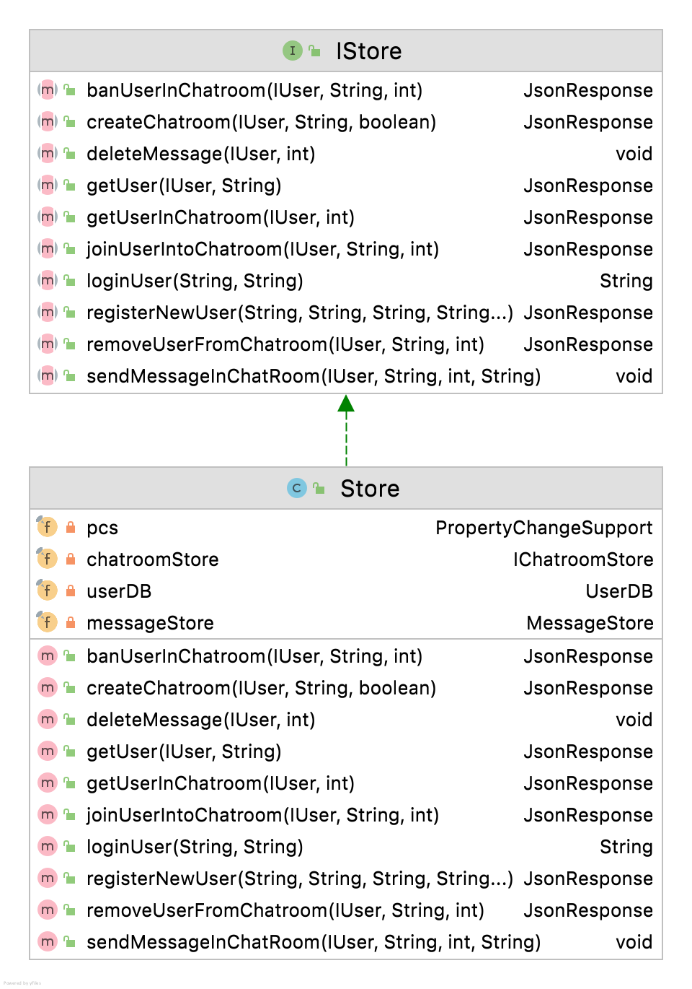
Use cases realizations
USER
Create Account
Present user’s info
Login Registered User
CHATROOM
Create Chat Room
Join chat room
Invite user to chat room
MESSAGE
Send Message
Receive Message
Edit Message
Delete Message

Slide 5
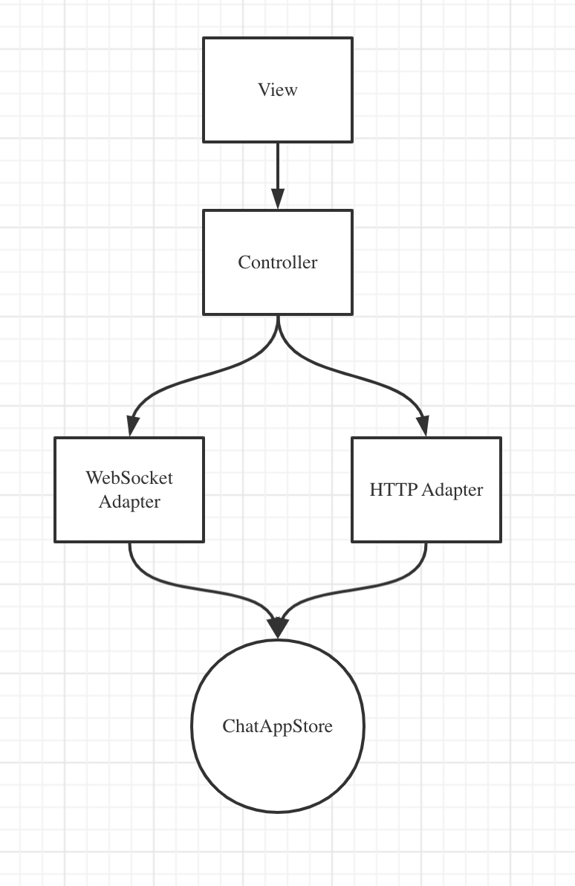
Use cases realizations
Request
Rest API : extensible/robust
WebSocket : stable on messaging
Adpaters preprocess request/call methods of IStore instance
HTTP Adapter
WebSocket Adapter

Slide 6
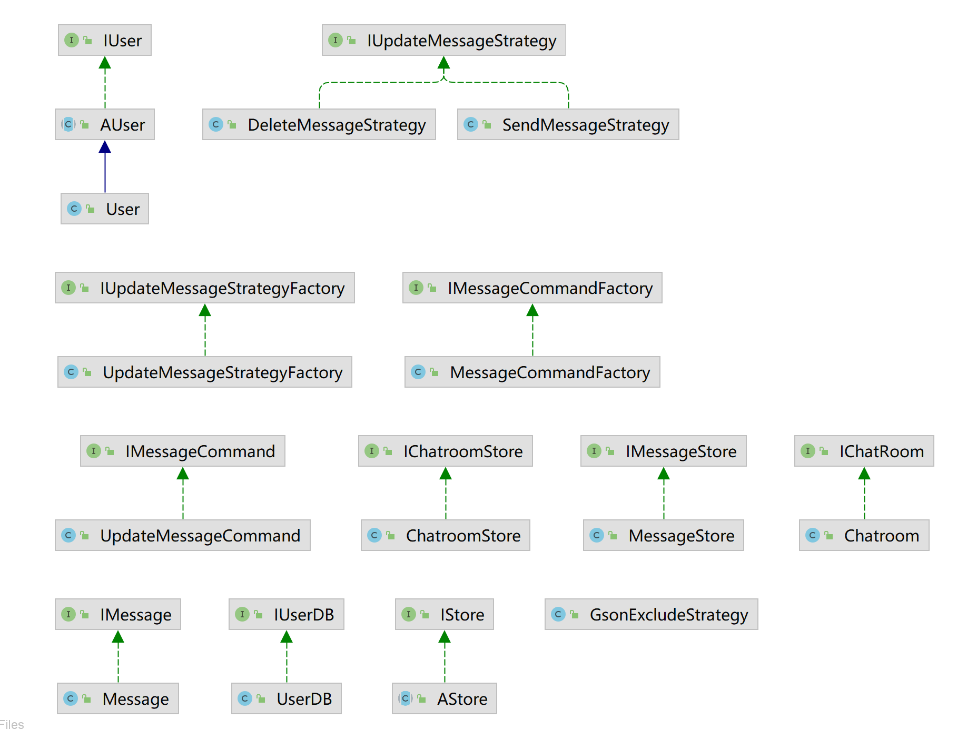
App Design

Slide 7
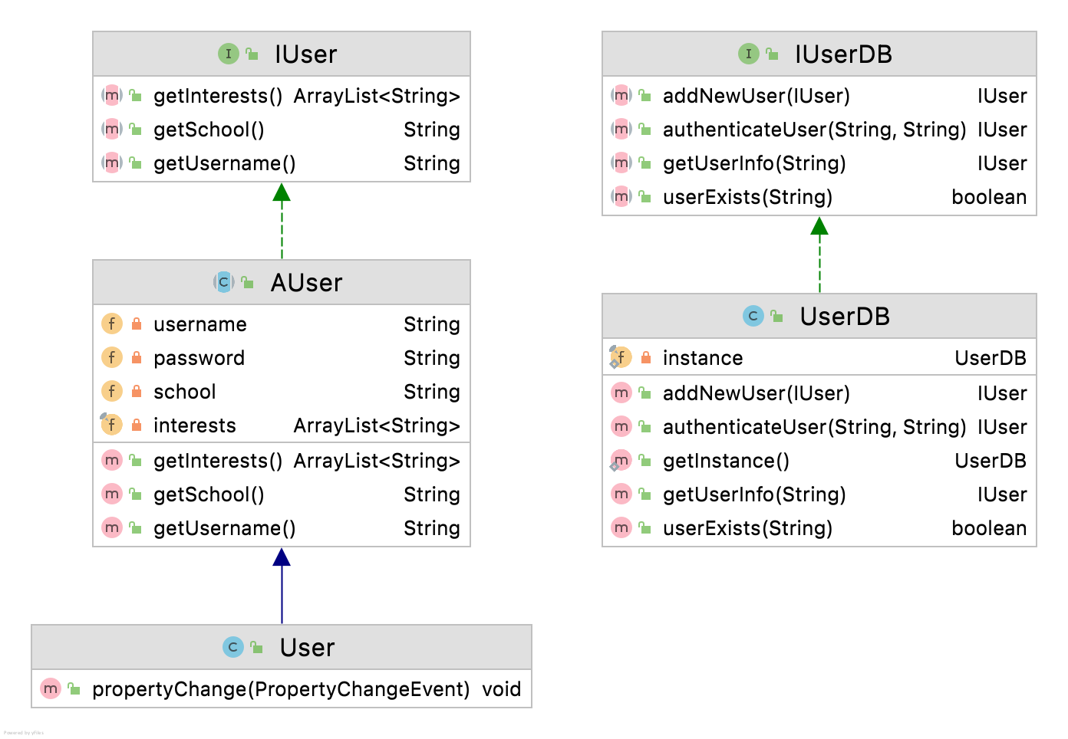
User / UserDB
USER
Defines User behavior
Can be extended by new class implementing IUser
UserDB
Holding IUser instance
Implemented by in-memory storage
Extendable by implementing IUserDB interface for data persistence requirements

Slide 8
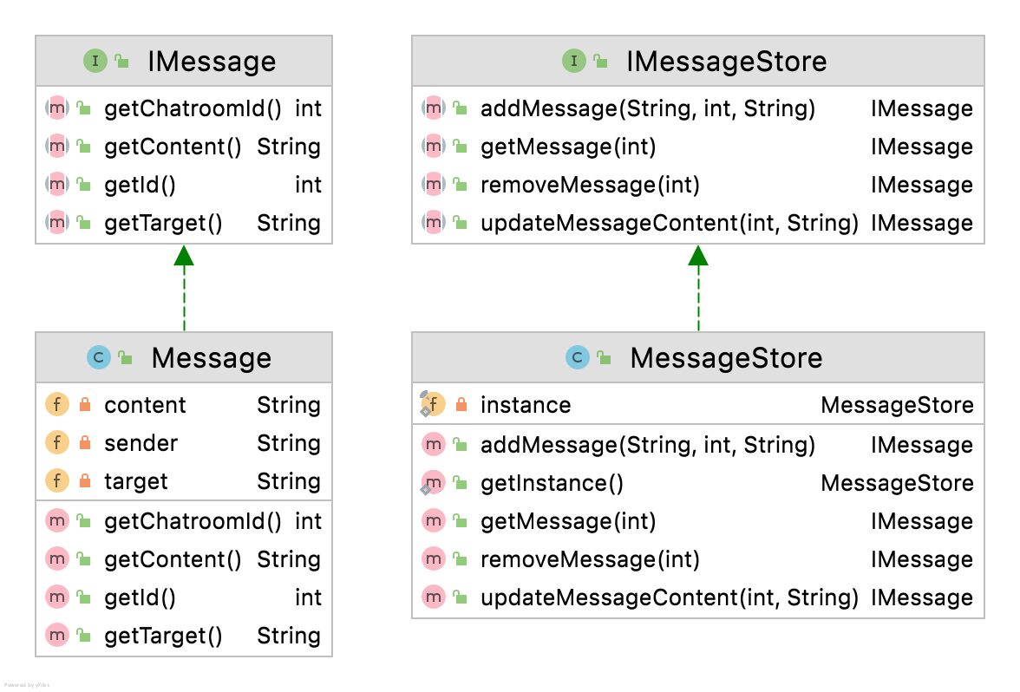
Message / Message Store
Message
Defines Message property
Can be extended by new class implementing IMessage for new kinds messages, like files, images
MessageStore
Hold all the messages
Maintaining the state for the messages

Slide 9
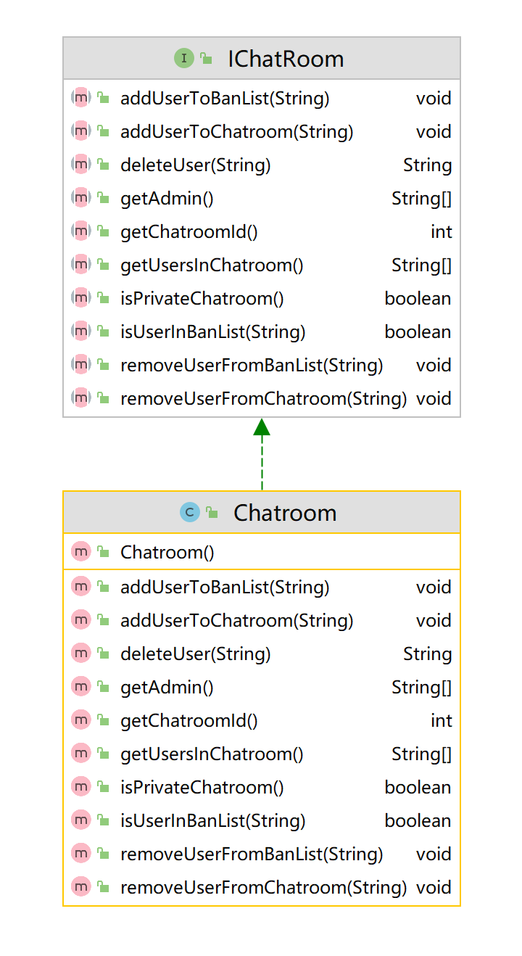
Chatroom
Property
IChatroom defines basic chatroom interface
Chatroom storing user infomatiom
Methods
Chatroom verifies if user is in the chatroom
Chatroom verifies if user is admin

Slide 10
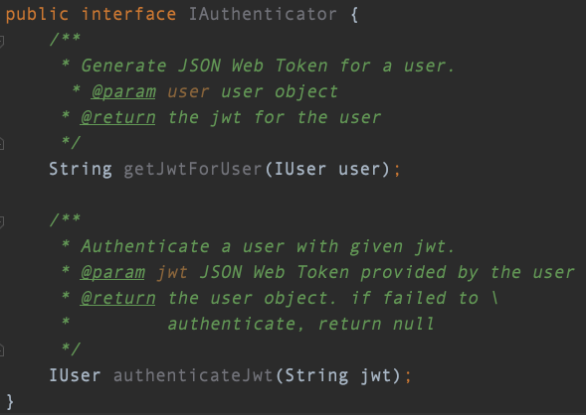
Authentication
Generating
JWT(JSON Web Token) is generated and signed with a secret in the server and sent to the users
User will set JWT as its cookie and pass it to the server along with every requests
Authenticating
Server will validate the JWT with server’s secret and return the valid IUser instance

Slide 11

Websocket Timeout Handling
Heartbeat mechanism
Client side set a time interval
Renew the session’s timeout countdown
Server side neglect the message

Slide 12


Slide 13
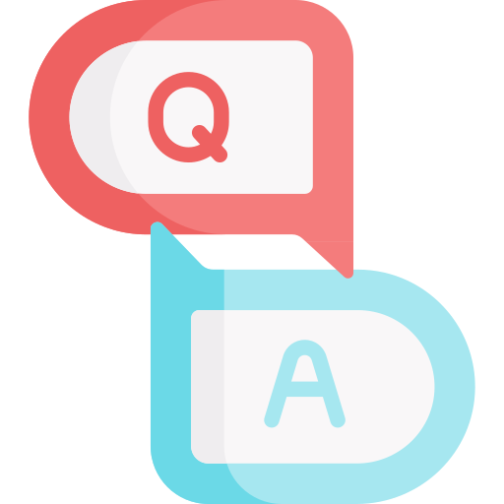
Q&A

Slide 14
Thanks for listening!

