Slide 1
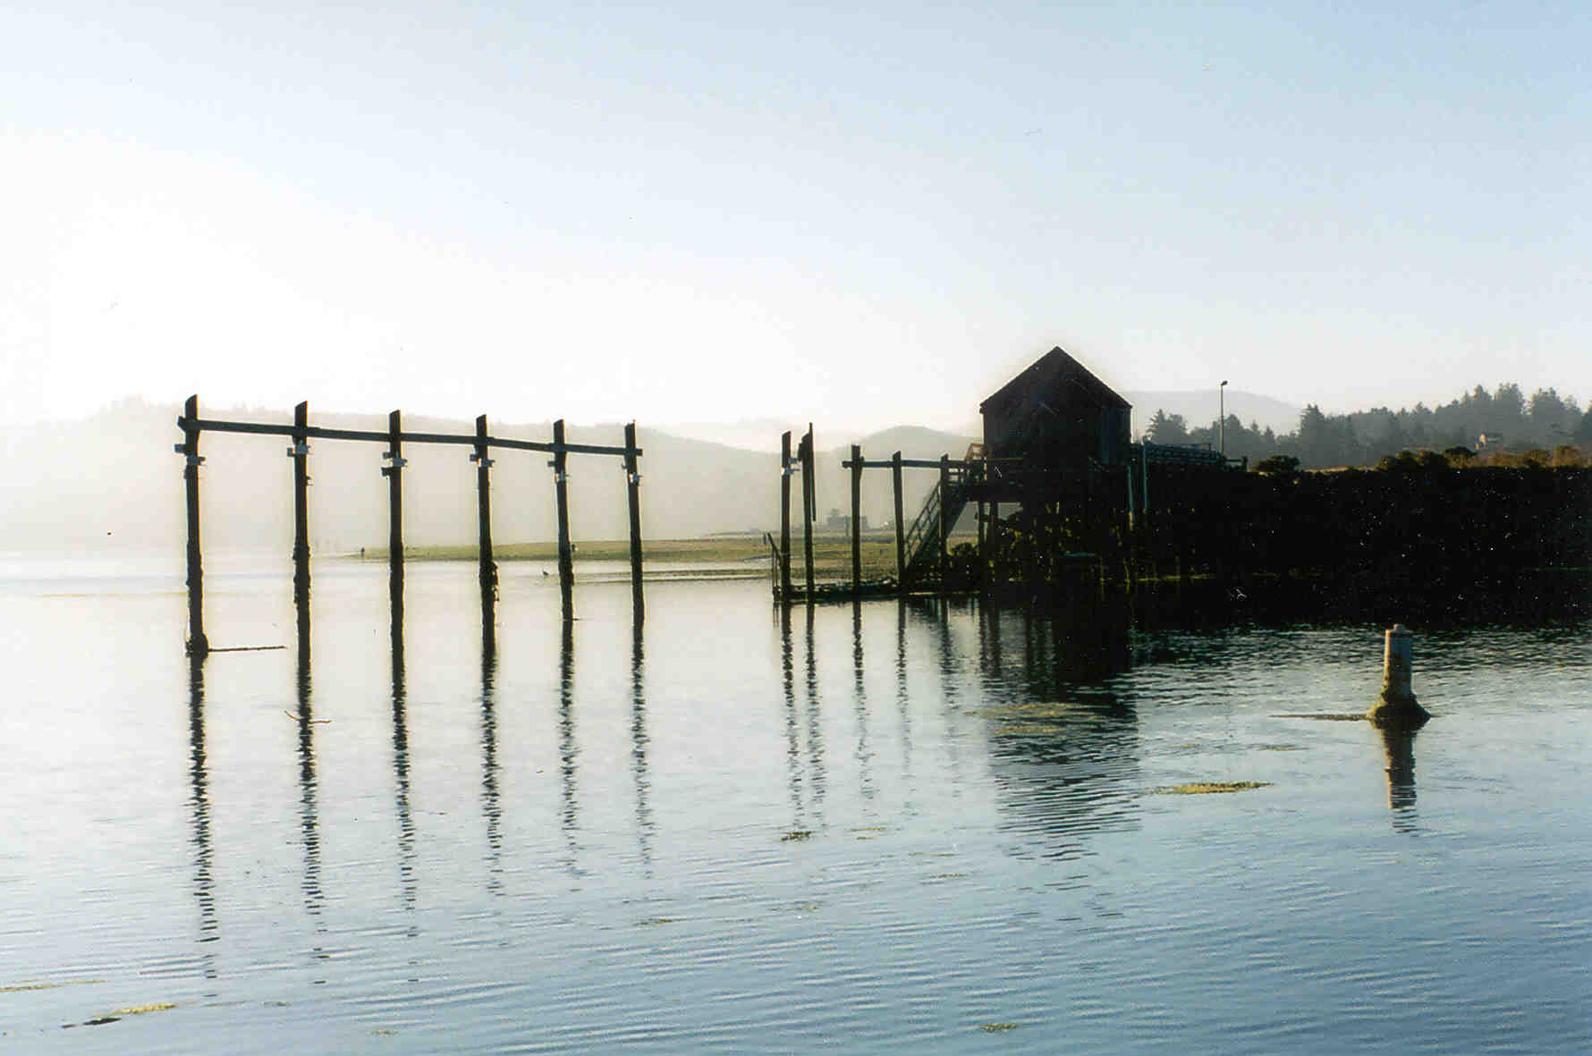

Stable Isotopic Indicators of Nutrient Sources and Cycling in a Temperate Northeastern Pacific Estuary, USA A.C. Sigleo and W. E. Frick College of Oceanic and Atmospheric Sciences Oregon State University, Newport, Oregon

Slide 2
The Research Objective
Determine annual nutrient budgets in Northeastern Pacific estuaries including major nutrient sources and sinks
Define nutrient cycles and processes using the distributions of *¹³C and *¹⁵N, TOC, TON and C:N ratios in suspended and benthic sediments

Slide 3
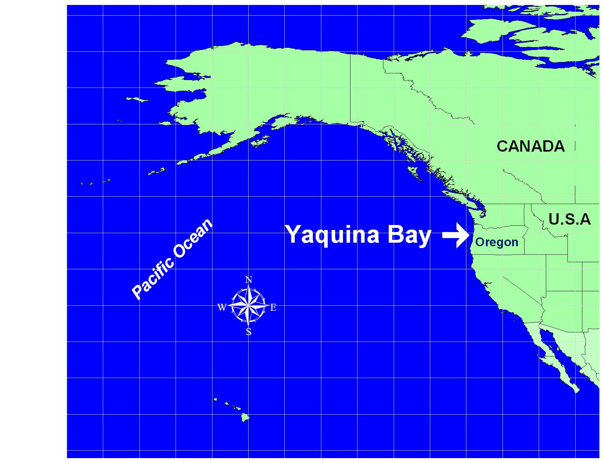
Example Oversize Graphic Template
REMOVE AFTER READING
Design Notes:
This slide is included as a guide to illustrate how to place oversize images/charts on a content page and retain the EPA/ORD communications standards. The background of the imported image must be set to white, and the frame stretched to cover the background EPA logo in the upper left corner.
The image element and the text box below are foreground elements that mask the default background image and text boxes from appearing.

Slide 4
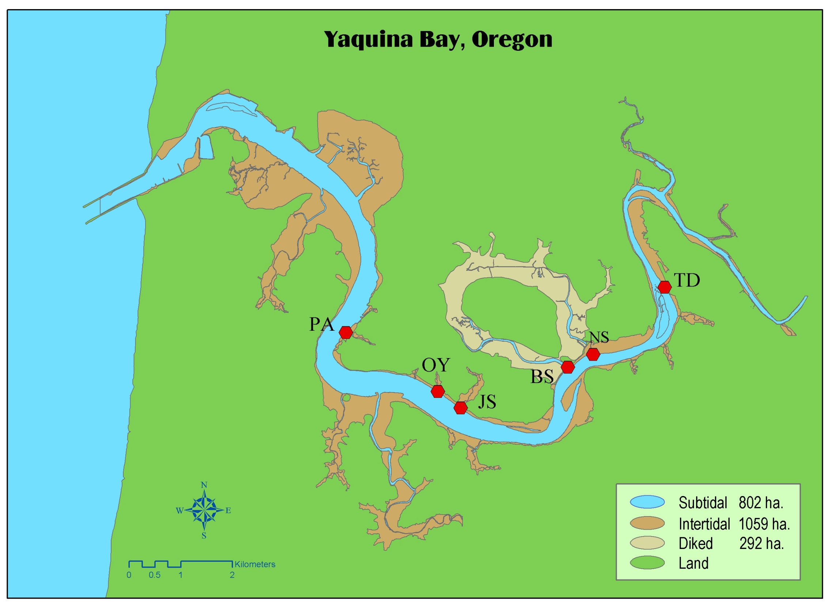

Slide 5
Mediterranean Climate:
Wet Winters
Dry Summers
Elevation
0 – 1249 m
Land Use
Silviculture
Forest type (97%)
Conifer
Riparian zones
Red Alder
Discharge Nov-Mar
Up to 78 m³ sec⁻¹
Summer discharge
0.28 m³ sec⁻¹

Slide 17
CONCLUSIONS
Relative to salinity, the isotopic increases in summer suspended particles were non-linear, indicating that processes in addition to simple mixing were occurring.
Significant sediment denitrification activity occurred in the estuary
Isotopic comparisons indicated that benthic sediments were time and source averaging
Heterotrophic remineralization and nutrient recycling were important in the tidal regions of the estuary, and were most pronounced in the late summer and fall.

