Slide 1
State Estimation

Slide 2
What is state estimation?
State estimation is the process of estimating the hidden true state of a system by combining a motion model, sensor measurements, and uncertainty.
Motion model
Estimator
Sensor data
Belief
How the robot should move
predict + update
Noisy evidence
State + confidence
Example robot state: x = [position_x, position_y, heading, velocity]
A good estimator answers: Where am I? How confident am I?
A3 State Estimation
03
Notes:
Define state estimation clearly. Then explain that robots cannot directly observe their true state. The estimator fuses a motion model with noisy sensor data, and the output is not just a point estimate. It also includes confidence or uncertainty.

Slide 3
Most estimators follow prediction and update
Previous belief
Prediction
Update
Use motion model
Use sensor measurement
bel(xₖ₋₁)
x̂ₖ|ₖ₋₁ = f(x̂ₖ₋₁, uₖ)
x̂ₖ|ₖ = prediction + correction
Prediction usually increases uncertainty because motion is imperfect. Update usually decreases uncertainty because new sensor data gives evidence.
A3 State Estimation
04
Notes:
The recursive structure is the central idea. First, the robot predicts where it should be after moving. This introduces uncertainty. Then the robot receives a measurement and corrects the prediction. This correction usually reduces uncertainty.

Slide 4
KALMAN FILTER
Compact belief: one mean and one covariance
Kalman Filter represents belief as a Gaussian distribution.
covariance = uncertainty width
Assumption
linear model + Gaussian noise
Output
best estimate x̂ and covariance P
Strength
fast and mathematically elegant
Limitation
less suitable for strongly nonlinear or multi-modal uncertainty
Trust prediction or trust sensor? Kalman gain decides.
05
Notes:
Introduce the Kalman Filter as a compact way to represent uncertainty. It only needs the mean and covariance. The Kalman gain controls how strongly the filter corrects the prediction using the measurement.

Slide 5
KALMAN FILTER
Solved example: one-dimensional position estimate
Prediction
Numerical example
x̂⁻ = x̂ + u P⁻ = P + Q
Given
x̂ = 0.00, P = 1.00, u = 1.00, Q = 0.20
Measure
z = 1.30, R = 0.30
Update
Predict
x̂⁻ = 1.00, P⁻ = 1.20
K = P⁻ / (P⁻ + R)
Gain
K = 1.20 / (1.20 + 0.30) = 0.80
x̂ = x̂⁻ + K(z − x̂⁻)
P = (1 − K)P⁻
Update
x̂ = 1.00 + 0.80(1.30 − 1.00) = 1.24
Uncertainty
P = (1 − 0.80)(1.20) = 0.24
Interpretation: K is high when the measurement is reliable, so the correction is stronger.
Result: estimate moves toward the measurement, uncertainty drops from 1.20 to 0.24.
A3 State Estimation
06
Notes:
Walk through this slowly. The prediction says the robot should be at 1.00. The sensor reads 1.30. Because the measurement noise is lower than the predicted uncertainty, the Kalman gain is 0.80. The updated estimate becomes 1.24, which is between prediction and measurement, and the uncertainty decreases to 0.24.

Slide 6
Kalman filtering extends to nonlinear robot localization
In the simulation, the state contains the robot pose, velocity, and landmark positions.
State vector
Nonlinear motion
Sensor model
x = [ robot x, robot y, heading ψ, speed V, landmark₁, …, landmark₅ ]
xₖ₊₁ = xₖ + V cos(ψ)Δt
Measurements include heading, speed, landmark bearing, and landmark range.
yₖ₊₁ = yₖ + V sin(ψ)Δt
The robot and map are estimated together.
EKF linearizes this model using Jacobians.
R controls sensor noise. Higher R means the filter trusts measurements less.
This is why changing sensor accuracy changes the size of the red uncertainty ellipses in the results.
A3 State Estimation
07
Notes:
Connect the Kalman Filter to the actual simulation. Because robot motion uses sine and cosine, the standard linear Kalman Filter is not enough. EKF handles this by linearizing the nonlinear motion and measurement models. The most important parameter for the result comparison is the measurement covariance R.

Slide 7
PARTICLE FILTER
Sample-based belief: many guesses with weights
Particle Filter does not force belief into one Gaussian. It represents many possible robot states.
1
Initialize particles
2
Predict motion
3
Weight by sensor likelihood
4
Resample high-weight particles
particles = possible states
Key intuition: bad guesses disappear, good guesses survive.
A3 State Estimation
08
Notes:
Particle Filters are useful when uncertainty is nonlinear, non-Gaussian, or multi-modal. Instead of tracking a mean and covariance, we track many hypotheses. Measurements assign weights, and resampling keeps the particles that agree with sensor data.

Slide 8
PARTICLE FILTER
Solved example: measurement weighting and resampling
Assume a 1D position measurement z = 1.0 with sensor standard deviation σ = 0.2.
Particle weights
Resampling intuition
particle
x
raw likelihood
normalized w
1
0.2
0.0003
0.0002
2
0.7
0.3247
0.1968
before: spread guesses
3
1.0
1.0000
0.6062
4
1.3
0.3247
0.1968
5
1.9
0.00004
0.00002
wᵢ ∝ exp(− 1/2 · (xᵢ − z)² / σ²)
after: concentrated near z = 1.0
Particle 3 dominates because it best explains the measurement.
A3 State Estimation
09
Notes:
Show the measurement likelihood calculation. Particle 3 is exactly at the measurement, so it receives the largest weight. Particles 2 and 4 still survive somewhat. Particles far away from the measurement almost disappear. Resampling turns this weighted distribution into a new particle set focused around the likely state.

Slide 9
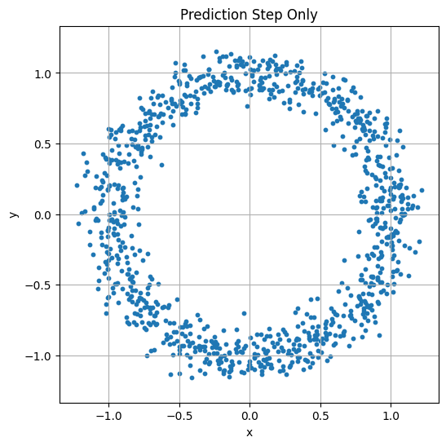
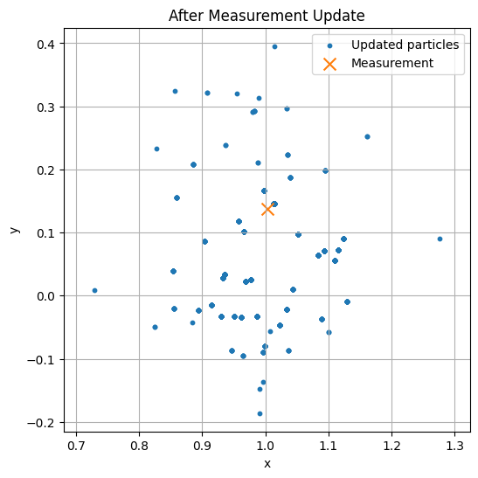
PARTICLE FILTER RESULTS
Nonlinear system: prediction only versus measurement update
Prediction only
After measurement update
Analysis: heading uncertainty creates a circular prediction cloud. The measurement update assigns high weights near the observed state and resampling collapses the cloud around the measurement.
10
Notes:
Use the left plot to explain prediction without correction. Because the initial heading uncertainty is extremely large, particles move in many directions, forming a ring. On the right, the measurement z equals state plus noise with R equal to 0.01. The particles closest to the measurement get high weights, so after resampling the distribution becomes concentrated near the true state.

Slide 10
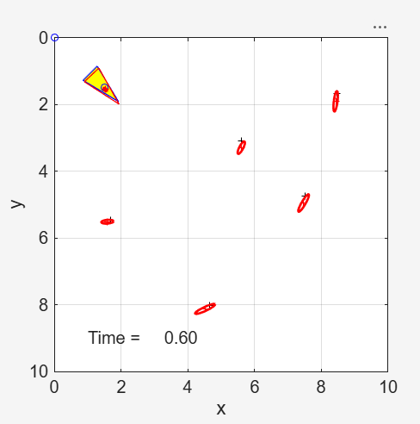
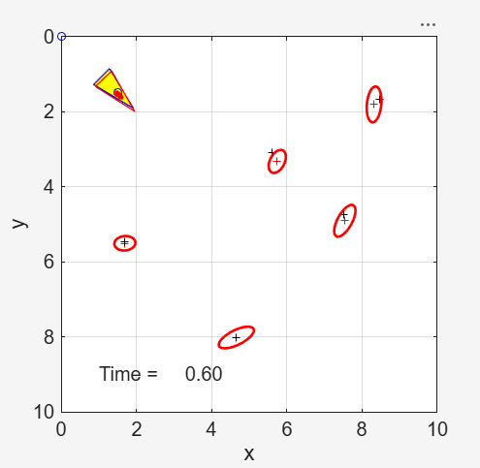
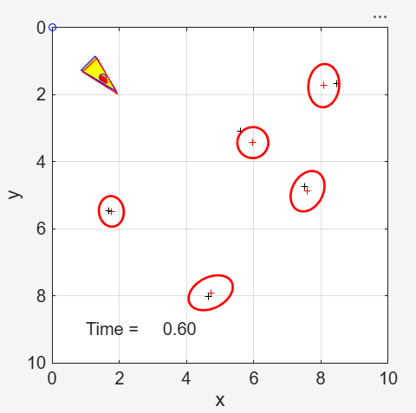
Sensor accuracy changes the confidence ellipses
Better sensor
Original sensor
Worse sensor
Small ellipses: high confidence
Medium ellipses: baseline confidence
Large ellipses: low confidence
Red ellipses show 95% confidence regions for the estimated robot and landmarks. Larger ellipses mean higher covariance and lower certainty.
11
Notes:
Compare the three figures visually. In the better sensor case, landmark uncertainty ellipses are tight. With the original sensor, the ellipses expand. With the worse sensor, the ellipses become much larger, meaning the filter is less certain about landmark positions and robot pose. This does not necessarily mean the robot is totally wrong. It means the estimator correctly reports lower confidence.

Slide 11
Why the three EKF-SLAM outputs differ
Sensor covariance R
Kalman gain K
Covariance P
bearing + range noise
trust sensor vs prediction
ellipse size in plot
Better sensor
Lower measurement noise
Filter trusts measurements more
Tighter ellipses, clearer landmark estimates
Original sensor
Moderate measurement noise
Balanced prediction and measurement
Medium ellipses, expected baseline result
Worse sensor
Higher measurement noise
Filter trusts measurements less
Larger ellipses, uncertainty remains high
Main takeaway: the filter is not just estimating position. It is also estimating how much it should trust that position.
A3 State Estimation
12
Notes:
Explain this as a causal chain. R is measurement noise. As R increases, the Kalman gain decreases, so the filter trusts new measurements less. That means the covariance stays larger, which appears as larger red ellipses. This is the professional interpretation of the three output screenshots.

Slide 12
COMPARISON
Kalman Filter and Particle Filter solve the same problem differently
Kalman Filter / EKF
Particle Filter
Belief
mean + covariance
Belief
many weighted particles
Best when
uncertainty is close to Gaussian
Best when
nonlinear or non-Gaussian uncertainty
Speed
fast and efficient
Speed
more computation
Weakness
struggles with multi-modal belief
Weakness
needs enough particles
Both algorithms follow prediction → measurement update. They mainly differ in how they represent uncertainty.
13
Notes:
This is the comparison slide. Kalman filters are efficient because the belief is summarized by a mean and covariance. Particle filters are more flexible because they use many samples, but that flexibility costs computation.

Slide 13
ADVANCED EXTENSION
KITTI Dead Reckoning and EKF State Estimation
Goal: move from small simulated examples to a real driving dataset using IMU-only dead reckoning and IMU + GPS EKF fusion.
Why this belongs here
What changes
It directly applies the same state-estimation idea: predict from motion, correct with measurements, and analyze uncertainty and drift.
The problem becomes real-data based: timestamps, coordinate conversion, sensor quality, bias, and evaluation against a reference trajectory.
KITTI extension

Slide 14
DATASET CHOICE
KITTI Raw is the correct release for IMU/GPS experiments
Use the raw synced drive, not only the odometry benchmark, because the raw release contains OXTS GPS/IMU packets.
Item | Choice in this report | Reason
Release | KITTI Raw synced | Contains synchronized GPS/IMU OXTS files
Example drive | E_cars_2017 | Common pykitti example drive and easy to reproduce
Reference | OXTS-derived local pose | Usable baseline reference, but not independent mocap truth
Frame | Local ENU-like x-y frame | Converts latitude/longitude into meters for plotting and RMSE
Important reproducibility note
KITTI Raw downloads require registration and the raw sequence zip was not attached here. Therefore, the report gives runnable code and expected analysis, but does not invent numeric RMSE values.
KITTI extension

Slide 15
PREPROCESSING PIPELINE
From KITTI OXTS packets to estimator-ready data
Download raw synced drive
Read OXTS files
Parse timestamps
Convert coordinates
Quality handling
→
lat, lon, alt, roll, pitch, yaw, velocities, accelerations, angular rates
→
compute dt for integration and EKF propagation
→
→
use pos_accuracy and status flags to downweight bad GPS
KITTI Raw + date calibration zip
lat/lon to local x-y meters using Mercator/ENU-like frame
Minimum checks: dt is nonzero after the first sample, yaw is unwrapped, GPS position is in meters, and missing or low-quality OXTS entries are handled.
A common mistake is treating every GPS update as equally reliable. Adaptive R based on reported position accuracy makes the EKF more robust.
KITTI extension

Slide 16
MODELS
Two baselines: IMU-only dead reckoning and IMU + GPS EKF
Baseline A: IMU-only dead reckoning
Baseline B: IMU + GPS EKF
State: [x, y, theta, v] Inputs: forward acceleration af and yaw rate wz Prediction: integrate acceleration and heading over time Expected issue: small IMU bias becomes large position drift after integration.
State: [x, y, theta, v] or [x, y, theta, v, bg, ba] Prediction: IMU-driven motion model Update: GPS x-y position measurement Expected benefit: GPS correction keeps position error bounded.
Core EKF idea
Prediction from IMU motion model + correction from GPS position measurement = improved state estimate
Bias-augmented EKF is the stronger version because gyro and accelerometer bias are the main drivers of long-term drift.
KITTI extension

Slide 17
EVALUATION DESIGN
How to turn the experiment into defensible results
Output | What it shows
Trajectory plot | Visual drift: reference vs IMU-only vs EKF
Error vs time plot | Whether error grows unbounded or stays corrected
RMSE [m] | Average position disagreement with OXTS reference
Final error [m] | Endpoint drift after the full sequence
Max error [m] | Worst-case deviation during the drive
KITTI-style relative error | Subsequence performance over 100 to 800 m segments
How to phrase the reference carefully
Report the numbers as agreement with the OXTS-derived reference, not as perfect ground truth. This avoids overstating precision.
KITTI extension

Slide 18
What should differ between dead reckoning and EKF
Method | Expected visual result | Expected numeric result | Reason
IMU-only dead reckoning | Trajectory drifts away, especially after turns and speed changes | RMSE and final error grow quickly | Noise and bias are integrated into velocity and then position
IMU + GPS EKF | Trajectory follows the OXTS path much more closely | Lower RMSE, lower final error, bounded max error | GPS updates correct accumulated inertial drift
Bias-augmented EKF | Similar path shape but usually more stable heading and velocity | Lower or more stable error than no-bias EKF | Estimated gyro and accel bias reduce systematic drift
Main analytical point: dead reckoning explains why state estimation is necessary, and EKF shows how sensor fusion reduces uncertainty and drift.
KITTI extension

Slide 19
LITERATURE COMPARISON AND IMPROVEMENT ROADMAP
Where this baseline can go next
Improvement | Why it helps
Add explicit IMU bias states | Reduces systematic heading and velocity drift
Move from EKF to error-state EKF or IEKF | Better handles nonlinear pose geometry and improves consistency
Adaptive or learned covariance tuning | Lets Q and R respond to changing motion and GPS quality
Add camera, wheel odometry, or LiDAR | Provides geometric constraints that inertial/GPS alone cannot provide
Measurement gating and outlier rejection | Prevents low-quality GPS packets from destabilizing the update
Literature pattern: stronger methods improve by modeling bias, using more sensors, and treating sensor uncertainty more carefully.
This connects naturally to your larger project direction: EKF/UKF baselines first, then IEKF/InEKF and adaptive noise tuning.
KITTI extension

Slide 20
FINAL KITTI TAKEAWAY
How to present this as the ending section
1. Weak baseline
2. Classical baseline
3. Research extension
IMU-only dead reckoning intentionally drifts. It shows why sensor fusion is necessary.
IMU + GPS EKF corrects drift and gives a defensible baseline estimator.
Bias states, IEKF/InEKF, adaptive noise tuning, and multimodal fusion make the estimator more robust.
The KITTI experiment turns state estimation from a formula into a real robotics problem..
Specifically, noisy motion creates drift and the filter design determines how trustworthy the final trajectory is.
KITTI extension

