Slide 1
Seeing People Through WiFi
Reproducing SiWiS (MobiCom '24) on commodity Raspberry Pi hardware
Human body-mask segmentation and 2D pose estimation from WiFi CSI alone
Full pipeline: capture → preprocessing → cross-modal labels → training → evaluation

Slide 2
What we set out to do
Reproduce a MobiCom '24 paper's results using hardware we actually have
The paper: SiWiS — fine-grained human detection using a single WiFi device
A dual-branch DNN predicts a human body mask and 17 COCO keypoints from WiFi signals alone. Video is used only during training, as a supervision signal — never at inference.
Our starting point
An existing Python reproduction of the paper's architecture: signal encoder (conv + self-attention), two cross-attention decoders, and the paper's loss functions (Eqns. 12–14).
Our hardware
Raspberry Pi 4B (bcm43455c0) running nexmon_csi against a TP-Link Archer AX10 router, plus a webcam for label generation. No GPU.
The task
Verify the code is correct, adapt it to real hardware, collect data, train it, and measure whether it actually learns anything.

Slide 3
The fundamental hardware gap
Named up front, because it shapes every result that follows
 | SiWiS paper | This reproduction
Sensing front end | Custom self-mixing RF circuit | None — stock WiFi NIC
Antennas | 4 patch antennas + LO reference | 1 built-in Pi antenna
Signal used | Self-mixed Y(k), Eqn. 5–11 | Standard CSI H(k), §2.1
Phase behaviour | Coherent; ∝ reflector distance (Lemma 2.1) | Corrupted by CPO; random per packet
Sampling | Dedicated ADC @ 10 MSps | Bursty WiFi packet arrivals
Why this matters
SiWiS's headline advantage — phase-coherent sensing — comes from hardware we do not have. The paper's own §2.2 shows that standard CSI phase is randomised packet-to-packet by carrier phase offset. So this work is best understood as a CSI-based reproduction of the paper's architecture and training recipe, closer in sensing modality to the CSI baselines SiWiS outperforms than to SiWiS itself.

Slide 4
Phase 1 — Auditing the code against the paper
Cross-referenced every equation and figure against the implementation
Defect | Impact | Status
Mask labels divided by 255 twice | Ground-truth masks crushed to ~0.004; model would learn 'no person' everywhere | Fixed
Frames sorted lexicographically, not by timestamp | Breaks the paper's chronological 80/20 split (§4.2); leaks test data into train | Fixed
Associative-embedding push loss counted self-pairs but normalised as if it hadn't | Biased the reported loss value (gradients unaffected) | Fixed
load_csi_pcap accepted num_antennas but ignored it | Silently single-antenna regardless of the argument | Flagged, then replaced in Phase 4
The mask-scaling bug is the instructive one: Mask R-CNN already returns probabilities in [0, 1], but the code treated them as 0–255 pixel values. Training would have run, loss would have decreased, and the model would have learned nothing — a silent failure, not a crash.

Slide 5
Phase 2 — Verifying the CSI wire format
Checked against the nexmon_csi source, not assumed
Header length: 18 bytes — confirmed
The README's field table sums to 19 (a typo: FrameControl listed as 2 bytes next to type uint8). The authoritative check is their own MATLAB reference parser: HOFFSET = 16 words = byte 60 of the frame, minus 42 bytes of Ethernet + IP + UDP headers = 18. Matches the code's existing value.
Byte order: was wrong — found and fixed
The code unpacked CSI samples as big-endian. The reference parser reads them in native order on a little-endian machine, so the wire format is little-endian. Every I/Q sample had its two bytes swapped — no crash, just silently corrupted values, which is worse.
CSI encoding: plain int16 — correct for this chip
bcm4358 / bcm4366c0 need a compressed float decoder; the Pi's bcm43455c0 uses straightforward interleaved int16 pairs, which is what the code already assumed.

Slide 6
Phase 3 — Finding hard-won prior evidence
A sibling project had already measured what works on this exact rig
PROJECT_NOTES.md from the Collision-detection project documented empirical results on the same Pi, same router, same firmware — and several contradicted assumptions already baked into the reproduction.
Measured finding | Consequence for our pipeline
The 2×2 router alternates TX chains; each presents a different channel. Mixing them: per-subcarrier std 0.285 → split: 0.162 | Must separate chains before use. n_tot = 2, not 1
Guard/pilot/DC subcarriers hold ~94% of total power and are constant | Must delete them before averaging
Amplitude coherence 0.826 vs complex/phase 0.258 | Use amplitude; discard phase
Packet jitter: 2.85 ms median, gaps to 35 ms | Must resample to a uniform grid
SHARP's phase sanitization degraded coherence 0.933 → 0.363 here | Do not use it on this hardware
None of these steps existed in the reproduction's loader. Running our data through it as-written would have reproduced exactly the failure modes this document warns about.

Slide 7
Phase 4 — Rebuilding the CSI front end
Ported the proven recipe into data/csi_pcap_loader.py
# | Step | Why
1 | Parse with csiread.Nexmon | Replaces hand-rolled byte parsing with a tested library
2 | Filter to one source MAC | Otherwise CSI from every device on the channel is mixed together
3 | Drop all-zero packets | Corrupt frames would poison a window
4 | Split TX chains (KMeans on amplitude profile) | Chain identity isn't in the metadata; must be recovered
5 | Delete guard/pilot/DC subcarriers | They hold ~94% of power and are constant over time
6 | Per-packet amplitude normalisation, discard phase | Removes AGC steps; phase is CPO-corrupted
7 | Resample all streams to one shared uniform grid | Windowing and Conv1d both assume even spacing
Also updated: config.py (2 streams, amplitude-only channels, derived window length), dataset.py, infer.py, train.py, check_sync.py, requirements.txt.

Slide 8
A bug that only testing could catch
Code that compiles, runs, and produces perfectly useless numbers
The symptom
First run of the new loader on real data:
stream 0: mean=1.0000 std=0.0000
stream 1: mean=1.0000 std=0.0000
Both streams were exactly constant. No error, no warning — just a signal with zero information.
The cause
Each packet was normalised by its own mean across subcarriers, then collapsed to a scalar by taking the mean across subcarriers again. The mean of x / mean(x) is exactly 1, always.
The fix
After normalising away packet power, the information left is the shape of the frequency response — so collapse with the standard deviation across subcarriers, not the mean.
stream 0: mean=1.9516 std=0.0796
stream 1: mean=1.9671 std=0.0891

Slide 9
Validating the front end on real data
poses.pcap — 100,000 packets over 78.6 s
90.6%
packets kept after
MAC filtering
0.93
correlation between the
two recovered TX chains
300.0 Hz
uniform resampled rate
(23,566 samples)
0
NaN or Inf values
in the output tensor
Why the 0.93 matters
The two streams are recovered by unsupervised clustering — nothing guarantees the split is meaningful. But both chains observe the same room, so a correct split should produce two highly correlated signals. A near-zero correlation would have meant the clustering was splitting noise. 0.93 is strong evidence the TX-chain separation is doing what it claims.
Windowed variance also fluctuates across the recording (0.010–0.059), consistent with a session that alternates between movement and stillness — not a flat, dead signal.

Slide 10
Phase 5 — Video, timestamps, and labels
The cross-modal supervision path (Fig. 13, 'Vision Processing')
Frame extraction — capture/extract_frames_from_video.py
OpenCV reported 2,472 frames for poses.mkv; only 2,468 actually decode — matching the original ffmpeg encode log. The script indexes off decoded frames, not the unreliable container estimate, so the tail of the recording isn't silently mislabelled. 823 frames written at 10 fps.
Sync verification — check_sync.py
CSI spans 78.6 s, video spans 82.2 s; tcpdump and ffmpeg started ~3.5 s apart. 786 of 823 frames (95.5%) fall inside CSI coverage; the other 37 get a zero-padded window, handled gracefully.
Label generation — data/build_labels.py
Mask R-CNN + HRNet-w32 over all 823 frames on CPU (~1 hour). Every frame produced a valid person detection; 13.75 of 17 keypoints visible on average.

Slide 11
Phase 6 — Getting the stack to install
Five interlocking dependency conflicts, resolved in order
Problem | Resolution
No Python env had torch / mmpose / mmcv at all | Created a dedicated venv
mim broke: setuptools ≥ 77 removed pkg_resources | Pinned setuptools 70.0.0
No prebuilt mmcv wheel for torch 2.14 | Pinned torch 2.1.0 + torchvision 0.16.0 (CPU)
torch 2.1 built against NumPy 1.x; NumPy 2.4 installed | Pinned numpy < 2 (verified torch.from_numpy works)
chumpy (mmpose dep) can't build — legacy setup.py | Installed wheel + --no-build-isolation
mmdet 3.3 needs mmcv < 2.2; mmpose 1.3 needs mmdet < 3.3 | Pinned mmcv 2.1.0 + mmdet 3.2.0
Verified end state: every package imports together, mmpose.apis loads, and HRNet-w32 COCO weights were fetched through mim rather than a guessed checkpoint URL.

Slide 12
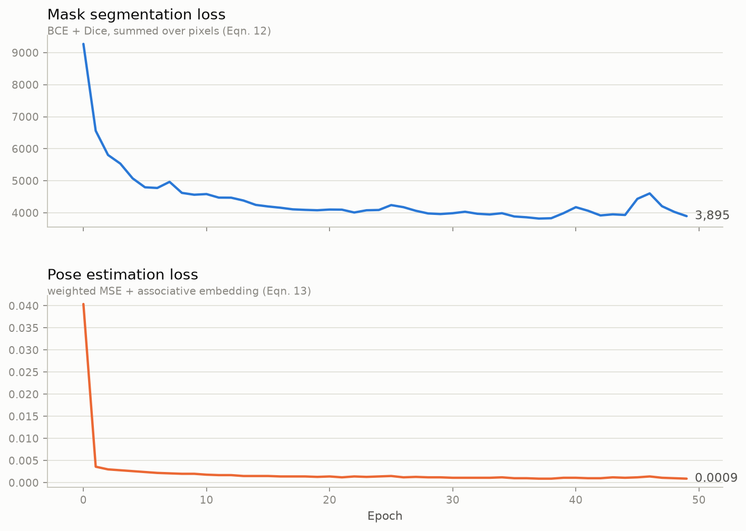
Phase 7 — Training
50 epochs, CPU only, 658 train / 165 held-out test frames
Reading the curves
Both losses show the same healthy shape: a steep drop in the first few epochs, then a slow decline into a noisy plateau.
Mask loss is large in absolute terms because Eqn. 12 is an unnormalised sum over pixels, not an average — the trend matters, not the magnitude.
The plateau from roughly epoch 20 onward says the model has extracted most of what this single session supports at this capacity and learning rate.

Slide 13
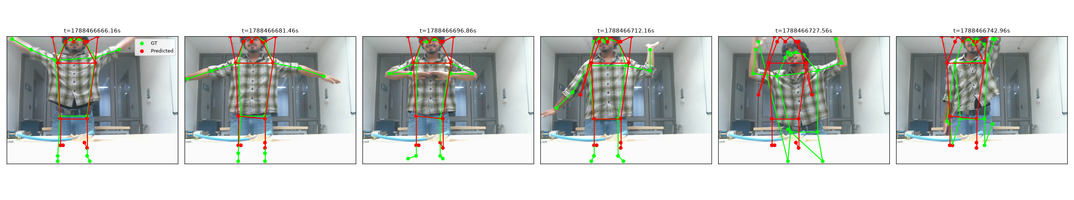
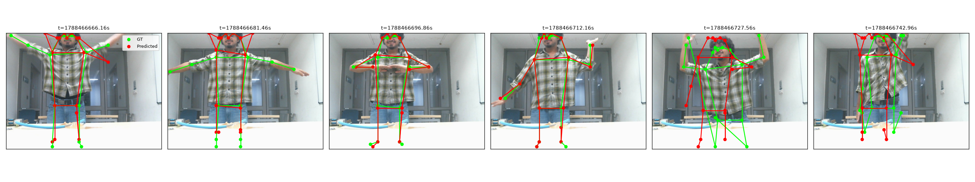
Result — pose, before and after training
Predicted skeleton in red, vision-branch ground truth in green
2-epoch baseline — the same generic skeleton in every frame, regardless of the actual pose
After 50 epochs — arms now track the real configuration: wide, together, raised, reaching
Legs and ankles stay weak throughout — they are partly out of frame and move less informatively in this session.

Slide 14
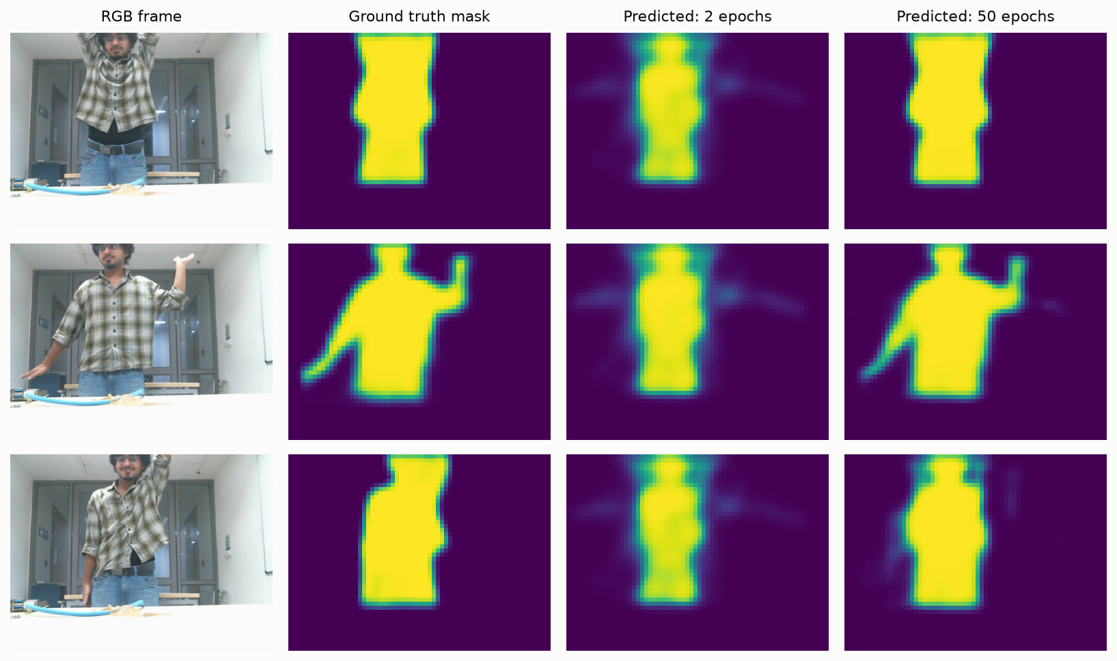
Result — mask, before and after training
Same three frames, ground truth beside both checkpoints
At 2 epochs the mask is a fixed blob, identical in every frame. After training it reproduces the raised arm and the extended arm — the silhouette now responds to the input signal, though it stays softer than the ground truth.

Slide 15
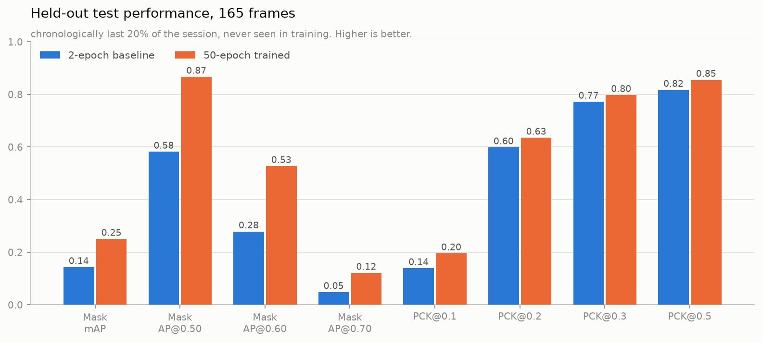
Phase 8 — Measured performance
evaluate.py — the paper's Eqn. 15 mask mAP and Eqn. 17 single-person PCK
Mask improved most
mAP 0.143 → 0.250 (+75%), and gains at every IoU threshold.
Loose PCK was already high
PCK@0.3–0.5 barely moved: face, torso and hips hardly shift between poses, so a near-average guess already passed a loose threshold.
PCK@0.1 is the real signal
The tight threshold rose 41% — this is the metric that punishes a frozen skeleton, and it moved most.

Slide 16
What these numbers do and don't say
Stated plainly, so the results aren't over-read
They are held-out, not fitted
Evaluated on the chronologically last 20% of the session, never seen during training.
They are one session, one person, one room
No claim of generalisation. The paper used 12 scenes and 510,894 frames; this is 823 frames from a single recording. Cross-session and cross-room behaviour is untested.
Mask AP@0.80 is exactly 0.000 — before and after
The model never produced a near-pixel-perfect mask on any test frame. 'Improved' is not 'accurate'.
Pose uses single-person PCK, not the paper's multi-person OKS mAP
OKS mAP needs associative-embedding decoding to separate individuals, which this codebase never implements — it computes L_group as a training loss but never decodes it back into people.
Not comparable to the paper's Table 2
Different sensing hardware, different scale, different metric for pose. These numbers measure our pipeline against itself, not against SiWiS.

Slide 17
Where this goes next
Ordered by expected value per unit of effort
Priority | Action | Rationale
1 | Collect more sessions — vary person, clothing, room, distance, approach angle | 823 frames from one session is the binding constraint, not model capacity
2 | Evaluate across sessions, not just within one | The sibling project measured a large drop from within-session to leave-one-session-out
3 | Longer / scheduled training, mask-branch capacity | Loss plateaued but mask precision is clearly the weaker of the two heads
4 | Preserve per-subcarrier structure (e.g. PCA) instead of one scalar per packet | The current front end discards frequency-selective information that may carry pose detail
5 | Implement associative-embedding decoding | Required for genuine multi-person support and the paper's OKS mAP metric

Slide 18
What was built
New and substantially rewritten components
Rewritten
data/csi_pcap_loader.py — csiread parsing, MAC filter, TX-chain split, guard-subcarrier removal, amplitude extraction, resampling
config.py — stream count, amplitude channels, derived window length
data/dataset.py, train.py, infer.py, check_sync.py — real-valued signal path and new CLI
New
capture/extract_frames_from_video.py — timestamped frame extraction from recorded video
evaluate.py — mask mAP (Eqn. 15) and single-person PCK (Eqn. 17) on the held-out split
visualize_predictions.py — mask/pose grids, skeleton overlays, per-joint channel maps
make_deck.py — regenerates this deck
Fixed defects: mask label double-scaling · chronological frame ordering · associative-embedding push-loss normalisation · CSI byte order · zero-variance feature collapse

Slide 19
Summary
The pipeline works end to end.
WiFi CSI from a commodity Raspberry Pi goes in; a human body mask and a 17-joint skeleton come out. Every stage was validated on real captured data, not assumed.
Five real defects were found and fixed
— three by reading the paper against the code, one by checking the firmware's own reference parser, and one that only appeared when the code was actually run on real data.
The model demonstrably learns from the signal
Predictions moved from a fixed average pose to input-conditioned masks and skeletons, confirmed both visually and by held-out metrics (mask mAP +75%, tight-threshold PCK +41%).
The limits are known and stated
One session, one person, no phase coherence, no cross-room evidence, and no near-perfect masks. More data is the next binding constraint — not architecture.

