Slide 1

MDA 620 Final Capstone Men’s Tennis Grand Slam Winners
By Kate Jorjoliani
December 14, 2023

Slide 2

Dataset Overview
VARIABLES:
YEAR
TOURNAMENT
WINNER
RUNNER-UP
WINNER NATIONALITY
WINNER ATP RANKING
RUNNER-UP ATP RANKING
WINNER LEFT OR RIGHT-HANDED
TOURNAMENT SURFACE
WINNER PRIZE

Slide 3
Business Issue and Goals
Players, tournament staff, and sponsors need to know the idea of the amount of prize money
Knowing prize money contributes to a deeper understanding of sports ANALYTICS
Goal: Predict winner prize money using different predictive model

Slide 4
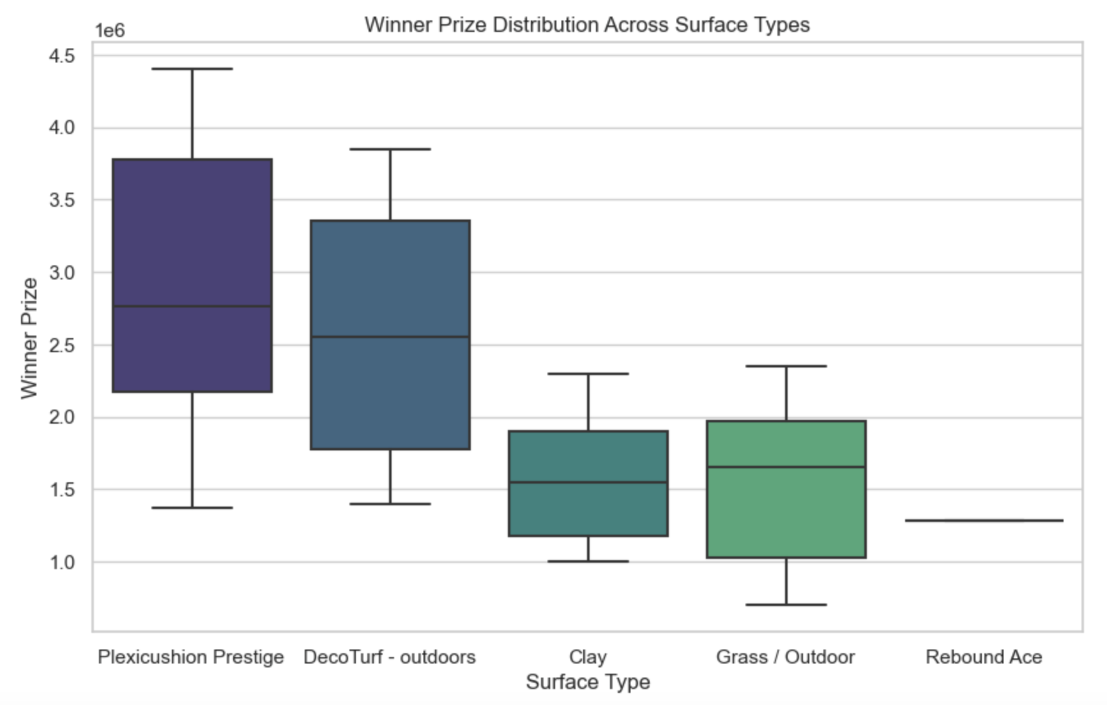
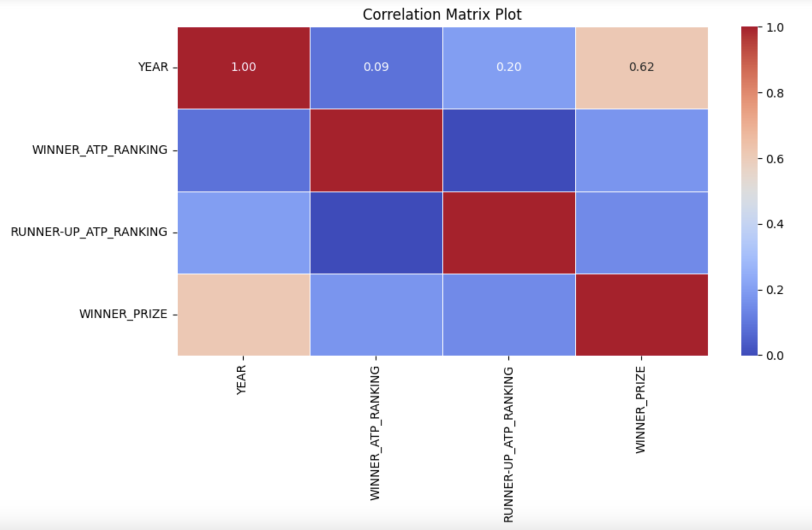
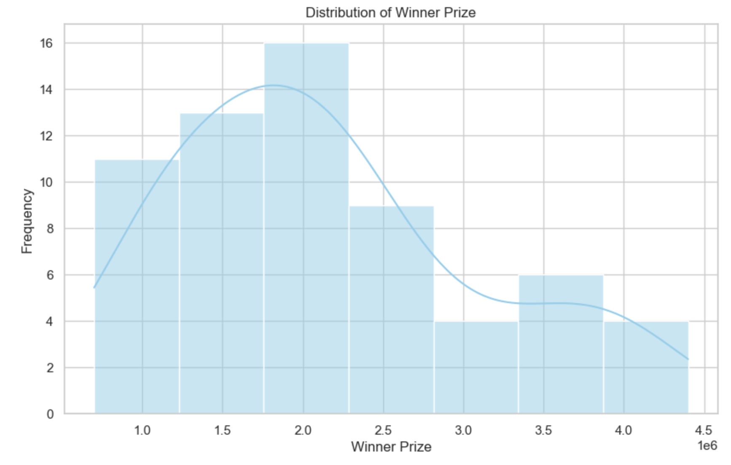
Data Exploration/Visualization

Slide 5
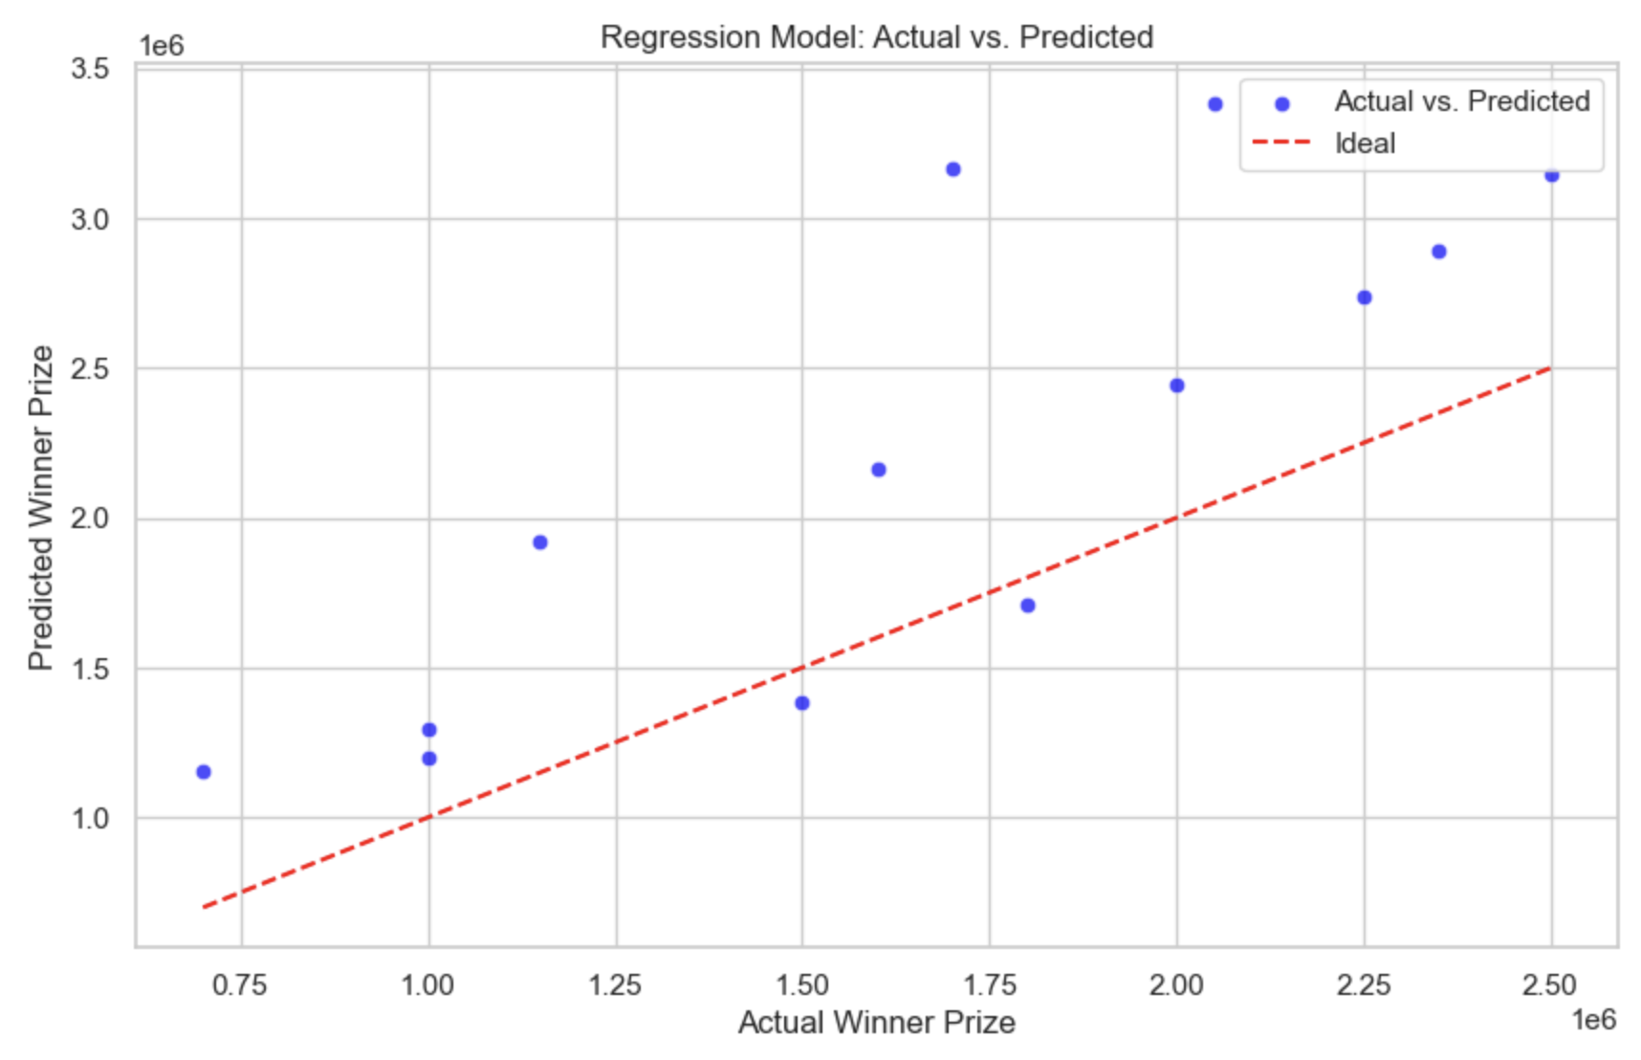
Methodology/Model Building
Linear Regression Model
Mean Squared Error: 486742065541.7877

Slide 6
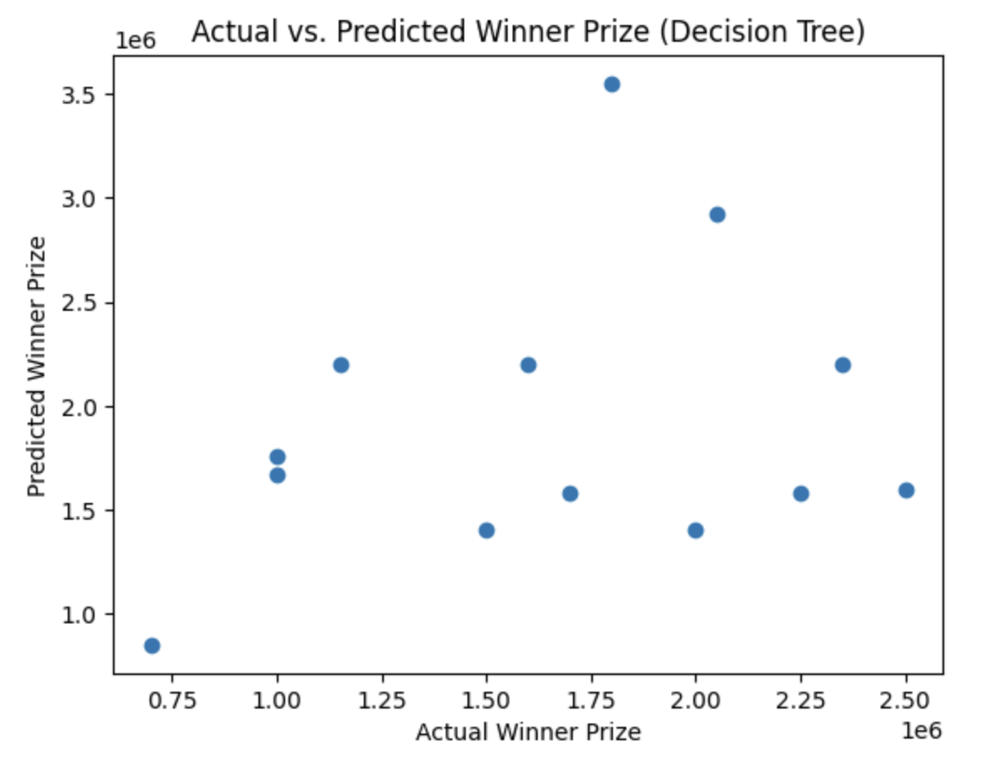
Decision Tree Model
Mean Squared Error: 614071572649.5726

Slide 7
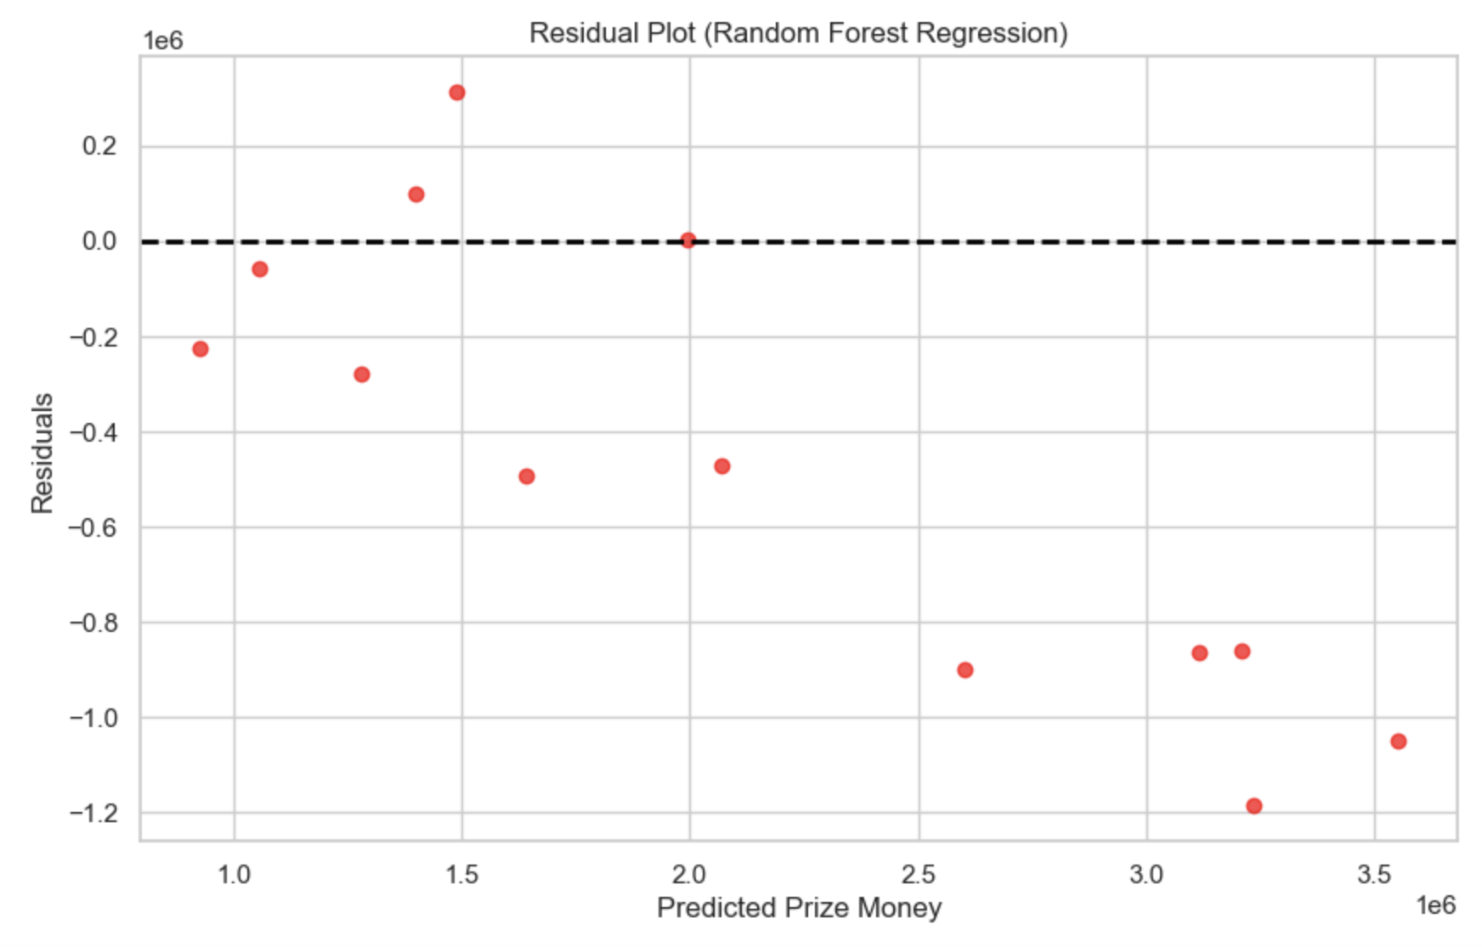
Random Forest Model
Mean Squared Error: 424048950023.0769
The best model out of the three(still not good)

Slide 8
Conclusion
Very low accuracy in all models
Challenging to predict winner prize money
Recommend adding more variables/different approaches for predictions

Slide 9

THANK YOU!
QUESTIONS?

