Slide 1
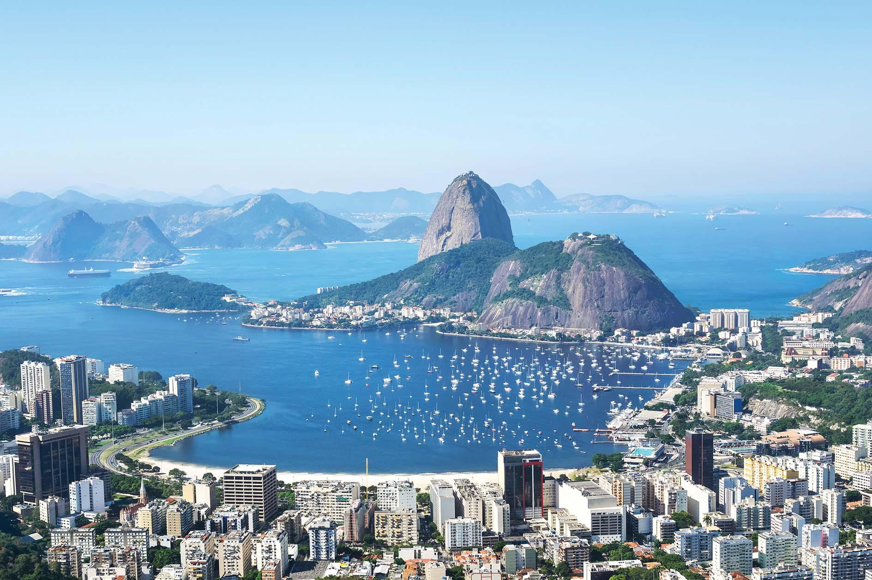
Expanding to Brazil:
Data Insights

Slide 2
12%
sellers sell
technology products

Slide 3
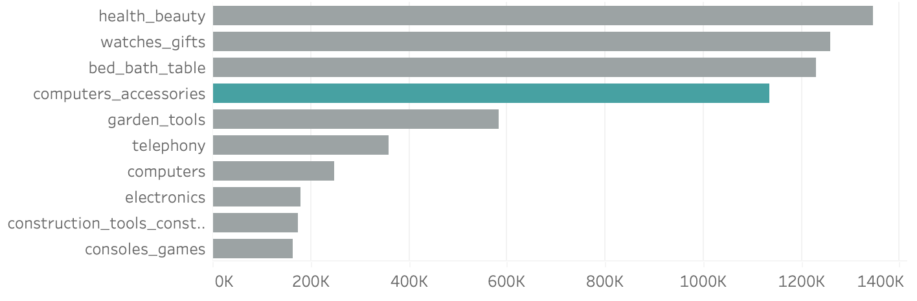
Total Sales per Category
1.347.968 €
1.135.544 €
247.580 €
Computer accessories is a key contributor 13.16% of total sales

Slide 4
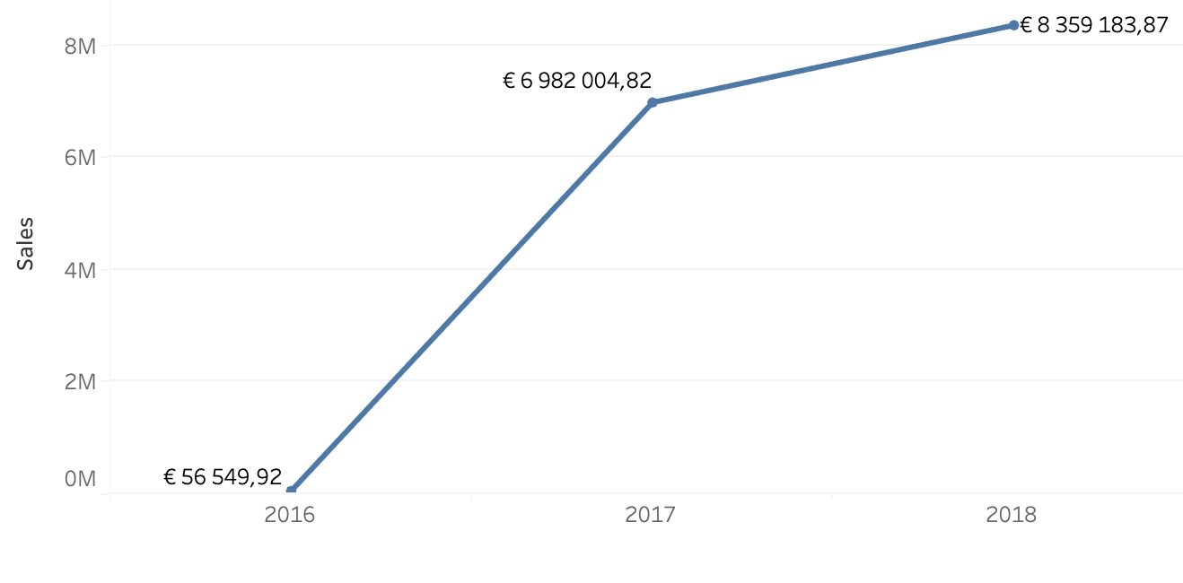
Good conditions with a growth rate of 19.72% of total sales in 2018

Slide 5
Technological products show strong demand and remain crucial in the economic landscape.
21.17 %
of total sales in Magist

Slide 6
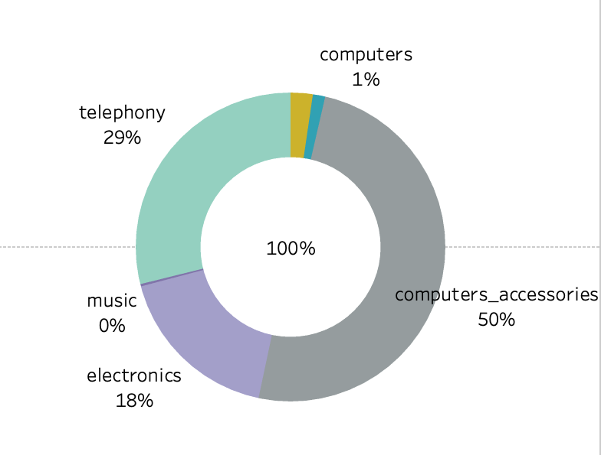
Product distribution shares in the Technology category

Slide 7
of orders are delivered
on time
99441
Total number of delivered during the study period
90,44%
9,56%
deliveries arrived late

Slide 8
64%
of customers give a review score of 5 and 4 stars
VS
12%
of customers give a review score of 1 and 2 stars

Slide 9
Keywords low rate reviews
Damaged
Delivery Time
Disappointed
Lost
Cancellation

Slide 10
NEGATIVE
Reviews
Lack of information (+ years)
The sales in other categories have slow performance
POSITIVE
Growth is significant
Tech products is a key contributor of the total sales
We recommend NOT partnership with Magist

Slide 11
Presented by:
kate.kovalova@gmail.com
alejandrocascajo@gmail.com
Alejandro Hernandez
Kovalova Kateryna

Slide 12
Appendix

Slide 13
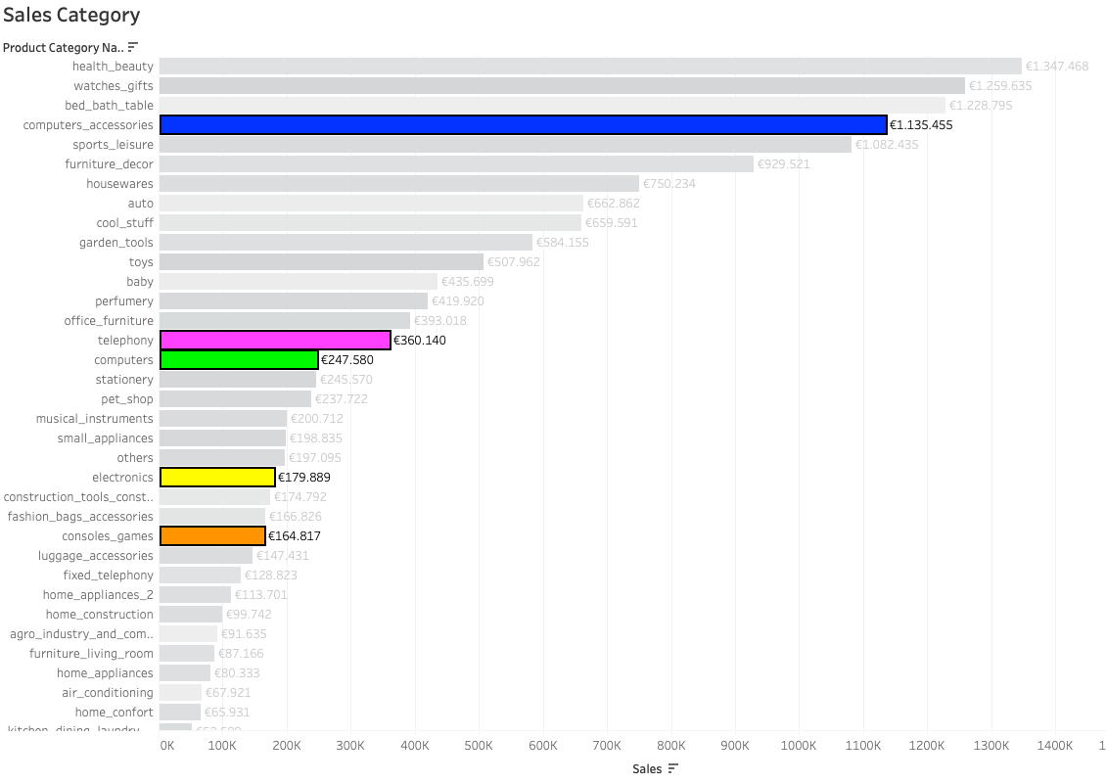
Total Sales per
Category
164.817

