Slide 1
Software support for processing test results in educational disciplines

Slide 2
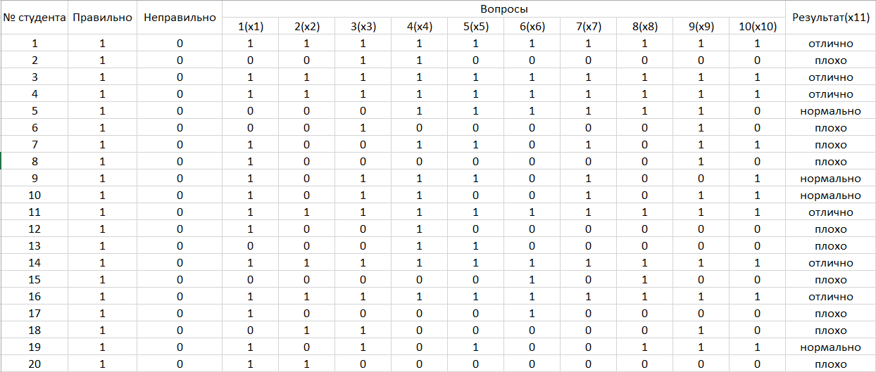
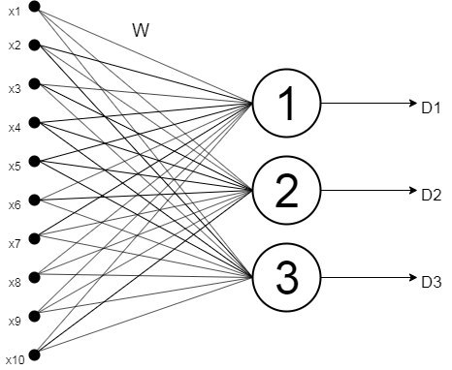
Structure neural network
She has:
10 input parameters(attributes)
30 initial weight coefficients
30 final weight coefficients
3 exits(classes)

Slide 3
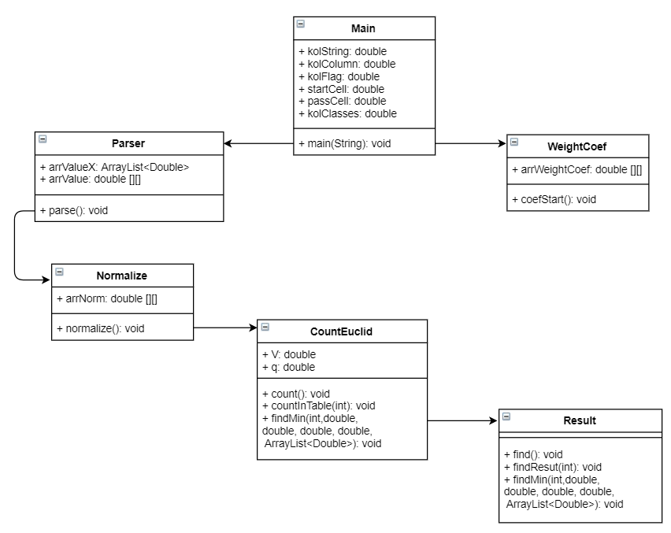
Structure software
Java
IntelliJ IDEA
Apache Maven
Microsoft Excel

Slide 4
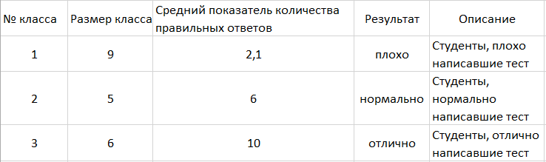
Work result
You must to do to get the result
load date from excel
make normalization
set initial initial weight coefficients
recount weight coefficients
make grouping date

Slide 5
Conclusion
Neural network allows processing quickly and qualitatively different results
She uses to improve indicators result
She helps make grouping of different date for several classes

