Slide 1

Photoresistor
Raspberry Pi Chapter 10

Slide 2
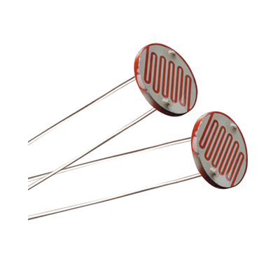
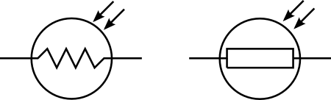
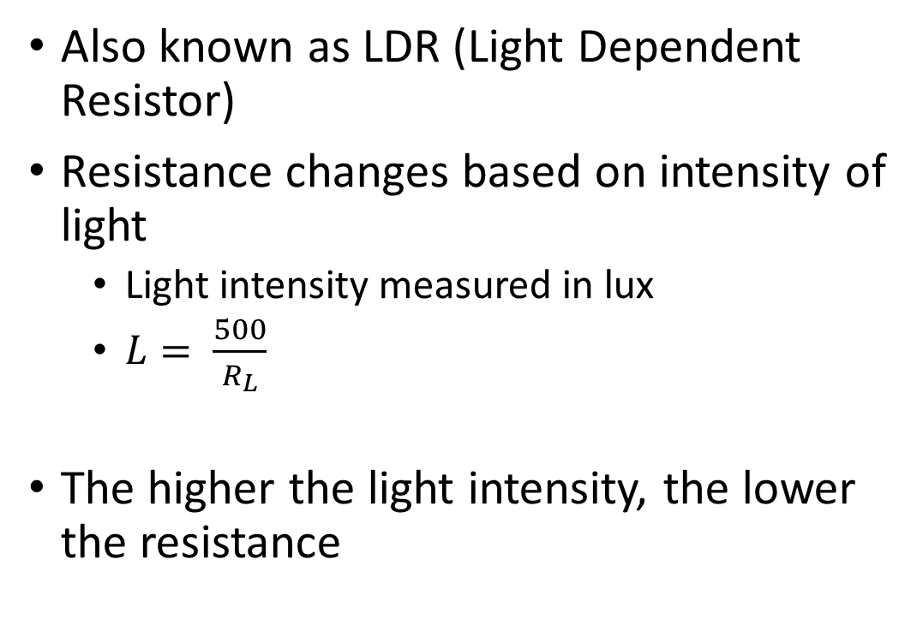
Photoresistor
Also known as LDR (Light Dependent Resistor)
Resistance changes based on intensity of light
Light intensity measured in lux
$L= \frac{500}{R_{L}}$
The higher the light intensity, the lower the resistance

Slide 3
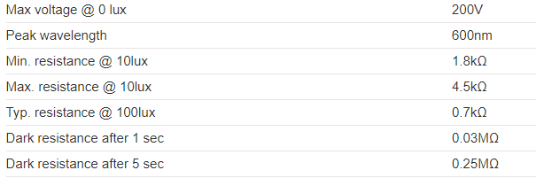
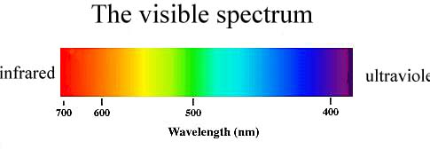
Specifications
Cost: $7.95 for a pack of 5 (Sayal)

Slide 4
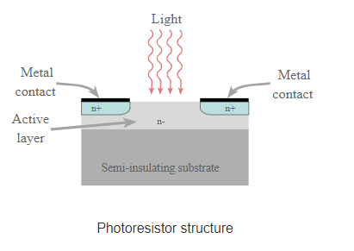
How it Works
Made of a semiconducting material that has a rigid hold on electrons
When light hits the semiconducting material, the electrons break free, conducting electricity
This decreases resistance

Slide 5
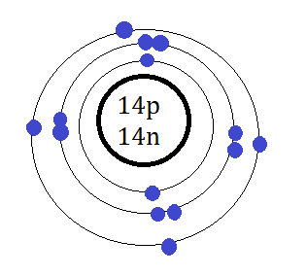
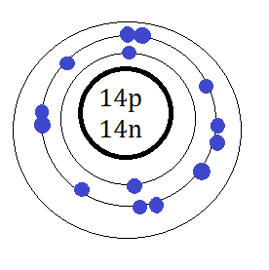
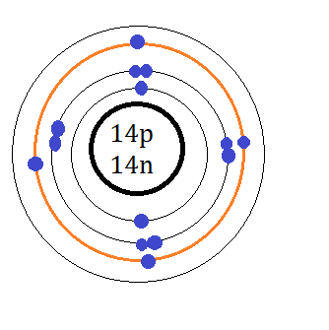
Intrinsic vs. Extrinsic Photoresistor
Intrinsic – pure semiconductor material
Electrons jump from outer valence shell to inner shell
Extrinsic – semiconductor materials with impurities
New orbital is created, electrons move from outer shell to orbital
Used for longer wavelengths, e.g. infrared

Slide 6
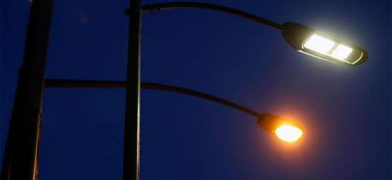
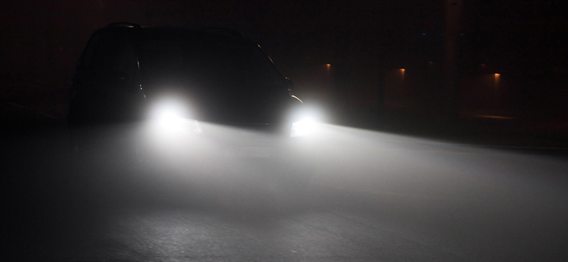
Applications
Streetlight
Security System – Bank, Jewellery Store
Car Headlights
Alarm Clocks

Slide 7
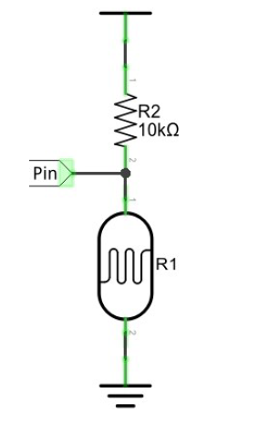
Wiring a Photoresistor
Voltage Divider Circuit
10 kΩ resistor – used as a reference point
Current is constant at all points of the circuit
Ohm’s law: E_{t} = Ir_{t}
Rearranging to solve for current: I = E_{t} /R_{t}
Voltage drop across the photoresistor: E_{n} = E_{t} /R_{t} x R_{n}
E_{n} = E_{t} x R_{n}/R_{t}

