Slide 1
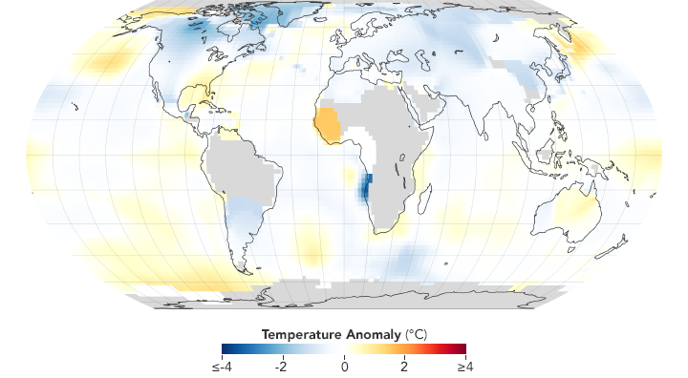
Temperature Sensors
Raspberry Pi Chapter 11

Slide 2
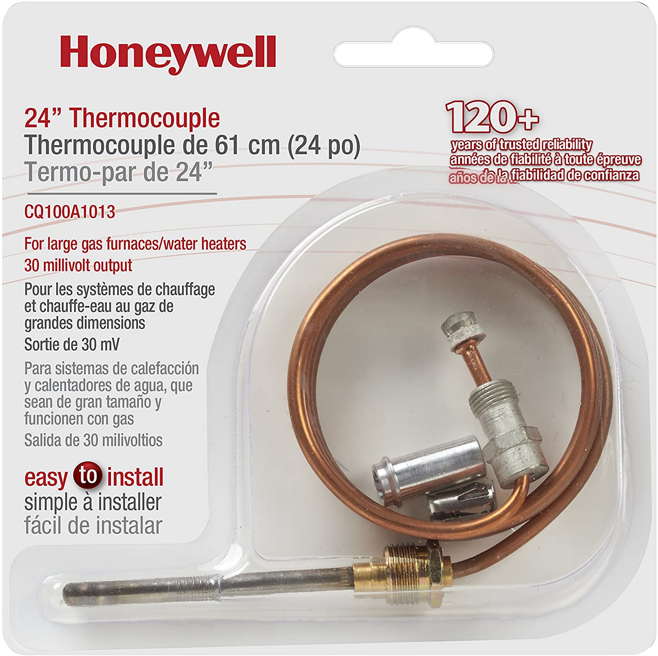
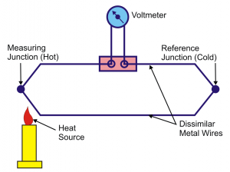
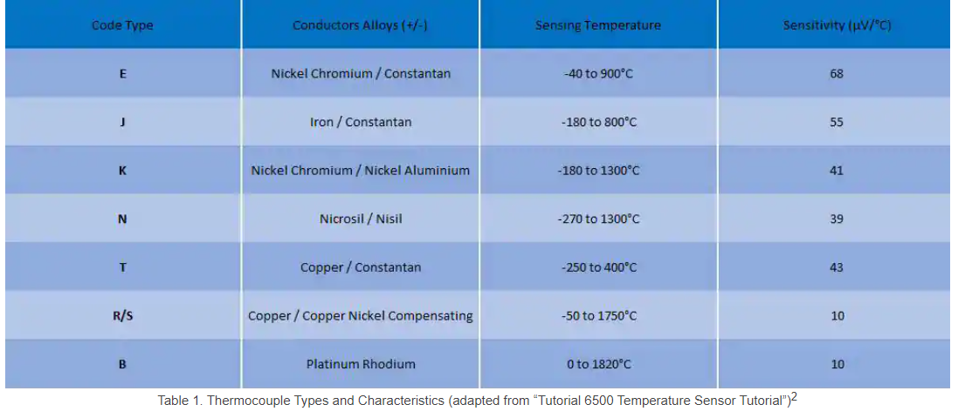
Thermocouple
Most popular type of temperature sensor
Two conductors are joined together – voltage difference is observed
Difference in voltage is proportional to temperature difference (Seebeck Effect)
K-type – most common

Slide 3
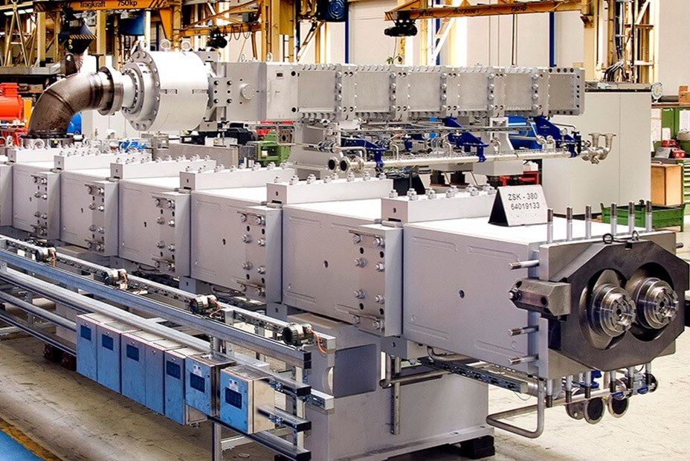
Thermocouple
Advantages
Disadvantages
Wide range of temperature sensing (K type is 0 – 1260 degrees C)
Quick sensing
Self-powered
Accuracy diminishes with long wire length
Seebeck effect is produced among the cold junction, which has to be accounted for
Applications: Monitoring oven temperature, manufacturing, furnaces, extruders

Slide 4
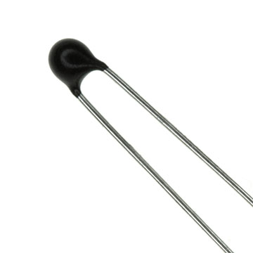
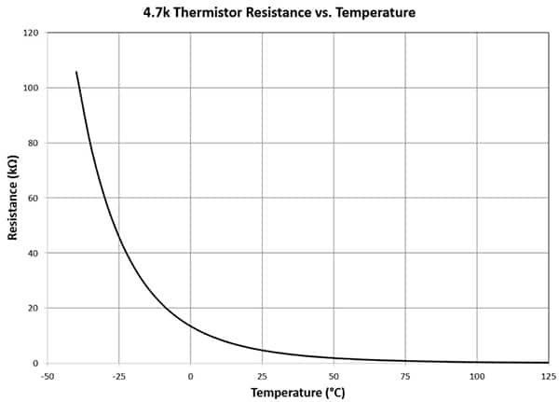
Thermistor
A resistor whose resistance changes depending on temperature
NTC Thermistor – As temperature increases, resistance decreases
PTC Thermistor– As temperature increases, resistance increases
Made of a metal oxide, covered in an insulator
Accurate to +/- 0.2 degrees C in its optimal range (room temp)

Slide 5
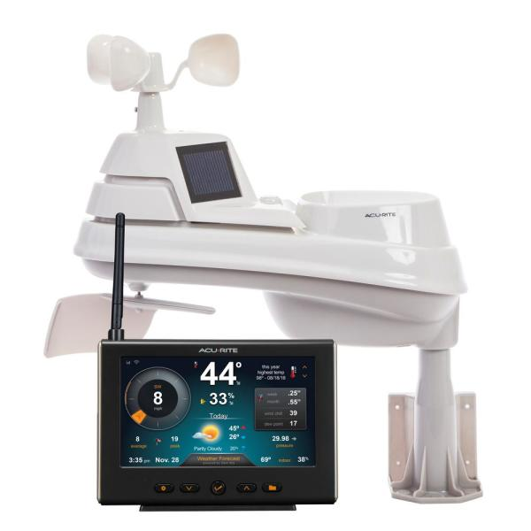
Thermistor
Advantages
Disadvantages
Low cost (under $5)
Stable
Easy to wire – use voltage divider circuit
Requires signal voltage
Small range (-50 – 150 degrees C)
Non-linear temperature/resistance relationship
Slow response time
Applications: Measuring air temperature (weather station), oven thermometer, fire alarm

Slide 6
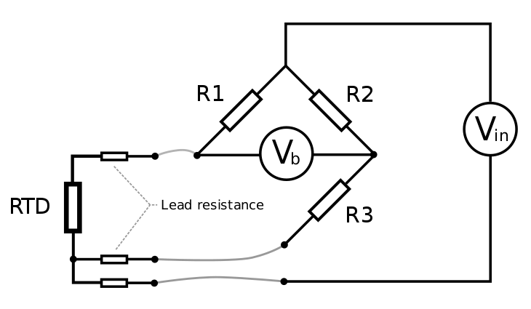
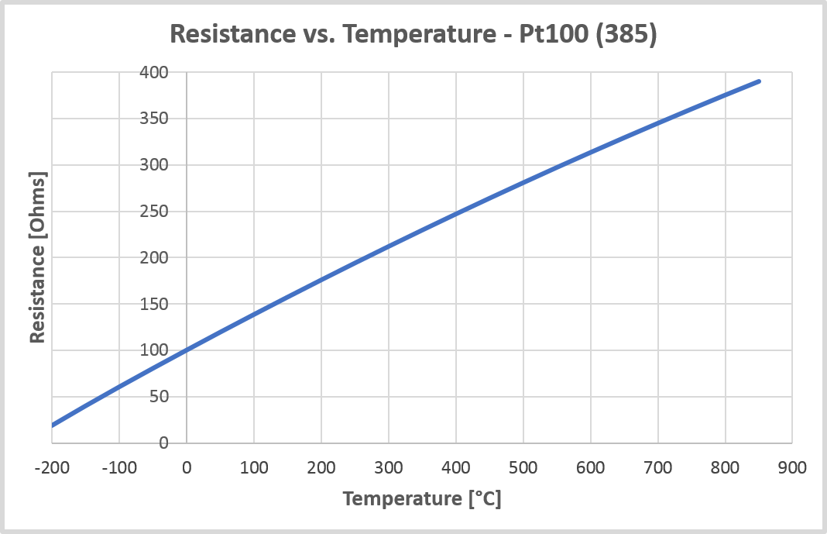
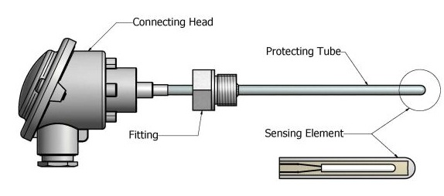
RTD (Resistance Temperature Detector)
Similar idea to thermistor
Resistance of the metal, usually platinum, increases proportional to temperature
Linear relationship between resistance and temperature

Slide 7
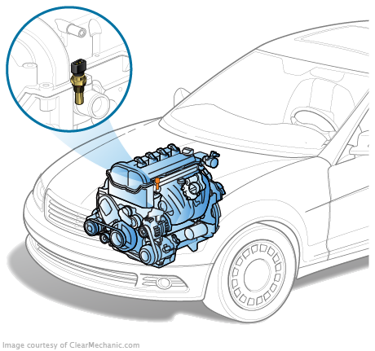
RTD
Advantages
Disadvantages
Accurate temperature reading
Stable
Wide temperature range: -260 to 850 degrees C
Requires signal voltage
Expensive (around $100)
Fairly slow response time
Applications: Measuring automotive engine temperature, medical equipment, computer power supply

Slide 8
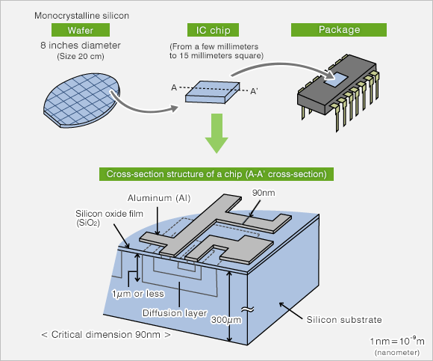
Semiconductor Based ICs
Measures voltage/current of transistor
Local temperature sensor – reads own temperature
Remote temperature sensor – reads transistor not part of the chip
Does not react to temperature changes

Slide 9
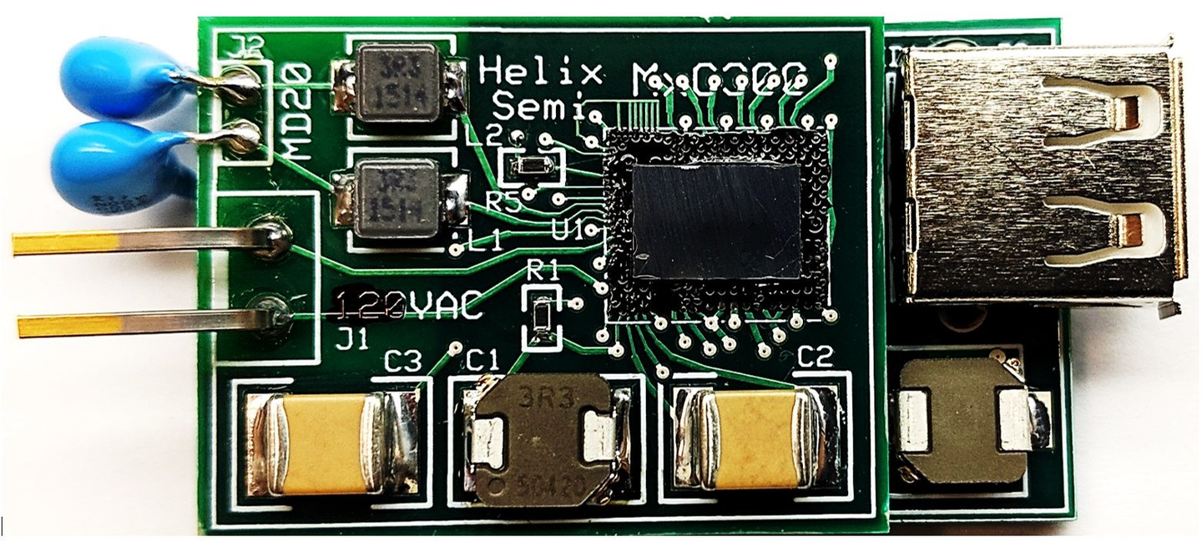
Semiconductor based ICs
Advantages
Disadvantages
Compact
Easy to integrate in digital circuits
Unstable and fragile
Small range of values that could be read (-40 to 120 degrees C)
Does not react to temperature change
Applications: Measuring temperature of circuit board components, such as amplifier, transistors, other ICs

