Slide 1
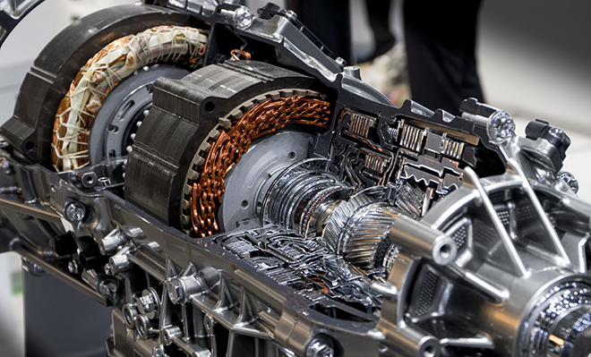
Motor and Driver
Raspberry Pi Chapter 13

Slide 2
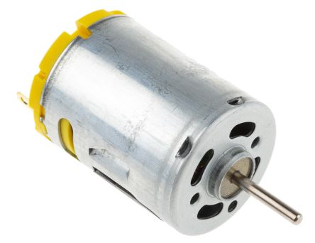
Motor
Converts electrical energy into mechanical energy
Direction of rotation changes with polarity
Consists of:
Stator – permanent magnet with opposing charges
Rotor – wrapped in copper wire, electrical current generates torque

Slide 3
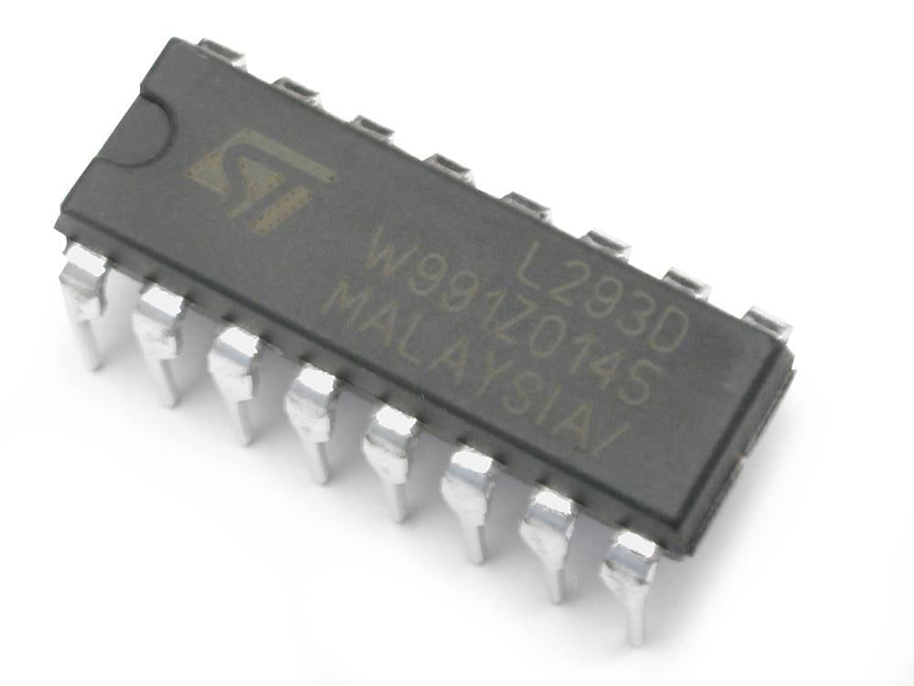
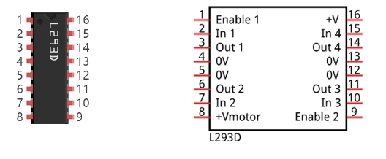
Controlling a Motor – L293D
An IC Chip that acts as a motor driver
Why do we need to use L293D?
Control speed/direction
Provide higher power output

Slide 4
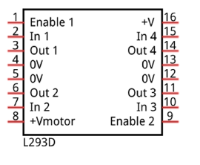
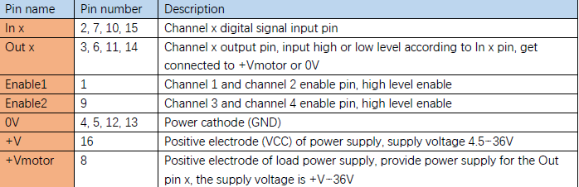
L293D Pinout

Slide 5
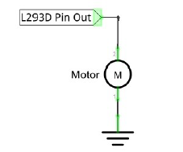
Wiring a Motor
Problem: One direction control only

Slide 6
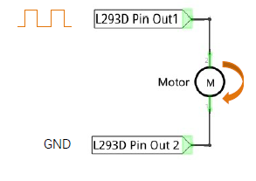
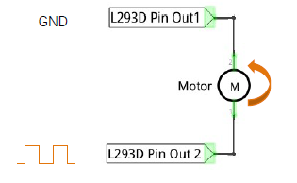
Wiring a motor

Slide 7
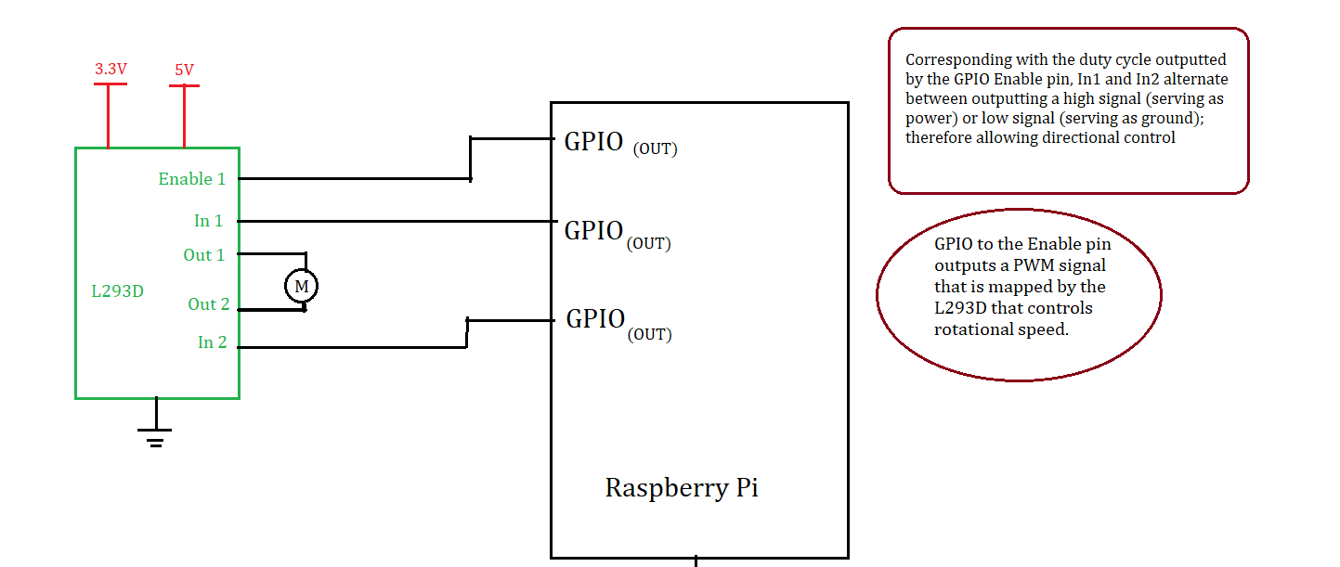
Schematic

