Slide 1
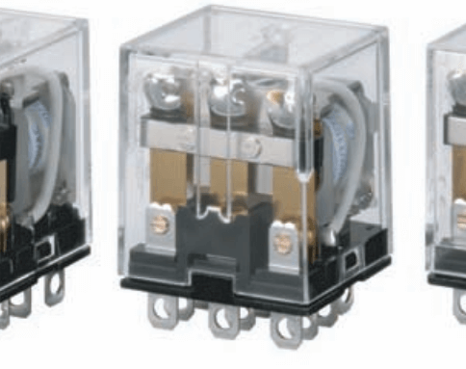
Relays
Raspberry Pi Chapter 14

Slide 2
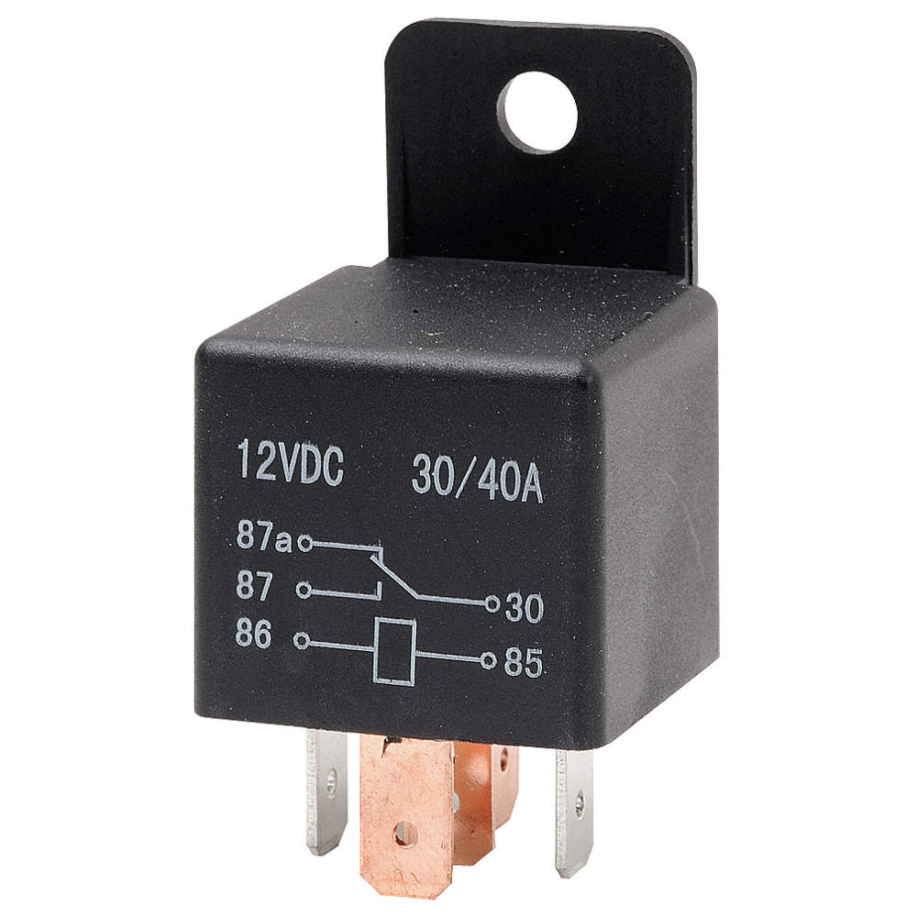
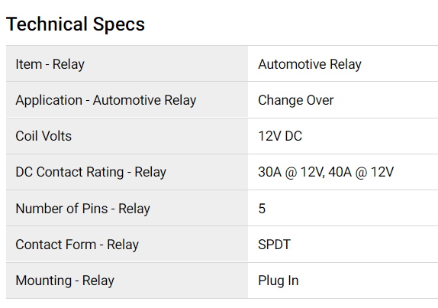
Relay – Use and Purpose
An electromagnetic switch
Controls a circuit using current flow
Use a low power circuit to control a high power circuit
Low power – microcontroller, digital logic
High power – Actuator circuit
Can be used as amplifier

Slide 3
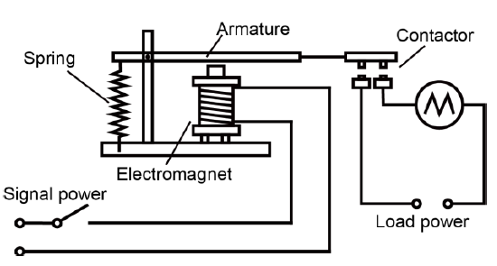
How a Relay Works
Electrical current magnetizes coil
Coil is an inductor – converts electrical to magnetic energy
Unit – inductance, measured in Henrys (H)
Coil attracts armature, which lowers contact to connect circuit

Slide 4
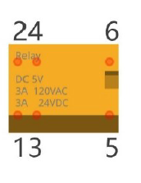
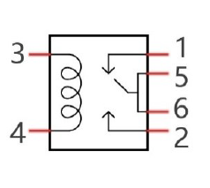
Relay Pinout
Pin | Purpose
1 | Closed contact
2 | Open contact
3 | Connects to inductor coil
4 | Connects to inductor coil
5 | Connects to actuator & pin 6
6 | Connects to actuator & pin 5
Specs: Trigger voltage – 5V
Maximum DC voltage and current: 24V, 3A
Maximum AC voltage and current: 120V, 3A

Slide 5
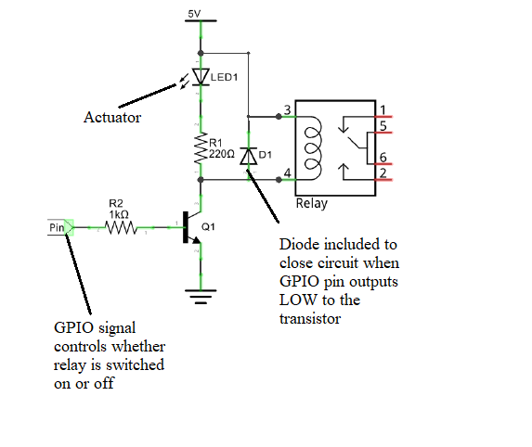
Circuit

Slide 6
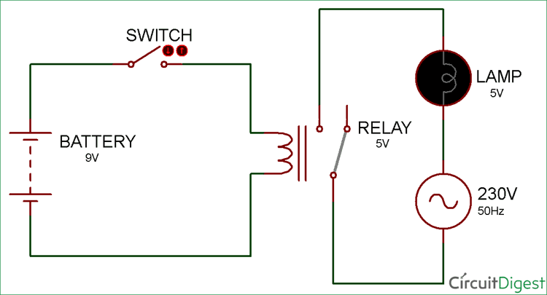
Applications of Relays
Automotive Relays – turning on the starter motor, headlights, etc. at the same time
Power bar – If AC current is detected, connect to transformer circuit to provide DC power
Buildings – Heating, cooling, lights, etc.

