Slide 1
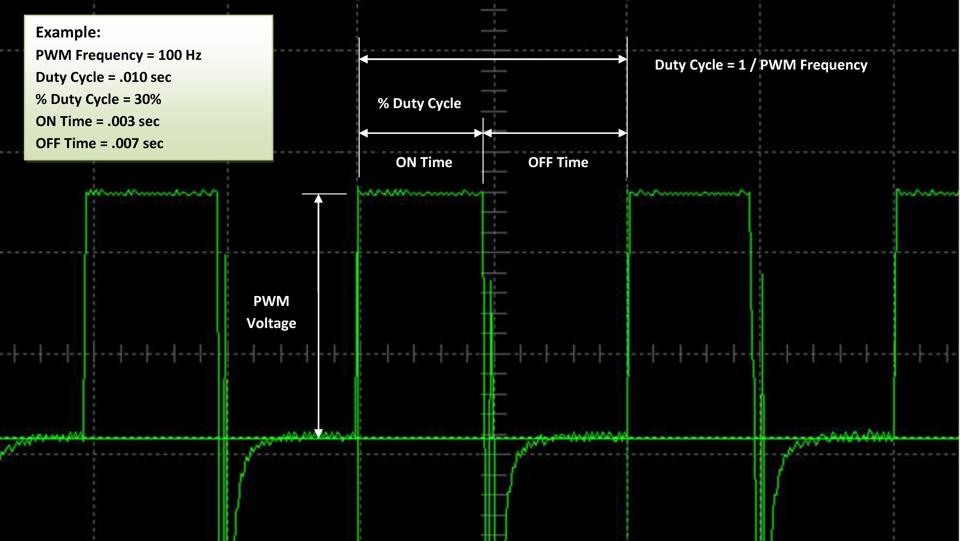
PWM
Raspberry Pi Chapter 4

Slide 2
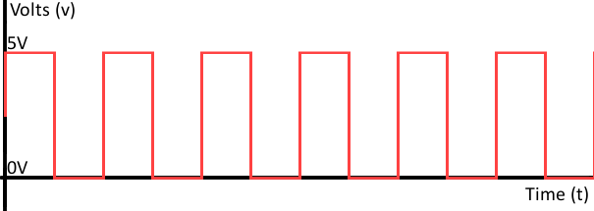
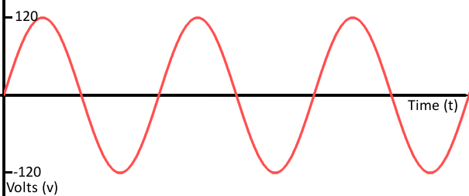
Purpose
Digital signals – two values, either logic high or low
Analog signals – continuous signal, can have floating point values
PWM – Pulse width modulation
Uses digital signals to represent an analog signal
Usage: control brightness of LED, speed of DC motor

Slide 3
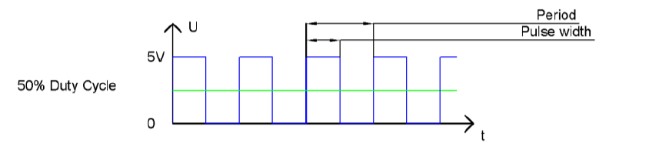
Terminology
Period – length of time for one set of a logic high and logic low pulse
Frequency – number of sets of a logic high and low pulse for a given amount of time (1/period)
Affects resolution
Pulse width – length of time for a logic high signal
Duty cycle – percentage of period for which a signal is logic high

Slide 4
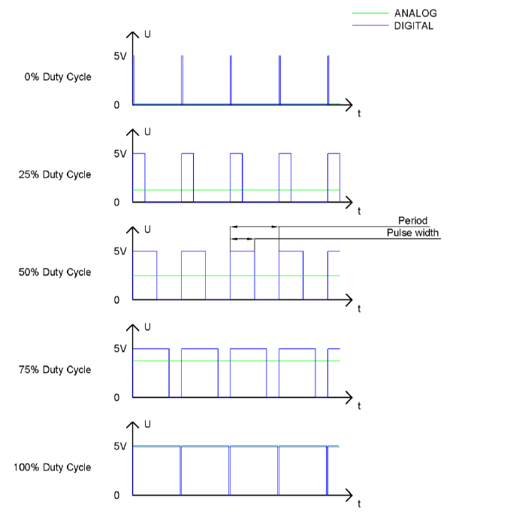

Slide 5
Hardware vs. Software PWM
Hardware
Software
Uses microprocessor to generate pulses
Accurate timing, does not use CPU resources
Emulates PWM
“On”, delay, “Off” in a loop
Uses CPU resources, inaccurate timing
Raspberry Pi GPIO 18 – 10 bit accuracy software PWM

