Slide 1

Buzzers and Transistors
Raspberry Pi Chapter 6

Slide 2
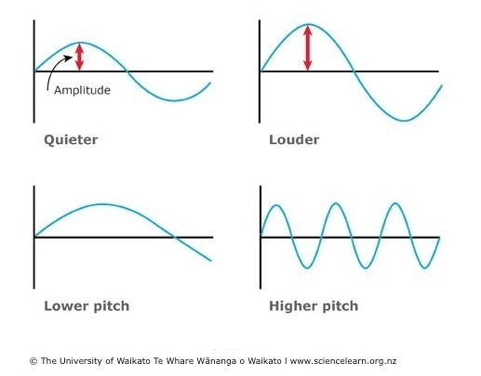
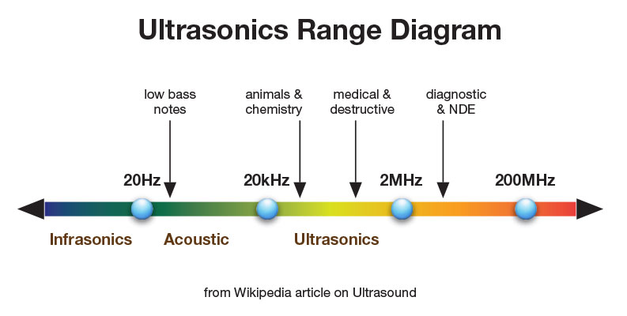
What is a Buzzer?
A device that converts electrical energy to sound energy
Sound – represented by a sinewave
Amplitude – volume
Frequency - pitch
Audible frequency – 20 Hz to 20 kHz
Most sensitive range – 2 to 5 kHz
Comfortable hearing range – 0 to 80 dB, up to 140 dB

Slide 3
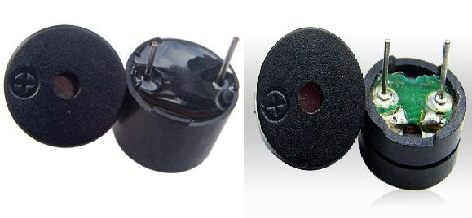
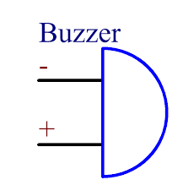
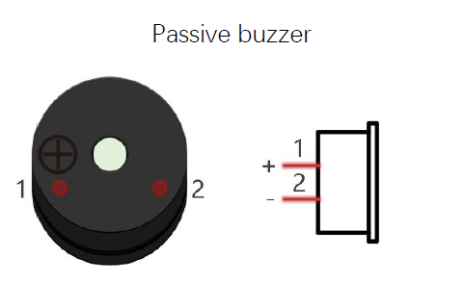
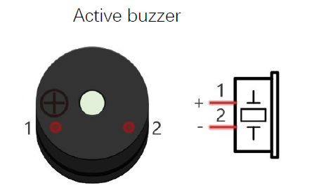
Types of Buzzers
Active Buzzer
Passive Buzzer
Power (5V) and ground pin
Fixed frequency and volume
Control: output high or low voltage using GPIO
Power (5V) and ground pin
Variable frequency and volume
Control: PWM

Slide 4

Problem
The rated voltage for an active buzzer is 6V, but the raspberry Pi can only supply 5V of power
If we only connect the power and ground pins, buzzer may not be able to sound at resonant frequency
Solution: Build an amplifier circuit using a transistor

Slide 5
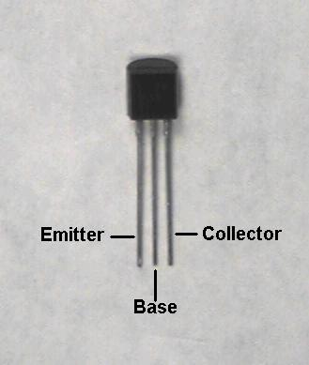
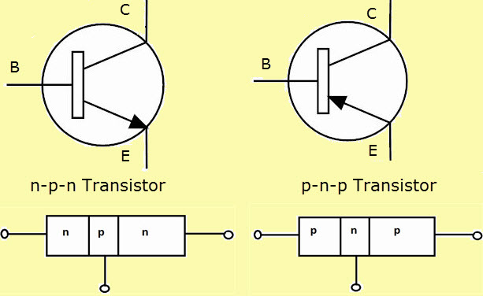
Transistors
Bi-polar junction transistor – semi-conducting device
Has three pins: collector (c), base (b), and emitter (e)
Consists of layers of n-type (negatively charged) metal and p-type (positively charged) metal
Electricity is conducted from n to p
Used as a switch or amplifier circuit

Slide 6
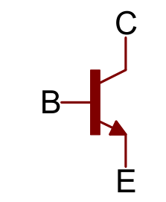
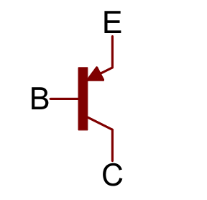
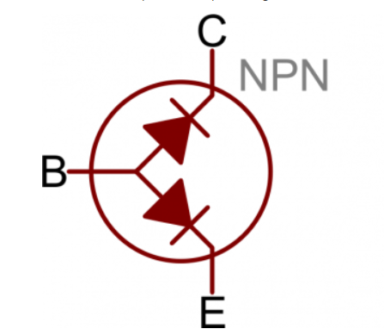
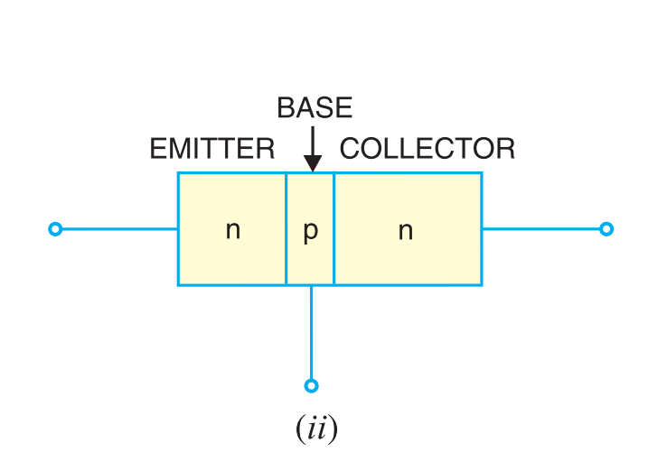
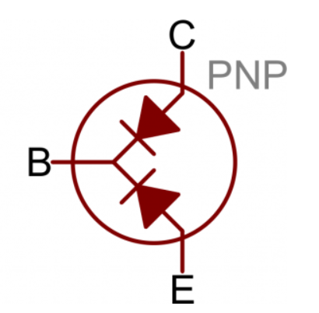
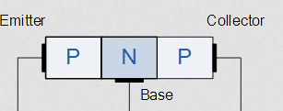
Types of transistors
NPN Transistor
PNP Transistor
Collector and emitter are n-type
Base is p-type
Number: 8050
Collector and emitter are p-type
Base is n-type
Number: 8550

Slide 7
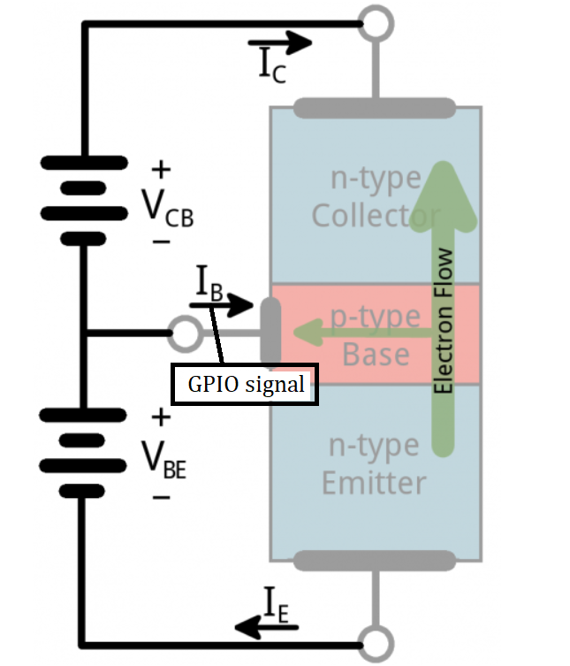
How Transistors Work (Using NPN)
Electrons are emitted from the emitter to the base
Base controls electrons that is emitted to the collector
Current flowing through base aids in controlling electron flow from e to c
Electricity is conducted from c to e
PNP works the same way, but emits “holes”

Slide 8
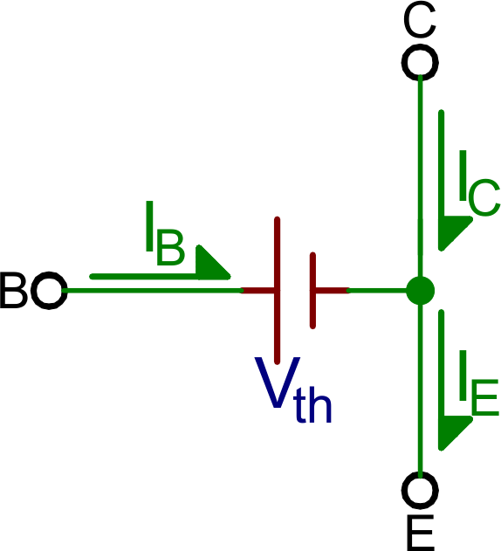
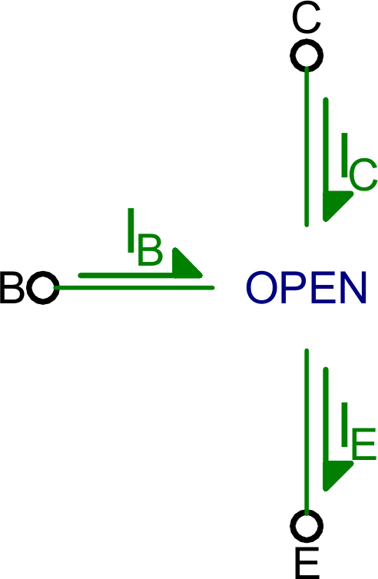
Operation Modes
Saturation – Current flows freely from collector to emitter
NPN Condition: V_{E} < V_{B} and V_{C} < V_{B}
PNP Condition: V_{E} > V_{B} and V_{C} > V_{B}
Cut-off mode – No current flows from collector to emitter
NPN Condition: V_{E} > V_{B} and V_{C} > V_{B}
PNP Condition: V_{E} < V_{B} and V_{C} < V_{B}
V_{th} :Low voltage to trigger saturation, around 0.6 V

Slide 9
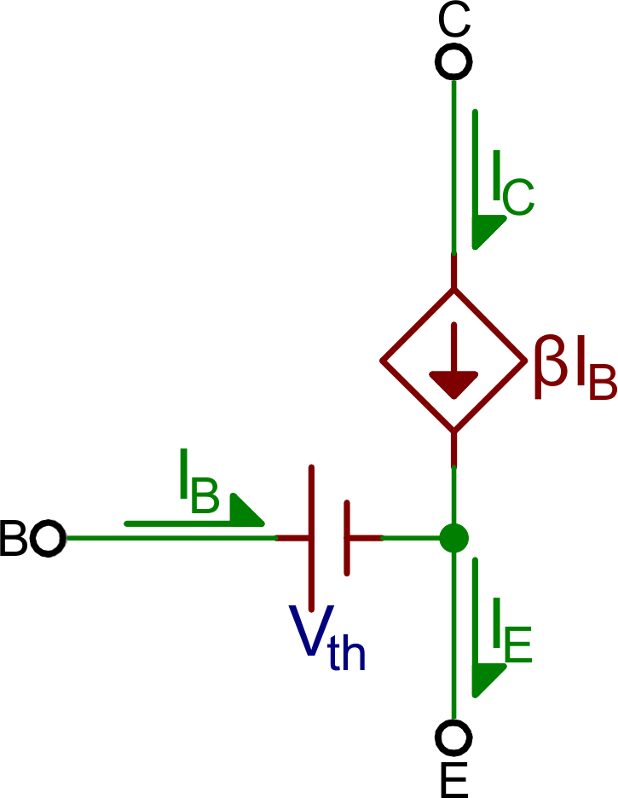
Operation Modes
Active mode – current flowing from collector to emitter is amplified, proportional to base current
NPN Condition: V_{E} < V_{B} < V_{C}
PNP Condition: V_{E} > V_{B} > V_{C}
Reverse-active mode – current flows from emitter to collector (rare case)
NPN Condition: V_{E} > V_{B} > V_{C}
PNP Condition: V_{E} < V_{B} < V_{C}

Slide 10
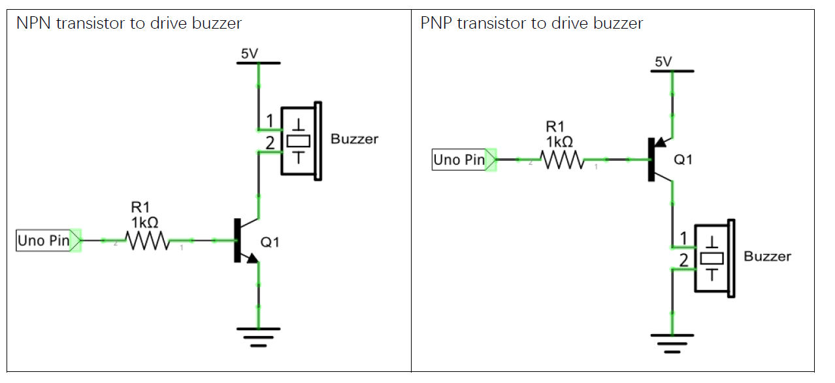
Circuit Diagram with Raspberry Pi

