Slide 1
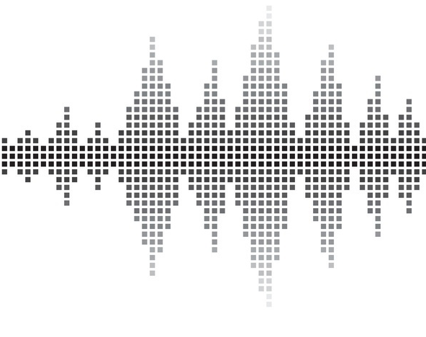
AD/DA Converter
Raspberry Pi Chapter 7

Slide 2
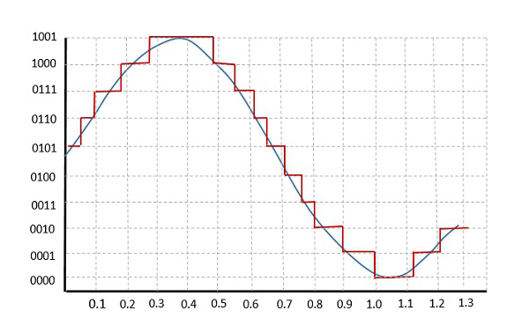
Quantization
Converting an analog to a digital signal
An analog sample is taken, and a point is approximated as a number of digital bits

Slide 3
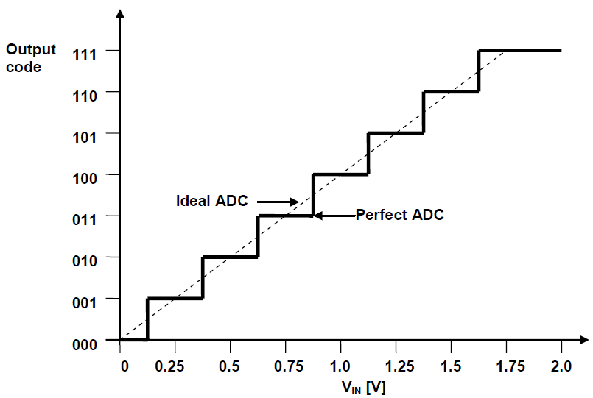
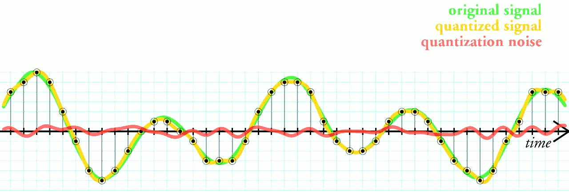

Quantization Errors
An analog value can never be accurately converted to digital, but it can come close
For each bit there is a range of possible analog values
Increase sampling frequency
Increase bit resolution
E.g. Given 0V – 3.3 V range,
8-bit converter: within 0.013V accuracy
16-bit converter: within 0.00005V accuracy
Error in sensor input: E.g. Thermistor
At a high signal of 3.3V, an 8-bit converter has a margin of error of around 0.0001 degrees Celsius, whereas 16-bit is virtually 0
2 bit audio quantization and noise
8 bit audio quantization and noise

Slide 4
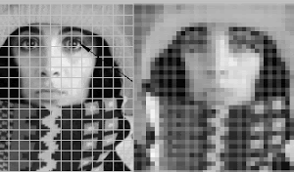
Applications of Quantization
Audio – Recording sound
Video/Imaging – compressing video and image files, converting file types
Reading sensor input
E.g. Potentiometer, Photoresistor, Thermistor

Slide 5
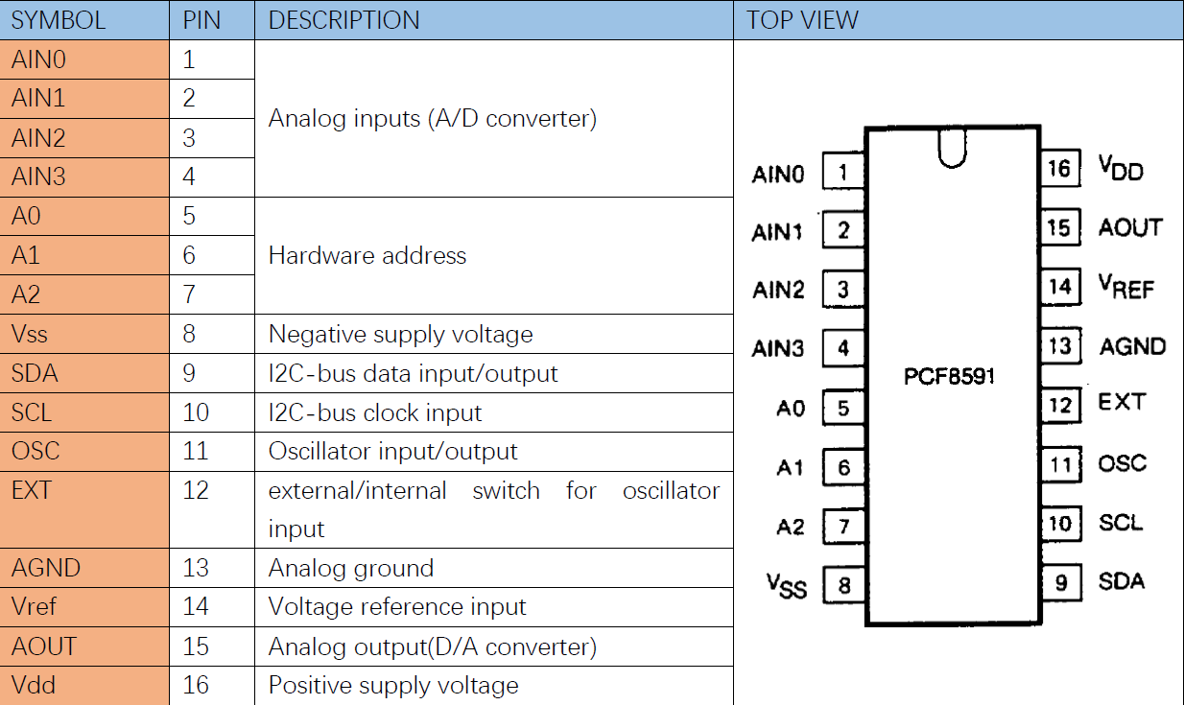
AD/DA Converter
Take analog input
Process input and convert to digital bit
Map bit number as a percentage of high voltage
Output analog signal
Achieved through the PCF8591 chip
8-bit resolution
Controlled by Raspberry Pi using I2C protocol
*Cost for ADC/DAC chips: 8-bit: $1.97, 12-bit: $5.97, 16-bit: $11.39

Slide 6
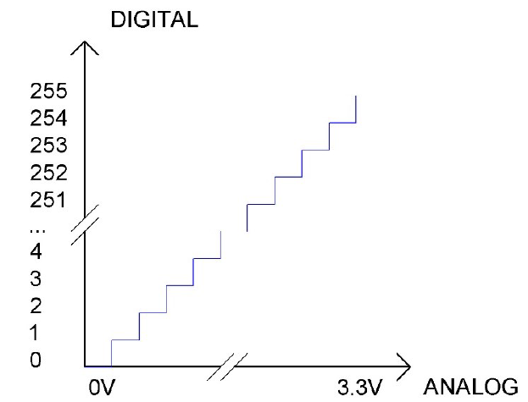
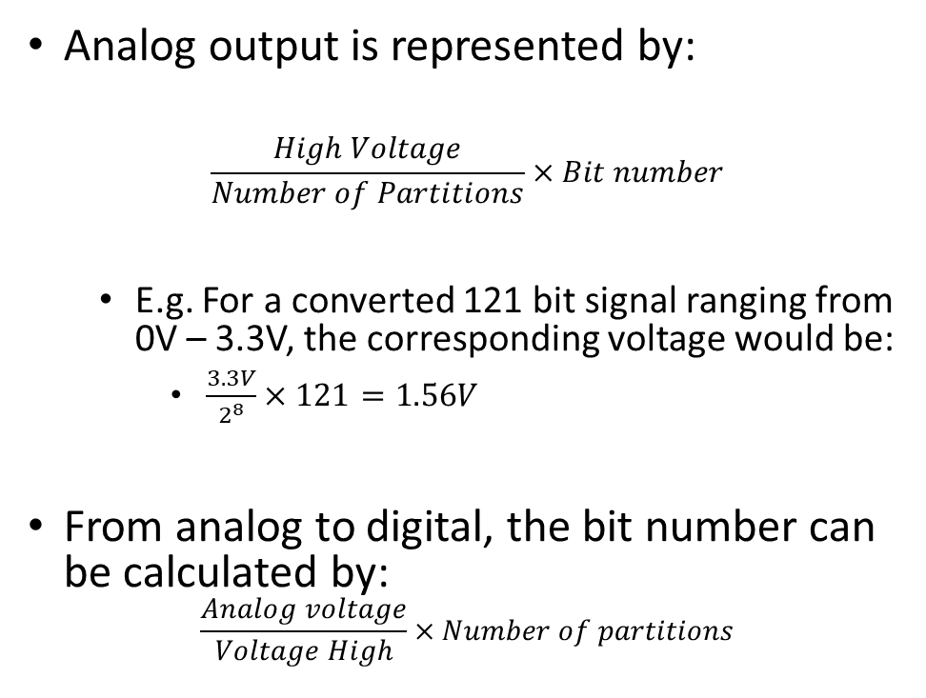
Quantization with PCF8591
Analog output is represented by:
$$\frac{High Voltage}{Number of Partitions}×Bit number$$
E.g. For a converted 121 bit signal ranging from 0V – 3.3V, the corresponding voltage would be:
$\frac{3.3V}{2^{8}}×121=1.56V$
From analog to digital, the bit number can be calculated by:
$$\frac{Analog voltage}{Voltage High}×Number of partitions$$

Slide 7
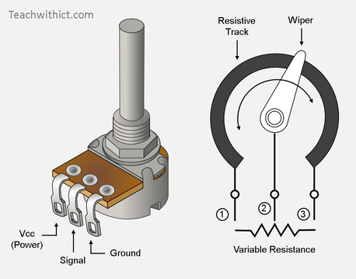
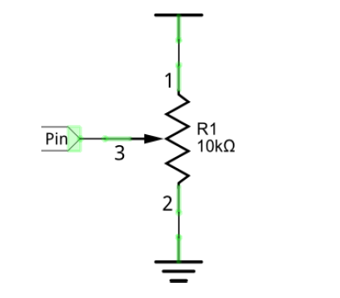
Analog Input - Potentiometer
Potentiometer – A type of variable resistor
Three leads – 1) and 3) connect to power and ground
2) connects to circuit – manually controls resistance
Rotating the potentiometer leads to differing resistance values between (1 and 2) and (2 and 3)
GPIO inputs voltage read between (1 and 2)

