Slide 1
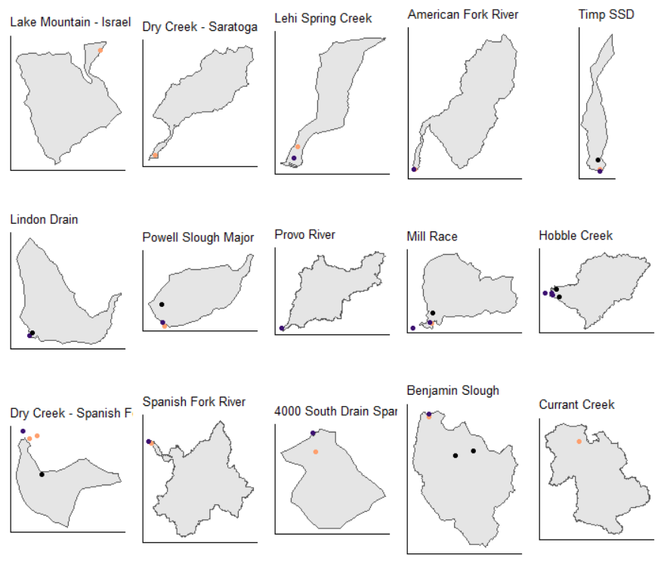

Slide 2
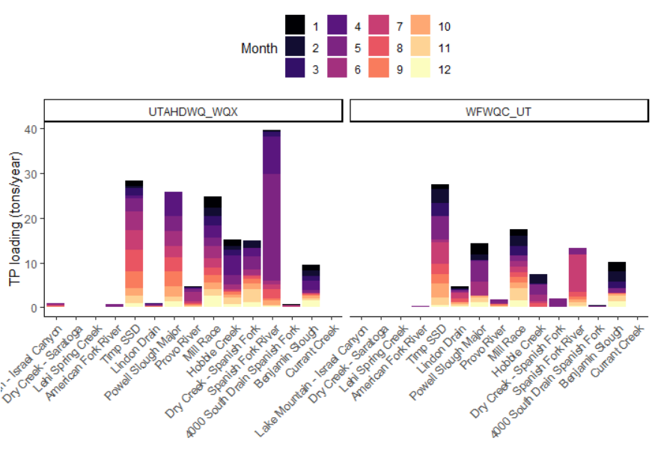
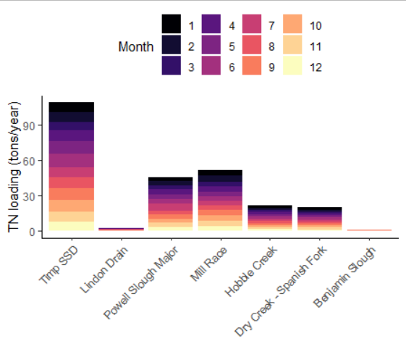

Slide 3
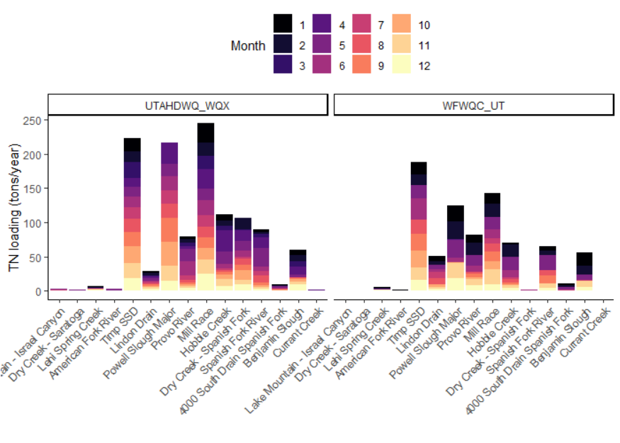
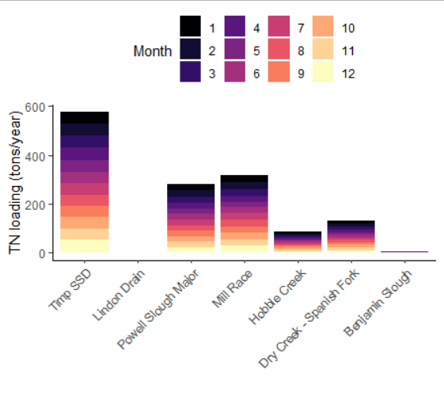

Slide 4
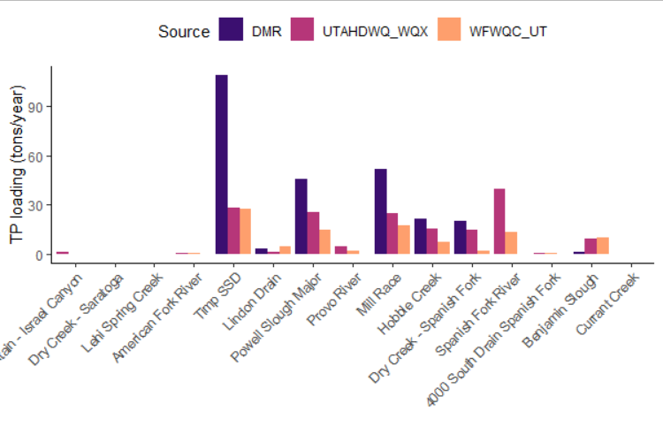
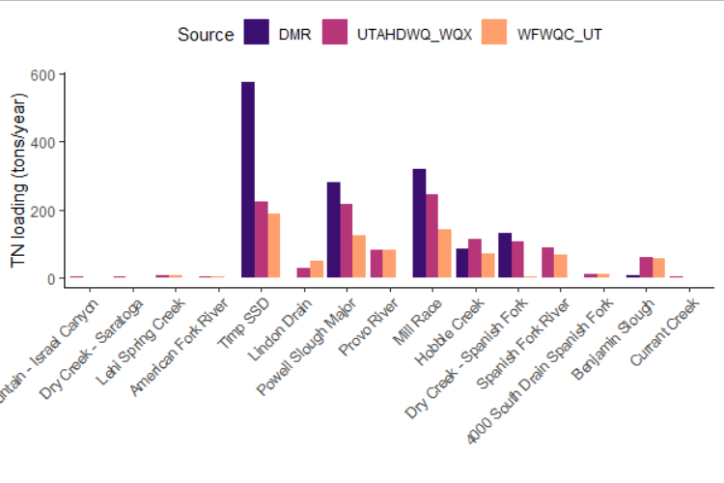

Slide 5
TP LOADING – METRIC TONS/YEAR
Watershed | Utah DWQ Sites | WFWQC Sites | DMR data | Merritt and Miller 2016 | PSOMAS and SWCA 2007
Lake Mountain – Israel Canyon | 0.91 | --
Dry Creek – Saratoga | 0.13 | -- |  |  | 0.2
Lehi Spring Creek | 0.07 | 0.02 |  | 0.41
American Fork River | 0.61 | 0.29 |  | 0.63
Timp SSD | 28.2 | 27.5 | 108.9 | 58.3 | 39.0
Lindon Drain | 0.97 | 4.7 | 3.0
Powell Slough Major | 25.8 | 14.4 | 45.9 | 36.5 (Orem) | 82.4
Provo River | 4.6 | 1.9 |  | 8.26 | 7.9
Mill Race | 24.7 | 17.3 | 51.9 | 61.4 | 74.4
Hobble Creek | 15.2 | 7.3 | 21.5 | 20.2 | 15.8
Dry Creek – Spanish Fork | 14.9 | 2.0 | 20.1 | 21.9 | 13.9
Spanish Fork River | 39.5 | 13.3 |  | 8.95 | 21.2
4000 South Drain | 0.61 | 0.52
Benjamin Slough | 9.47 | 10.0 | 1.5 (missing Payson) | 8.65 | 16.6
Currant Creek | 0.14 | --

Slide 6
TDP LOADING – METRIC TONS/YEAR
Watershed | Utah DWQ Sites | WFWQC Sites | DMR data | Merritt and Miller 2016
Lake Mountain – Israel Canyon | 0.16 | --
Dry Creek – Saratoga | 0.03 | --
Lehi Spring Creek | 0.03 | 0.01 |  | 0.31
American Fork River | 0.04 | 0.01 |  | 0.31
Timp SSD | 26.8 | 31.9 | 25.1 | 51.3
Lindon Drain | 1.2 | 4.2 | 0
Powell Slough Major | 23.8 | 12.0 | 25.7 | 34.1 (Orem)
Provo River | 2.2 | 1.3 |  | 6.5
Mill Race | 22.2 | 15.9 | 39.2 | 55.2
Hobble Creek | 13.5 | 6.8 | 16.1 | 17.7
Dry Creek – Spanish Fork | 9.7 | 1.8 | 13.6 | 19.9
Spanish Fork River | 3.6 | 2.2 |  | 1.73
4000 South Drain | 0.46 | 0.3
Benjamin Slough | 6.7 | 8.1 | 1.2 (Missing Payson) | 5.75
Currant Creek | 0.06 | --

Slide 7
N LOADING – METRIC TONS/YEAR
Watershed | Utah DWQ Sites (TN) | Utah DWQ Sites (TDN) | WFWQC Sites (TN) | DMR data (TKN) | Merritt and Miller 2016 (DN)
Lake Mountain – Israel Canyon | 2.6 | 4.0 | --
Dry Creek – Saratoga | 1.6 | 1.7 | --
Lehi Spring Creek | 7.2 | 7.0 | 6.2 |  | 11.9
American Fork River | 3.1 | 3.1 | 1.3 |  | 14.1
Timp SSD | 222.3 | 227.7 | 188.0 | 575.5 | 210
Lindon Drain | 29.2 | 30.3 | 50.3 | 0
Powell Slough Major | 216.9 | 209.5 | 124.3 | 279.5 | 97.3 (Orem)
Provo River | 79.4 | 101.5 | 82.1 |  | 142
Mill Race | 244.4 | 246.6 | 143.0 | 318.3 | 511
Hobble Creek | 112.3 | 116.5 | 70.9 | 85.0 | 149
Dry Creek – Spanish Fork | 106.5 | 111.1 | 2.4 | 132.5 | 146
Spanish Fork River | 89.1 | 101.2 | 65.7 |  | 105
4000 South Drain | 9.0 | 9.0 | 10.6
Benjamin Slough | 60.1 | 59.4 | 55.6 | 6.2 (missing Payson) | 100
Currant Creek | 1.3 | 1.1 | --

