Slide 1
UPDATE ON UTAH LAKE C, N, AND P PROJECT
Contributors

Slide 2
COMPONENTS
Quantification of conceptual model
External mass balance
SedFlux modeling

Slide 3
EXTERNAL MASS BALANCE
Lowercase text

Slide 4
Constituent | Method and Reporting Limit UDWQ | Method and Reporting Limit WFWQC
TP | EPA-NERL: 365.1: (4823) Phosphorus (all forms) by Semi-Automated Colorimetry 0.02 | Hach Co.: 8048: Orthophosphate by Colorimetry 0.021
TDP | EPA-NERL: 365.1: (4823) Phosphorus (all forms) by Semi-Automated Colorimetry 0.02 | Hach Co.: 8048: Orthophosphate by Colorimetry 0.021
TN | APHA 4500-N Persulfate Method for Total Nitrogen 0.2 | Hach Co.: 10242: (TNTplus 880) Simplified Spectrophotometric Measurement of TKN in Water and Wastewater 0.7
TDN | APHA 4500-N Persulfate Method for Total Nitrogen 0.2
TOC | APHA 5310 B Total Organic Carbon by Combustion-Infrared Method 0.5
DOC | APHA 5310 B Total Organic Carbon by Combustion-Infrared Method 0.5
Lowercase text

Slide 5
WATERSHEDS
Watersheds w/o WWTP, monitored by only UDWQ | Watersheds w/o WWTP, monitored by both UDWQ and WFWQC | Watersheds with WWTP
Tickville Wash | Lehi Spring Creek | Timp SSD (Timpanogos)
Dry Creek – Saratoga | American Fork River | Powell Slough Major (Orem)
Dry Creek – Spanish Fork | Lindon Drain | Mill Race (Provo)
Currant Creek | Provo River | Spring Creek – Springville (Springville)
 | Hobble Creek | Dry Creek – Spanish Fork (Spanish Fork)
 | Spanish Fork River | Benjamin Slough (Payson, Salem)
 | 4000 South Drain Spanish Fork
Use values directly
Compare entities, use values from one or both
Compare entities + address potential for attenuation of WWTP loading

Slide 6
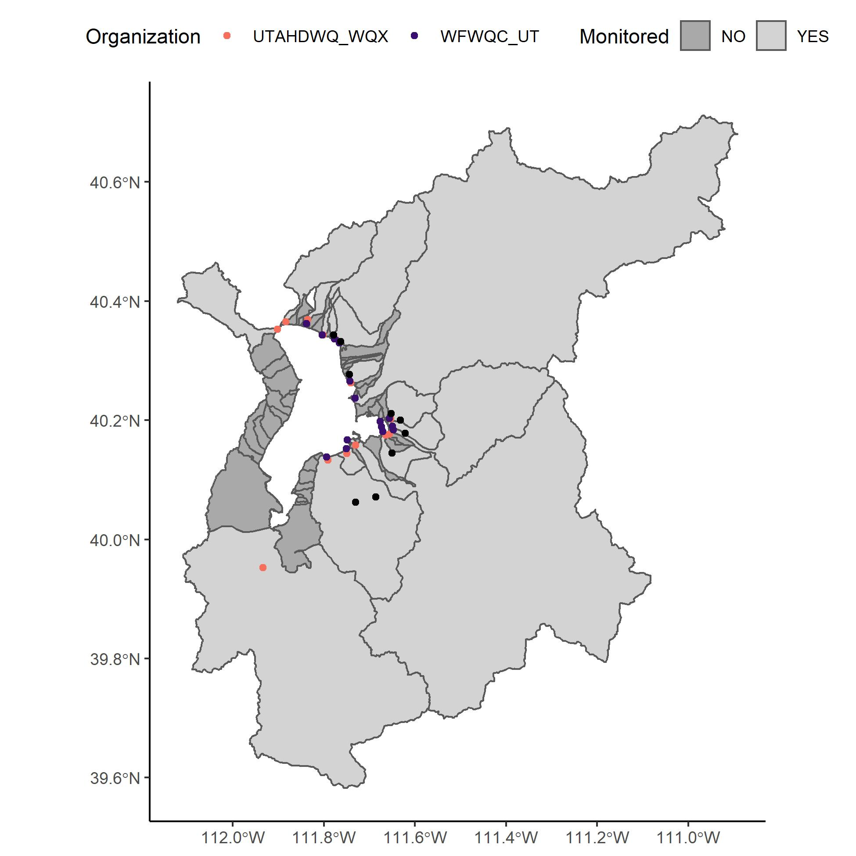
WATERSHEDS
UDWQ sites: orange
WFWQC sites: purple
Facility sites: black
Majority of watershed is monitored
Focus on these today
Unmonitored sites upcoming (paired watershed approach)

Slide 7
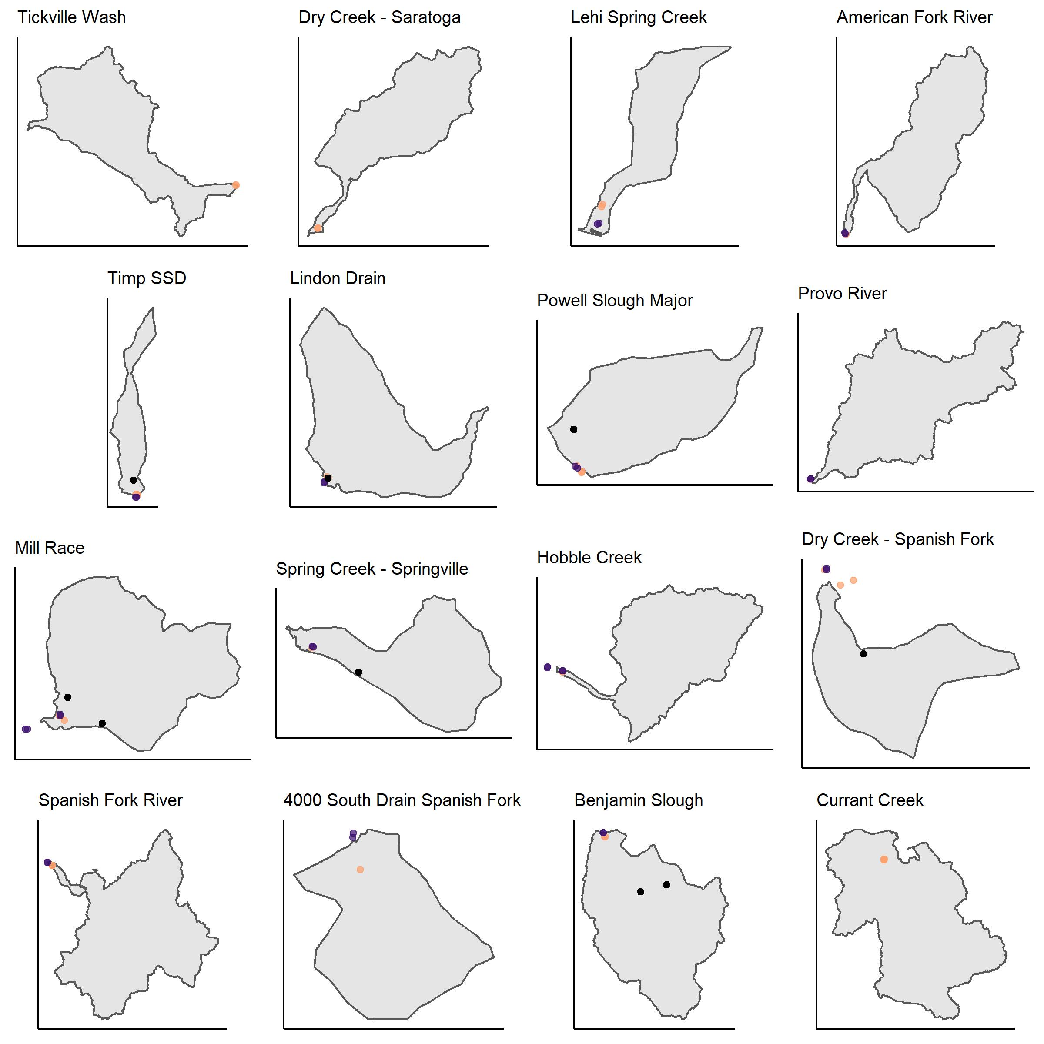
WATERSHEDS (NOT TO SCALE)
UDWQ sites: orange
WFWQC sites: purple
Facility sites: black
WFWQC sites are downstream or at the same location as UDWQ sites
Some sites are below the compromise elevation

Slide 8
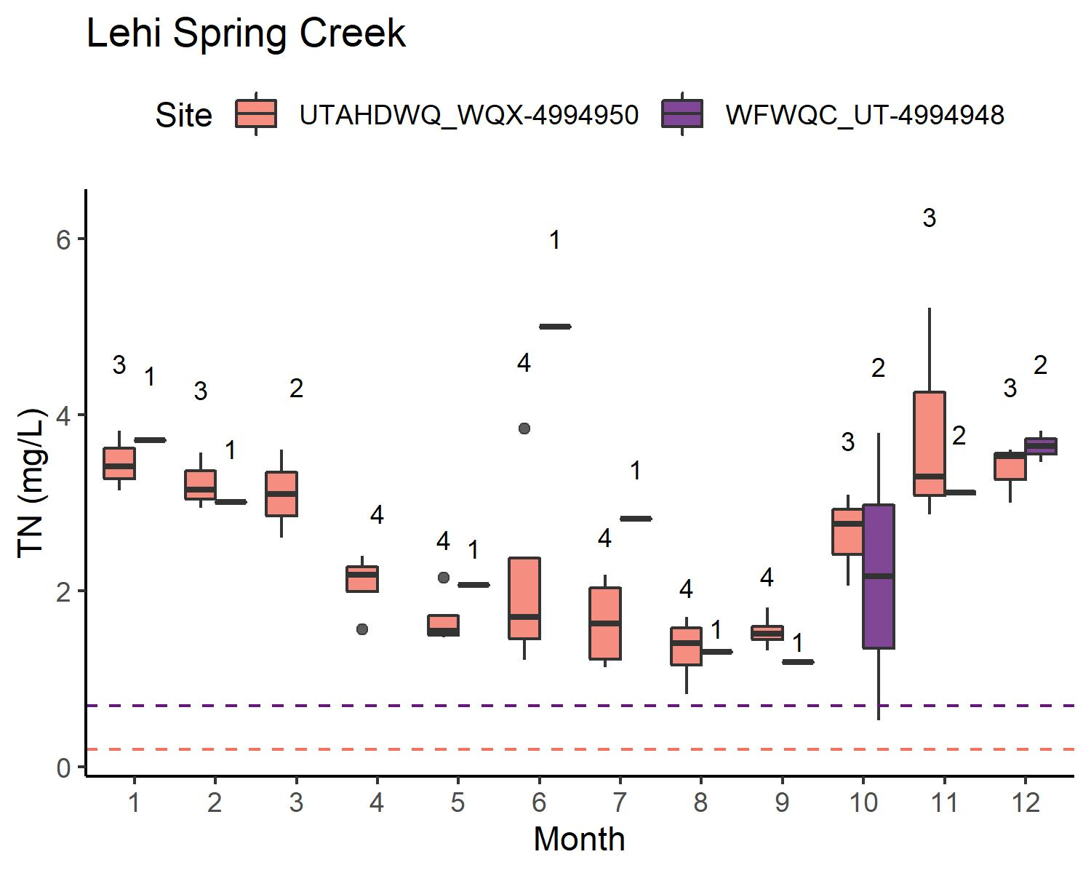
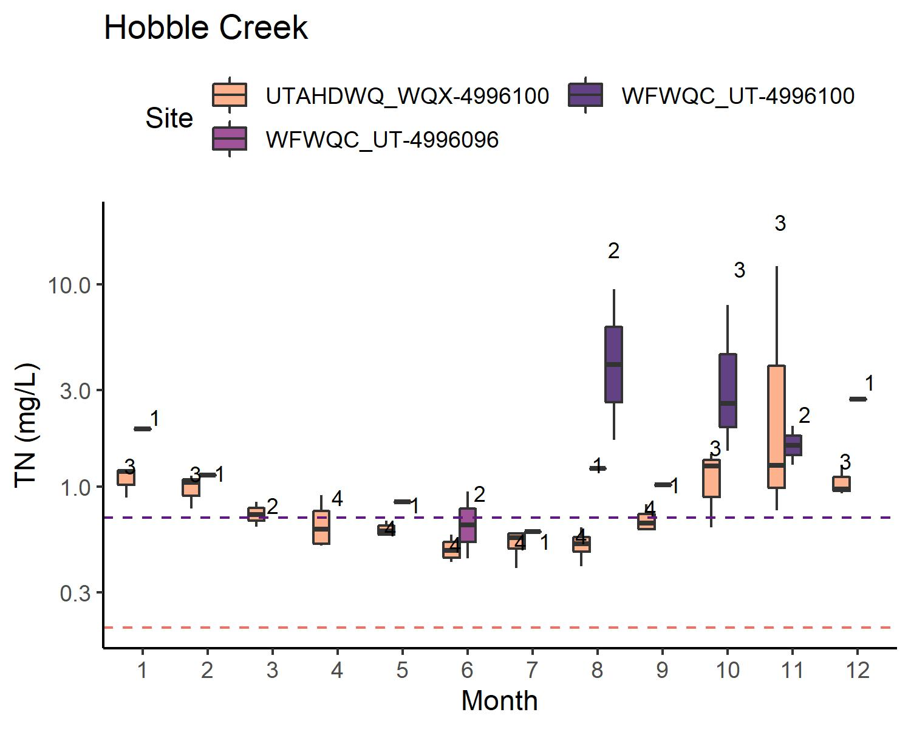
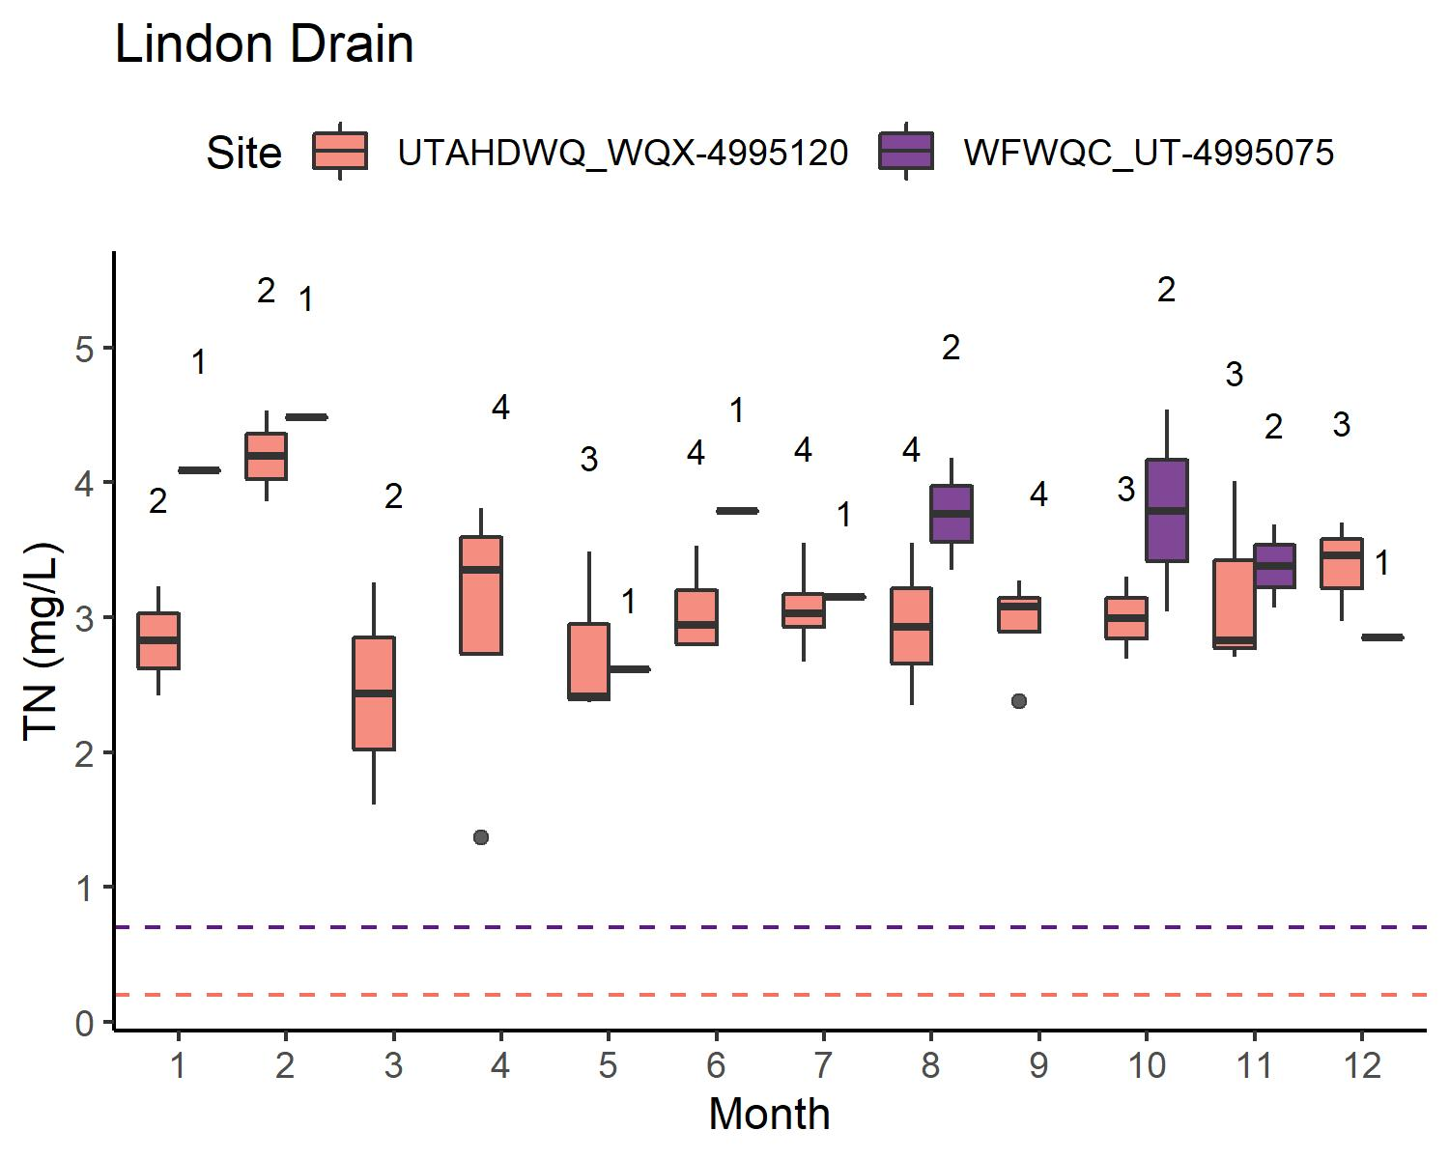
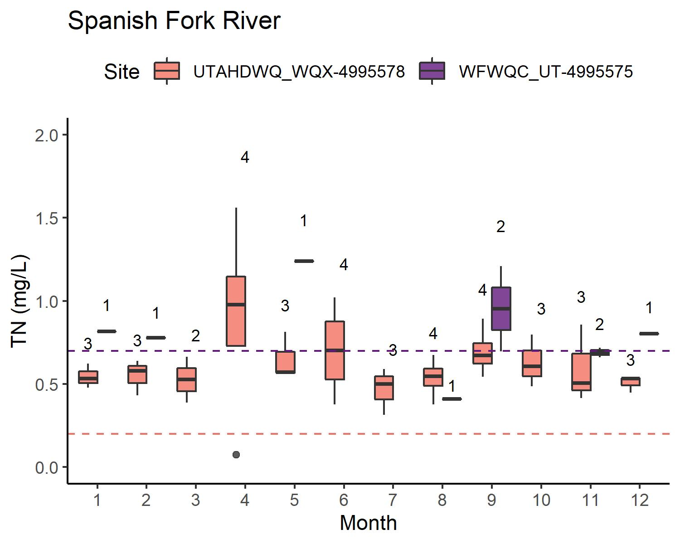
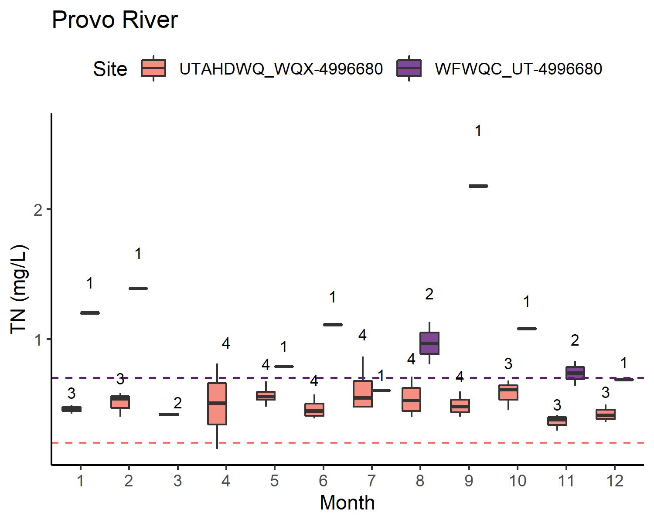
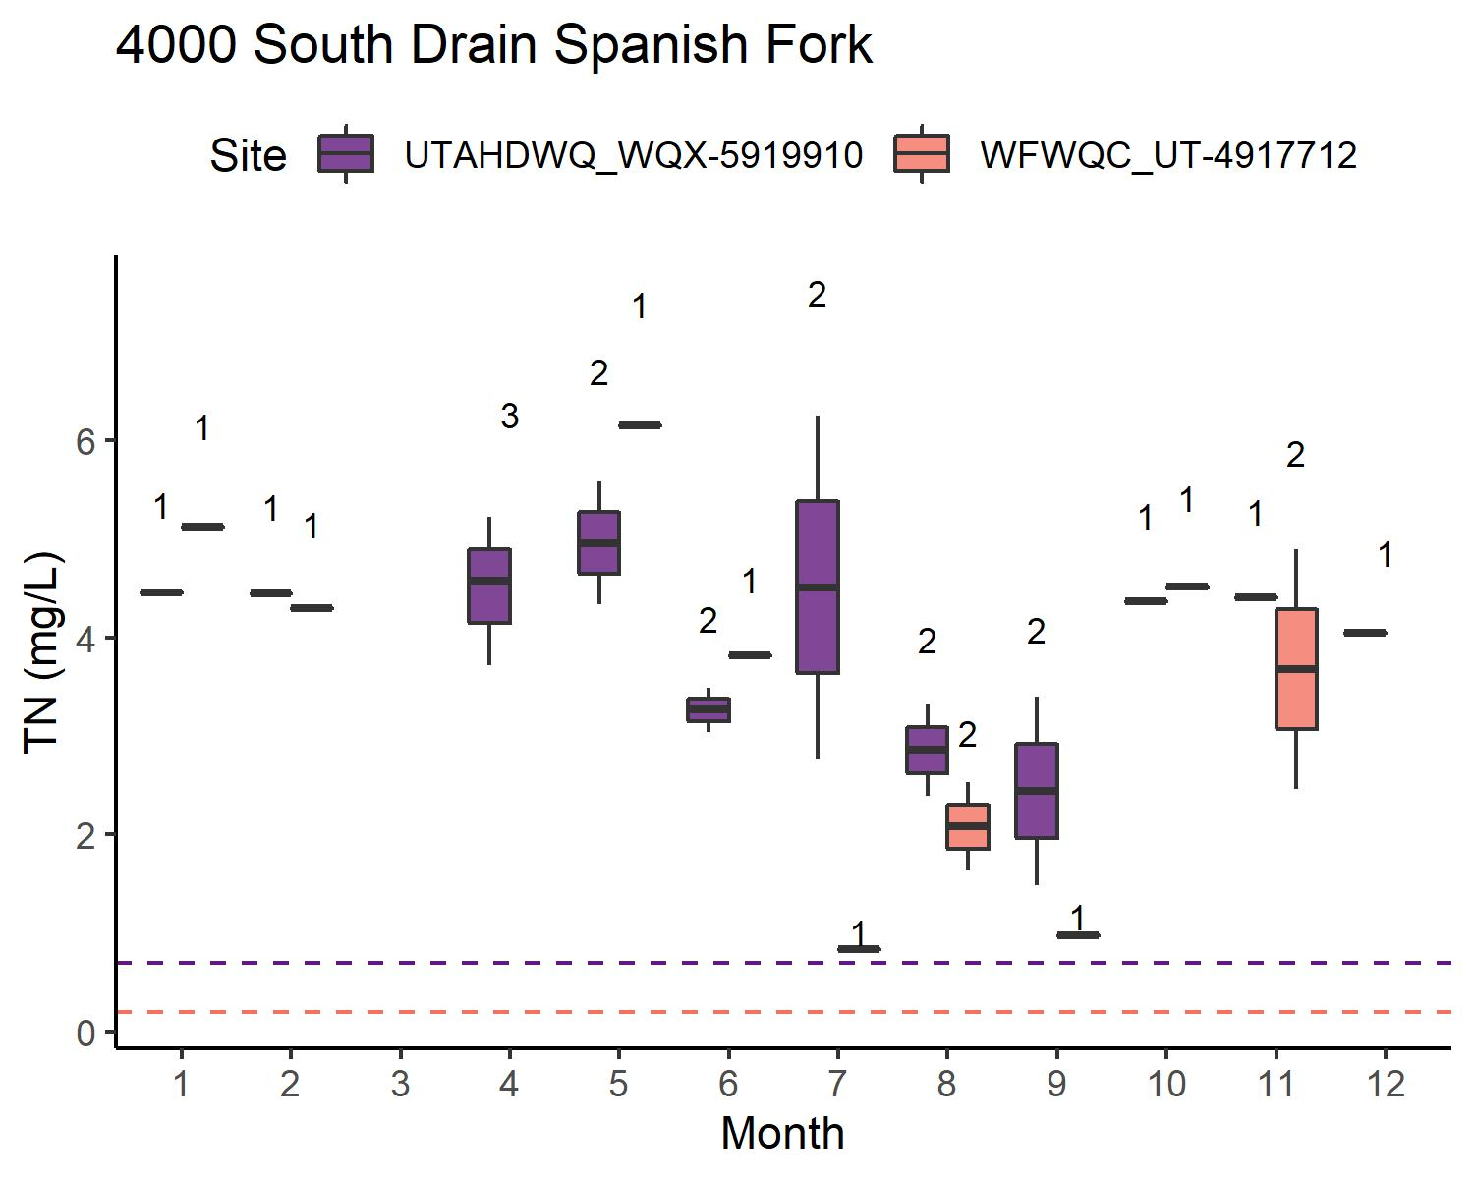
TN: WATERSHEDS W/O WWTP
Concentrations: typically UDWQ < WFWQC
Sample size: UDWQ > WFWQC
TN < WFWQC reporting limit for Provo River, Hobble Creek, Spanish Fork River
(American Fork River is intermittent, not shown)

Slide 9
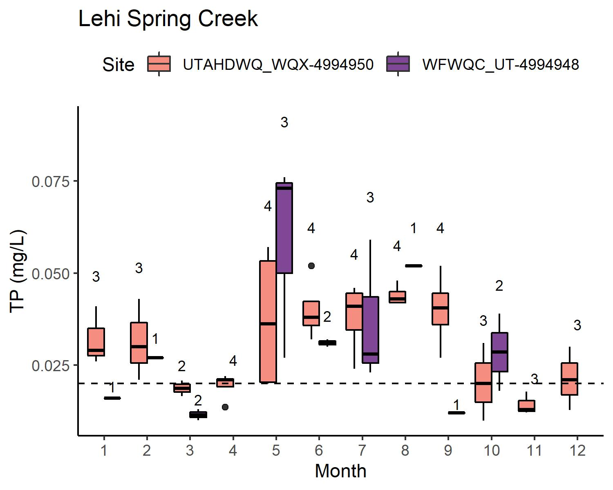
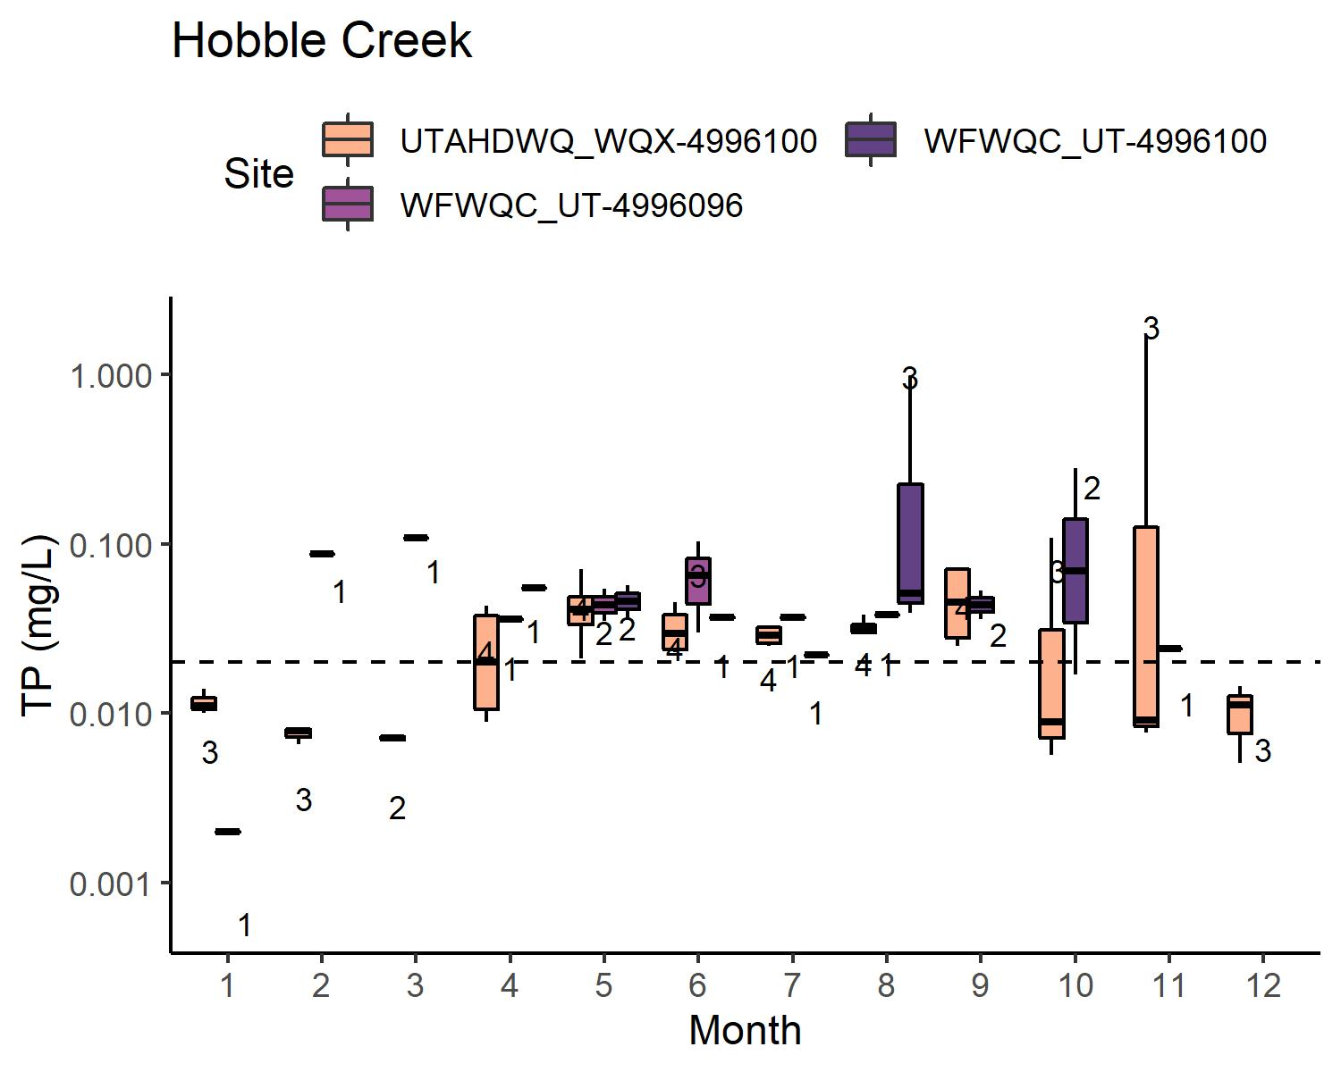
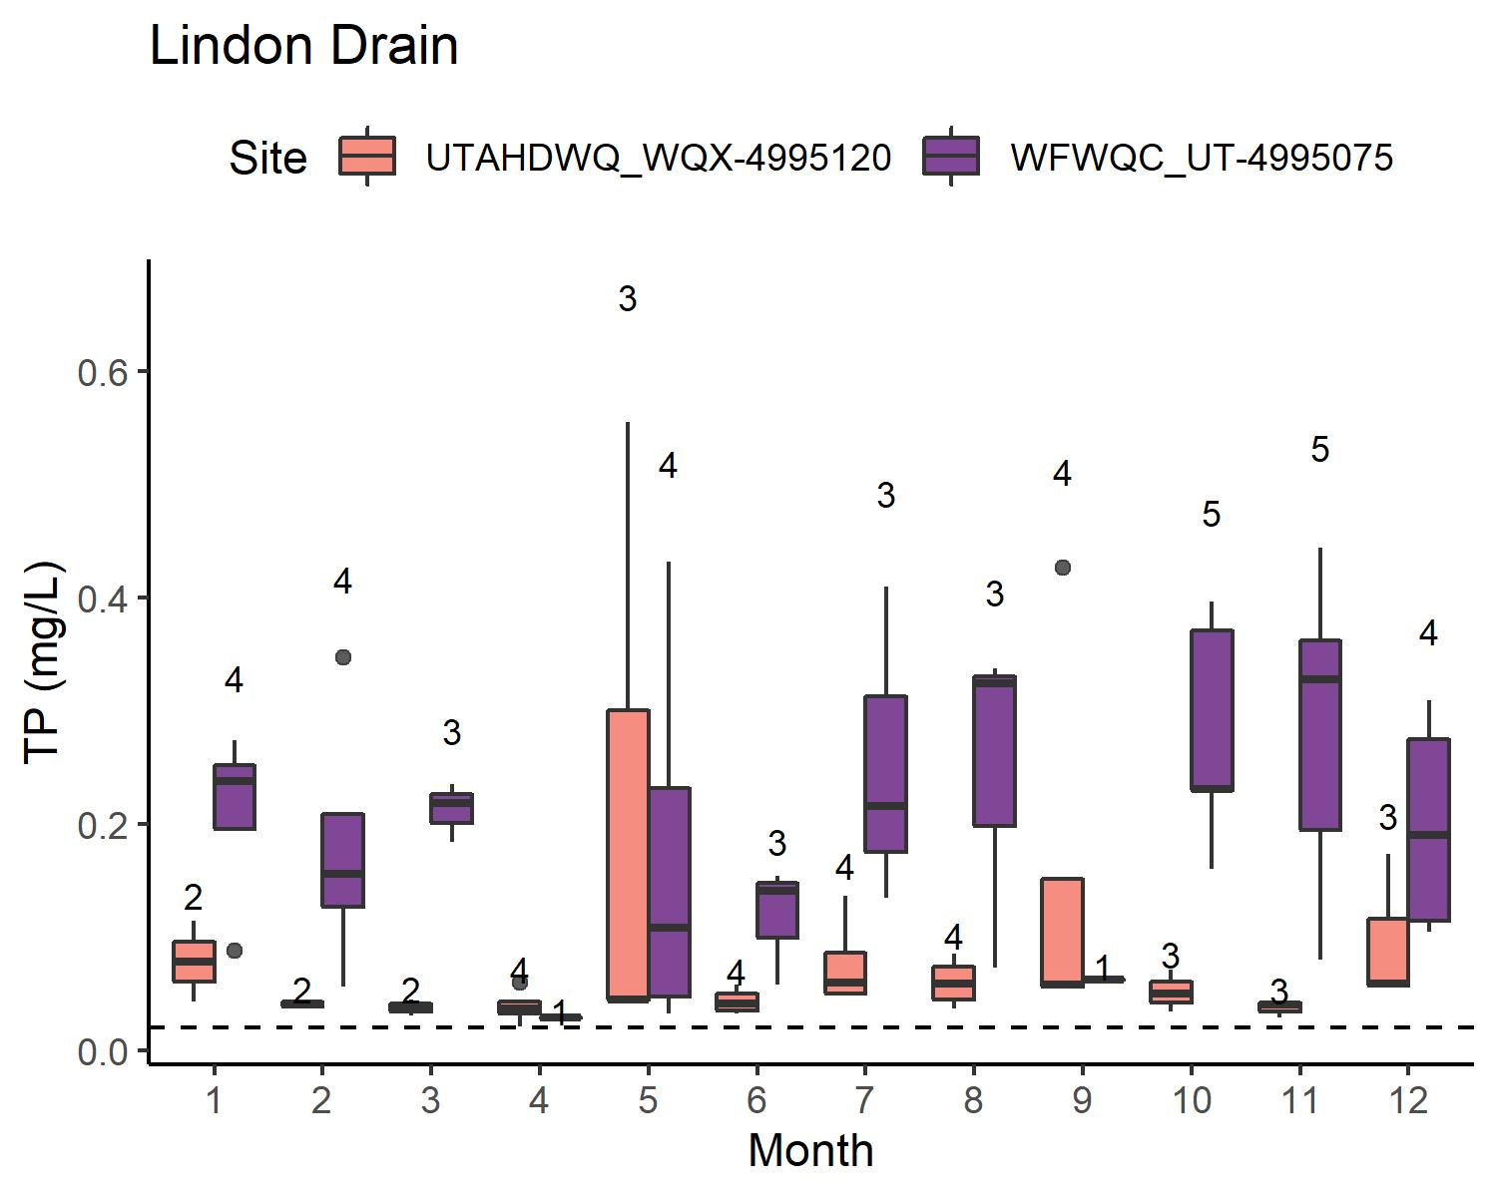
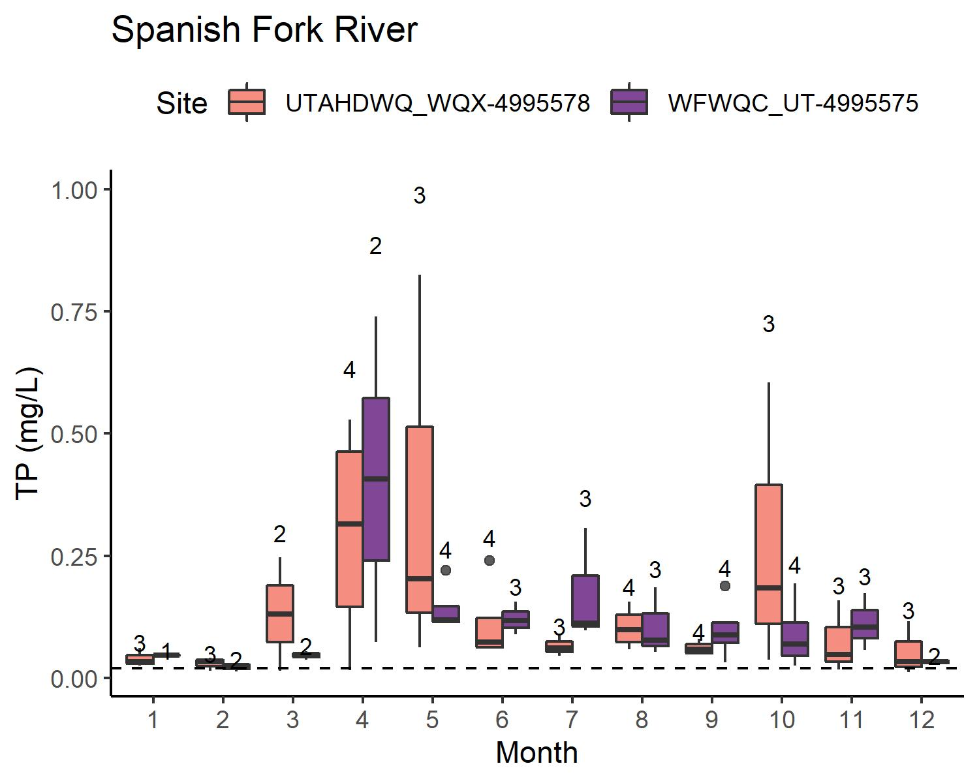
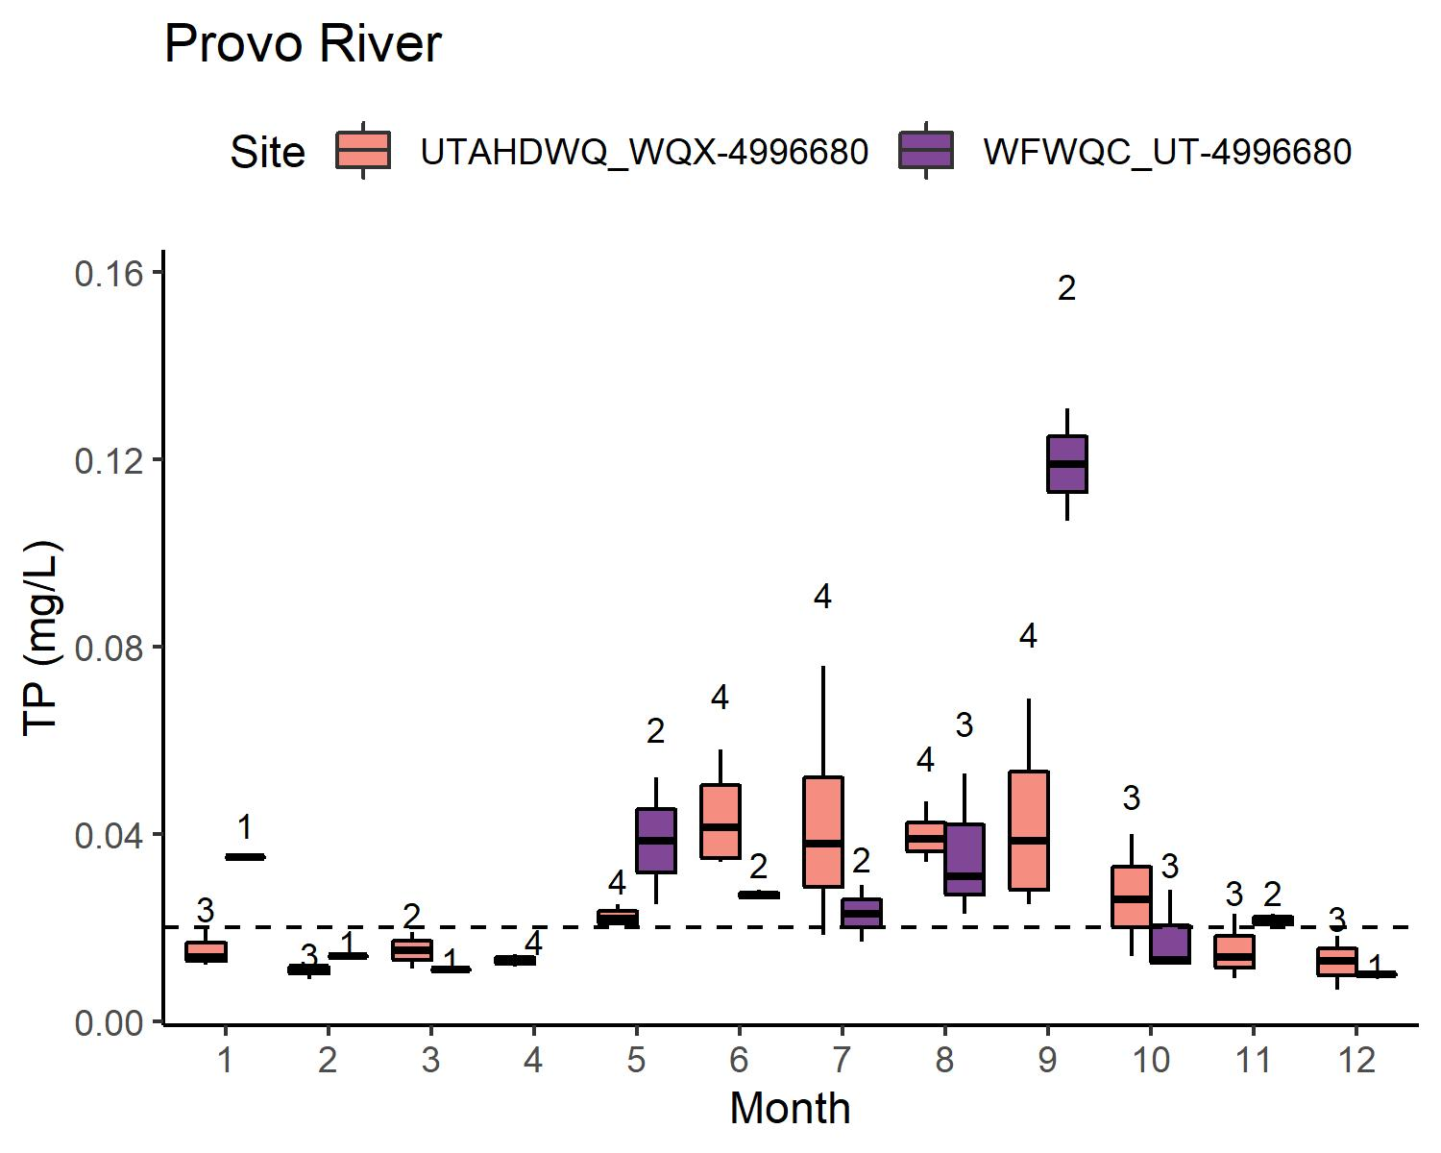
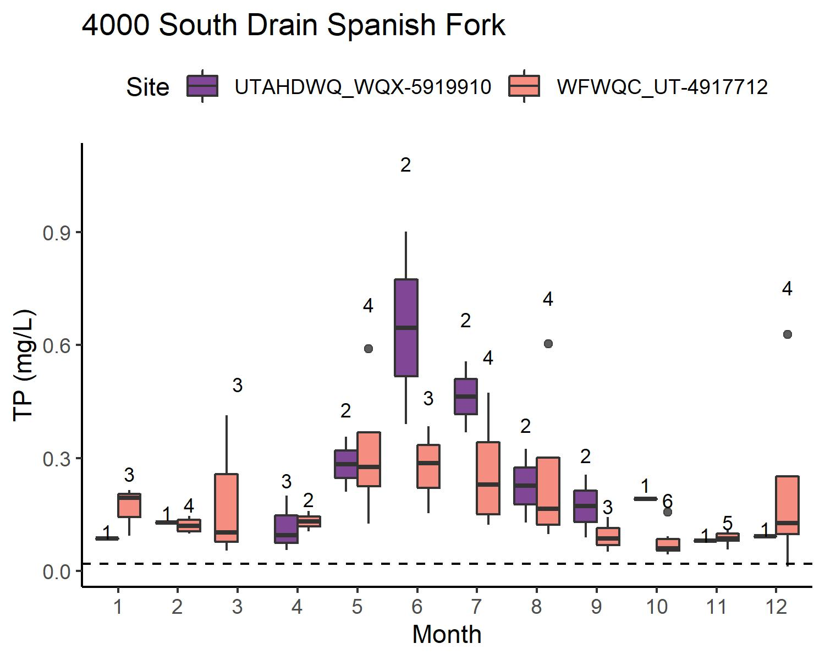
TP: WATERSHEDS W/O WWTP
Concentrations: typically UDWQ < WFWQC
Sample size: UDWQ > WFWQC
TP sometimes < reporting limit for Provo River and Hobble Creek
(American Fork River is intermittent, not shown)

Slide 10
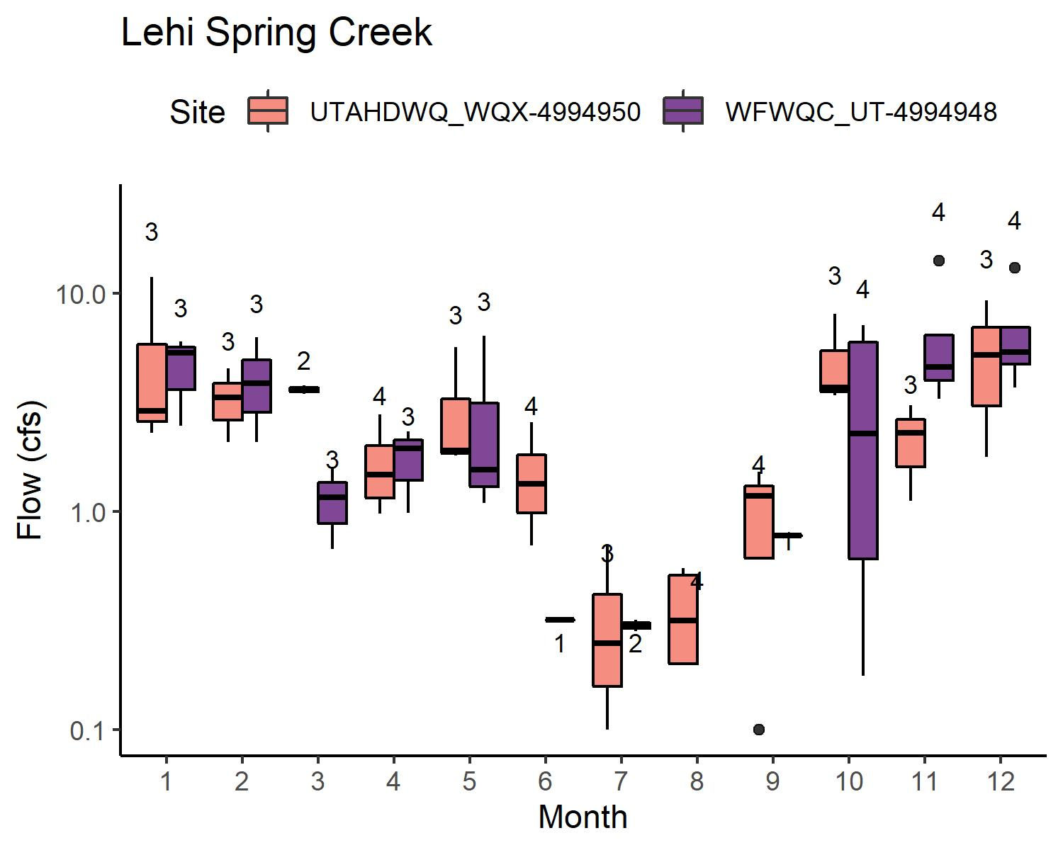
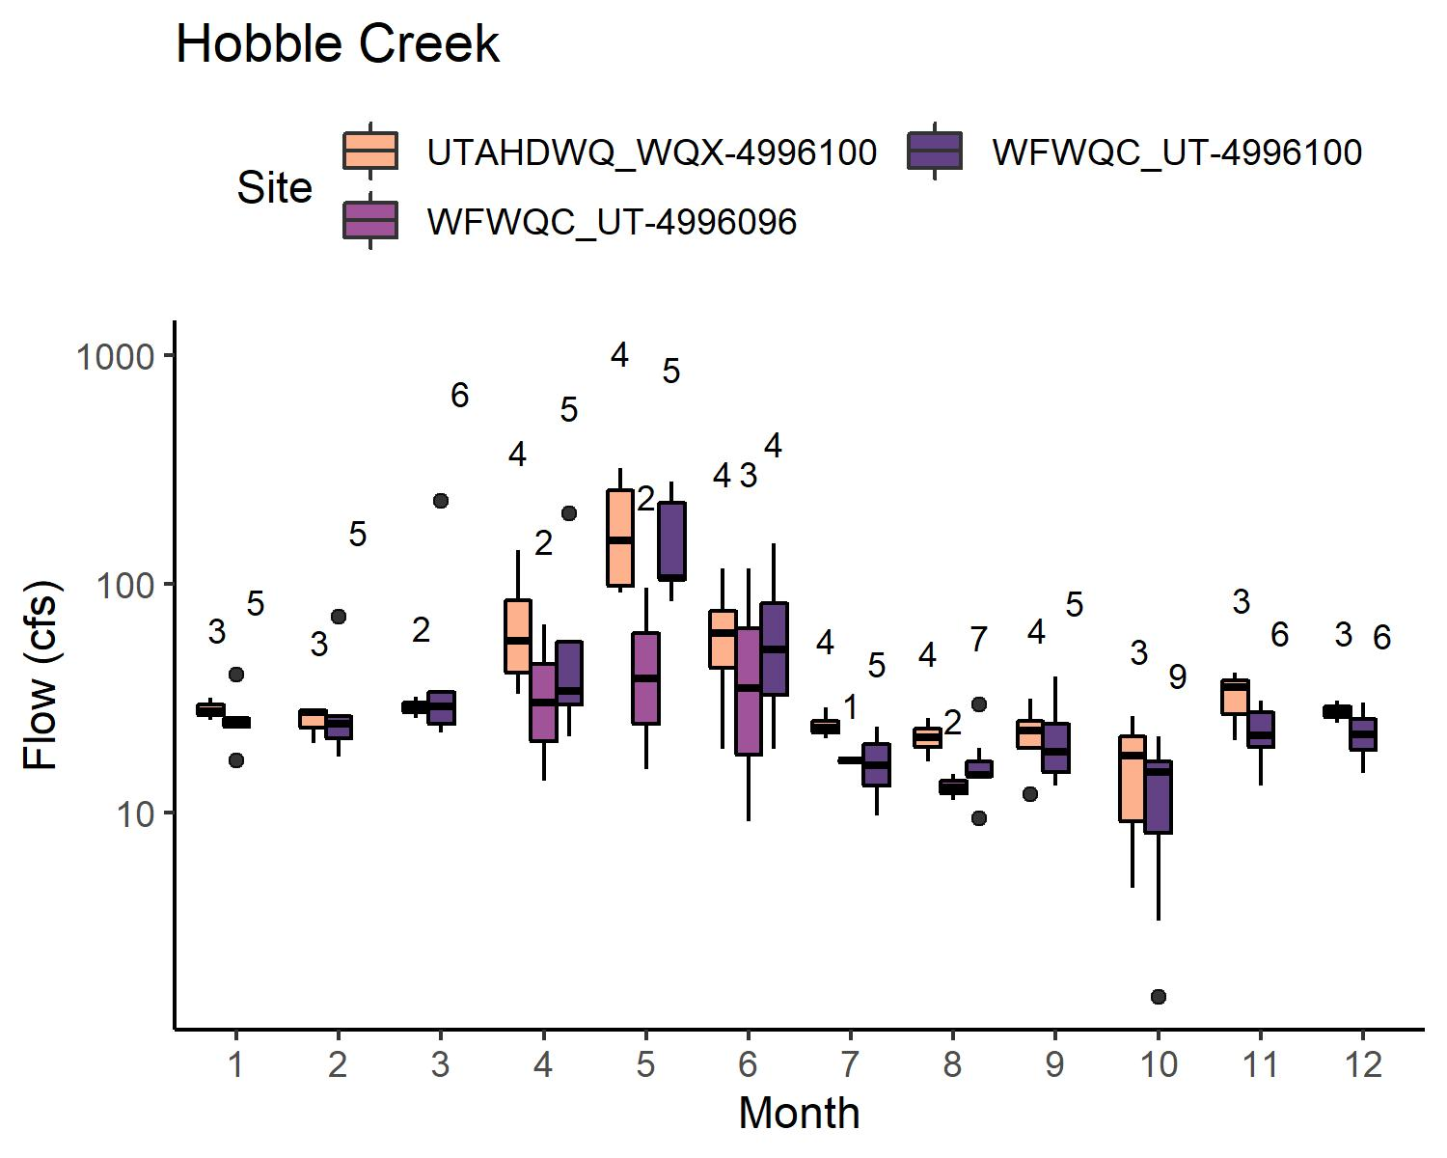
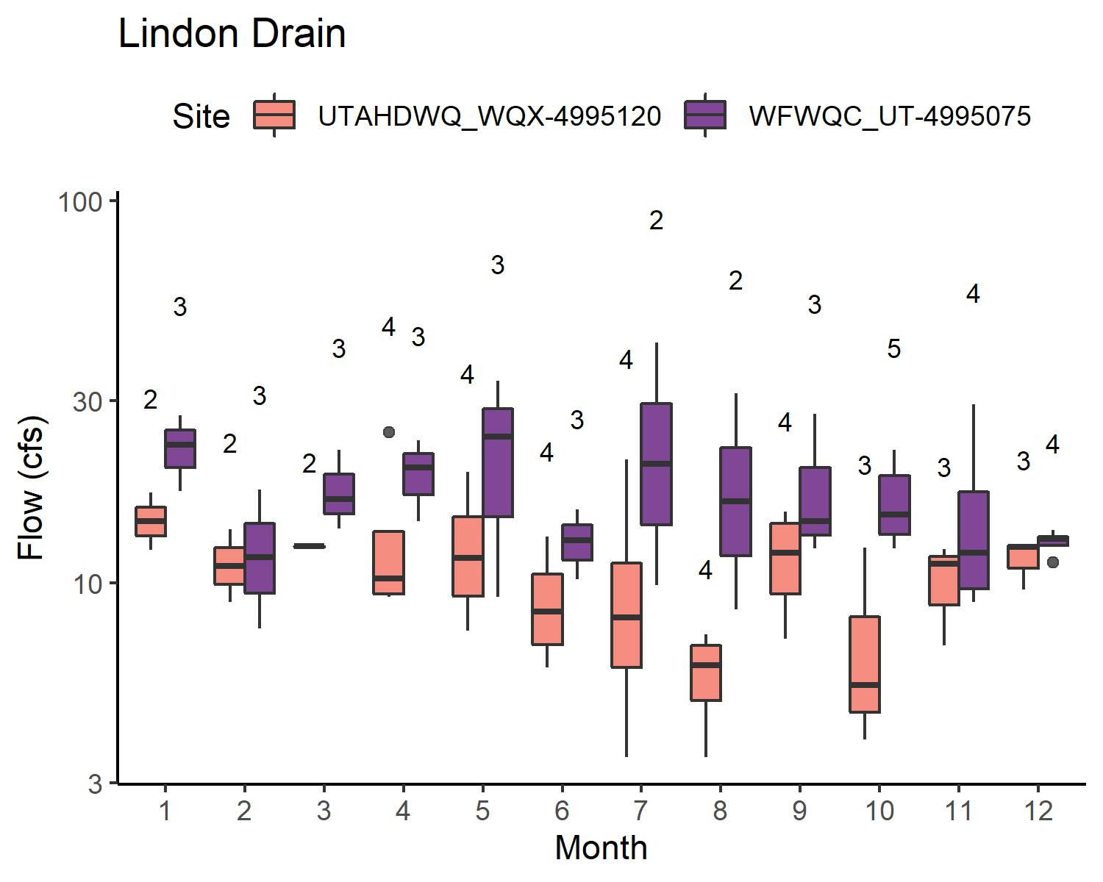
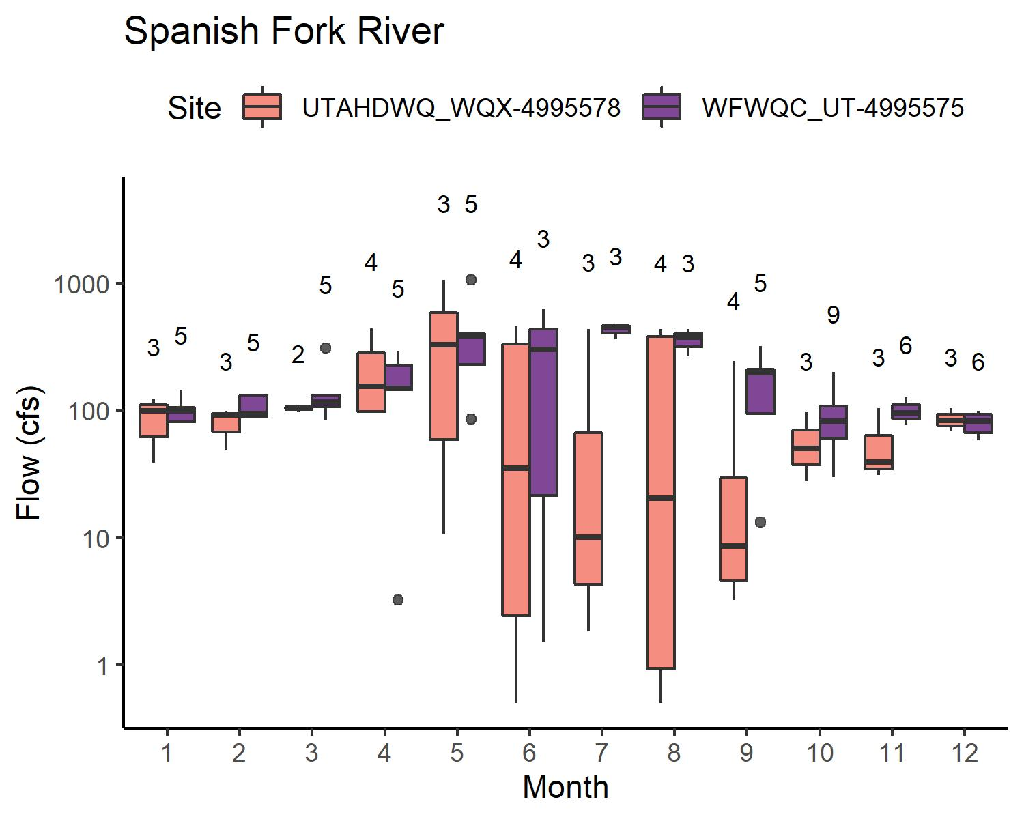
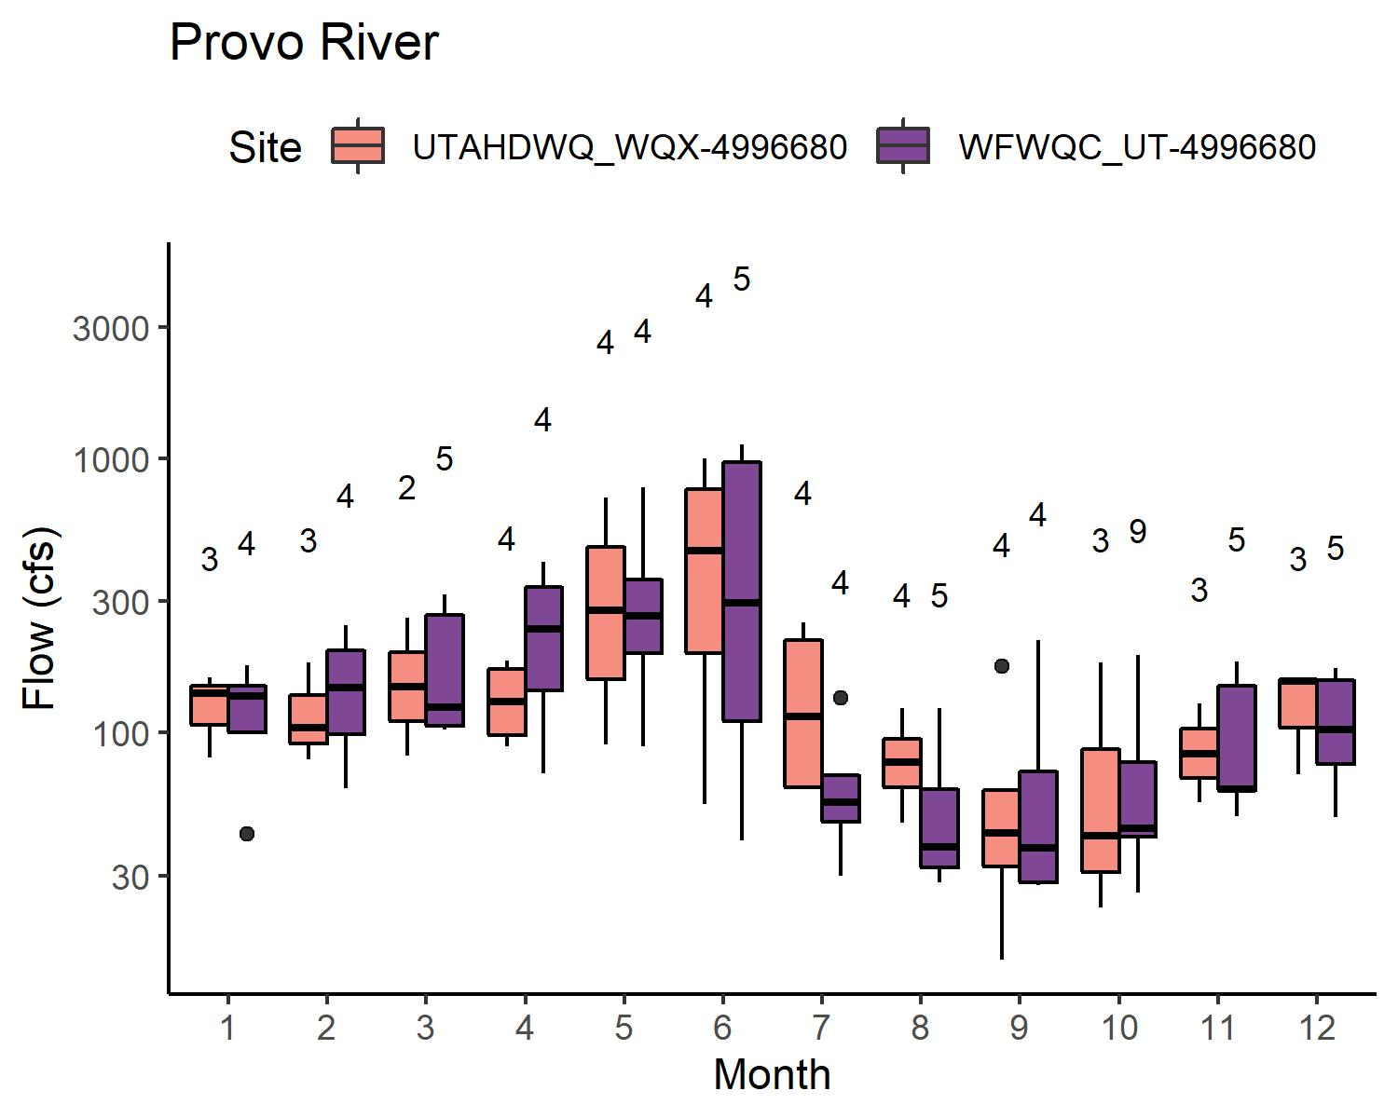
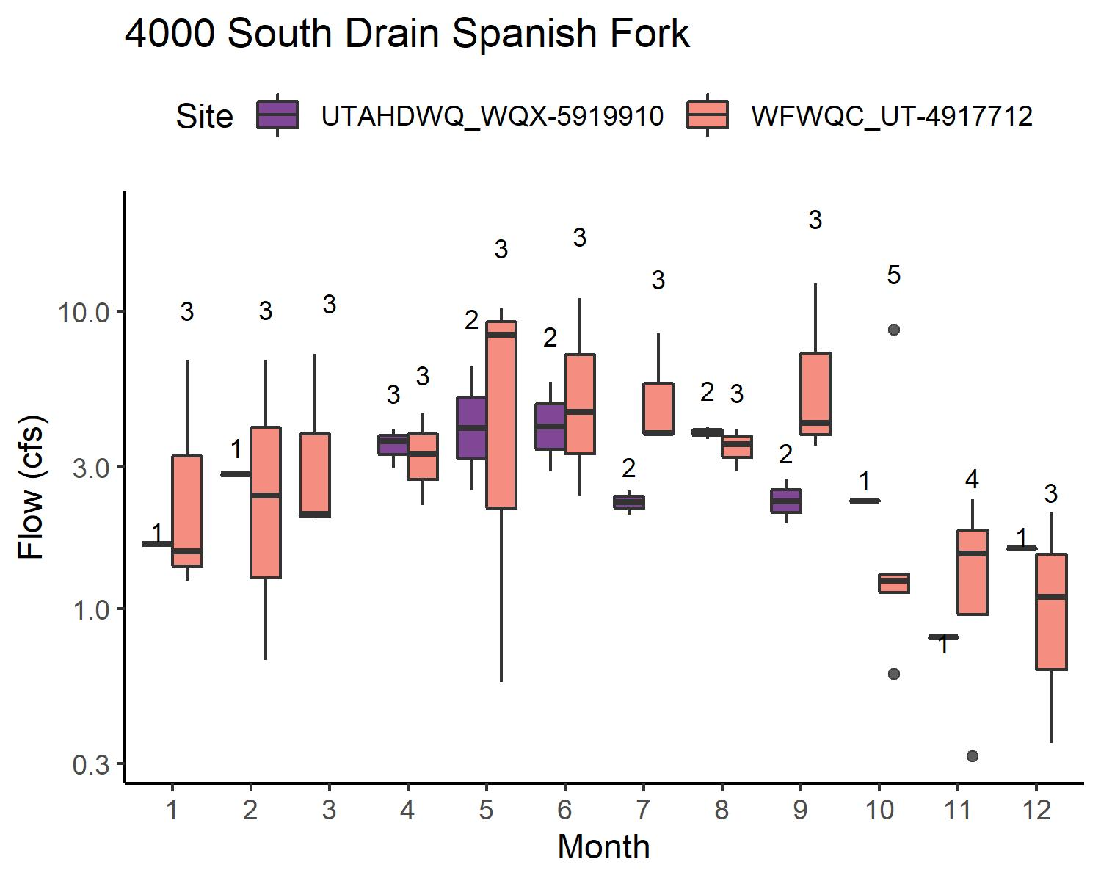
FLOW: WATERSHEDS W/O WWTP
Flow: UDWQ ≈ WFWQC
Lehi Spring Creek
American Fork River (variable, intermittent, not pictured)
Provo River
Hobble
Flow: UDWQ < WFWQC
Lindon Drain
Spanish Fork River
4000 South Drain Spanish Fork

Slide 11
UPPERCASE TITLES
Lowercase text

Slide 12
UPPERCASE TITLES
Lowercase text

Slide 13
UPPERCASE TITLES
Lowercase text

Slide 14
UPPERCASE TITLES
Lowercase text

Slide 15
UPPERCASE TITLES
Lowercase text

Slide 16
UPPERCASE TITLES
Lowercase text

Slide 17
UPPERCASE TITLES
Lowercase text

Slide 18
UPPERCASE TITLES
Lowercase text

Slide 19
UPPERCASE TITLES
Lowercase text

