Slide 1
UTAH LAKE C, N, AND P PROJECT

Slide 2
COMPONENTS
Quantify conceptual models of N and P cycles in Utah Lake
Create external mass balance of C, N, and P for Utah Lake
SedFlux modeling of sediment-water fluxes of nutrients and oxygen

Slide 3
Phosphorus model
External TP Loading
Outflow TP
23-84 tons/yr
TP
Main Basin: 0.01-1 mg/L
Provo Bay: 0.05-1 mg/L
Inflow sources
(streams, WWTPs, drains, springs, groundwater, precipitation)
152-298 tons/yr
PP
0-1 mg/L
Excretion
Carp: 51.1-117 tons/yr
Fish
1-4.5 % P
0.1-4.5 kg/acre
Excretion
0.01-1,000 µg/(ind.*d)
Zooplankton
0.5-1.6 % P
0.05-160,000 µg/L (small)
50-1,600 µg/L (large)
TDP
0.003-1 mg/L
Excretion, Decomp.
0.1-100 ng/(L*h)
Uptake not possible to calculate
Atmospheric Deposition
5.0±3.1 tons/yr
Uptake
0.1-100 ng/(L*h)
PO₄³⁺ ≈ SRP
Main Basin: 0.01-0.85 mg/L
Provo Bay: 0.02-4 mg/L
Phytoplankton
0.7-2 % P
Uptake
0.17-480 µg/(ind.*d)
DOP
0-0.18 mg/L
PIP
PP settling
192-1,230 tons/y
0-83 tons/d
PP resuspension
173-257 tons/y
0-82 tons/d
Water
TDP Release
1.7-1.9 ± 0.7-4.0 tons/d
SRP Release
-4.5-27.2 tons/d
Sediment
Confidence
Uptake not possible to calculate
Macrophytes
0.2-0.6 % P
TP
Main Basin: 280-1730 mg/kg
Provo Bay: 465-1900 mg/kg
Very high
Porewater TDP
Main Basin: 1.48 mg/L (0.26-10.82)
Provo Bay: 3.85 mg/L (0.40-6.78)
Excretion, decomp. not possible to calculate
Periphyton
Negligible
Uptake not possible to calculate
Macroinvertebrates
5.3-17.0 mg/g dry weight
High
Uptake negligible
Literature-derived values
Medium
Excretion, decomp: negligible (periphyton), 0-496 µg/(g dry weight*h) (macroinvertebrates)
Low
Dashed boxes are derived from Randall et al. 2019 (PLoS ONE)
BD fraction
Fe/Mn compounds
49.1±1.8% (41-61%)
HCl fraction
CaPO₄ or acid-soluble organic P
38.6±2.1% (25-47%)
NH₄Cl, NaOH, and residual fractions
Loosely bound, exchangeable and organic P, refractory P
12.4%
Very low

Slide 4
Nitrogen model
Benthic N fixation
0.1-1.0 tons/h
Atmospheric N₂
External TN Loading
Denitrification, anammox
1,372 tons/yr
Water column N fixation
0-4.65 µg/(L*h)
Outflow TDN
367 tons/yr
150-6,847 kg/d
Inflow sources
(streams, WWTPs, drains, springs, groundwater, precipitation)
2022-2542 tons/yr
TN
Main Basin: 0.04-12.4 mg/L
Provo Bay: 0.7-12.4 mg/L
PN
0-0.50 mg/L
TDN
0.29-5.32 mg/L
Excretion
Carp: 496-1,140 tons/yr
Fish
8-12 % N
0.8-20 kg/ac
DON
0-11.9 (from TKN)
0-1.9 mg/L (from TDN)
Excretion
0.01-10,000 µg/(ind.*d)
Zooplankton
5-14 % N
0.5-1,400,000 µg/L (small)
500-14,000 µg/L (large)
Atmospheric Deposition
170 tons/yr
Excretion, Decomp.
10-10,000 ng/(L*h)
Uptake not possible to calculate
DIN
0.01-7.5 mg/L
Uptake
10-10,000 ng/(L*h)
Phytoplankton
5-9 % N
Uptake
1.2-2,160 µg/(ind.*d)
NO₂⁻ + NO₃⁻
0.001-5.2 mg/L
NH₃ + NH₄⁺
0.003-5.0 mg/L
Water
TIN Release
-3.8-554.4 tons/d
Ammonia Release
-12.7-554.4 tons/d
PN settling
0-130 tons/d
PN resuspension
0-129 tons/d
Sediment
Confidence
TN
0-3000 mg/kg
Macrophytes
0.8-1.3 % of dry mass
Uptake not possible to calculate
Very high
Porewater TDN
0-16 mg/L
Macroinvertebrates
42.7-141.2 mg/g dry weight
Excretion, decomp. not possible to calculate
Uptake negligible
Periphyton
Negligible
Uptake not possible to calculate
High
Medium
Excretion, decomp: negligible (periphyton), 0-168 µg/(g dry weight*h) (macroinvertebrates)
Low
Literature-derived values
Very low

Slide 5
EXTERNAL MASS BALANCE
Inputs
Tributaries
Atmosphere
Groundwater
Outputs
Jordan River

Slide 6
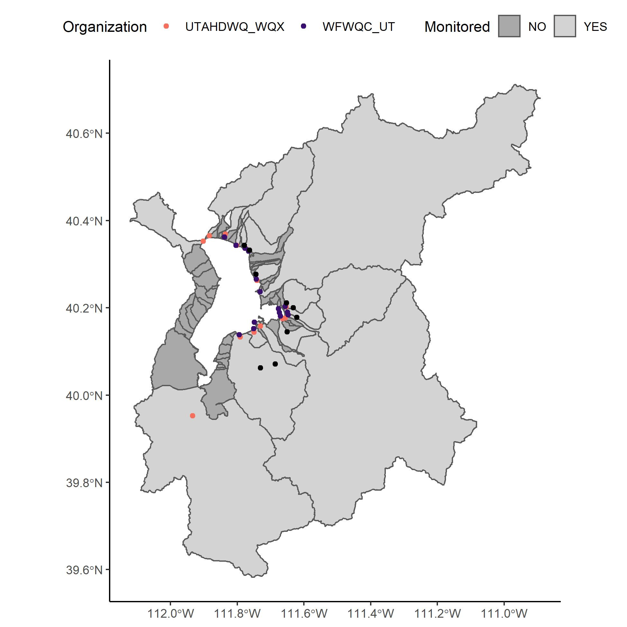
WATERSHEDS
UDWQ sites: orange
WFWQC sites: purple
Facility sites: black
Majority of watershed is monitored → infer unmonitored watersheds from similar monitored watersheds

Slide 7
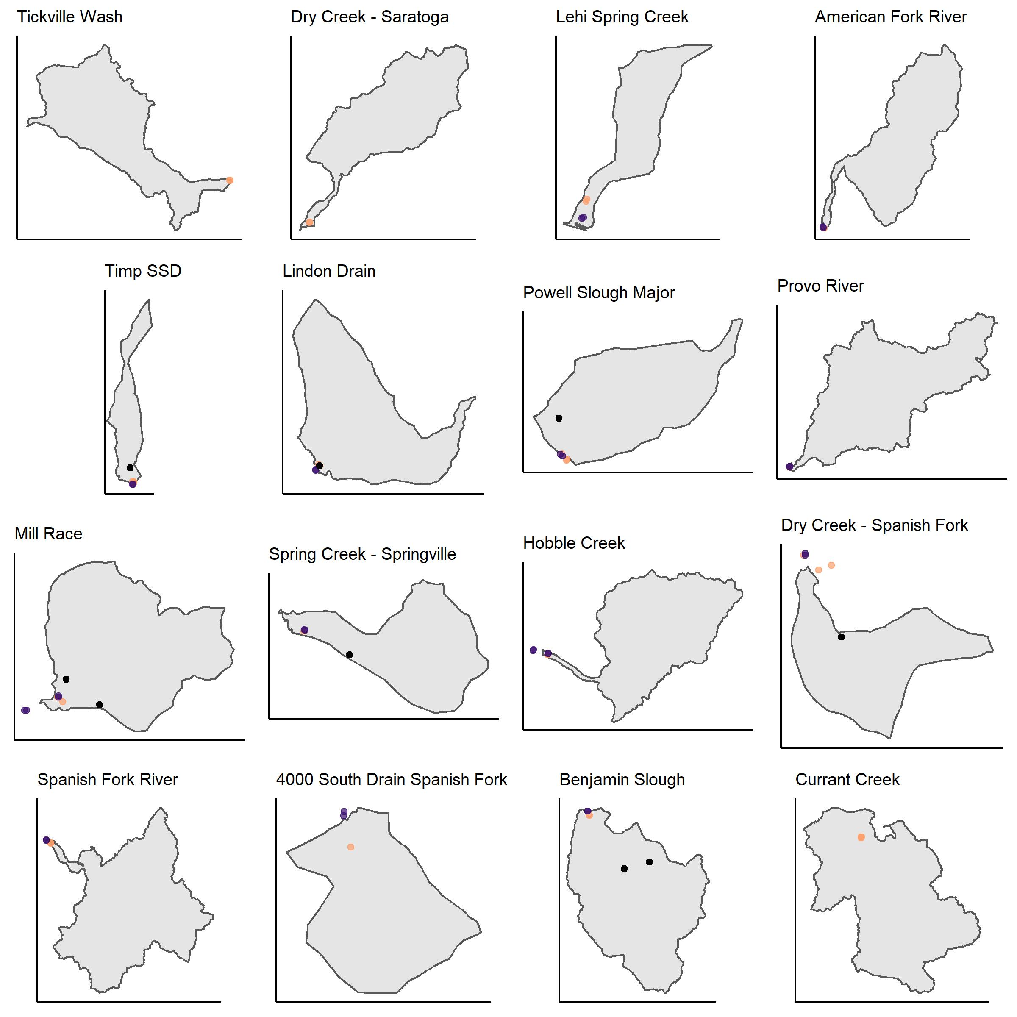
WATERSHEDS (NOT TO SCALE)
Most downstream monitoring location(s) used to generate nutrient loads to the lake
Comparing monitored sites with reported WWTP effluent, where appropriate
UDWQ sites: orange
WFWQC sites: purple
Facility sites: black

Slide 8
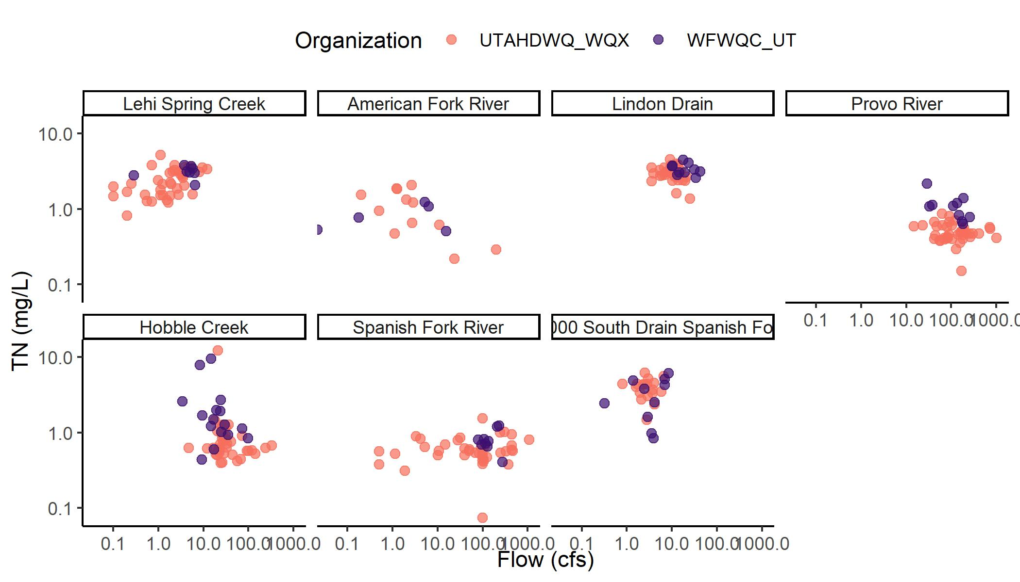
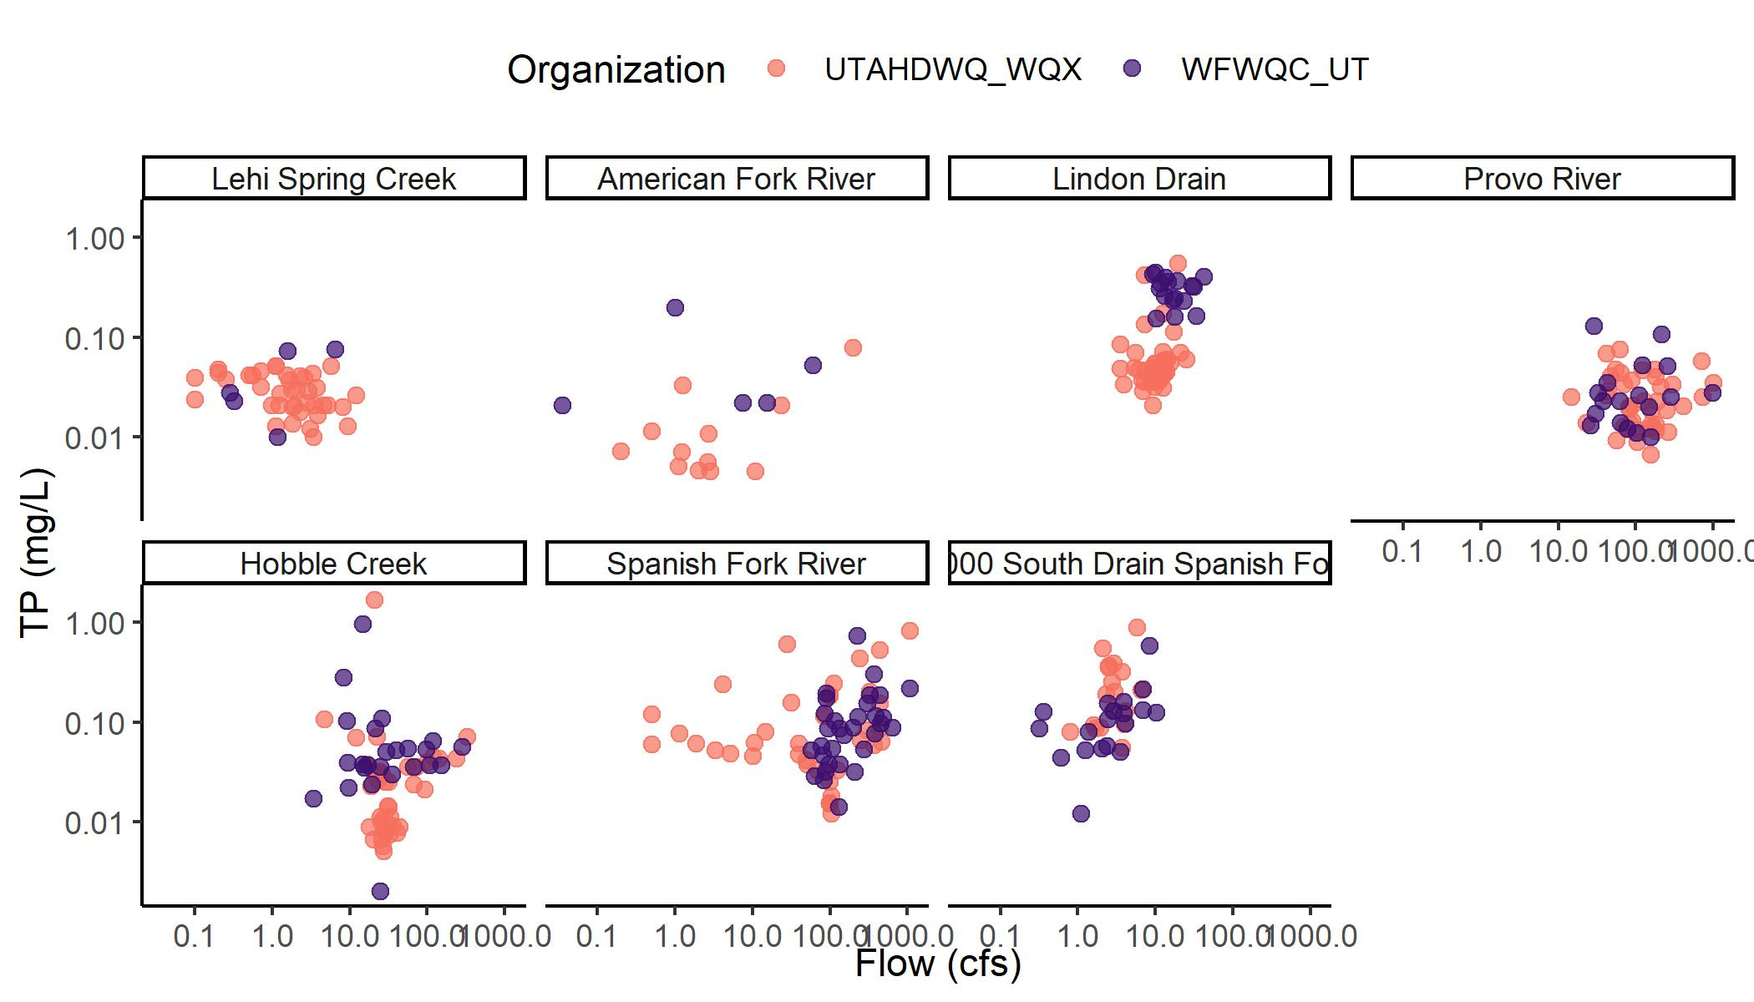
C-Q RELATIONSHIPS WATERSHEDS W/O WWTP
Flow x nutrient concentration = nutrient load
Monitored sites are sampled to varying degrees, depending on sampling entity and watershed → use this to inform load estimates

