Slide 1
Work-case №6
Performed by student
group RPZ-13a
Kateryna Hranat

Slide 2
installing several command interpreters:
# 1. Install command interpreters
sudo apt-get install <interpreter1> <interpreter2>
# Example:
sudo apt-get install zsh fish
As for the capabilities:
Zsh: Zsh is highly customizable and provides advanced features like powerful tab completion, spelling correction, and plugin support. It's known for its extensibility and scripting capabilities.
Fish: Fish, the Friendly Interactive Shell, focuses on user-friendliness with features like autosuggestions, syntax highlighting, and easy-to-understand syntax. It aims to be intuitive for new users.

Slide 3
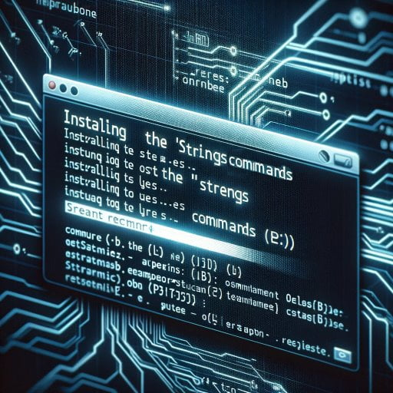
Creating users and assigning them to groups:
# Create groups
sudo addgroup technical_support
sudo addgroup developers
sudo addgroup financiers
sudo addgroup founders
sudo addgroup guests
# Create users and assign them to groups
sudo adduser user1 --ingroup technical_support
sudo adduser user2 --ingroup developers
sudo adduser user3 --ingroup financiers
sudo adduser user4 --ingroup founders
sudo adduser user5 --ingroup guests
# Repeat for the remaining users

Slide 4

Setting default command interpreters for each user:
# For Technical Support
sudo usermod -s /bin/bash user1
# For Developers (assuming <interpreter1> is the desired interpreter)
sudo usermod -s /path/to/<zsh> user2
# For Financiers (restricting access to command interpreters)
sudo usermod -s /bin/false user3
# For Founders (assuming <interpreter2> is the desired interpreter)
sudo usermod -s /path/to/<fish> user4
# For Guests (restricting access to command interpreters)
sudo usermod -s /bin/false user5
# Repeat for the remaining users

Slide 5

Demonstrating examples of each group's work:
# Example commands can be tailored based on the specific interpreter and system setup.
# Below are generic examples:
# Technical Support
systemctl status
ls /etc/
date
# Developers
git status
npm -v
python --version
# Financiers (restricted access)
# Founders
<command for fish>
# Guests (restricted access)

Slide 6

Conclusions:
After completing the given tasks, several conclusions can be drawn.
Firstly, I successfully installed additional command interpreters - Zsh and Fish, adding them alongside the standard bash. This expanded users' capabilities and provided more extensive customization options, enhancing usability.
Secondly, I created ten new users and distributed them into five groups according to their roles within the company. This facilitates access management to different resources and ensures each group has the necessary tools to fulfill their duties.
Thirdly, default command interpreters were assigned for each user group, aligning with their functional needs. Technical support and founders gained access to powerful interpreters, while developers obtained tools tailored to their work. Meanwhile, access to command interpreters was restricted for financiers and guests for security reasons.
Lastly, I demonstrated examples of each user group's work within their respective command interpreters. This showcased their ability to perform tasks relevant to their roles, ensuring efficiency and productivity.
Author – Kateryna Hranat

Slide 7
Thank you for attention!

