Slide 1



DEEP LEARNING ASSIGNMENT
NEXT WORD PREDICTION
KATERINA KINTH
AM:2126

Slide 2
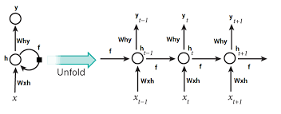
RECURRENT nEURAL nETWORKS
RNN are the state of the art algorithm for sequential data and are used by Apple's Siri and Google's voice search.

Slide 3
RNN
RNNs are Neural Network where the output from the previous step is fed as input to the current step. So RNN has two inputs: the present and the recent past, which allows them to be very precise in predicting what’s coming next.
It is the first algorithm that remembers its input, due to an internal memory.
LSTM vs RNN
simple RNNs have trouble “remembering” information learned earlier in the sequence.
A usual RNN has a short-term memory, only in combination with a LSTM they also have a long-term memory. LSTM includes a 'memory cell' that can maintain information in memory for long periods of time. This memory cell lets them learn longer-term dependencies. It consists of a set of gates used to control when an information enters the memory, how long and how much information may be kept, when it begins to decay or be forgotten and when it begins to provide output.
LSTMs deal with vanishing and exploding gradient problem

Slide 4
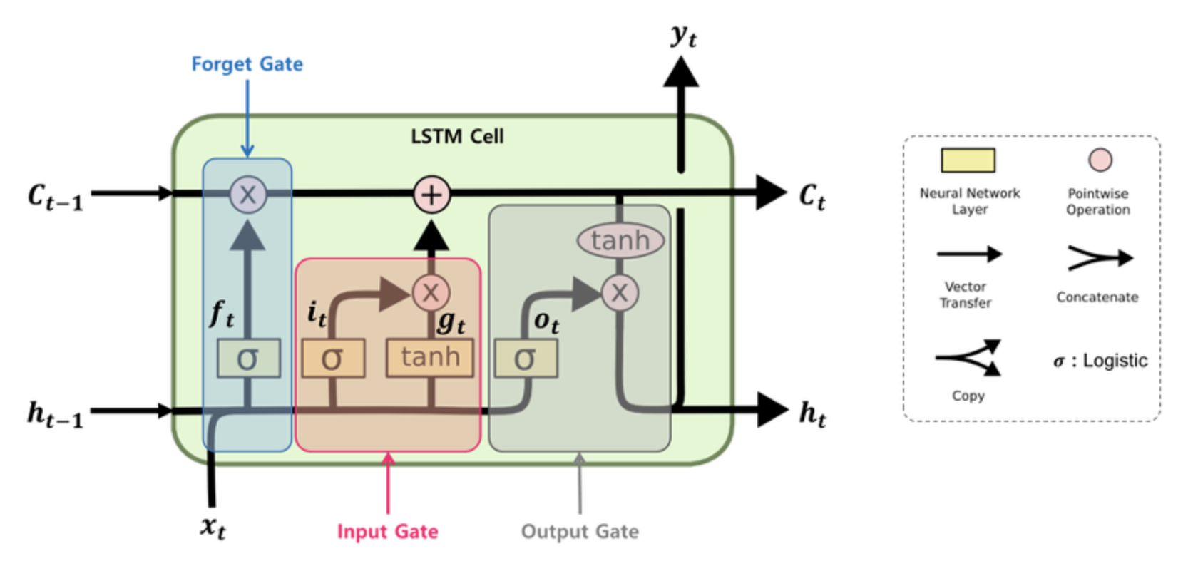
Long short-term memory networks are an extension for RNNs which basically extends the memory. This memory can be seen as a gated cell.
In an LSTM you have three gates: input, forget and output gate. These gates determine whether or not to let new input in (input gate), delete the information because it isn’t important (forget gate), or let it impact the output at the current timestep (output gate).
The assigning of importance happens through weights, which are also learned by the algorithm. This means that it learns over time what information is important and what is not.

Slide 5
In our multi-class classification problem we will learn the relationships among our words and then provide probabilities as to which word should be next in our sequence. The model can only provide probabilities for words it has seen. We have used n_gram sequences and Glove word embeddings to assist our model in learning the relationship between the words.
Report

Slide 6
First we install all the libraries we are going to need in our colab notebook. Mount the dataset, "80's detailed", a csv file downloaded from kaggle. The dataset contains song lyrics from 1980 decade. Then preprocess the dataset: Lowercased all letters in order to avoid duplicates. Removing numbers, punctuations, single characters, multiple spaces Extracting only "Lyrics" feature out of the dataset and Join the text into a series of strings. We tokenize our corpus to have a dictionary containing key/value pairs of the unique word and its assigned token based on word frequency. We have 2538 unique words in our dataset. .

Slide 7
We use n_grams to help us splitting our data to derive our labels. An n_gram is a sequence of words (n) sizes long. Next, iterate over each snippet to create n_grams. Since our model requires each input sequence of n_grams to be of the same length, we “pad” each n_gram sequence with zeros to the length of the longest n_gram We use word embeddings which enable us to represent words in a n_dimensional space where words with similar meaning have close representations and computer can understand it. We chose “Glove” pre-trained word embeddings model from Stanford university and produce a dictionary which contains the word/character as the key and a 50-dimensional array as the value. After that we create a matrix consisting of zeros x 50 dimensions of glove and iterate it over our unique words. “word_index” dictionary which contains the unique words “embeddings_index” = glove embeddings and create the embeddings_matrix

Slide 8
We build a model consisting of an embedding layer, two lstm layers, two dropout layers, and a fully connected dense layer. The first layer being the embedding layer will enable us to utilize the pre-trained glove word embeddings coefficients/weights. we will utilize a bidirectional Lstm which will learn the relationships among words reading the sentence from left-to-right and right-to-left. Finally, we’ll fit our model selecting 32 batch_size Train our model for 30 epochs where each epoch requires all n_grams to run through the model once. We’ll also apply an 80/20 split for training and validation data. Examine how well our model can generalize to given lyrics seeding the model with the first few words. Save the model
Plot loss and accuracy

Slide 9
FUTURE WORK Limited CPU didn’t allow us to see the model's full potentials. We could add more Lstm layers along with more data to improve the model. Moreover we could run more epochs to improve the model's accuracy

Slide 10
