Slide 1
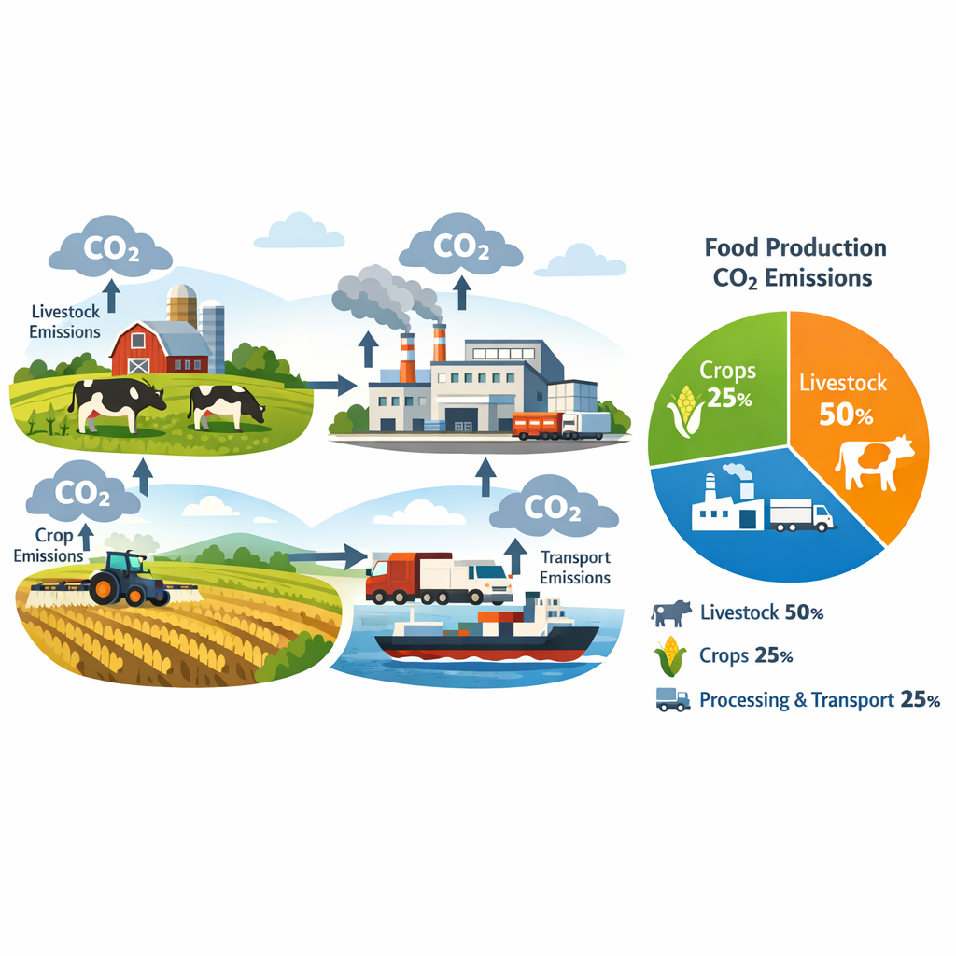
Food Production Impact on CO₂ Emissions
Big Blue Data Academy
Project 2
Aikaterini Lama

Slide 2
Source
https://www.kaggle.com/datasets/selfvivek/environment-impact-of-food-production
Subject
Study 43 most common foods grown across globe and how they contribute to greenhouse gas emissions
Data Information

Slide 3
Executive Summary
Important Key Takeaways
High impact on CO₂ emissions is derived from:
Meat and dairy products
Shrimps and oils (palm, soya etc.)
Animal based or high protein products
Farming production stage
Sustainability is affected from “Land Use Change”

Slide 4
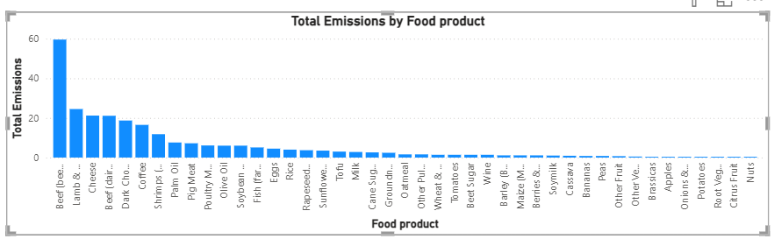
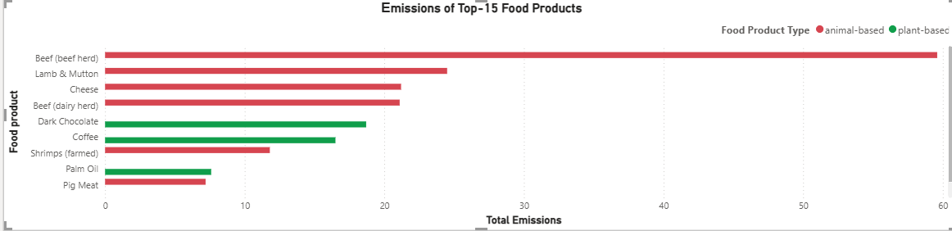
Total Emissions per Food Product
Which types of food have more negative impact on the environment?
Animal-Based Products vs Plant-Based Products

Slide 5
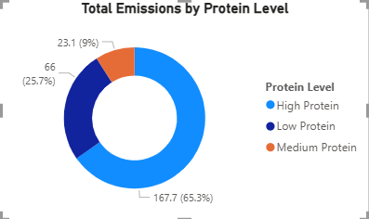
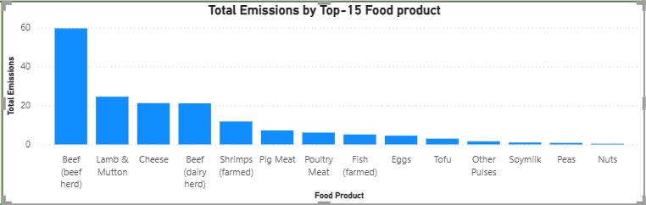
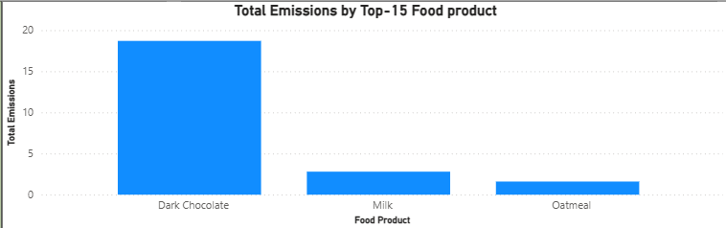
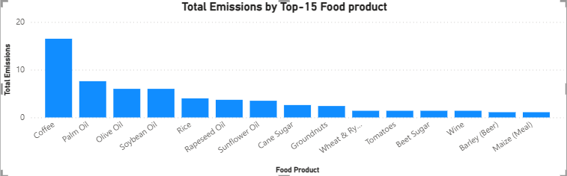
Carbon Footprint Comparison of High Protein vs Low Protein Foods?
High Protein Products
Medium Protein Products
Low Protein Products

Slide 6
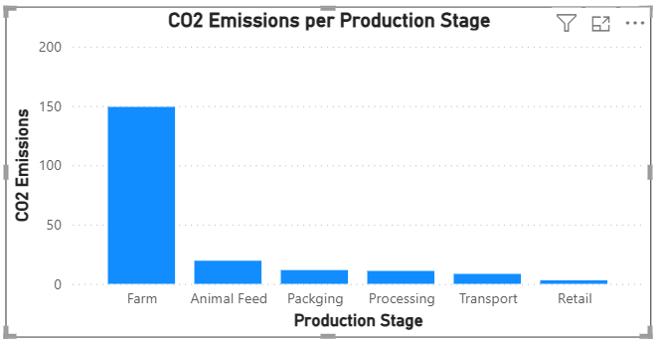
Food Production Stages vs Greenhouse Gas Emission on Food Level
Which stage of food production contributes more to the greenhouse gas emission?

Slide 7
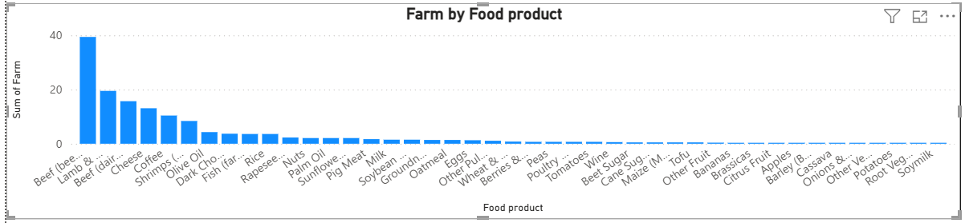
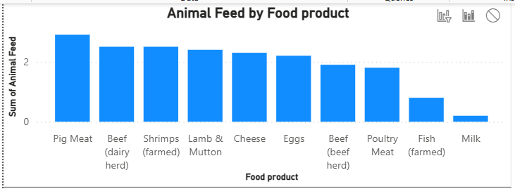
Food Production Stages per Product

Slide 8
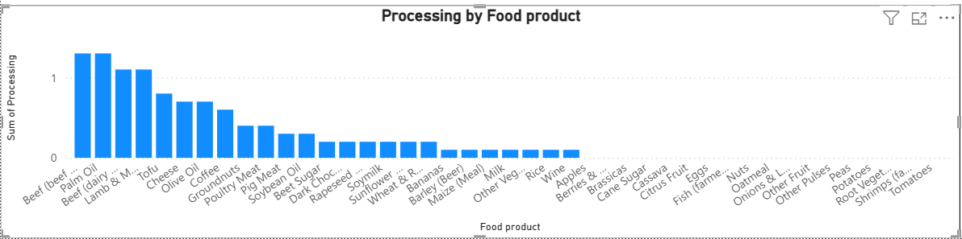
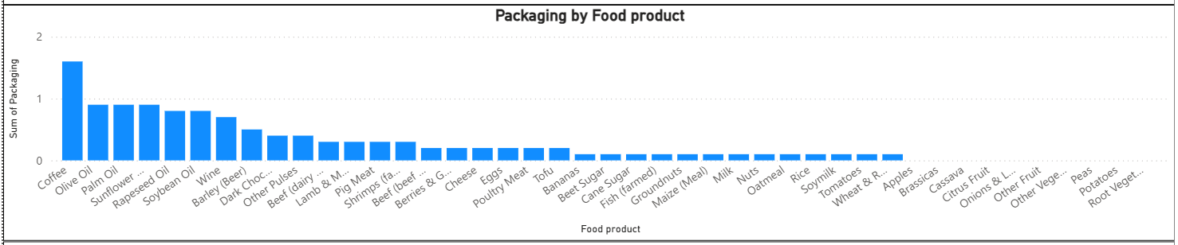
Food Production Stages per Product

Slide 9
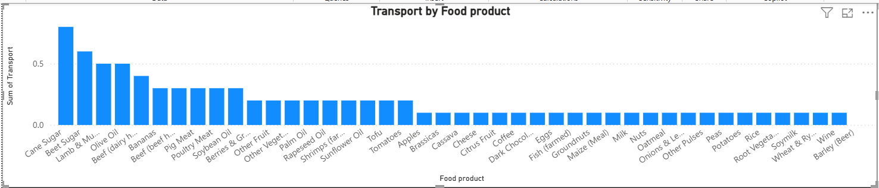
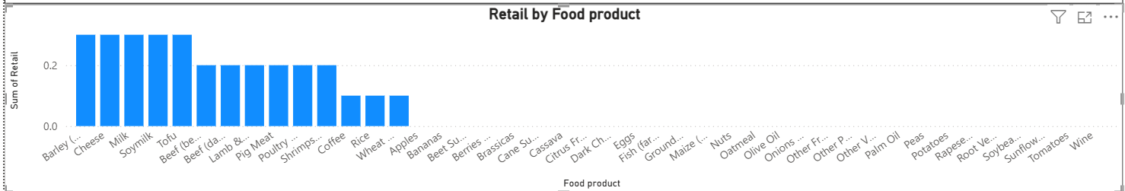
Food Production Stages per Product

Slide 10
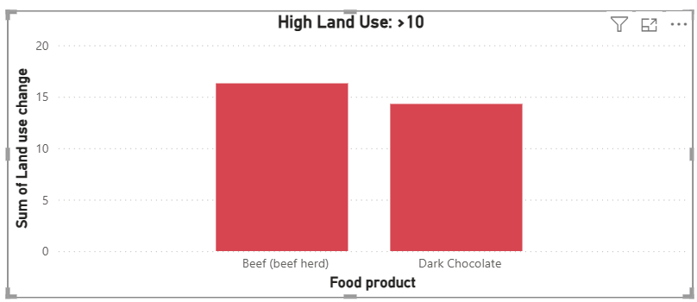
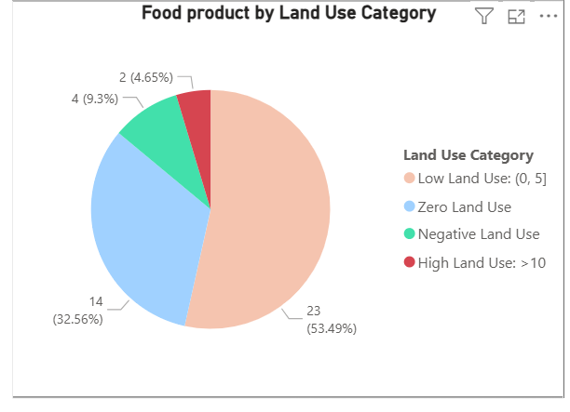
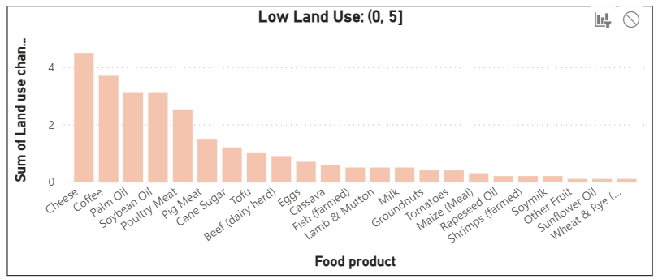
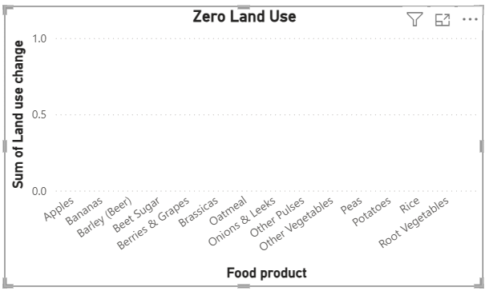
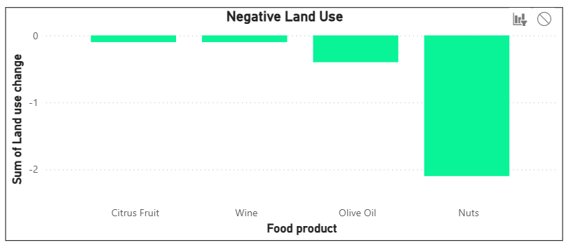
Food Product vs Land Use Change
What types of food production should be
encouraged to consume nutritious diet in
a sustainable way?
How food production affects the land use?

Slide 11
