Slide 1
Exploring the relationship between genetics and language acquisition
Katerina Spantidaki
Supervisors: Danielle Admiraal & Else Eising

Slide 2
Language Acquisition Phenotypes (Lifelines variables)
Main phenotypes
Multilingualism (speak + understand >= 7 → fluent).
Foreign speech mimicking ability.
Foreign language learning ability.
Foreign accents understanding ability.
Additional questions to answer with the main phenotypes
Educational attainment.
Type of situation of multiple language usage (home, work, social club, etc).
Type of people of multiple language usage (speaking with family, friends, etc.).
Age of acquisition (AoA) of a language.
To filter for non-cognitively impaired individuals
The Mini Mental State Examination (MMSE) is a brief cognition test used to assess cognitive impairments. It is commonly used in medicine and allied health to screen for dementia.

Slide 3
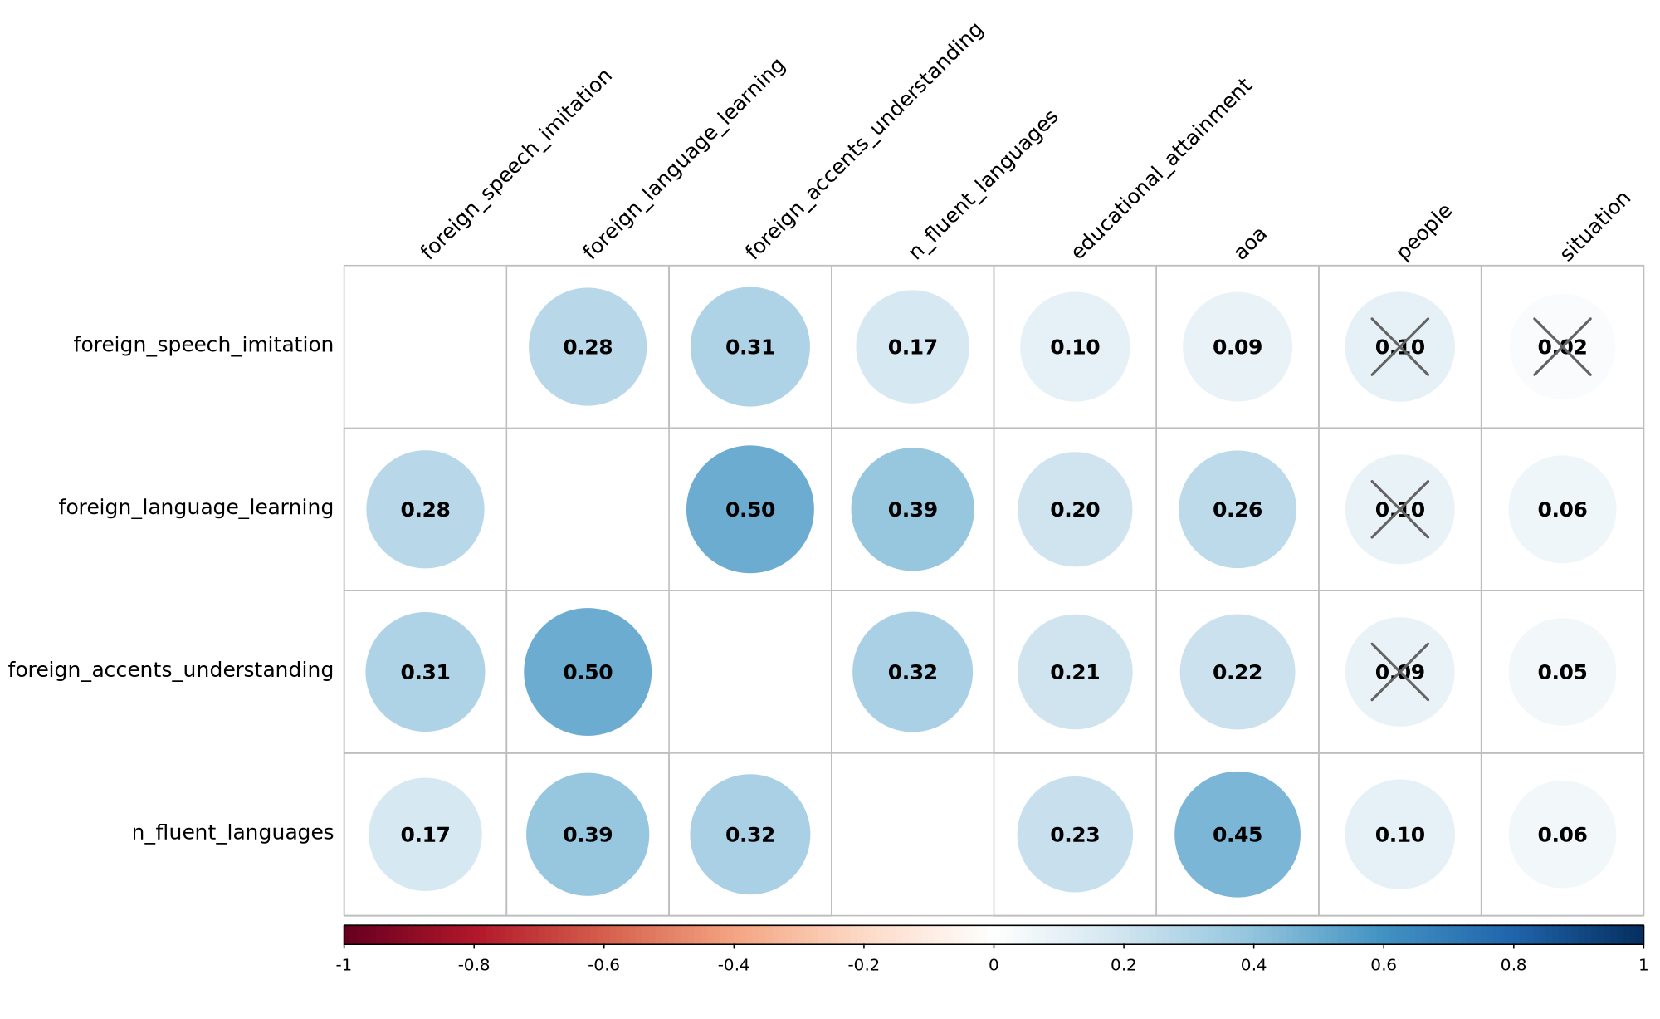
Main Phenotypes and Additional Questions Correlations

Slide 4
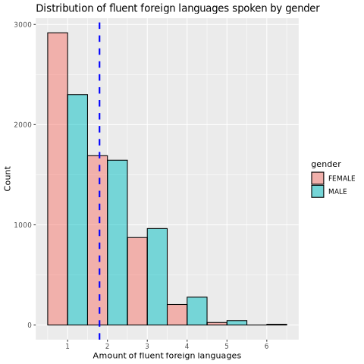
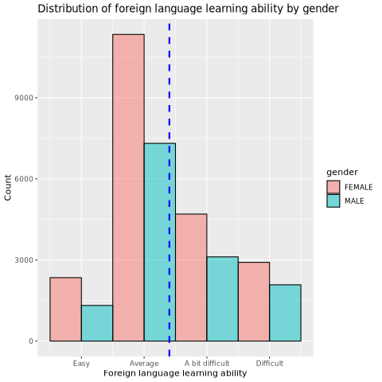
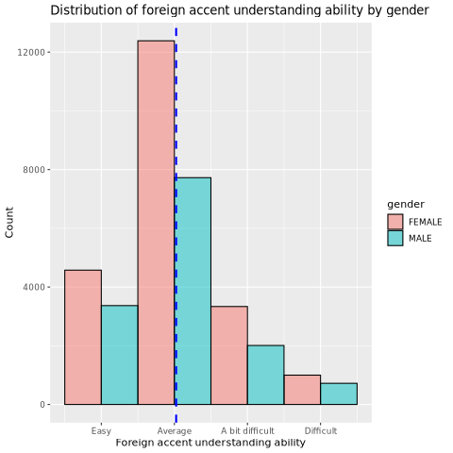
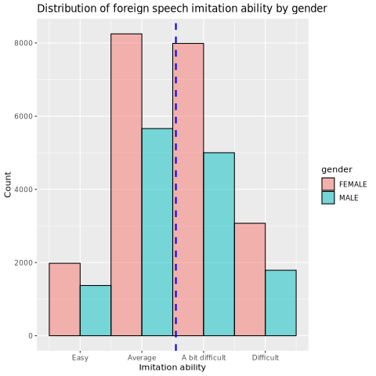
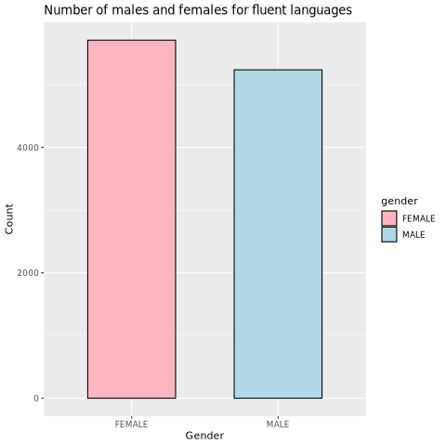
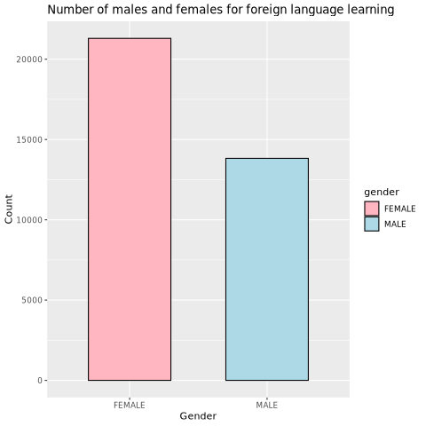
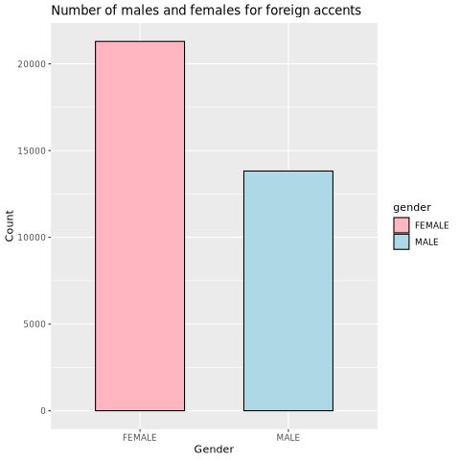
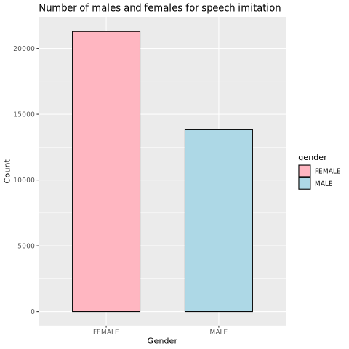
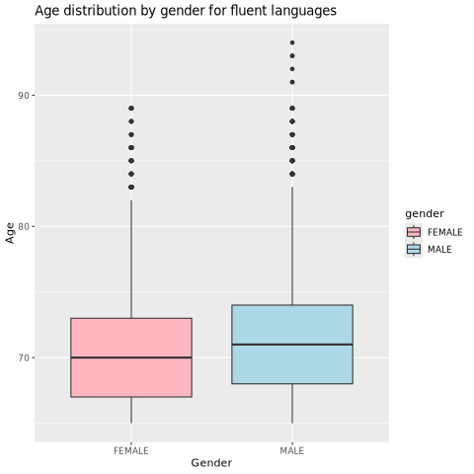
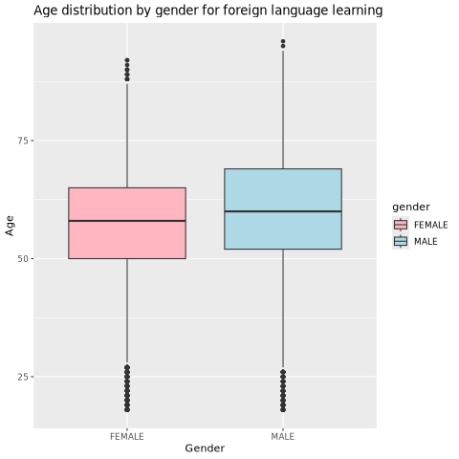
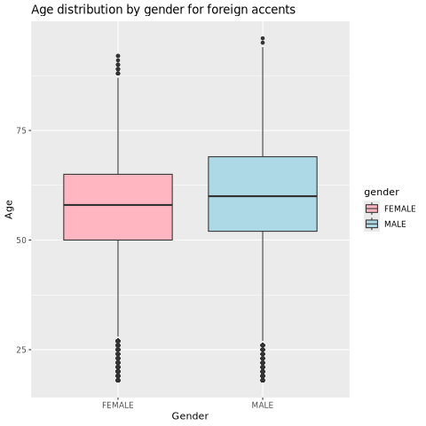


Slide 5
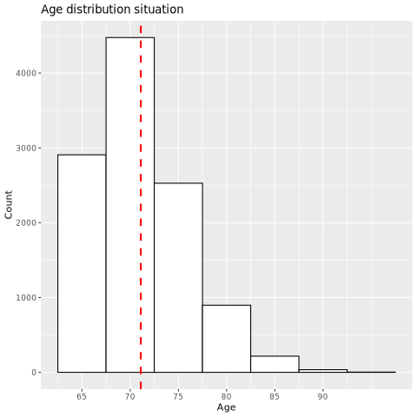
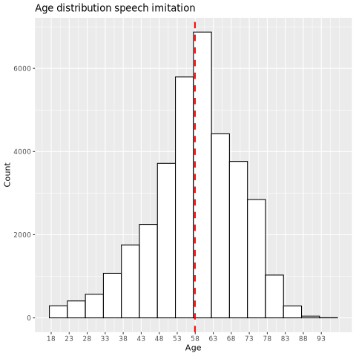
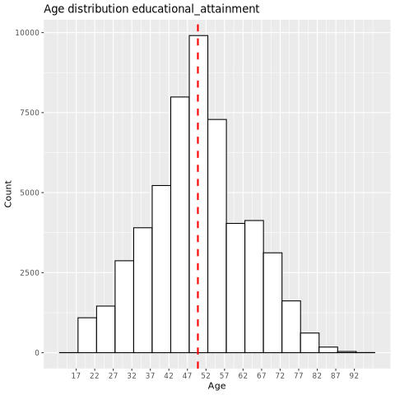
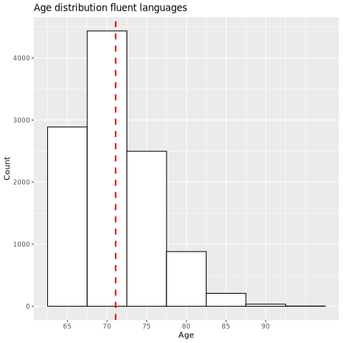
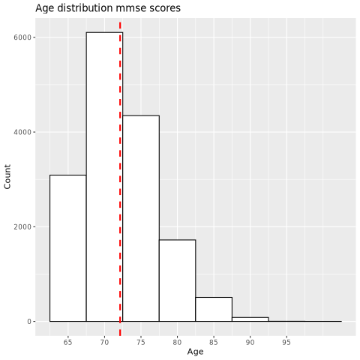
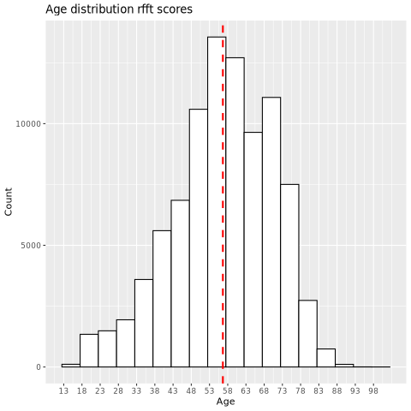
11059
35113
53466
10947
15857
89599

