Slide 1
Exploring the relationship between genetics and languages
Meeting No.2
Katerina Spantidaki
Supervisors: Danielle Admiraal & Else Eising

Slide 2
Lifelines variables
Main phenotypes
Multilingualism (score).
Foreign speech mimicking ability.
Foreign language learning ability.
Foreign accents understanding ability.
Additional phenotypes
Does the 'type of situation' in which you use multiple languages contribute to the number of languages you speak? (home, work, social club, etc)
What is the influence of various social circles on language ability? (speaking with family, friends, etc.)
Does the age of acquisition (AoA) strongly influence the number of languages you speak? (cut-off 12 years -> educational system starts providing language learning)
What is the relationship across educational attainment and the number of languages spoken?
What is the relationship across executive cognitive functioning and the number of languages spoken? (The RFFT is a measure of nonverbal fluency, a parameter of executive cognitive functioning. The RFFT consists of five parts, each presenting a different stimulus pattern of dots, in which the task is to draw as many unique designs as possible within a set time period.)
To filter for non-cognitively impaired individuals
The Mini Mental State Examination (MMSE) is a brief cognition test used to assess cognitive impairments. It is commonly used in medicine and allied health to screen for dementia.

Slide 3
Lifelines variables
Additional phenotypes to explain even further multilingualism
Do you currently still use multiple languages in your daily life?
At what age did you stop using multiple languages? / do you currently still use multiple languages in your daily life?
How often do you currently use multiple languages or have you used multiple languages in the past?
Do you view your own bilingualism as something positive and why?
Do you often switch between the languages that you speak?
Where and how did you learn this language?
How much time do you spend per week playing games with other online users (e.g. wow, lol, call of duty) (this does not include small-scale games)?

Slide 4
Lifelines variables
Question we want to answer
What is the influence of the living environment on language ability?
Questions available to answer that
What is the best description of the place where you lived most of the time when you were younger than 5 years old?
What is the best description of the place where you currently live?
How many times have you moved house in your life, including the period that you lived with your parents?
→ These only define momental situations, not situations over a long range of time. Thus, we think these are not representative for the question we want to answer. So, we don't think we should include them.

Slide 5
Initial steps workflow
QC the data
Define multilingualism
Measure phenotypic variance
Measure the captured genetic effect
Measure the genetic effect

Slide 6
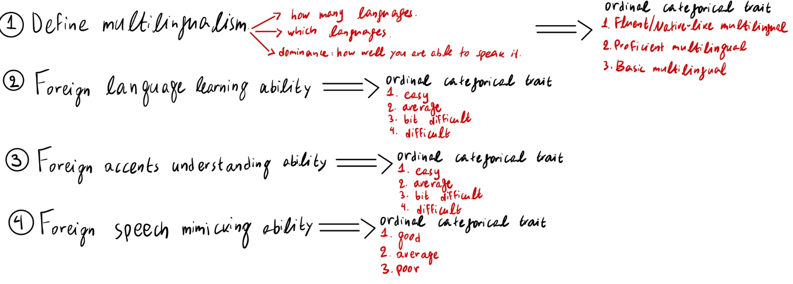
1. Clarify the four main traits that we will focus on

Slide 7
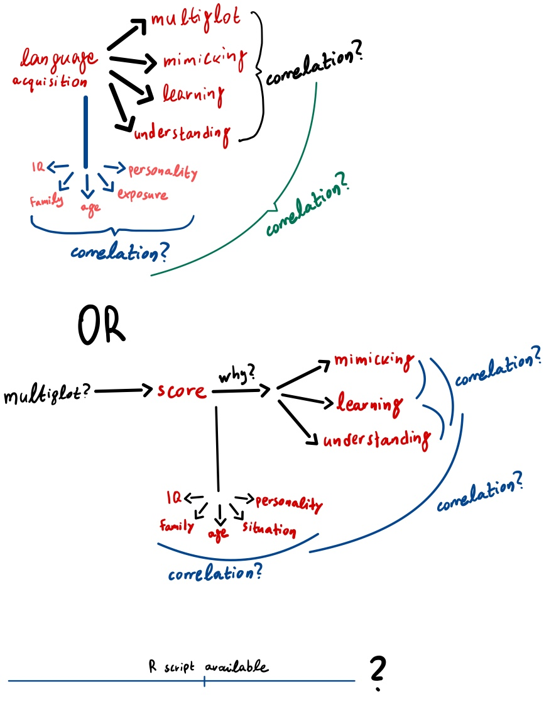
2. Measure Phenotypic variance

Slide 8
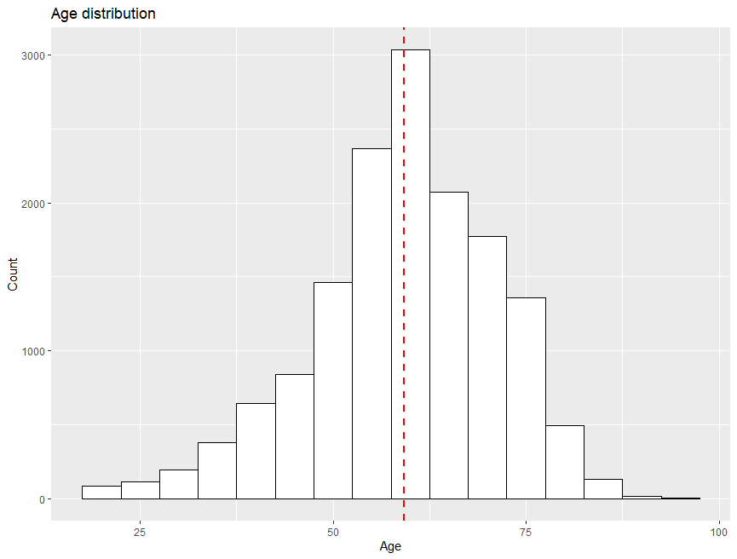
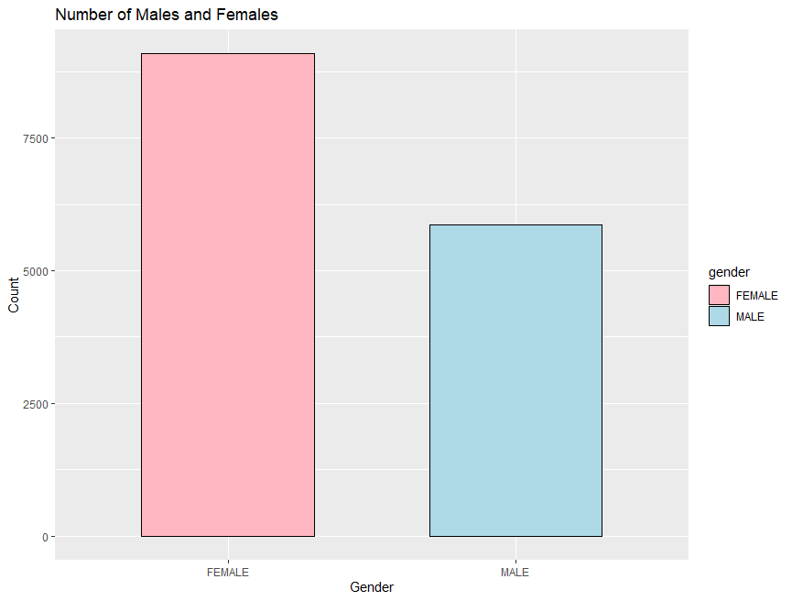
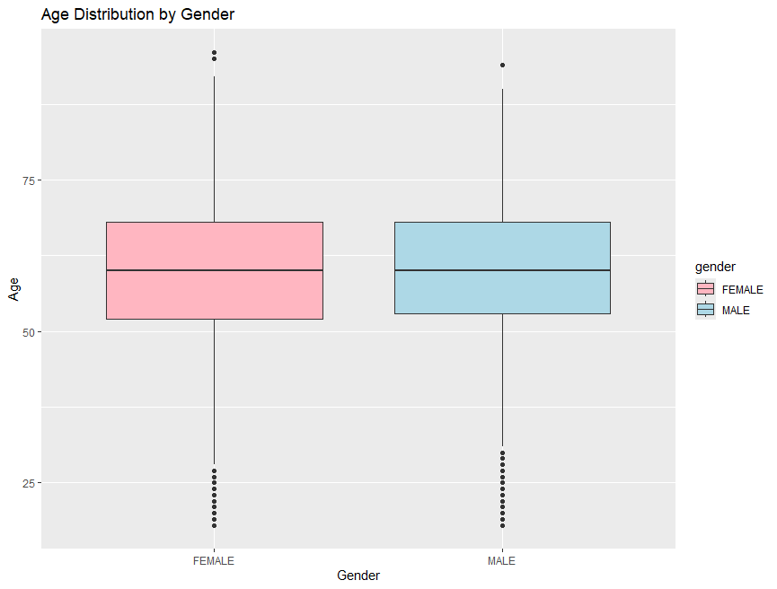
Age/Gender Distribution Plots

Slide 9
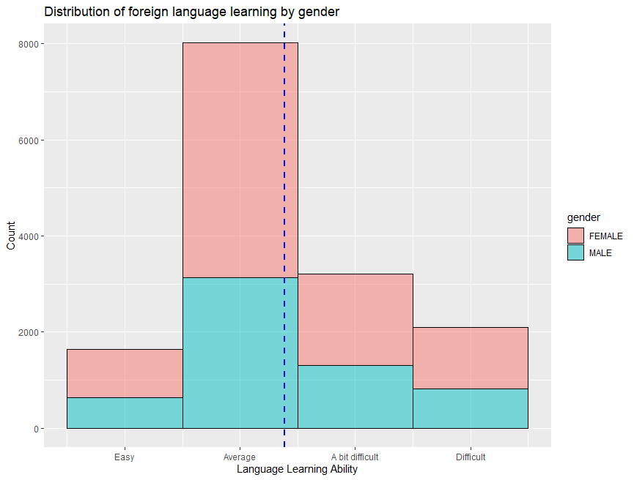
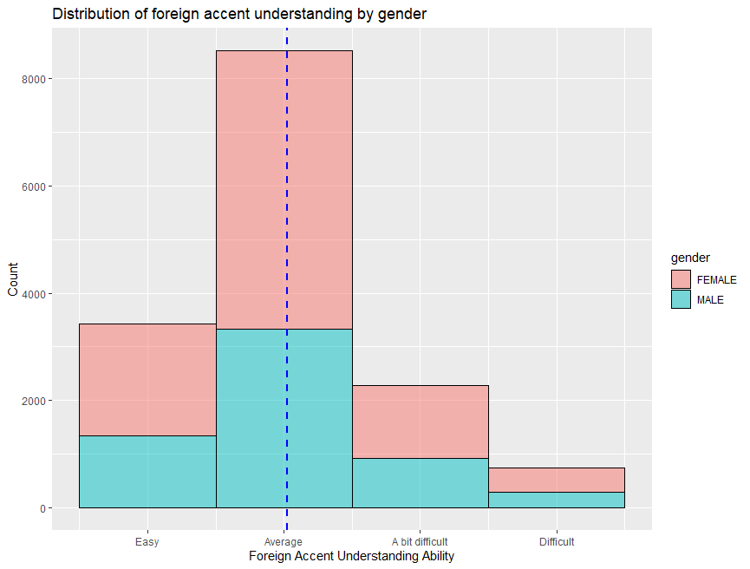
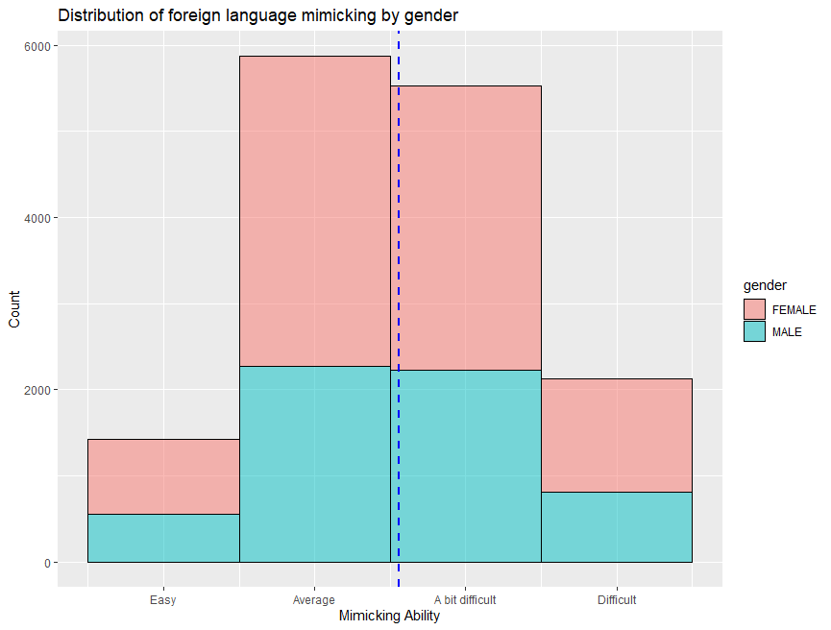
Language Acquisition Abilities Distribution Plots

Slide 10
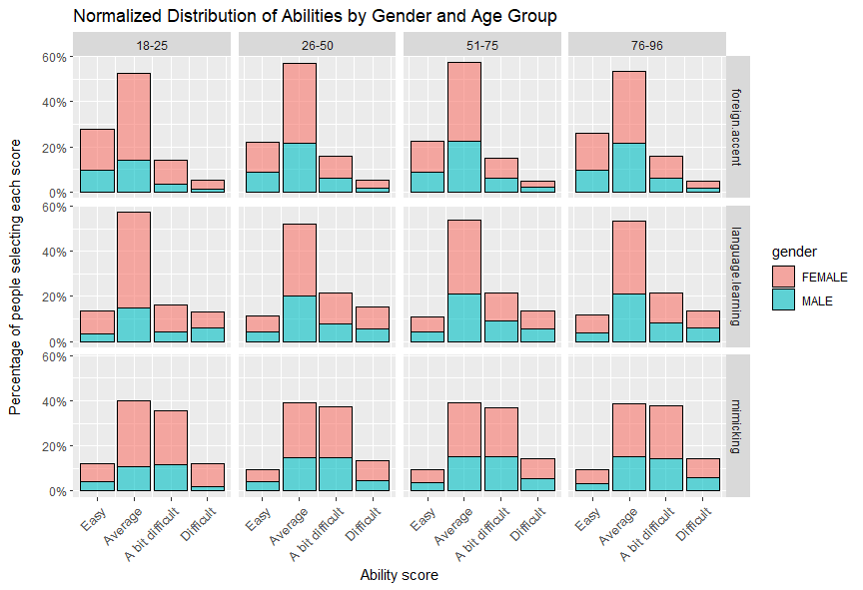
Language Acquisition Abilities Distribution Plots Grouped by Age and Gender

Slide 11
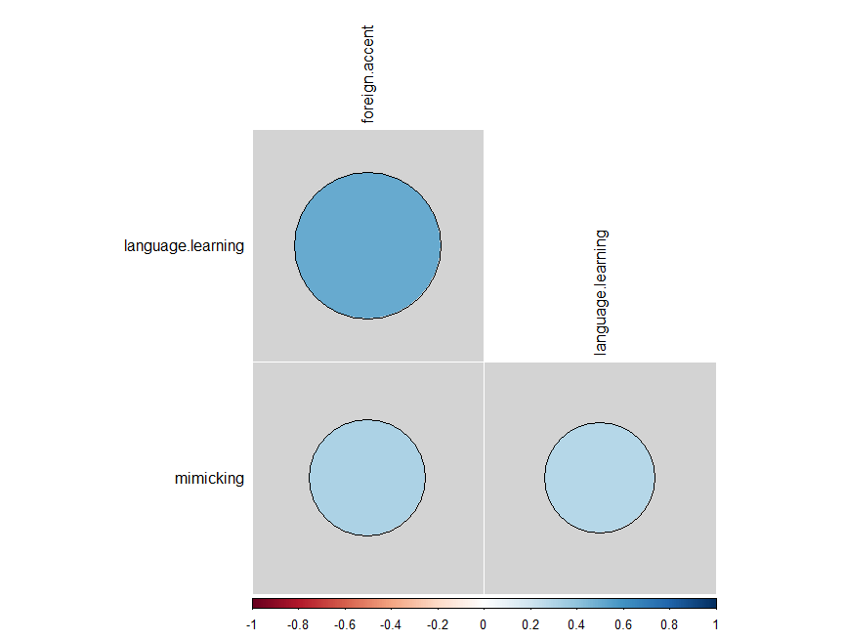
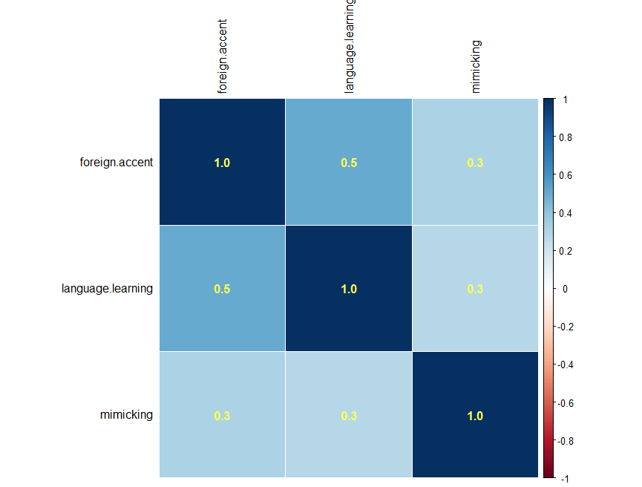
Language Acquisition Abilities Correlation Plots

Slide 12
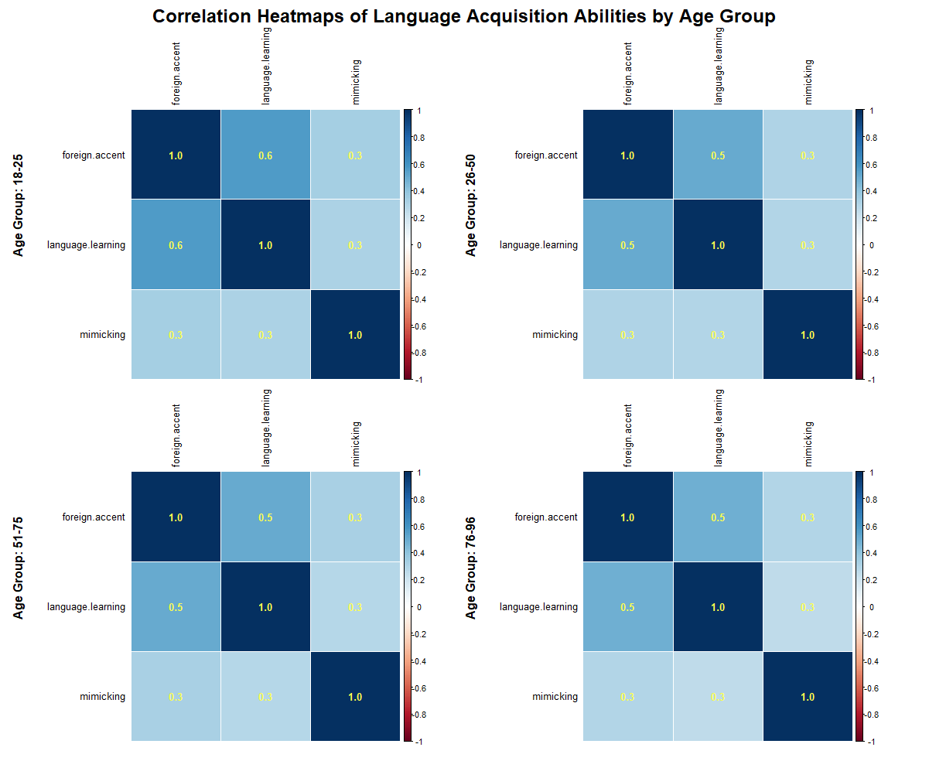
Language Acquisition Abilities Correlation Plots by Age Group

Slide 13
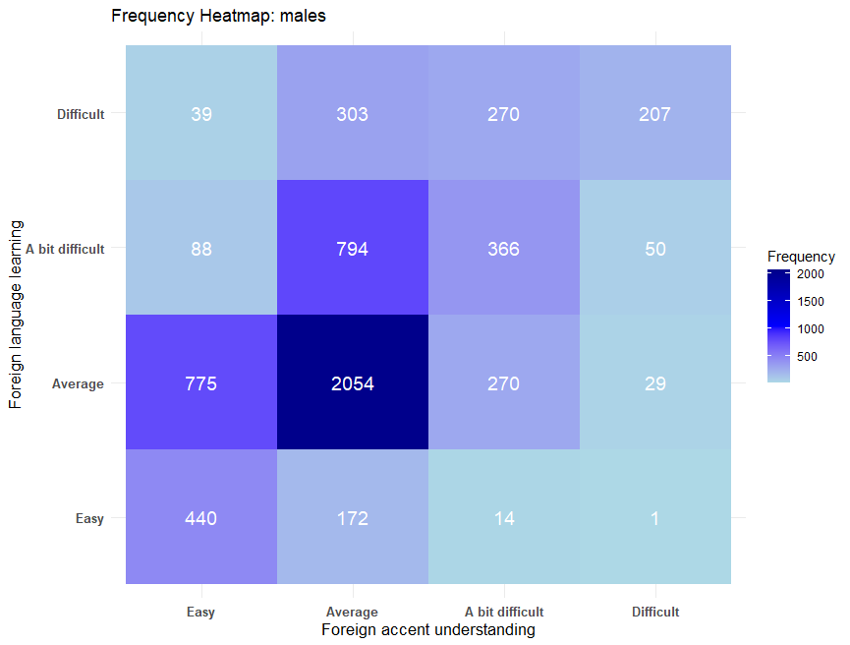
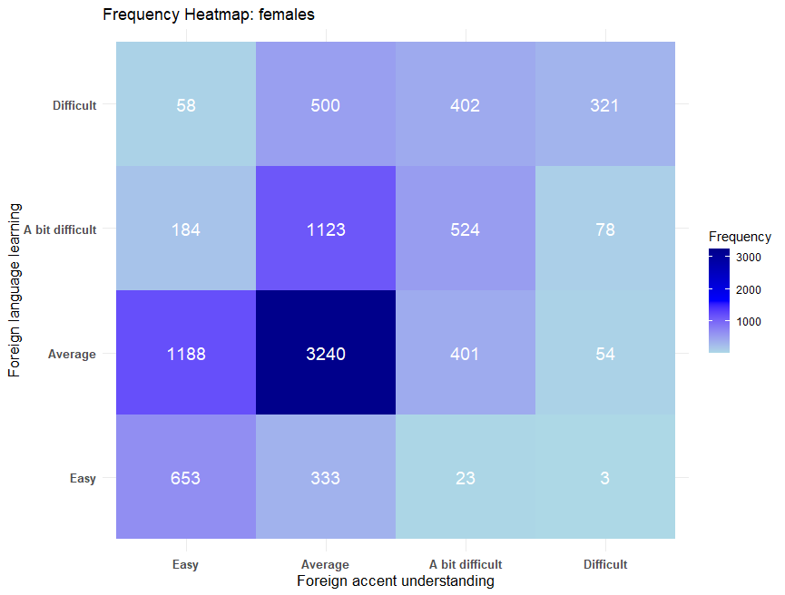
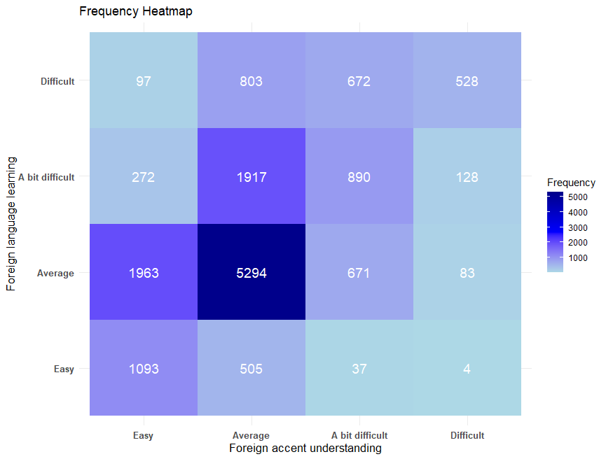
Frequency heatmaps for the two highly correlated abilities

Slide 14
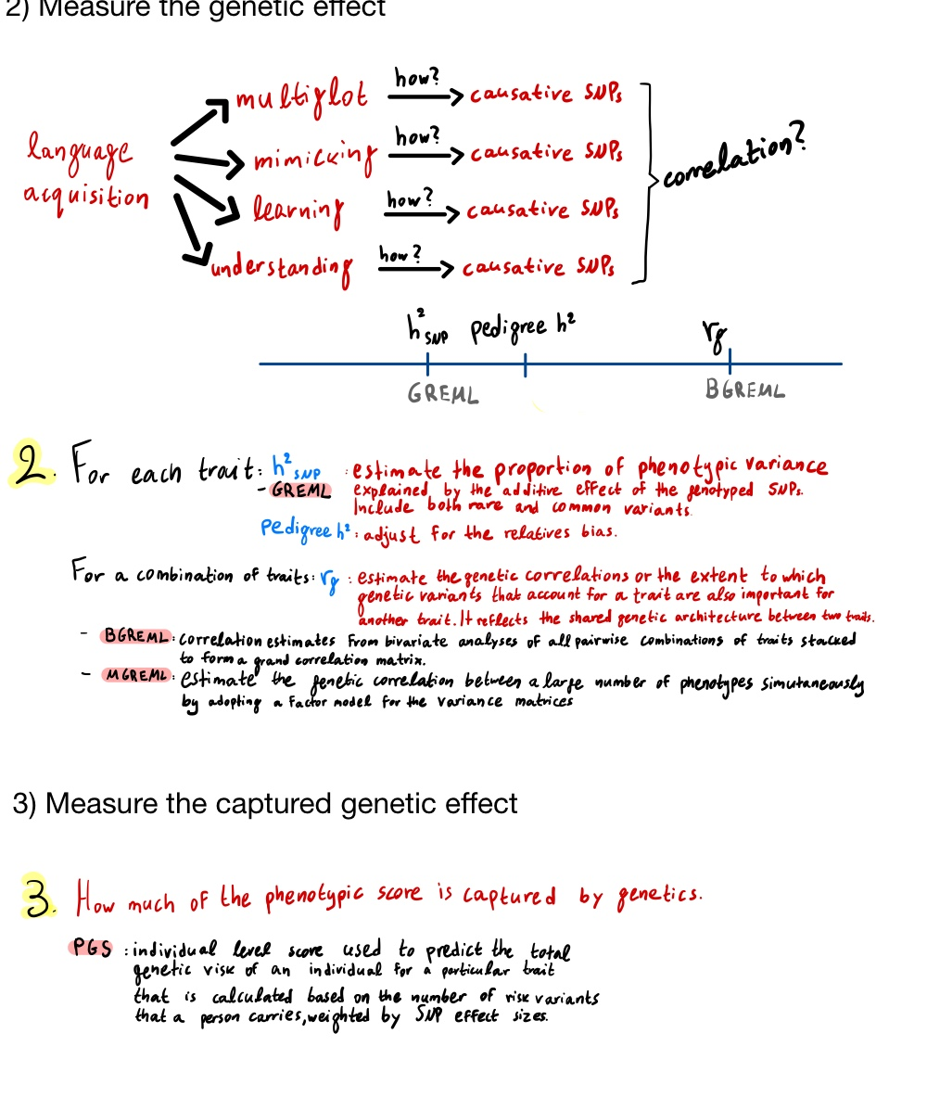
3. Measure the genetic effect

Slide 15

4. Measure the captured genetic effect

