Slide 1
Exploring the relationship between genetics and language acquisition
Katerina Spantidaki
Supervisors: Danielle Admiraal & Else Eising

Slide 2
Language Acquisition Phenotypes (Lifelines variables)
Main phenotypes
Multilingualism (speak + understand >= 7 → fluent).
Foreign speech mimicking ability.
Foreign language learning ability.
Foreign accents understanding ability.
Additional questions to answer with the main phenotypes
Educational attainment.
Type of situation of multiple language usage (home, work, social club, etc).
Type of people of multiple language usage (speaking with family, friends, etc.).
Age of acquisition (AoA) of a language.
To filter for non-cognitively impaired individuals
The Mini Mental State Examination (MMSE) is a brief cognition test used to assess cognitive impairments. It is commonly used in medicine and allied health to screen for dementia.

Slide 3
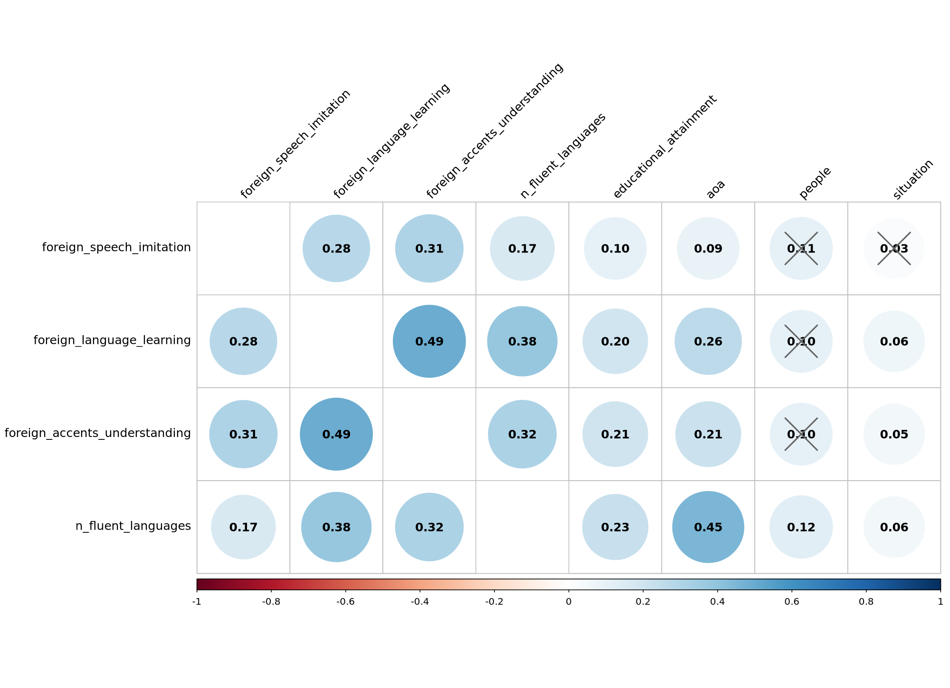
Main Phenotypes and Additional Questions Correlations

Slide 4
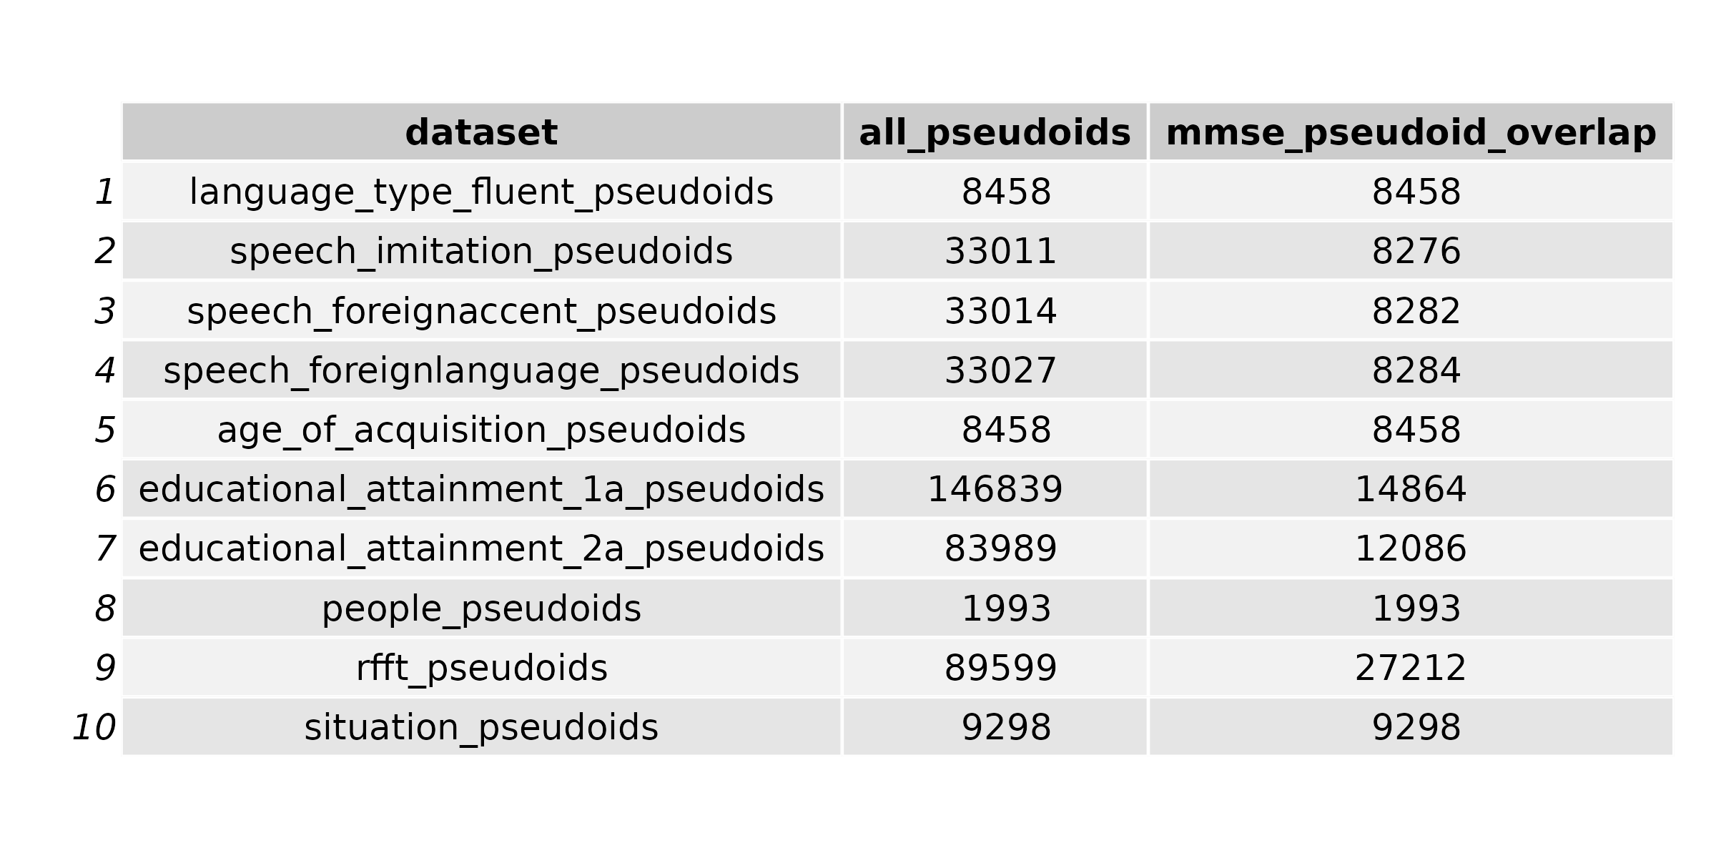
Overlapping table of mmse pseudoIDs and the rest of the traits pseudoIDs

Slide 5
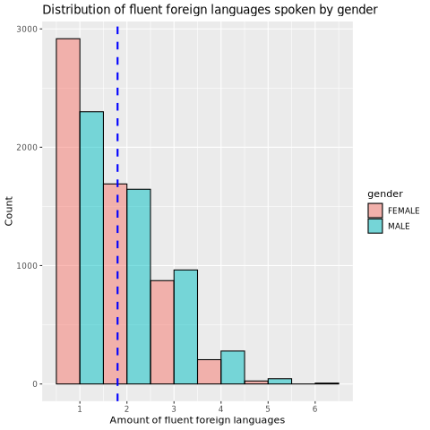
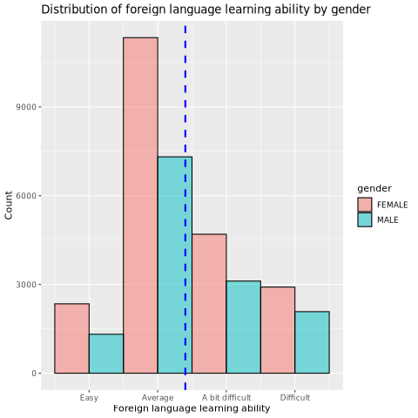
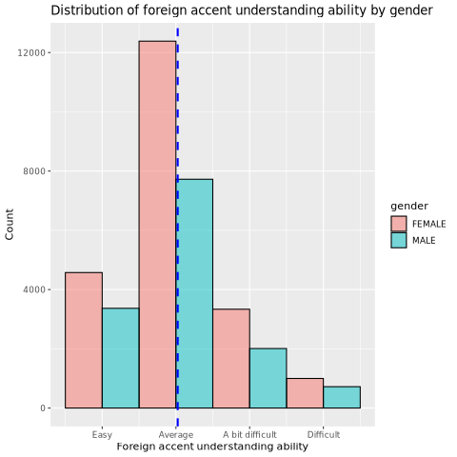
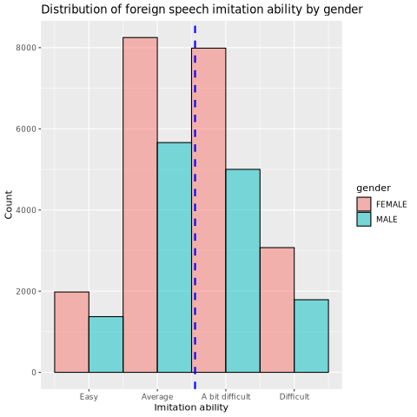
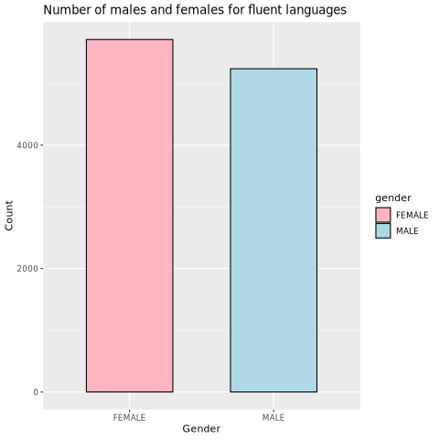
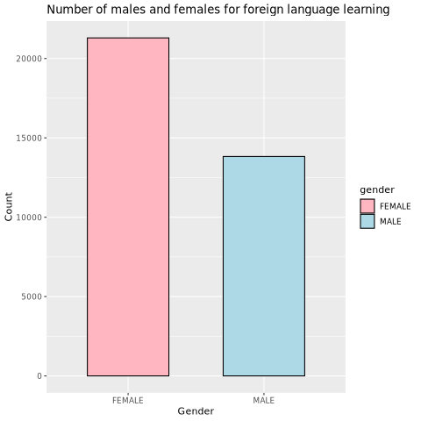
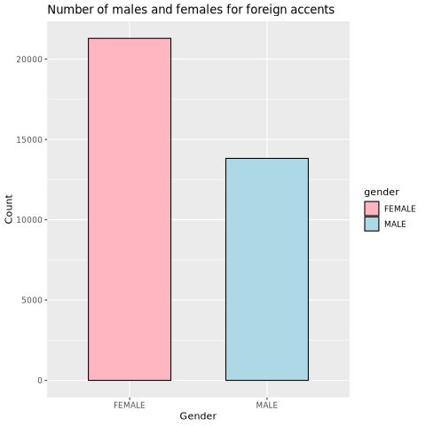
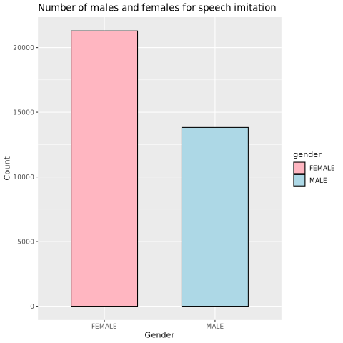
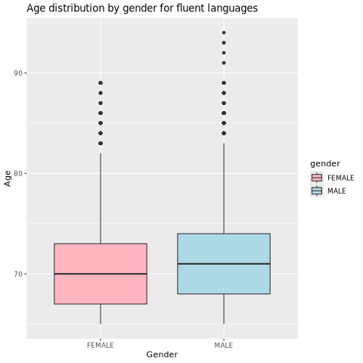
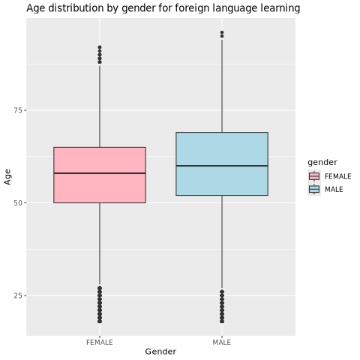
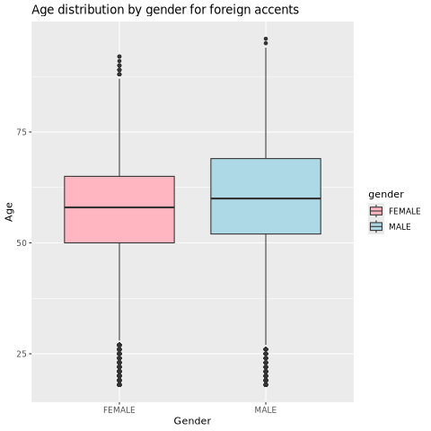


Slide 6
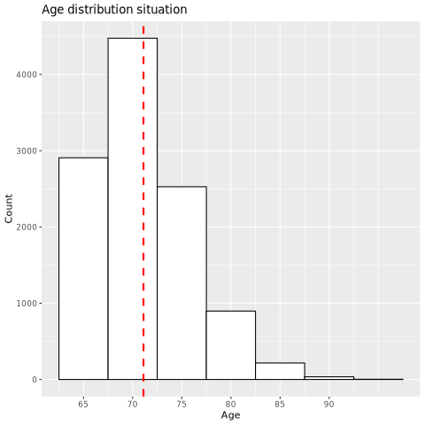
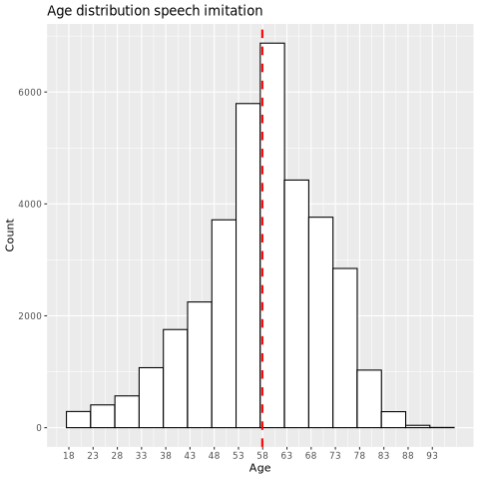
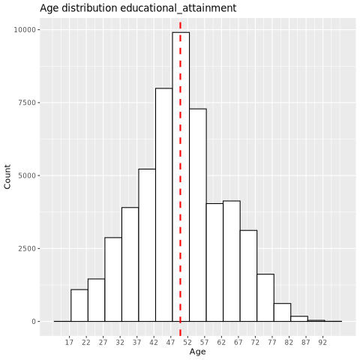
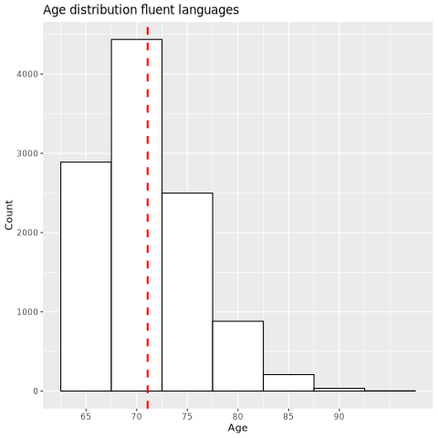
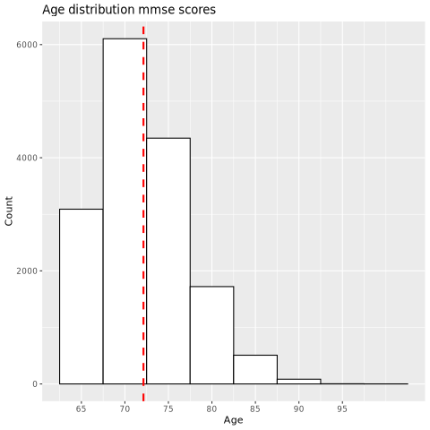
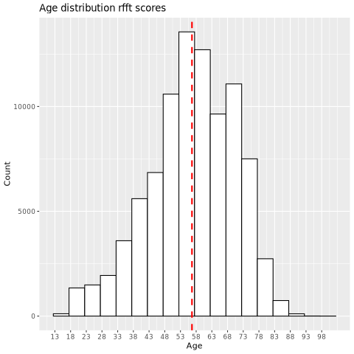
11059
35113
53466
10947
15857
89599

Slide 7
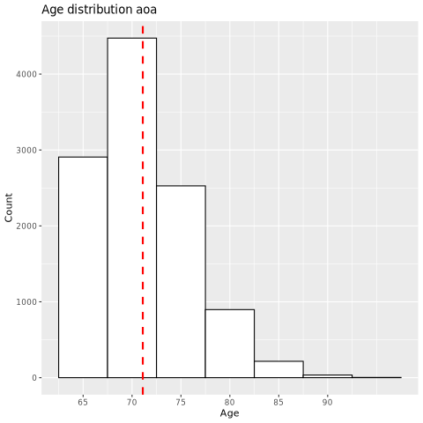

Slide 8
10947 people had fluent scores (7 and above) in both language understand and language speak columns for at least one language.
16 participants had more than 6 fluent languages. These were excluded.

Slide 9
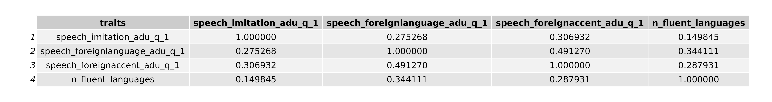
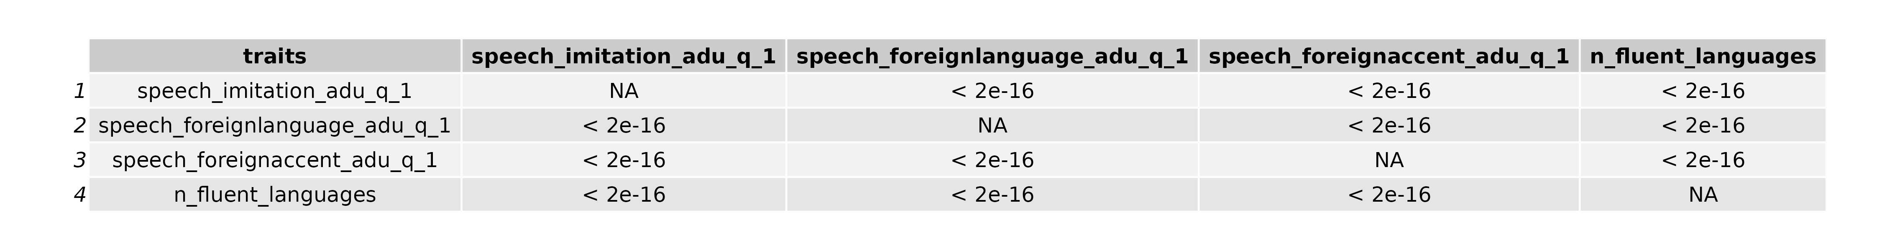
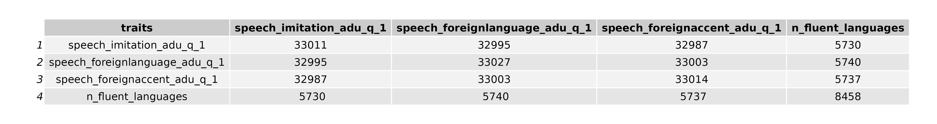
Correlation matrix • P-values • Number of overlapping pseudoIDs.

Slide 10
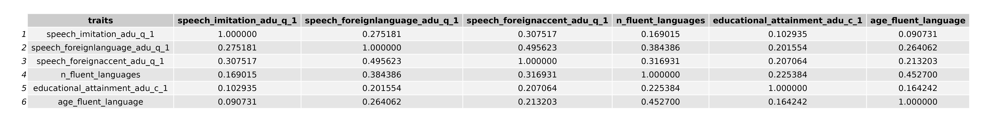
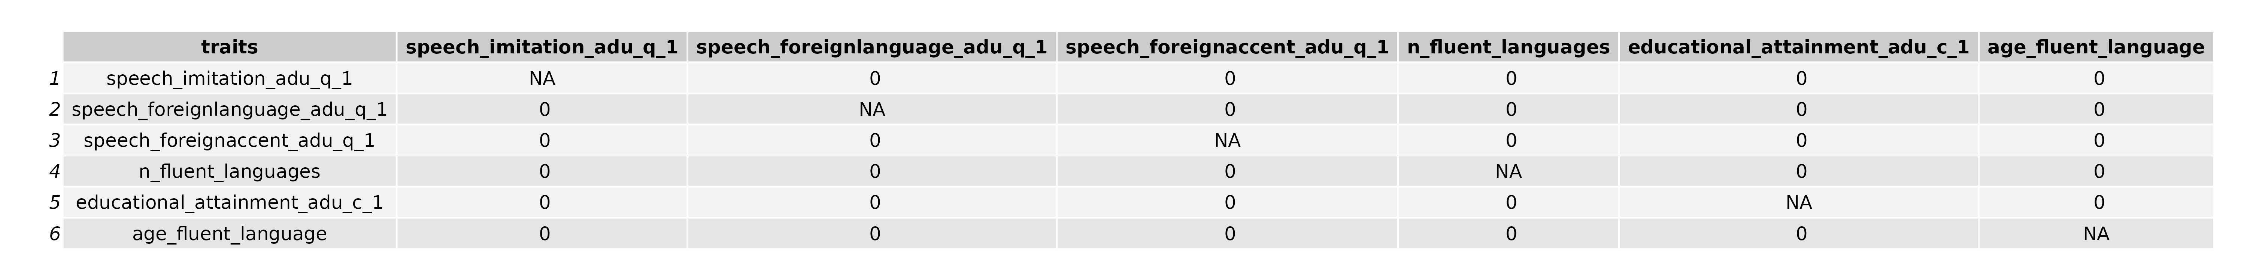
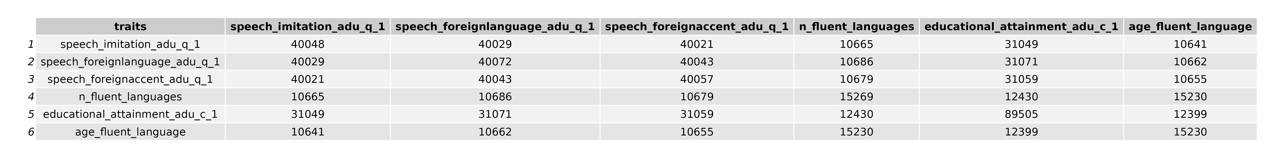

Slide 11
When did you acquire a new language?
--> Do people acquire a new language when they are younger or when they are older?
--> Does that correlate with their language skills? So are they acquiring a language better if they acquire it earlier/later in life?

Slide 12


Situation of multiple languages usage.
People with who multiple languages are being used.

