Slide 1
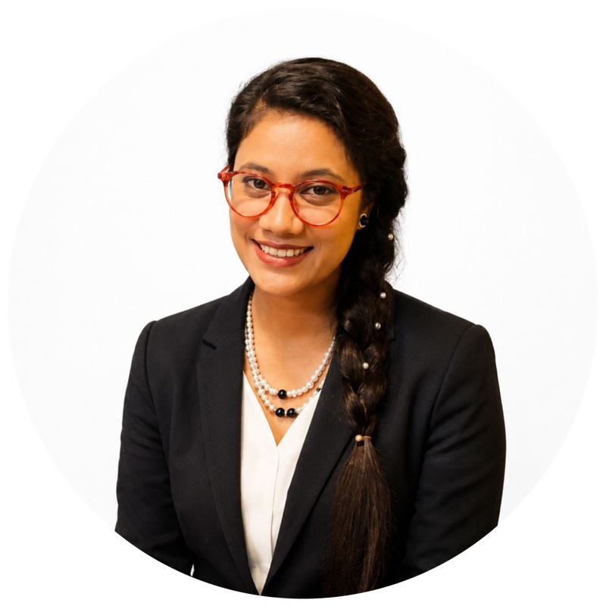
CV Writing for Freshers & Job Seekers
Write a CV that gets you shortlisted
Speaker: Jannatul Ferdous Katha
SQA Engineer, ADN Diginet Ltd. (Deployed at MetLife Bangladesh)
Online Session · Organized by BugBoundQA.com
Notes:
Welcome everyone. Introduce the session: practical, fresher-focused CV writing. Thank BugBoundQA.com for organizing.

Slide 2



About the Speaker
Jannatul Ferdous Katha
SQA Engineer, ADN Diginet Ltd.
Deployed at MetLife Bangladesh
Manual and automation testing (Playwright)
Notes:
Short personal intro: current role, deployment at MetLife Bangladesh, and why CVs matter from the QA hiring side.

Slide 3
Today's Agenda
1
Why your CV matters
5
Writing strong bullet points
2
CV vs Resume vs Biodata
6
Beating ATS filters
3
The ideal fresher CV structure
7
Common mistakes to avoid
4
Header, summary and skills
8
Final checklist and Q&A

Slide 4



Your CV Has Seconds to Make an Impression
7.4 sec
1 page
1 CV : 1 job
Average time a recruiter spends on a first scan of a CV*
Ideal length for a fresher. Two pages only with real experience
Tailor your CV for every application, never mass-send one copy
*Ladders eye-tracking study (2018)
Notes:
Recruiters skim before they read. The first third of page one decides whether they keep reading.

Slide 5
CV vs Resume vs Biodata
Resume
CV
Biodata
Length
1 to 2 pages
Contains
Focused on skills and results for one specific job
Used for
Most private-sector and IT jobs
Length
2+ pages
Contains
Full academic and professional history, publications, research
Used for
Academia, research, higher studies, some abroad roles
Length
1 to 2 pages
Contains
Personal details: date of birth, family, religion, address
Used for
Some government jobs and matrimony. Not for IT jobs
Notes:
In Bangladesh people say 'CV' but most IT companies actually want a resume. Never send a biodata for a software job.

Slide 6
Building Your CV, Section by Section
Structure, header, summary, skills, projects and education

Slide 7
The Ideal Fresher CV Structure
01
02
03
04
Header
Summary
Skills
Projects
Name, phone, email, LinkedIn, GitHub, city
2 to 3 lines: who you are and what you offer
Grouped technical skills, tools, soft skills
Your strongest proof as a fresher
05
06
07
08
Experience
Education
Certifications
Extras
Internships, part-time, freelance, volunteering
Degree, institution, year, CGPA if good
ISTQB, online courses, trainings
Awards, contests, clubs, languages
Notes:
Order matters: put your strongest evidence near the top. For freshers, projects usually beat experience.

Slide 8


The Header: Make It Easy to Contact You
Do include
Leave out
Full name in a larger font
One phone number you always answer
Professional email: firstname.lastname@gmail.com
LinkedIn and GitHub / portfolio links
City only (e.g. Dhaka, Bangladesh)
Funny emails like cutebaby123@...
Father's / mother's name, religion, NID
Marital status, height, weight, blood group
Full home address with house number
Photo, unless the job post asks for one
Notes:
Personal details like religion or family names add no value for an IT job and can invite bias. Keep the header to contact information.

Slide 9
From Generic Objective to Strong Summary
Weak
Strong
“Seeking a challenging position in a reputed organization where I can utilize my skills and grow with the company.”
“CSE graduate and ISTQB CTFL-certified QA enthusiast. Wrote 150+ test cases and automated 40 UI tests with Playwright across 3 academic projects. Looking to join a product team as a Junior SQA Engineer.”
Generic, about you, could be anyone
Specific, proven, aimed at the role
Notes:
Formula: who you are + proof (numbers, tools, certifications) + the role you want. Keep it to 2 to 3 lines.

Slide 10
Skills: Group Them, Don't Dump Them
Testing Skills
Tools & Tech
Soft Skills
Manual testing
Test case design
JIRA
Postman
Communication
Attention to detail
Bug reporting
API testing
Playwright
Selenium
Teamwork
Time management
Regression testing
SDLC / STLC
SQL
Git & GitHub
Problem solving
Curiosity
Tip: list only skills you can discuss in an interview. Every skill on your CV is a possible interview question.
Notes:
Example is for an SQA fresher; swap groups for your own field. Avoid skill bars and percentages: '80% Java' means nothing to a recruiter.

Slide 11

Write Bullet Points That Prove Impact
Action verb
+
What you did
+
Tool / method
+
Result + number
Before
Did testing of the university website.
After
Executed 120 manual test cases on the university portal and reported 35 bugs in JIRA, 8 of them critical.
Before
Worked on automation.
After
Automated 40 login and checkout scenarios with Playwright, cutting regression time from 3 hours to 20 minutes.
Notes:
Useful verbs: designed, executed, automated, reported, reduced, improved, built, led. No numbers? Use scope: how many test cases, users, modules, bugs.

Slide 12




No Experience? Show Proof Instead
Academic projects
GitHub portfolio
Crowdtesting
Final-year and course projects, with your role and the tech used
Test automation repos with a clear README
Bugs found on uTest, Test IO or bug bounty programs
Internships
Volunteering
Contests
Even short or unpaid ones count as real experience
Club, event or community work shows teamwork and ownership
Hackathons, programming contests, QA challenges
Notes:
For each project, write: name, one-line description, your role, tools, and a measurable outcome. Link the repo or live demo.

Slide 13




Education, Certifications and Extras
Education
Degree, institution, passing year. Add CGPA if it is 3.00+ (or mention it if the job asks). Skip SSC/HSC details once you have a degree, or keep them to one line.
Certifications
ISTQB CTFL, recognised online courses (Coursera, Udemy), bootcamps. Put the issuer and year; link a credential ID if you have one.
Achievements
Scholarships, dean's list, contest ranks, published papers. Quantify where you can: “Top 10 of 250 teams”.
Online presence
A LinkedIn profile that matches your CV, plus GitHub or a portfolio. Recruiters check both.

Slide 14
Getting Past the Screen
ATS-friendly formatting, tailoring and common mistakes

Slide 15

Make Your CV ATS-Friendly
An Applicant Tracking System (ATS) reads your CV before a human does. If it can't parse it, nobody sees it.
Do
Avoid
Simple single-column layout
Standard headings: Skills, Education, Projects
Fonts like Calibri or Arial, 10 to 12 pt
Keywords copied from the job post
Save as PDF named Firstname_Lastname_CV.pdf
Tables, text boxes and multi-column templates
Icons or images in place of text
Skill bars, charts and rating stars
Important info in headers and footers
Fancy Canva designs for IT roles
Notes:
Test it yourself: copy-paste your PDF into a plain text editor. If the text comes out jumbled, an ATS will struggle too.

Slide 16




Tailor Your CV in 4 Steps
Step 1
Step 2
Step 3
Step 4
Read the job post
Pick keywords
Edit your CV
Proofread & send
Highlight required skills, tools and responsibilities
Note the exact terms: “API testing”, “JIRA”, “Agile”
Mirror those terms in your summary, skills and bullets, honestly
Check spelling, links, file name, then apply
Keep a master CV with everything, then copy and trim it for each application.

Slide 17






Common Mistakes That Get CVs Rejected
Spelling and grammar errors
Copied templates and summaries
Duties instead of results
Especially painful for a QA role. Attention to detail is the job.
Recruiters spot the same internet sample again and again.
“Responsible for testing” says nothing. Show what changed.
Messy formatting
Irrelevant personal details
Unprofessional file or email
Mixed fonts, uneven spacing, misaligned dates look careless.
Religion, family, hobbies like “listening to music”.
“CV_final_final2.docx” or a nickname email address.

Slide 18
Final Checklist Before You Hit Send
Fits on one page (fresher)
Numbers added wherever possible
Contact details and links work
Spell-checked and read aloud once
Summary targets this specific role
Consistent fonts, dates and spacing
Skills match the job keywords
Saved as PDF with a clear file name
Every bullet starts with an action verb
A friend or mentor reviewed it

Slide 19

Thank You! Questions?
Your CV is your first test case. Make it pass.
Jannatul Ferdous Katha
SQA Engineer, ADN Diginet Ltd. (Deployed at MetLife Bangladesh)
Organized by BugBoundQA.com

