Slide 1


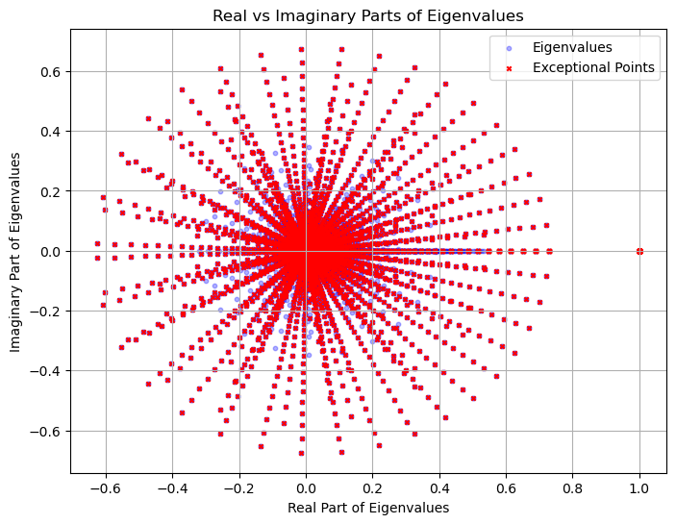
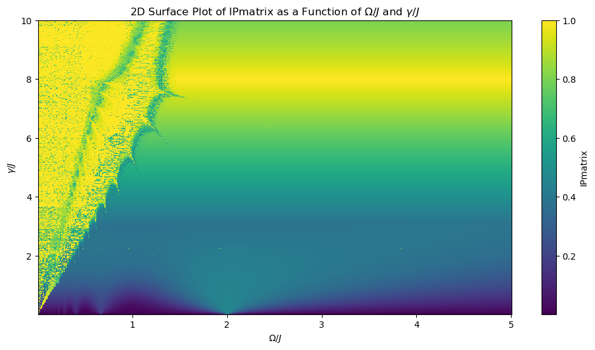
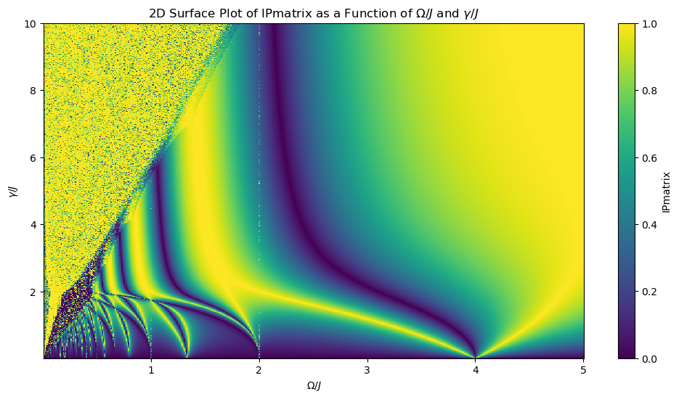







An Industry-University Cooperative Research Center
An Industry-University Cooperative Research Center
Floquet Lindbladian exceptional point contours in dissipative qubit and qutrit systems
$${Katha Haldar}^{1}, Dr. Yogesh N. Joglekar^{1}$$
Indiana University, Indianapolis
Project Overview
Proposed Research
Quantum State of the Art
Intro
Intro
Intro
We investigate the landscape of exceptional points (EPs) in the transient Lindblad dynamics of a two- or three-level system periodically coupled to low positive and negative temperature baths. Alternating spontaneous absorption and emission dissipators σ± with equal strengths γ are used to calculate the Floquet time-evolution operator GF(T) for the vectorized density matrix over one period T = 2π/$Ω$. By analyzing eigenvalue degeneracies and eigenvector coincidences, we map the EP landscape as a function of dissipator strength γ/J and coupling-modulation frequency $Ω$/J. For a qubit, this problem maps to one with time-dependent drive and a static dissipator, while for a qutrit, EP lines emerge at vanishingly small dissipator strengths γ/J ≪ 1. Periodic modulation of dissipation shapes the dynamics, revealing rich structures in the parameter space. Critical points in the parameter space mark transitions between damped and oscillatory behaviors, driven by eigenmode coalescences. The interplay between the non-Hermitian Hamiltonian and time-dependent decay terms produces rich dynamics, controllable via modulation of pump and dissipation strengths.
This project aims to map the landscape of exceptional points (EPs) in transient Lindblad dynamics for two- and three-level quantum systems. Specifically, we investigate how EPs emerge and evolve when the system is periodically coupled to baths at low positive and negative temperatures, leading to alternating dissipative processes.
Our objectives are as follows:
Mapping EP Landscape: Identify and map EPs as a function of dissipator strength $γ/J$ and modulation frequency $Ω/J$. This provides a systematic understanding of the parameter space where EPs arise, which is essential for exploring quantum control applications.
Analyzing Density Matrix Dynamics: Examine the transient behavior of the density matrix across EP lines to understand how EPs affect the temporal evolution of the system. This includes differentiating between dynamical regimes, such as damped and oscillatory behaviors.
Modeling Qubit and Qutrit Systems: For a qubit system, we map the problem to one with a static dissipator and time-dependent drive. For a qutrit system, we explore how EPs manifest at small dissipator strengths $γ/J$ ≪ 1, unveiling a distinct EP landscape.
Implications for Quantum Technologies: Investigate how proximity to EPs can enhance sensitivity to perturbations, making it valuable for potential applications in quantum sensing and control.
Exceptional Points (EPs): Floquet Lindblad dynamics are used to map EP landscapes, with emphasis on qubit and qutrit systems periodically coupled to dissipative baths. These EPs provide unique control points for tuning coherence, especially in regimes where eigenvalues and eigenvectors coalesce.
Periodic Dissipation and Control: Alternating absorption and emission dissipators allow researchers to analyze transitions between damped and oscillatory behaviours. This approach provides insights into controlling decoherence rates and transient dynamics, key for quantum sensing and information processing.
Transient and Long-Term Dynamics: Studies investigate how transient dynamics evolve around EPs, helping to pinpoint conditions for robust quantum state control under periodic modulation.
Deficiencies and Challenges
Scalability and Stability: Extending these models to multi-level or more complex quantum systems is computationally demanding and faces stability issues due to decoherence.
Error Management: Current error-correction techniques are challenging to implement in periodically modulated systems and need refinement for practical control.
Analytical and Numerical Complexity: Mapping EPs and understanding their behaviour across a wide parameter space remains complex, requiring advanced analytical and numerical tools.
Relevant Industry Needs
•Scalability and Stability
•Problem: Hard to create large, stable quantum systems due to qubit sensitivity to noise.
•Gap: Need advances in error correction, noise-resistant materials, and scalable designs.
•High Error Rates
•Problem: Quantum processors are prone to errors, limiting reliable computation.
•Gap: Efficient, low-overhead error correction methods are critical.
•Exceptional Points (EPs)
•Problem: EPs offer enhanced sensitivity but are hard to control in real-world systems.
•Gap: More research is needed to understand and harness EPs in practical applications.
•Integration with Classical Systems
•Problem: Quantum and classical systems don’t easily interface, limiting usability.
•Gap: Hybrid algorithms and integration protocols are essential for smooth operation.
Interaction with CQT Partners
Intro
Quantum Computing and Simulation: Companies working on quantum processors and simulation platforms can benefit from insights into coherence control and EP-based modulation, which can enhance qubit performance and enable more efficient error correction strategies.
Quantum Sensing and Metrology: The project’s exploration of EPs as control points for coherence provides valuable knowledge for industries focused on precision sensing, such as atomic clocks and magnetic or gravitational field sensors.
Quantum Communication: Insights into transient dynamics in open quantum systems can aid communication firms in developing error-resilient quantum communication protocols and secure quantum networks.
Objectives
EP Landscape Mapping
Identify EPs as a function of dissipator strength $γ/J$ and modulation frequency $Ω/J$
Purpose: Pinpoint regions of high sensitivity for quantum sensing and control.
Density Matrix Dynamics
Analyze transient dynamics across EP lines to distinguish between damped and oscillatory regimes.
Purpose: Improve coherence management in quantum operations.
Qubit vs. Qutrit Models
Compare EP behavior in qubit and qutrit systems with periodic dissipation.
Purpose: Inform scalable quantum computing designs.
Application to Quantum Technology
Explore how proximity to EPs enhances sensitivity to perturbations.
Purpose: Enable precise quantum sensing and control in practical applications.
Proposed Research Continued
Potential Follow-On Projects
Extended Parameter Exploration: In a second year, we would explore a broader range of parameters for exceptional points (EPs), optimizing control for applications in quantum sensing and communication.
Application-Specific Dynamics: With refined parameters, we would focus on real-world applications like coherence control in quantum sensing, improving both stability and sensitivity.
Experimental Verification: Collaborations with labs could test these EP dynamics on physical platforms like superconducting qubits or trapped ions.
Potential Spin-Off Projects:
EP-Enhanced Quantum Sensors for metrology.
Quantum Error Mitigation leveraging EP characteristics for improved qubit fidelity.
Non-Hermitian Quantum Simulations to broaden control methods in open quantum systems.
Intro
Background
Exceptional points (EPs) occur in non-Hermitian systems when both eigenvalues and eigenvectors coalesce. In a typical eigenvalue problem, eigenvalues $λ_{i}$are distinct, with associated independent eigenvectors $v_{i}$. However, at an EP, two or more eigenvalues $λ_{i}=λ_{j }$and their eigenvectors merge, causing a loss of linear independence. Mathematically, this can be represented as: ${(H − λI)}^{k}v=0$, where H is the non-Hermitian Hamiltonian, $λ$ is the eigenvalue at the EP, and k is the order of the EP. For a second-order EP, k=2, meaning that only one eigenvector remains linearly independent despite two identical eigenvalues. In open quantum systems, EPs reveal critical information about control and coherence. Systems near EPs exhibit enhanced sensitivity to perturbations, which can be harnessed for quantum sensing. Moreover, the non-trivial topology around EPs can drive controlled transitions between different dynamical regimes (e.g., damped vs. oscillatory behavior) aiding in the precise management of quantum states and coherence in the presence of dissipation. This makes EPs a powerful tool in designing resilient quantum technologies.
Deliverables
In the first year, we expect to achieve the following outputs:
Map exceptional points (EPs) in qubit and qutrit systems under periodic dissipative dynamics.
Develop semi-analytical models and numerical simulations of eigenvalue behavior.
Produce visualizations of EPs and transitions in parameter space.
Submit research papers and present findings at conferences.
If follow-on projects are funded, potential outputs include:
EP-based control protocols for optimizing quantum coherence.
Experimental demonstrations and collaborations with labs to validate results.
Enhanced simulation tools for modeling open quantum systems with time-dependent dissipation.
Development of new quantum error correction strategies.
Advanced publications and potential patent filings for EP-driven quantum technologies.

