Slide 1

Basic Details of the Team and Problem Statement
Ministry/Organization Name/Student Innovation: Ministry of Defence
PS Code: 1414
Problem Statement Title: Drone Base Intelligent Magnetic Sensing System & Metallic Anomaly Detection System
Team Name: Geo-Explorer
Team Leader Name: KATHAN MASTER
Institute Code (AISHE): 028
Institute Name: L.D. COLLEGE OF ENGINEERING
Theme Name: Miscellaneous

Slide 2
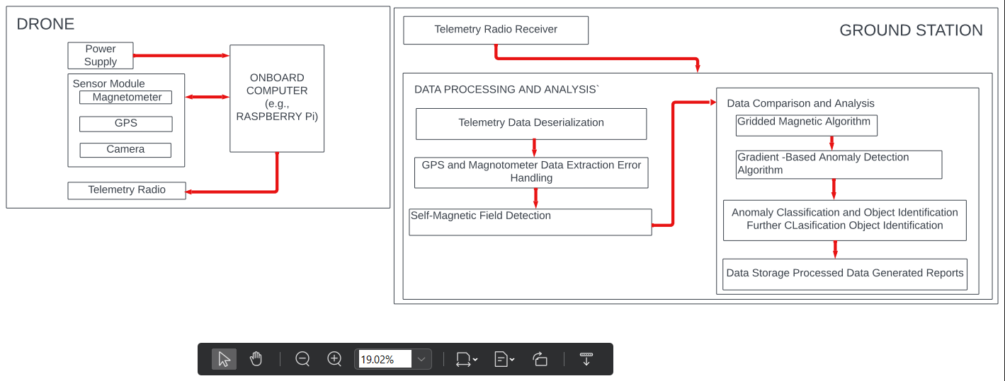
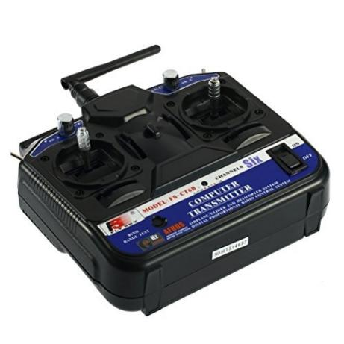
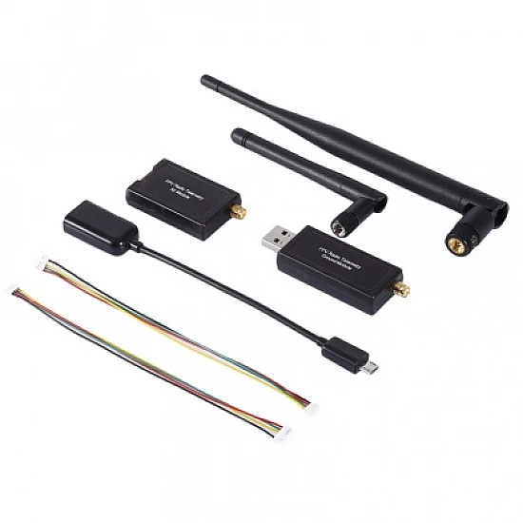


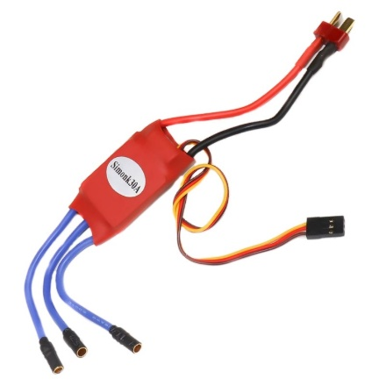

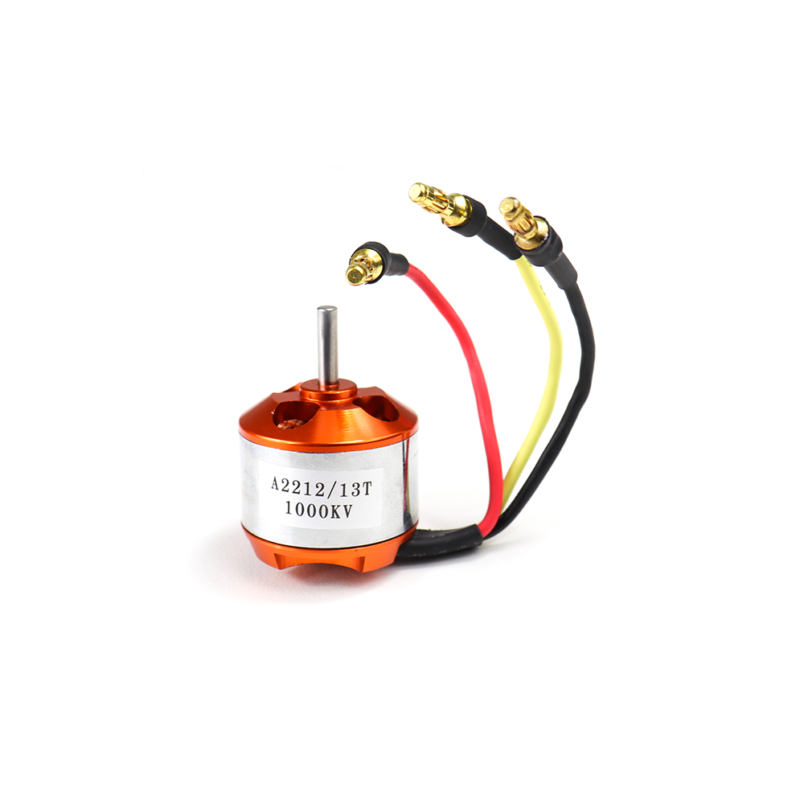

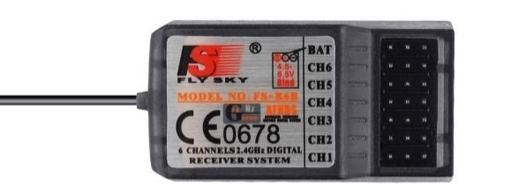

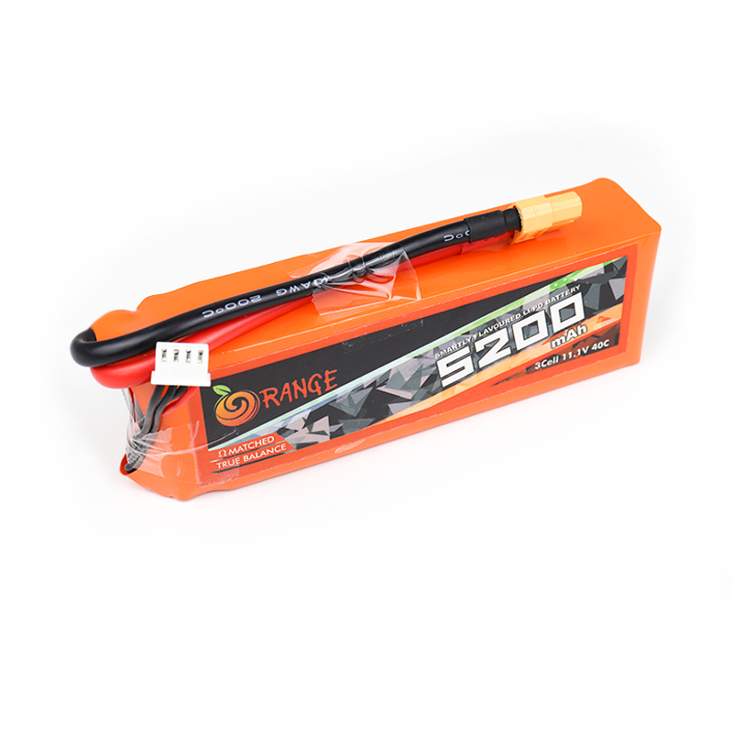
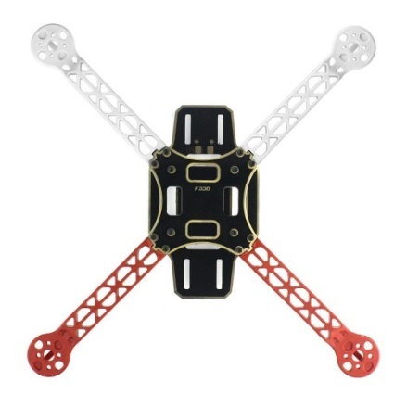

Idea/Approach Details
Describe your idea/Solution/Prototype here:
Drone Configuration: Our project uses a versatile quadcopter drone with telemetry, GPS, a camera, and a high-precision magnetometer. It's controlled by a Raspberry Pi and UGCS-like software for precise flight management.
Data Acquisition and Processing: We gather GPS and magnetometer data, transforming it into CSV format on the Raspberry Pi. We've implemented robust error handling mechanisms to maintain data integrity. This CSV data is then transmitted via telemetry radio to our laptop ground station for reliable data transfer.
Anomaly Detection and Analysis: Upon receiving telemetry data, we use open-source geomagnetic data for effective processing. To detect objects, we employ a Gridded Magnetic Algorithm, comparing and analyzing magnetic field data. Simultaneously, our system uses the Gradient-Based Anomaly Detection Algorithm to detect, classify, and analyze anomalies, providing precise magnetic signature analysis.
Self-Magnetic Deduction Technique: We've also incorporated a self-magnetic deduction technique to remove the drone's own magnetic field from measurements, enhancing data accuracy and anomaly detection.
Describe your Technology stack here:

Slide 3
Idea/Approach Details
Describe your Dependencies / Show stopper here
Describe your Use Cases here
Stoppers:
1. Data Quality: Ensuring high-quality data from sensors is crucial. Any sensor malfunction or inaccuracies can halt accurate anomaly detection.
2. Hardware Reliability: Dependence on drone hardware and components demands reliability to prevent interruptions during operations.
3. Telemetry Connectivity: Stable telemetry connectivity is vital for real-time data transmission; signal loss can impede data flow.
4. Algorithm Performance: The success of anomaly detection relies on the effectiveness of the implemented algorithms.
Dependencies:
1. Sensor Data: Accurate sensor data, including magnetometer and GPS readings, is essential for effective anomaly detection.
2. Telemetry Radios: Continuous telemetry communication between the drone and ground station is dependent on reliable radios.
3. Algorithm Implementation: Successful execution of detection algorithms is essential to interpret data correctly.
4. Open-Source Geomagnetic Data: Access to up-to-date geomagnetic data is a critical dependency for comparison and analysis.
1. Security and Defense: Enhance security operations by detecting concealed metallic objects in urban and remote areas, critical for military and law enforcement.
2. Infrastructure Inspection: Facilitate efficient infrastructure inspection by identifying buried utilities, pipelines, and metallic structures, minimizing maintenance downtime.
3. Archaeological Exploration: Aid archaeologists in uncovering buried artifacts and historical sites, preserving cultural heritage.
4. Environmental Research: Contribute to environmental studies by monitoring changes in the Earth's magnetic field, impacting geophysics and climate research.
5. Resource Exploration: Assist in resource exploration, including locating valuable mineral deposits and enhancing mining operations.
6. Disaster Response: Enable rapid disaster response by detecting hidden structures in debris, supporting search and rescue efforts.
7. Scientific Research: Advance scientific research by providing precise magnetic anomaly data for geological and geospatial studies.

Slide 4
Team Member Details
Team Leader Name: KATHAN MASTER
Branch (Btech/Mtech/PhD etc): BE Stream (ECE, CSE etc): ECE Year (I,II,III,IV): III
Team Member 1 Name: PRAGATI MODHIYA
Branch (Btech/Mtech/PhD etc): BE Stream (ECE, CSE etc): ECE Year (I,II,III,IV): III
Team Member 2 Name: HIMANI VANDARA
Branch (Btech/Mtech/PhD etc): BE Stream (ECE, CSE etc):ECE Year (I,II,III,IV): III
Team Member 3 Name: DIVYA PRAJAPATI
Branch (Btech/Mtech/PhD etc): BE Stream (ECE, CSE etc): ECE Year (I,II,III,IV): III
Team Member 4 Name: KARAN MISHRA
Branch (Btech/Mtech/PhD etc): BE Stream (ECE, CSE etc): ECE Year (I,II,III,IV): III
Team Member 5 Name: Type Your Name Here
Branch (Btech/Mtech/PhD etc): BE Stream (ECE, CSE etc): Year (I,II,III,IV): IV
Team Mentor 1 Name: DHAVAL PATEL
Category (Academic/Industry): Expertise (AI/ML/Blockchain etc): Domain Experience (in years):
Team Mentor 2 Name: ABHAY UPADHYAY
Category (Academic/Industry): Expertise (AI/ML/Blockchain etc): Domain Experience (in years):

