Slide 1
Block diagram of Multi-Purpose Drone
Motor 4
(CCW)
Supply
Signal
ESC 30A
WIFI Camera
5V
GND
Signal
ESC 30A
Motor 3
(CW)
Signal
Receiver
KK2.1 Flight controller
Signal
Motor 2
(CCW)
ESC 30A
Transmitter
Signal
Servo Circuit connected with Relay
Signal
ESC 30A
Motor 1
(CW)
DC Motor Pump connected with Relay
Lipo Battery 11.1V 30C
Supply
Supply

Slide 2
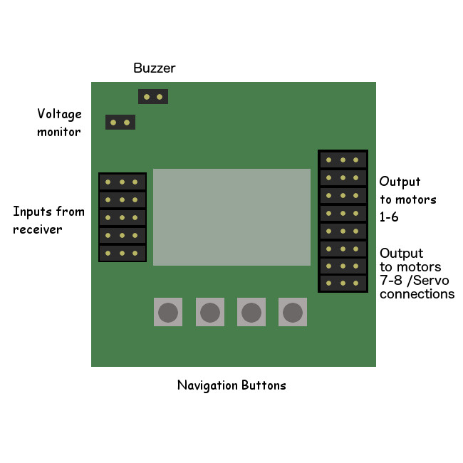
Circuit diagram of Multi-Purpose Drone
Relay with Pump
ESC 30A
M1 (CW)
ESC 30A
M2 (CCW)
+--
CH6
CH5
CH4
CH3
CH2
CH1
Recevier
ALIERON
ELEVATOR
THROUTTLE
RUDDER
AUXILARY
ESC 30A
M3 (CW)
SIGNAL
ESC 30A
M4 (CCW)
ESP 32 CAM
5V
+
_
Battery 11.1V
2200mAh

Slide 3
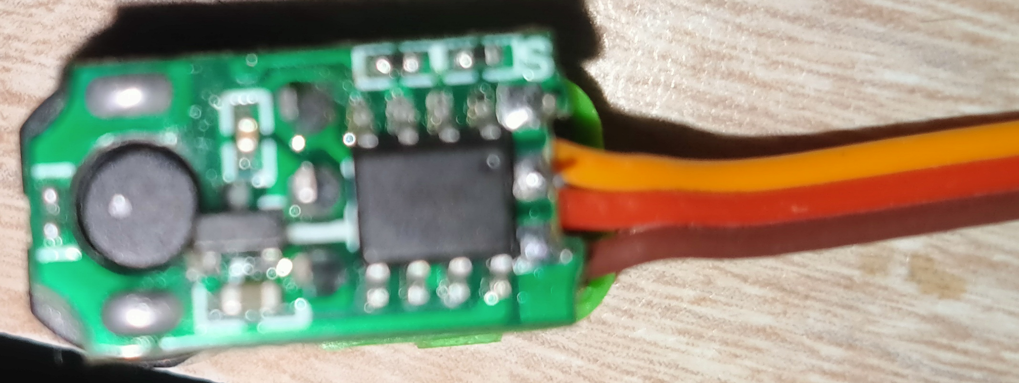
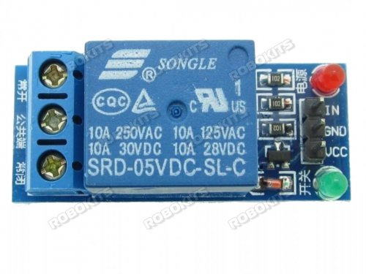
DC Motor Pump
Relay
Servo motor circuit Board
Signal
VCC
GND
Receiver
Channel 6
Supply

