Slide 1


OBJECT DETECTION AND TRACKING IN THE PRESENCE OF OCLUDED ENTITIES USING DEEPSORT
Kathan Bhavsar AU2040170 Maulik Ranadive AU2040117 Nand Patel AU2040183
Arsh Mansuri AU2040185
PRESENTED TO
Prof. Mehul Raval
PRESENTED BY
Group 1
CSE 541 Computer Vision

Slide 2


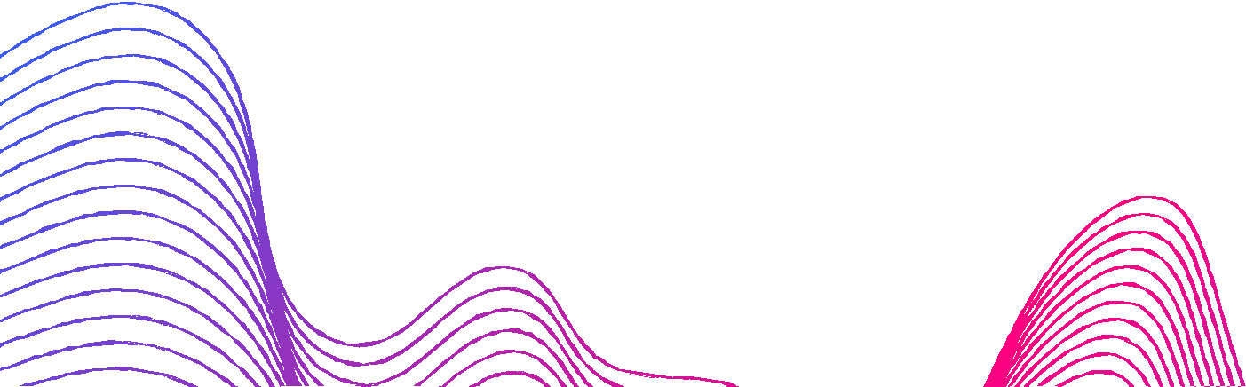
Introduction and Problem Statement
Issue of detecting and tracking objects and entities when they are occluded by substances such as Clouds, Fog, Rain, and Walls.
Objects that are partially or completely obscured by other objects or the environment lead to errors in object detection and tracking, which can impact the overall performance of the system.
The goal of this project is to develop a robust object detection and tracking system using DEEPSORT which aims to achieve high accuracy and robustness in tracking multiple objects in challenging scenarios and enable a wider range of application.

Slide 3
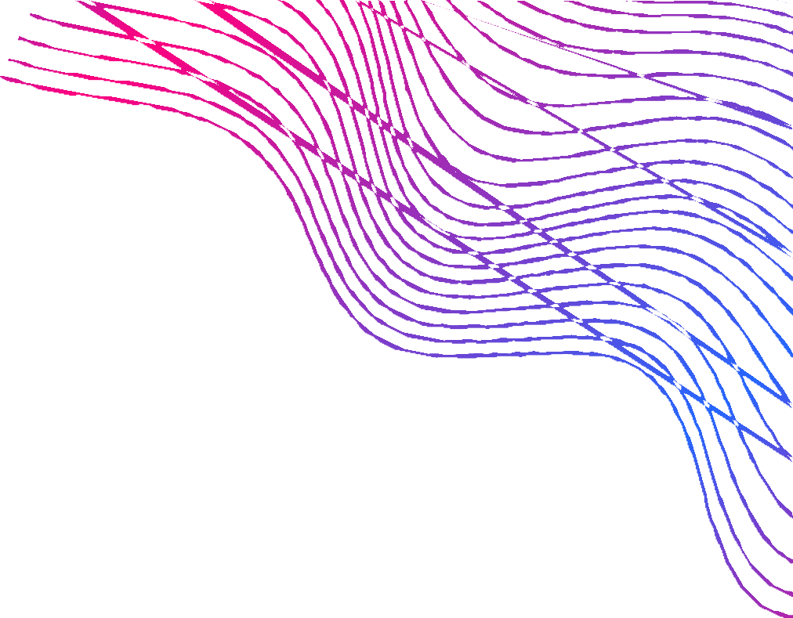
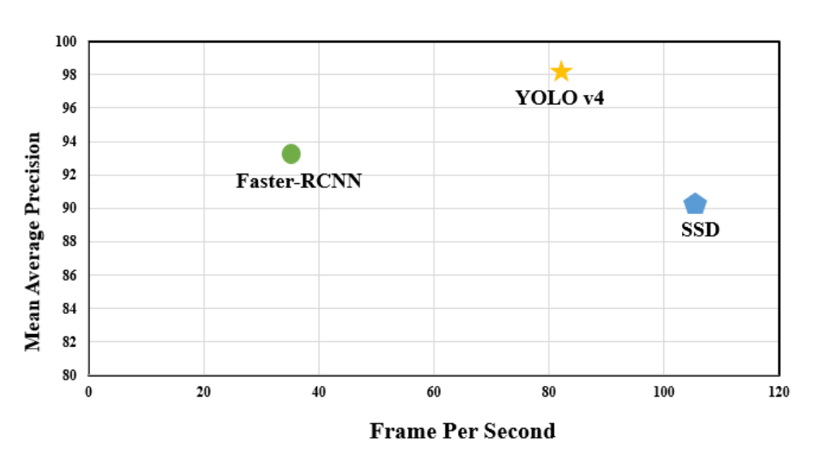
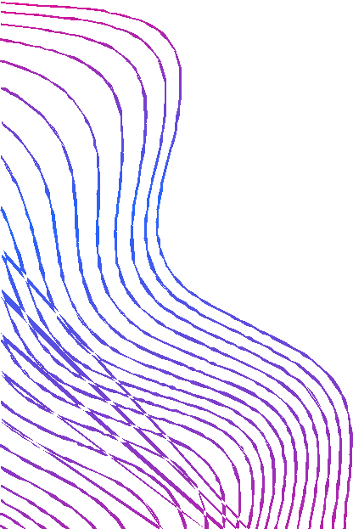
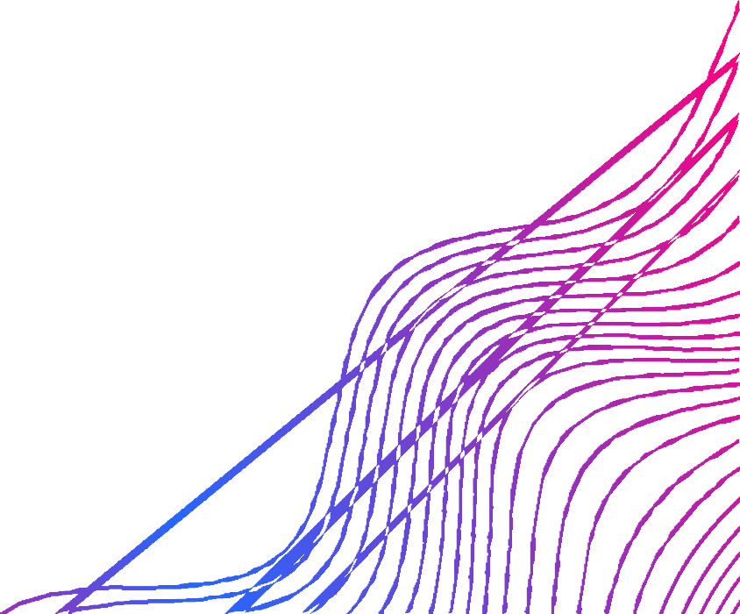
Existing Body of Work
Existing techniques include traditional computer vision-based methods such as Haar cascades, HOG, and SVM.
Methods rely on handcrafted features and require extensive parameter tuning. More recently, deep learning-based approaches such as CNN, Faster R-CNN, and SSD have shown great promise in object detection and tracking.
These techniques use convolutional neural networks (CNNs) to automatically learn features from raw image data and achieve state-of-the-art performance on various object detection benchmarks.

Slide 4


Our Approach
Detection
Estimation
Appearance
Association
Target entities' life cycle
Using yoloV4
Tlost frames
Cnn - Resnet
Using Kalman Filters
Detection and Track Association (Hungarian Algorithm)

Slide 5

Yolov4 Model & Data Description
As discussed, we implemented the YOLOv4 (You Only Look Once version 4) for object tracking.
We made use of the Darknet repository to implement YOLOv4 for object detection.
We have used 2000 labeled images for training the yolov4 model.
We used the bdk100k dataset for image labeling and for the labeling we use was labelImg tool, which is an open-source tool.
We use a total of 18 different classes.

Slide 6

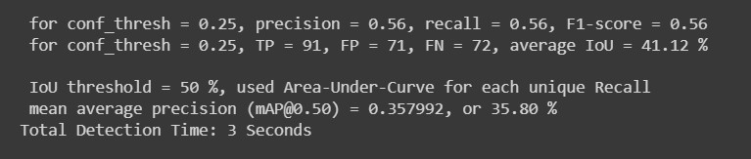
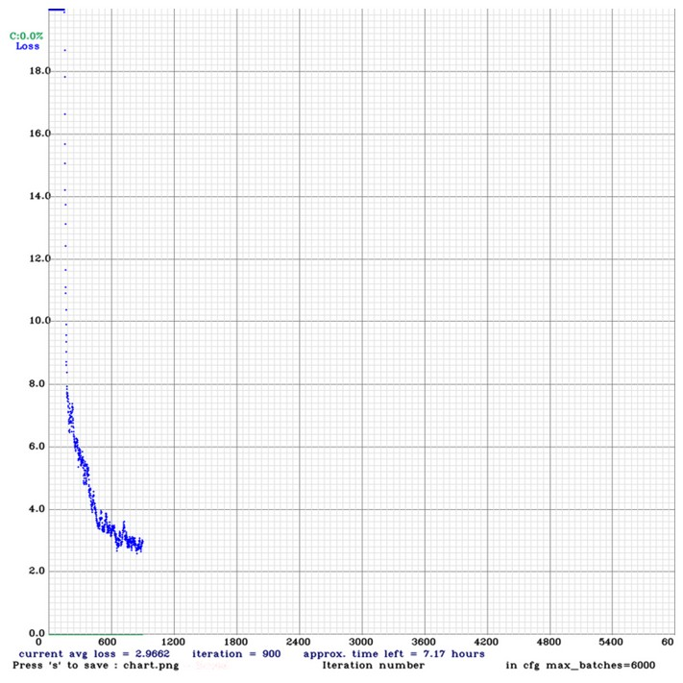
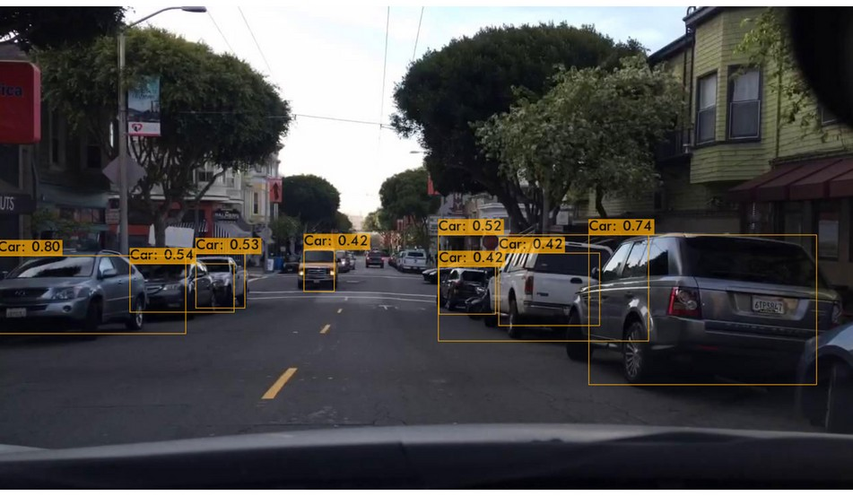
Initial Results
ACCURACY OF TRAINING
INITIAL RESULT
SCATTER PLOT ( 0.3 TO 0.5 )

Slide 7

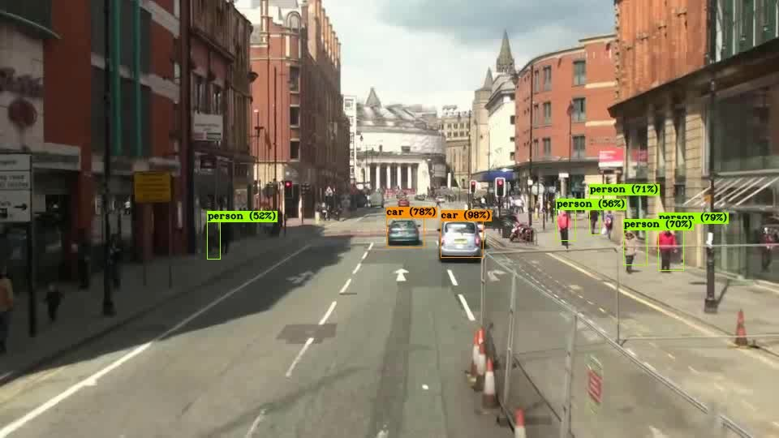
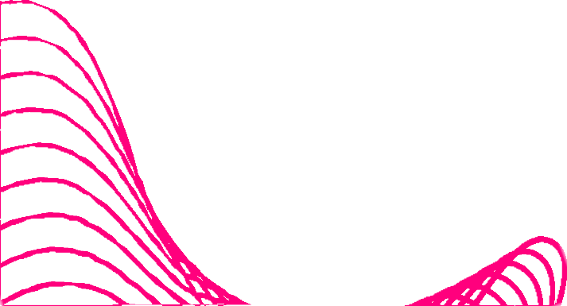
Results

Slide 8
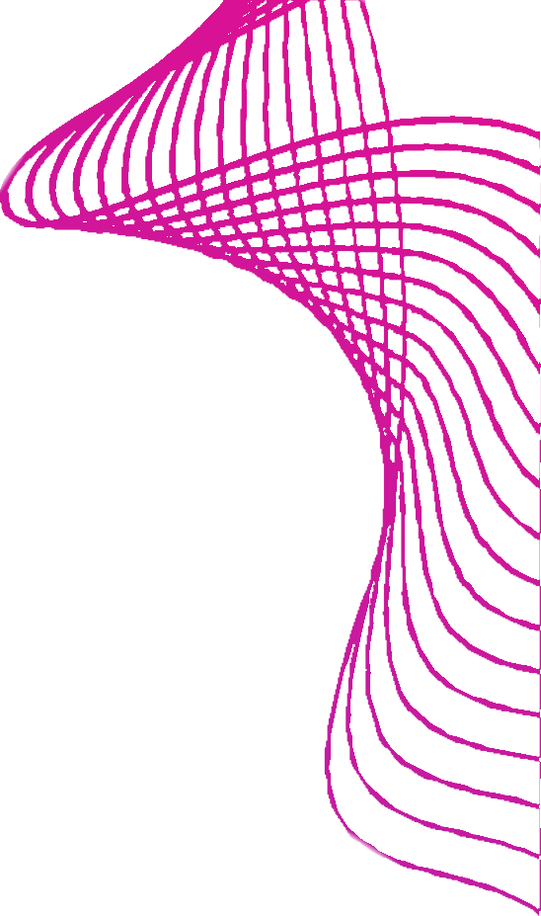
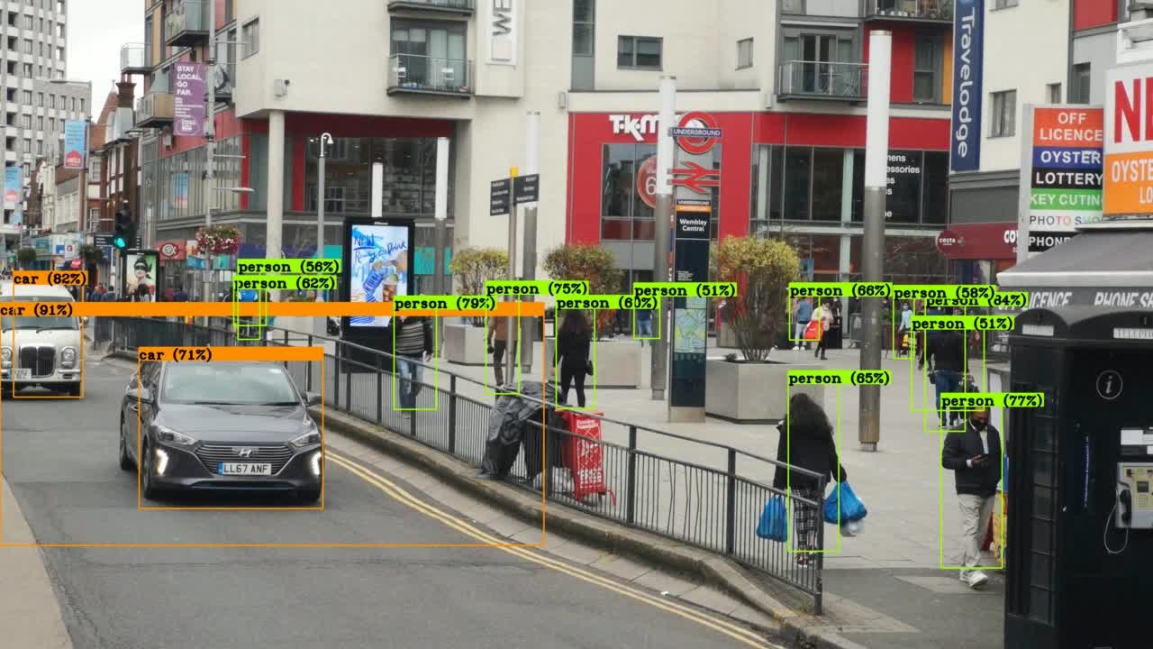

Results

Slide 9





Results for Estimation Using Kalman
We implemented a Kalman filter for both 1D and 2D object tracking. A constant velocity model has considered the acceleration of the detected object.
The prediction is done with the help of Measurements provided by the yolo and it involves the center of the bounding box in x and y and the previous velocity of the object in both directions based on that future values will be predicted.
We generate multiple bounding boxes on a single object so we use non- maximal suppression for removing unnecessary bounding boxes and filtering the ROI boxes.
Assigned unique ID to detected bounding boxes using the Euclidean distance method.

Slide 10
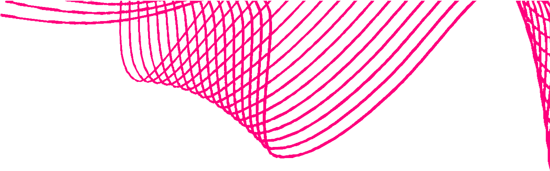
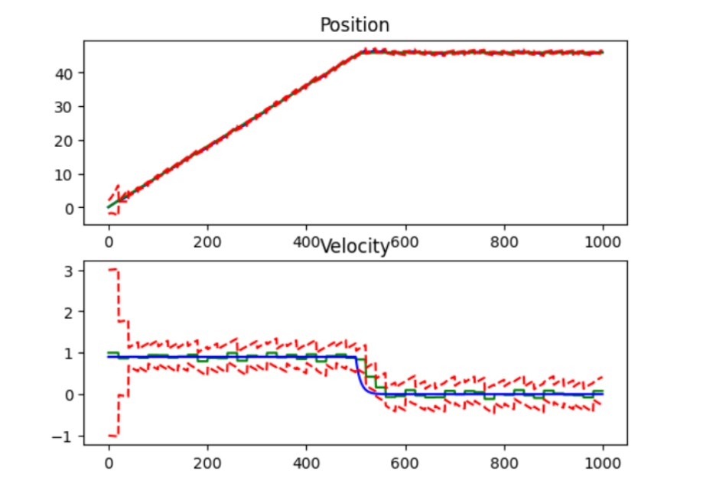

Results
1D Kalman implementation for constant velocity model

Slide 11
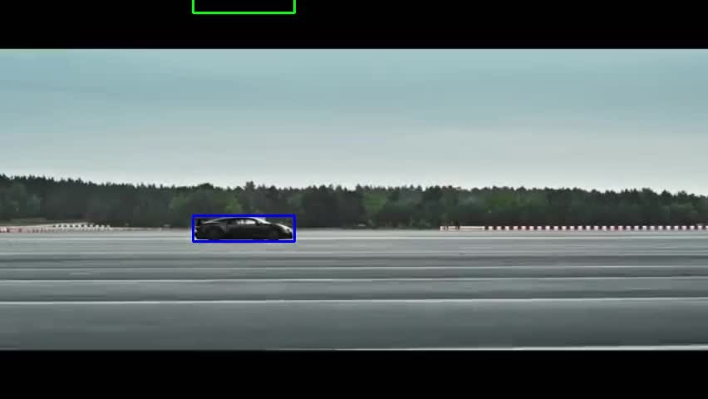
Initial Results

Slide 12
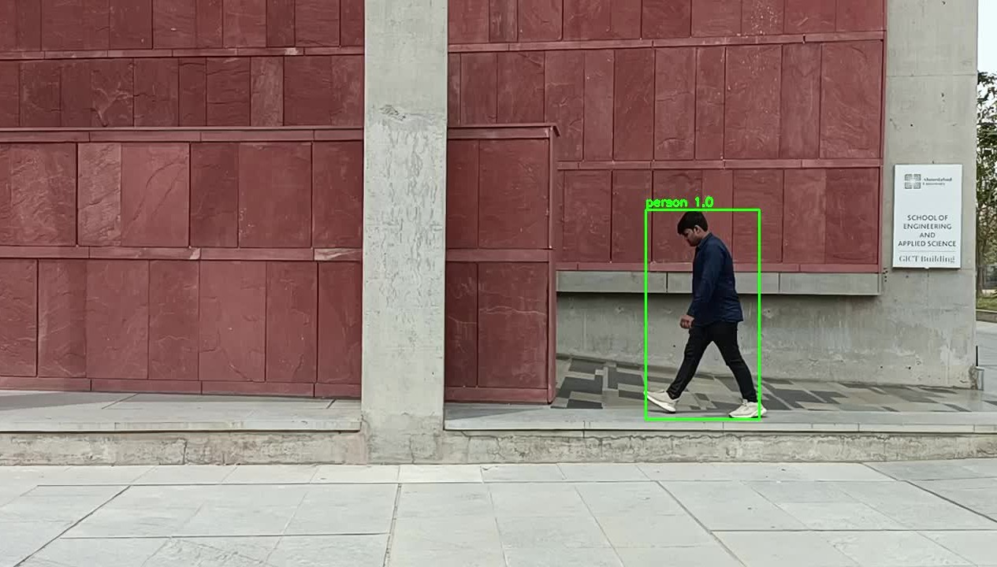
Initial Results

Slide 13
Simple Online and Realtime Tracking with a Deep Association Metric (SORT):
https://arxiv.org/abs/1703.07402
Deep SORT: A Deep Learning-based Object Tracking Approach for Visual Tracking Benchmark:
https://arxiv.org/abs/1703.07402
YOLOv4: Optimal Speed and Accuracy of Object Detection:
https://arxiv.org/abs/2004.10934
References
https://medium.com/analytics-vidhya/train-a-custom-yolov4-object- detector-using-google-colab-61a659d4868
https://github.com/theAIGuysCode/OIDv4_ToolKit https://nanonets.com/blog/object-tracking-deepsort/
https://learnopencv.com/understanding-multiple-object-tracking-using- deepsort/

Slide 14
Contributions
Kathan
Logic for Deepsort and Training Yolov4, Appearance vectors
Nand
Training and Implementation Yolov4, Cost Matrix evaluation
Arsh
Implementation of Resnet for Feature Extration.
Maulik
Image Annotation, Implementation of Kalman

Slide 15
Conclusion
In conclusion, this project aimed to address the challenge of object detection and tracking under occlusion using DeepSort, Kalman Filter, ResNet50, Hungarian Algorithm, and YOLO. The proposed method achieved object detection and tracking in the presence of occlusion.
The results of the experiments also improved in terms of accuracy and robustness, demonstrating its potential for practical applications. However, there is still room for improvement and further research in this area.
In terms of implications, this project highlights the importance of considering occlusion in object detection and tracking, and demonstrates the potential of DeepSort and its components for addressing this challenge.
We also aim for further exploration and development in this project for even better results in the future. Correctness in Hungarian Algorithm

Slide 16


Thank You

