Slide 1


OBJECT DETECTION AND TRACKING IN THE PRESENCE OF OCLUDED ENTITIES USING DEEPSORT
Kathan Bhavsar AU2040170 Maulik Ranadive AU2040117 Nand Patel AU2040183
Arsh Mansuri AU2040185
PRESENTED TO
Prof. Mehul Raval
PRESENTED BY
Group 1
CSE 541 Computer Vision

Slide 2



Introduction and Problem Statement
Issue of detecting and tracking objects and entities when they are occluded by substances such as Clouds, Fog, Rain, and Walls.
Objects that are partially or completely obscured by other objects or the environment lead to errors in object detection and tracking, which can impact the overall performance of the system.
The goal of this project is to develop a robust object detection and tracking system using DEEPSORT which aims to achieve high accuracy and robustness in tracking multiple objects in challenging scenarios and enable a wider range of application.

Slide 3
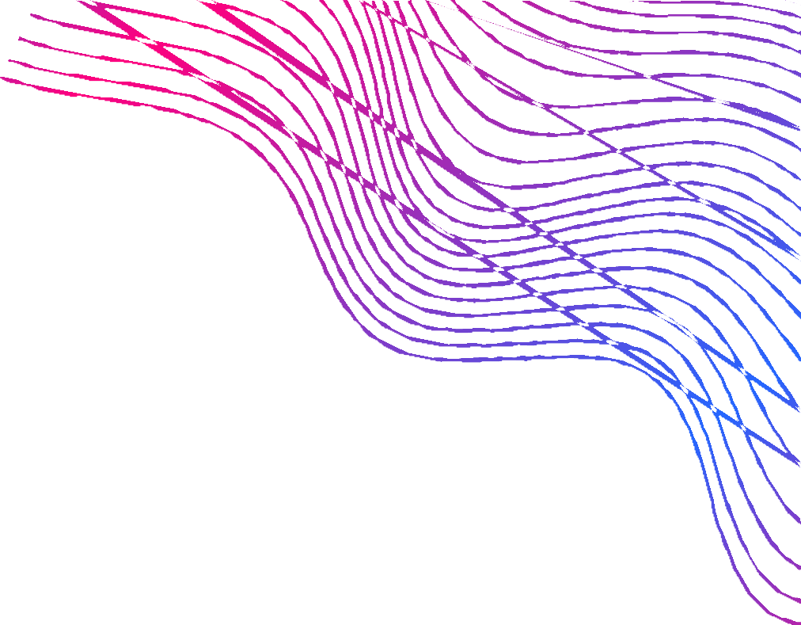
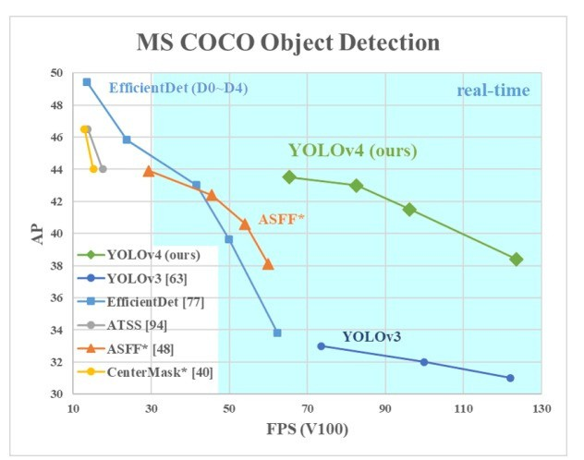

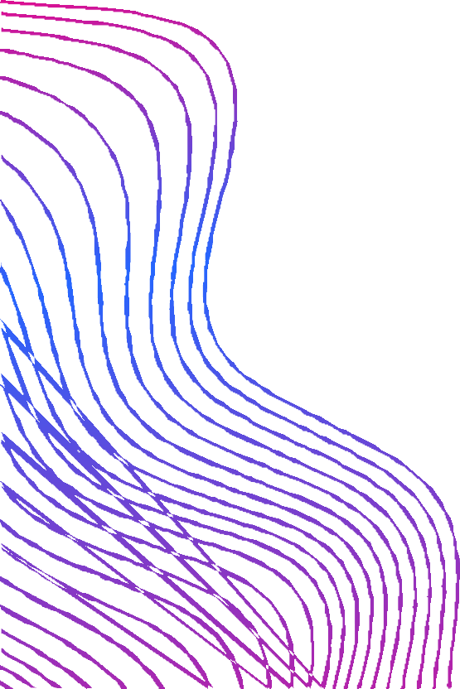
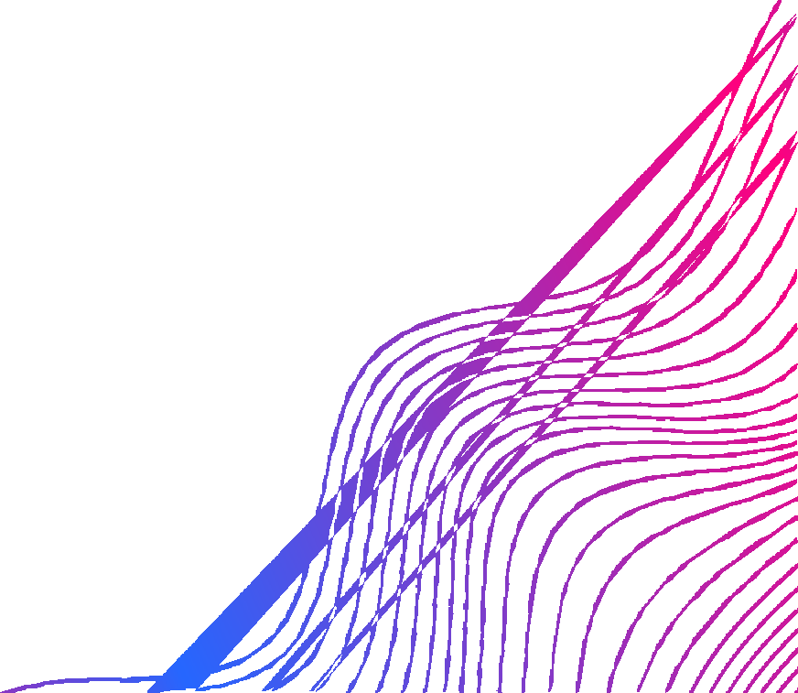

Existing Body of Work
YOLOv4 is a deep learning-based object detection algorithm that has been shown to achieve state-of-the-art performance on a variety of object detection benchmarks, including those with occlusion. The changes from the previous versions were
More convolutional layers
Mish activation function
Pyramidal pooling(allows to detect multiple objects in different scales) Path aggregation network (a feature aggregator has been employed in order to improve the learning of the parameters)

Slide 4


Our Approach
Detection
Estimation
Appearance
Association
Target entities' life cycle
Using yoloV4
The Appearance Vector
Target Association
Using Kalman Filters
Target Association (Hungarian Algorithm)

Slide 5

Initial Results
Till now we have implemented the YOLOv4 (You Only Look Once version 4) for object tracking.
We have cloned the darknet repository to implement YOLOv4 for object detection.
We have used 108 labeled images for training yolo and 50 images for testing the model.
We are planning to use a total of 5000 labeled images for training and around 1000 images for testing the model in future

Slide 6

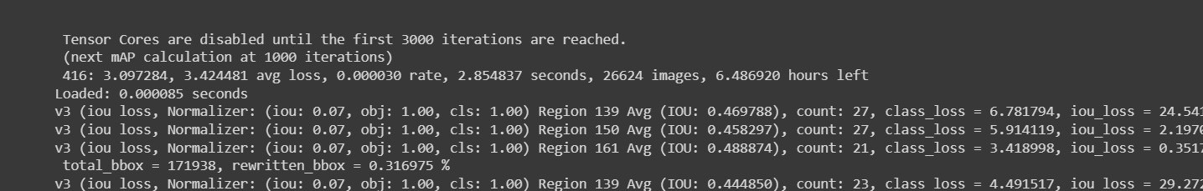
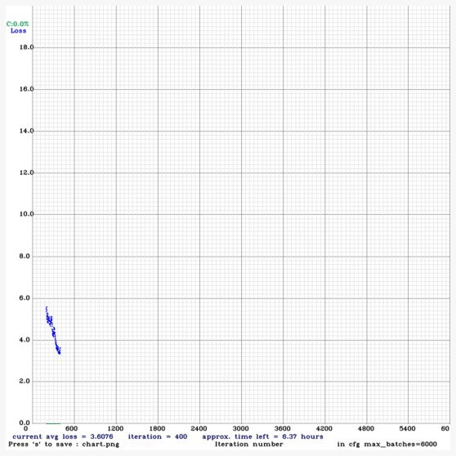
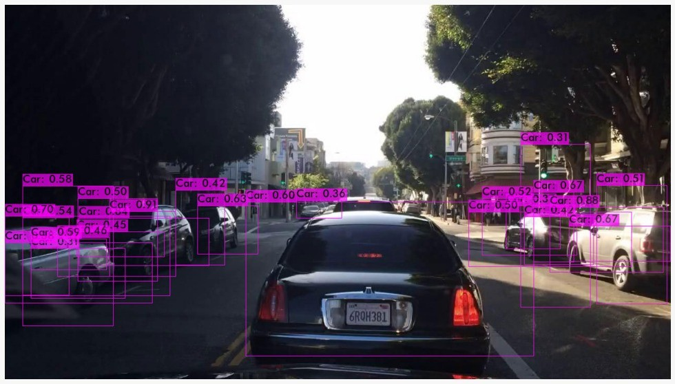
Initial Results
ACCURACY OF TRAINING
INITIAL RESULT
SCATTER PLOT ( 0.3 TO 0.5 )

Slide 7

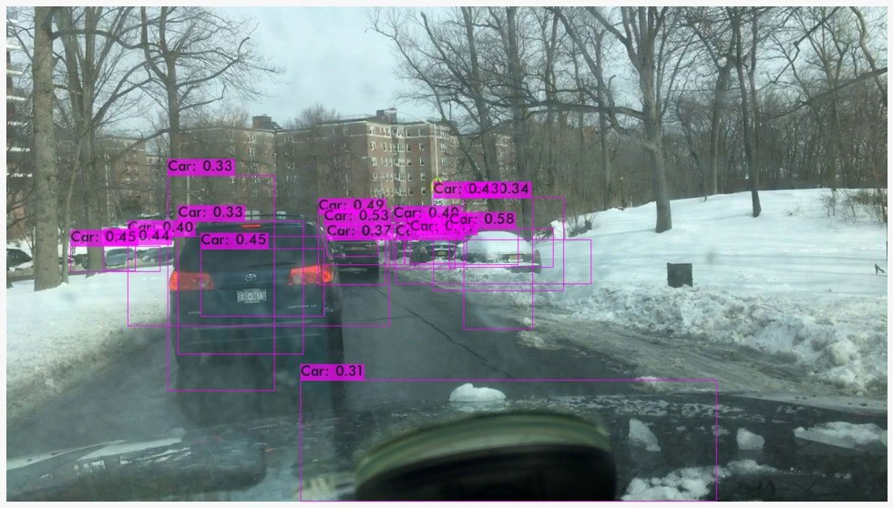
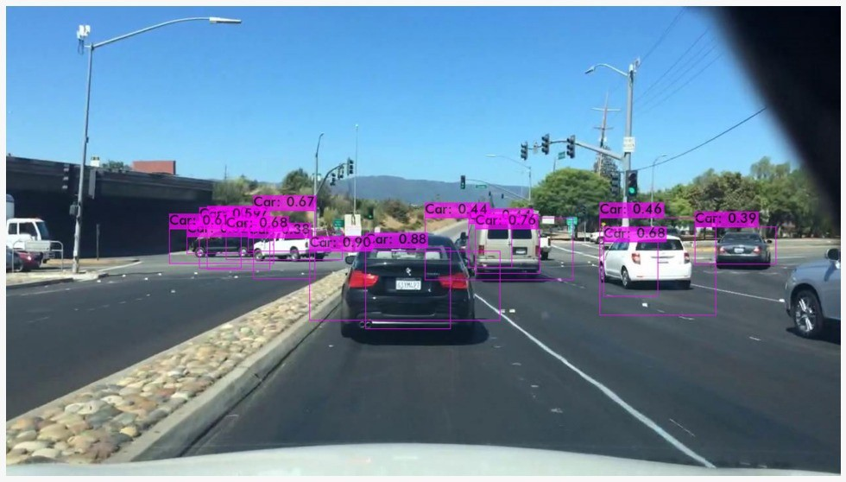
Initial Results
SOME MORE RESULTS
NORMAL CONDITION
RESULTS UNDER SNOW

Slide 8
Roles and Future work
Maulik
Implementation of Deepsort and Image Labelling, Training Yolov4, Kalman Filters
Arsh
Filtering Appearance vectors and Implementatio n of Kalman Filters
Kathan
Training Yolov4, Hungarian Algorithm Implementation
Nand
Yolo Training, Image Labelling, Traning Data, Apperance Vectors
Integration of Appareance Vectors and Hungarian Algorithm which will be done with the help of Neural Networks and the Kalman Filter which will track the object using velocity and position.

Slide 9
Conclusion
Overall, the progress of our project is evident in the results
That we have implemented the YOLOv4 model successfully with the mentioned yolo rate in the results.
We have also started implementing the other important aspects of the project such as the appearance vector, Kalman vector, and the Hungarian Algorithm in code but since we did not have the labels dataset for training the entire model we did not have time to complete that implementation.
Our maximum time was consumed in labeling the dataset for yolo.

Slide 10
Simple Online and Realtime Tracking with a Deep Association Metric (SORT):
https://arxiv.org/abs/1703.07402
Deep SORT: A Deep Learning-based Object Tracking Approach for Visual Tracking Benchmark:
https://arxiv.org/abs/1703.07402
YOLOv4: Optimal Speed and Accuracy of Object Detection:
https://arxiv.org/abs/2004.10934
References
https://medium.com/analytics-vidhya/train-a-custom-yolov4-object- detector-using-google-colab-61a659d4868
https://github.com/theAIGuysCode/OIDv4_ToolKit https://nanonets.com/blog/object-tracking-deepsort/
https://learnopencv.com/understanding-multiple-object-tracking-using- deepsort/

Slide 11
Thank You

