Slide 1
Web Search Engine Advanced Computing Concepts Comp 8547
Group Members:
Kathan Vaidya - 110074928
Siddhant Yadav - 110084645
Tanya sethi - 110079209
Atharva joshi - 110074947
Preet amish shah - 110084839
Professor
Dr. Olena Syrotkina

Slide 2
Project Team Members and Contribution
Kathan Vaidya (110074928) – Web Crawler and Url Finder using Regex
Siddhant Yadav (110084645) – Page Ranking using HashMap
Tanya Sethi (110079209) – File suggestion
Atharva Joshi (110074947) – Pattern Matching
Preet Amish Shah (110084839) – HTML to Text converter

Slide 3
Presentation Flow
Introduction
Flow of the Search Engine
Features of Search Engine and Concepts used
Demonstration
Future Enhancement scopes
Conclusion
References

Slide 4
Introduction
A search engine is an online answering machine that searches, understands, and organizes material results in its database depending on end-user-inputted (internet user) search queries (keywords).
To show search results, all search engines first locate the most useful results in their database, sort them into an ordered list based on the search algorithm, then present them to end users.
The search results are usually shown in a line, which is referred to as a search engine results page (SERPs).
Some examples of web search engine are Google, Yahoo and Bing.

Slide 5

Flow of Search Engine
Web Crawler
HTML to Text
URL Suggestion using Regex
Pattern Search
Page Ranking
File Suggestion

Slide 6
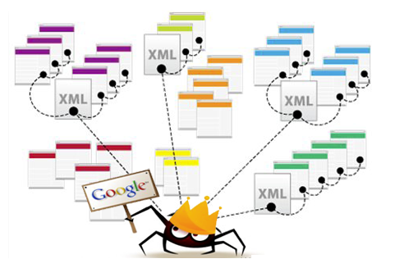
Web Crawler
The web crawler is essentially a program that navigates the internet in search of new or updated pages.
To extract hyperlinks, the crawler starts with a large number of seed websites or popular URLs and searches depth and breadth.
Web crawler should be kind and gentle i.e it should avoid frequent website visits. Robust means to avoid malicious websites and spider webs.
It is mainly implemented using the Jsoup Library of java
A HashSet to avoid duplicate urls and also an ArrayList is used to store the urls received from current page which is being crawled.

Slide 7
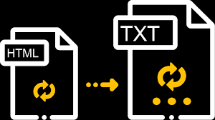
HTML to Text converter
To convert HTML files into Text files, we have used Jsoup Library of Java.
First the web crawler will retrieve all HTML files from the specified URL. Once the files are downloaded they will be converted into text files using Jsoup library.
The data of HTML is stored in String format using parser and later the strings are written in text file using the BufferedWriter.

Slide 8
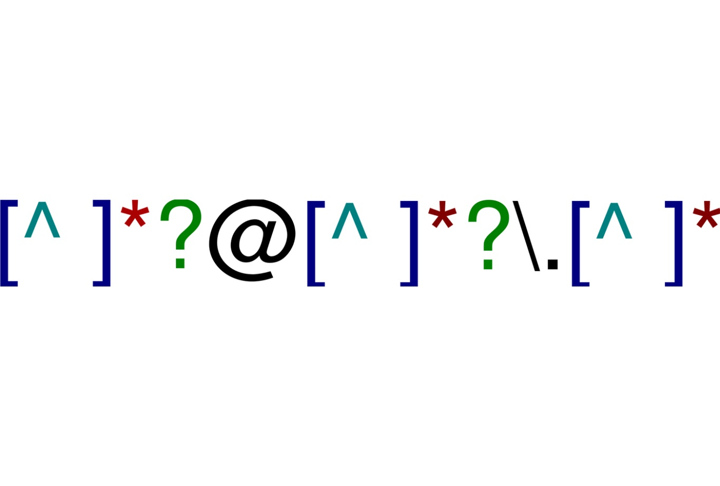
Suggest URLs using Regex Pattern
The web crawler will create one file which has all the urls which that are crawled and also the hyper links from the webpages that are crawled.
Using a regex pattern, we will try to avoid some unsecure urls and find only those urls which start with https.
Then we will try to compare the pattern using the matcher class and suggest the urls based on the user input.

Slide 9
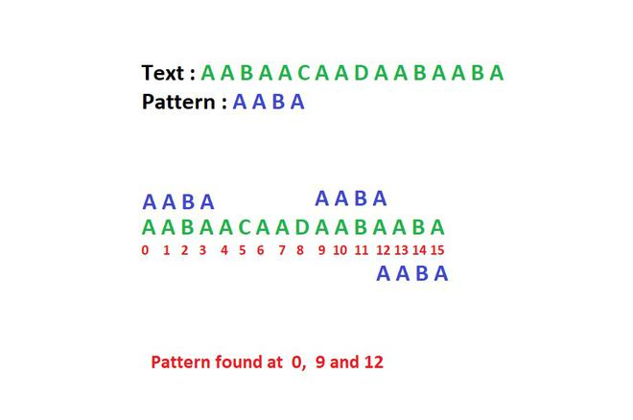
Pattern Searching Using Boyer Moore
Boyer Moore Pattern Search algorithm is one of the most efficient pattern search algorithms available and it is frequently used as a standard for pattern search algorithm.
It works simply by pre-processing the string to be searched for. It then skips chunks of the text using the information acquired during the pre-processing step. The algorithm's main features are that it matches on the tail of the pattern rather than the head, and that it skips down the text in multiple character jumps rather than checking every single letter.

Slide 10
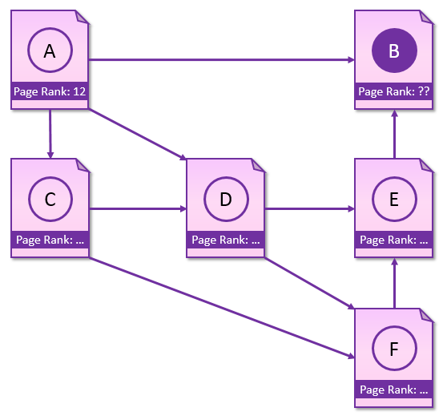
Page Ranking
Page ranking searches the word in all the files and then sorts them in descending order based on the frequency of the word in the file.
Later, the top 5 urls containing the word are shown as results.
A HashMap is used to store the key value pair of the file and the word count in it.
Stream is used to sort the HashMap in descending order of the frequency

Slide 11
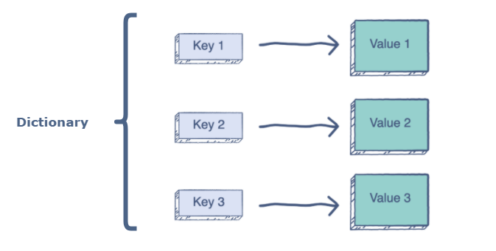
File Suggestion
This feature suggests common files where the user input string is present
Consists of two sections-
Dictionary Maker- creates a dictionary file using the text files and stores it in a Hash Map
Suggestion- takes string as input and provides intersection of files in which the string is found
Text preprocessing is done using Apache Lucene library- stemming

Slide 12

Live Demonstration

Slide 13
Future Enhancements Scope
Creating a GUI for the search engine.
Make the search engine more scalable by hosting it on AWS or Azure.
Storing the results of the crawler in some relational database for better control and efficiency.
Integrate Word frequency counter and file suggestion feature (TF-IDF).

Slide 14
Conclusion
In this project , we have successfully designed a working web search engine in java.
We have used features like Web Crawler , Jsoup library , Boyer Moore algorithm , URL finder using Regex, page ranking, file suggestion
We have also done the testing of the WebSearch engine using concepts of Junit
So far, the web search engine behaves as expected and gives correct output for the search.

Slide 15
References
https://www.javatpoint.com/web-crawler-java
https://medium.com/@siddharth.21/the-boyer-moore-string-search-algorithm-674906cab162

Slide 16
Thank You

