Slide 1
CSE 523
Machine Learning
Athlete profiling based on similar characteristics
Group name - Decision Makers
AU2140066 - Harman Jani
AU2140077 - Kaival Shah
AU2140080 - Divykumar Patel
AU2140113 - Kathan Dave

Slide 2
Problem Statement
Grouping athletes into clusters based on similar characteristics and analyzing cluster characteristics.
Various features that can influence player’s performance, like sleep patterns, training details, etc.
Goal - Cluster athletes based on similar profile and show XAI on clustering
Benefits? Help coaches improve player’s performance by providing data-backed factors for improvement.
Notes:
Introduction
Machine learning analysis of athlete data
Main objective: Cluster athletes based on similar characteristics
Reveal patterns and relationships affecting performance
Employ explainable AI to interpret clusters
Identify key features influencing athletic performance

Slide 3
Dataset and Data Transformation
Data from Sacred Heart University's Division-1 team.
Includes vertical jump, RSI (Season 2 & 3), and Season 2 & 3 with Polar.
Missing Value Handling: MICE addressed missing data uncertainty for a more accurate analysis.
Feature Selection: Features with excessive missing values were dropped in Seasons 2 and 3.
Data Normalization: MinMaxScaler ensured consistent feature range (0-1) across all data.
Notes:
The datasheet we have obtained: RSI_Vertical Jump Season 3, Season 2 with Polar, Season 3, Vertical Jump Season 2
of Division-1 Women's basketball Sacred Heart University
'NA' values greater than 1000 (Season 2) and 1500 (Season 3) led to dropping particular features.
Reduced Season 3 to 64 features and Season 2 to 36 features.
Merging 23 common features across seasons for each athlete.
Traditional methods failed to handle missing data uncertainty adequately.
MICE sequentially imputed missing values, reducing bias potential.
All features were normalized using MinMaxScaler to a range of 0 to 1.

Slide 4
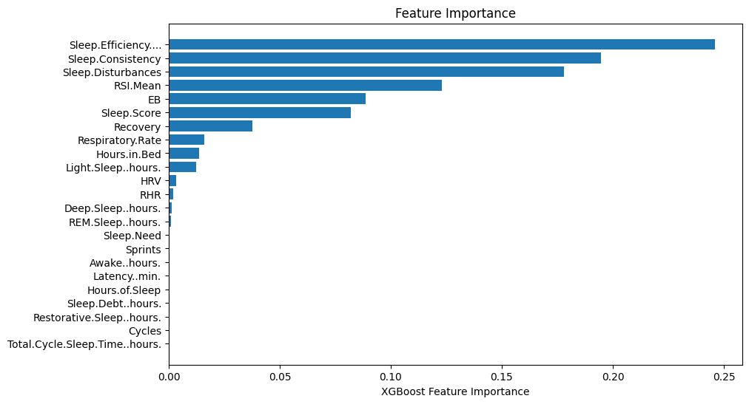
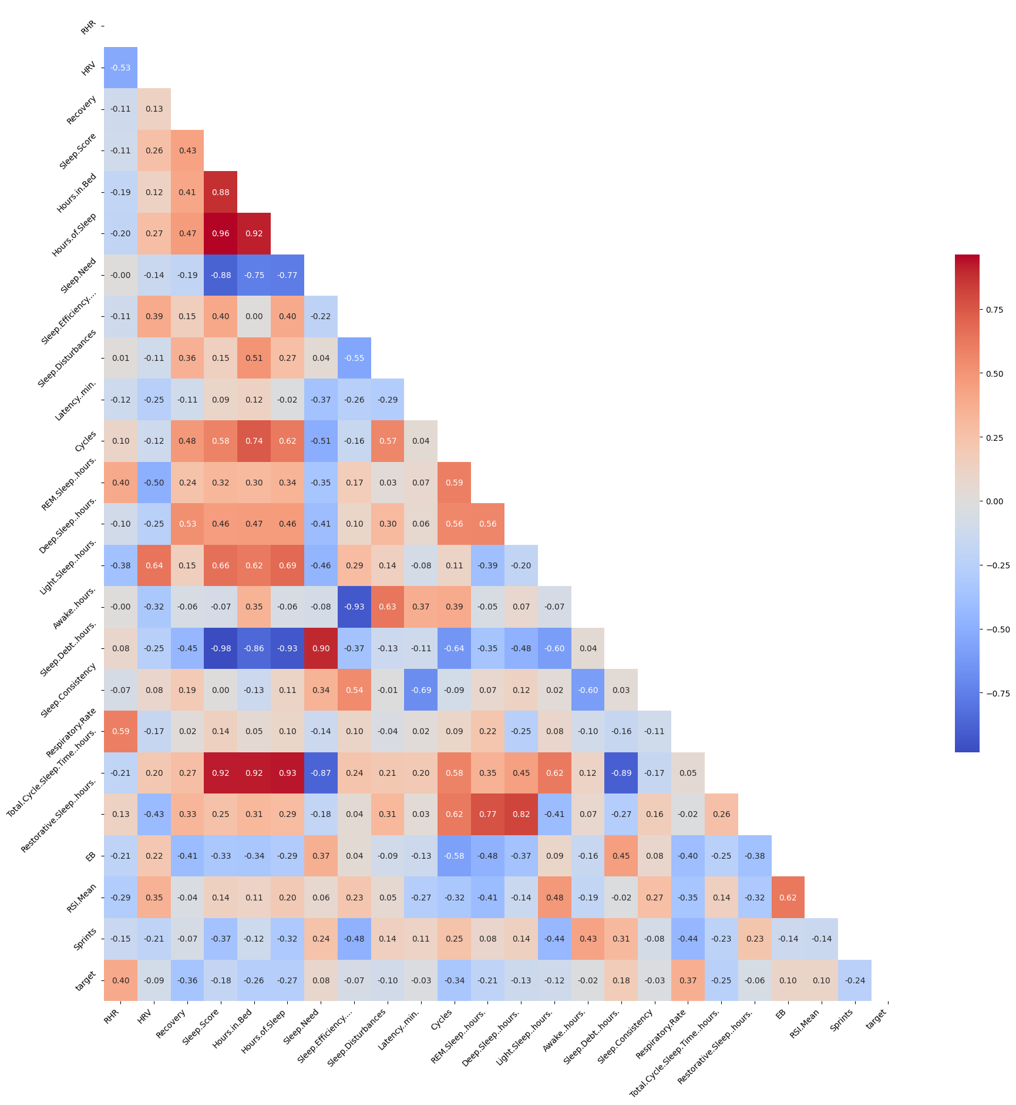
Feature Selection
Feature Importance generated using XGBoost
Selected Features: RSI.Mean, HRV, Recovery, Sleep.Consistency, Sleep.Efficiency, Respiratory.Rate, Sleep.Disturbances
Feature dependence using
correlation matrix
Notes:
Feature Importance generated using XGBoost
Feature dependence using correlation matrix
Colab Link

Slide 5
Model Selection
Clustering - GMM
Handles clusters of varying shapes, sizes, and probabilities.
Works well even for data on cluster edges or with mixed memberships.
Effective for complex cluster structures.
Implementation
Applied GMM clustering on 23 features.
Also applied GMM on 7 prominent features.
Compared results using silhouette score.

Slide 6
Parameter Optimization
PCA
PCA was applied for dimensionality reduction.
Prioritizes features capturing the most data variation, potentially improving cluster separation.
Remove irrelevant features, leading to cleaner clusters in GMM.
Problem: Curse Of Dimensionality

Slide 7
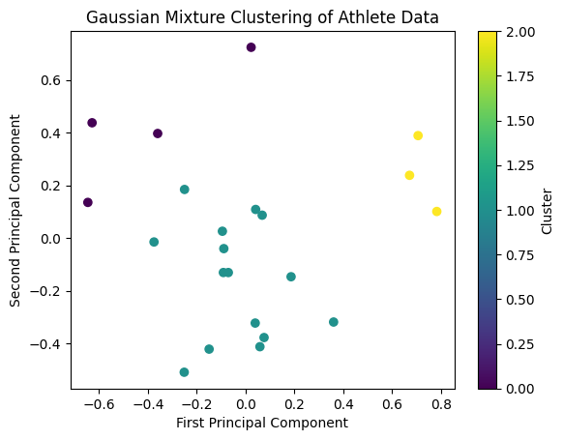
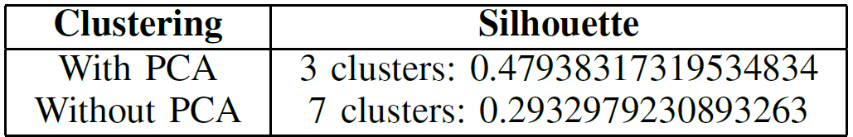
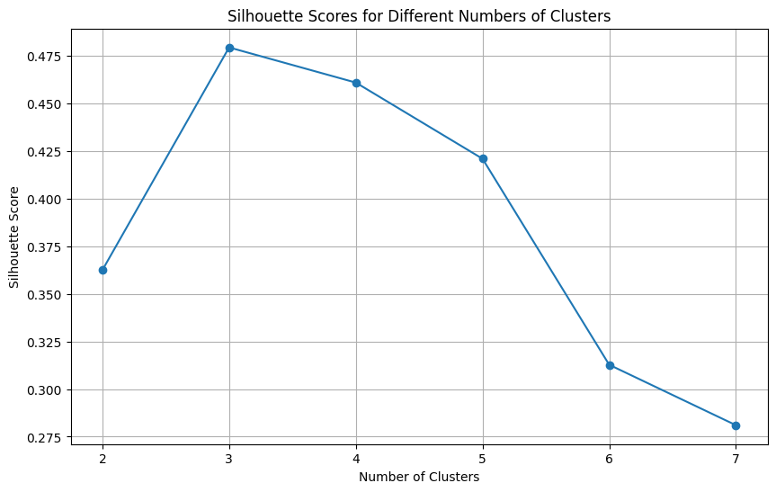
Clustering
SILHOUETTE SCORES MAX OBTAINED

Slide 8
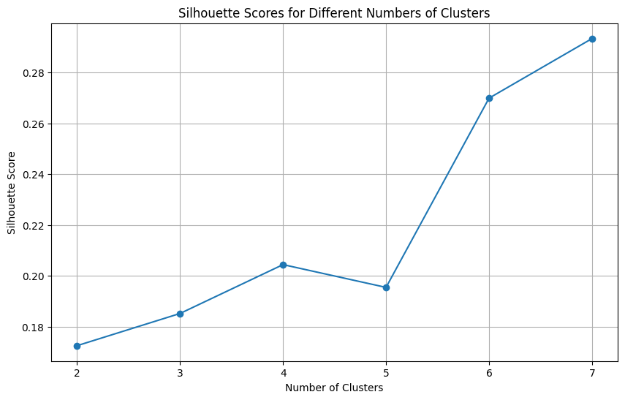
Clustering
Silhouette score
Compares distance within a cluster to distance between clusters.
Indicates well-separated, tight clusters.
Optimize via Silhouette Score
Explore feature combinations for optimal clustering comparing silhouette score.
Notes:
Silhouette score Cohesion vs. Separation: Compares distance within a cluster to distance between clusters.
Higher Score is Better: Indicates well-separated, tight clusters.

Slide 9
Explainable AI (XAI)
LIME(Locally Interpretable Model Agnostic Explanation)
LIME, being model agnostic, relies on local approximations rather than global behavior.
It explains black-box models by providing insights into their decision-making process.
Athletes are clustered, then Lime Tabular analysis with RandomForestClassifier is applied to construct a surrogate model
The surrogate model captures complex data patterns, facilitating feature contribution explanations for each athlete.
Feature contributions are elucidated using both PCA and non-PCA methods, providing comprehensive insights into athlete data.

Slide 10
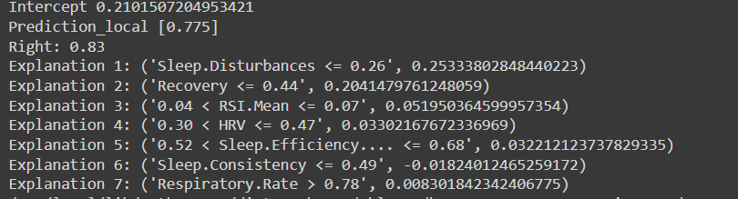
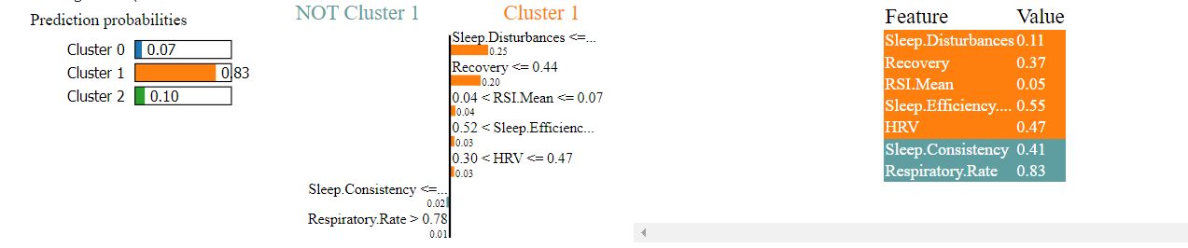
Results
Code

Slide 11
Conclusion
Feasibility of ML Classification: Explored using ML to classify basketball athletes.
MICE for Missing Data: Handled missing data effectively using MICE.
GMM for Complex Clusters: Chose GMM for flexible cluster modeling.
LIME Interpretability: Gained insights with LIME for feature importance.
XAI: Future work: delve deeper into group characteristics and feature interactions. and employ SHAP for comparing purposes.
Dashboard Creation for Atheletes and Coaches.
From Insights to Action: Goal: personalized training and recovery plans.

Slide 12
References
Taber, C.B., Sharma, S., Raval, M.S. et al. A holistic approach to performance prediction in collegiate athletics: player, team, and conference perspectives. Sci Rep 14, 1162 (2024). https://www.nature.com/articles/s41598-024-51658-8
S. Senbel et al., ”Impact of Sleep and Training on Game Performance and Injury in Division-1 Women’s Basketball Amidst the Pandemic,” in IEEE Access, vol. 10, pp. 15516-15527, 2022, .doi: 10.1109/ACCESS.2022.3145368
H. Wan, H. Wang, B. Scotney and J. Liu, ”A Novel Gaussian Mixture Model for Classification,” 2019 IEEE International Conference on Systems, Man and Cybernetics (SMC), Bari, Italy, 2019, pp. 3298-3303,doi: 10.1109/SMC.2019.8914215.
Li, L. (2021, December 10). Principal component analysis for dimensionality reduction. Medium. https://towardsdatascience.com/principal-componentanalysis-for-dimensionality-reductin-115a3d157bad
How LIME works, Understanding in 5 steps, Openlayer.(n.d). https://www.openlayer.com/blog/post/understanding-lime-in-5-steps

Slide 13
Thank You

