Slide 1
CSE 523
Machine Learning
Athlete profiling based on similar characteristics
Group name - Decision Makers
AU2140066 - Harman Jani
AU2140077 - Kaival Shah
AU2140080 - Divykumar Patel
AU2140113 - Kathan Dave

Slide 2
Problem Statement
Grouping athletes into clusters based on conference performance and analyzing cluster characteristics.
What do we know? There are various features that can influence the performance of the player, like sleep patterns, training details, mental state and more.
What to find? A framework which would efficiently cluster athletes based on the characteristics derived using above mentioned features. The other goal is to understand which characteristics are unique to each clusters.
What are the benefits? Help coach improve performance of players individually, as a team, and at conference by providing data-backed factors for improvement.

Slide 3
Introduction
Machine learning analysis of athlete data
Main objective: Cluster athletes based on similar characteristics
Reveal patterns and relationships affecting performance
Employ explainable AI to interpret clusters
Identify key features influencing athletic performance

Slide 4
Data Imputation
'NA' values greater than 1000 (Season 2) and 1500 (Season 3) led to dropping particular features.
Reduced Season 3 to 64 features and Season 2 to 36 features.
Merging 23 common features across seasons for each athlete.
Traditional methods failed to handle missing data uncertainty adequately.
MICE sequentially imputed missing values, reducing bias potential.
All features were normalized using MinMaxScaler to a range of 0 to 1.

Slide 5
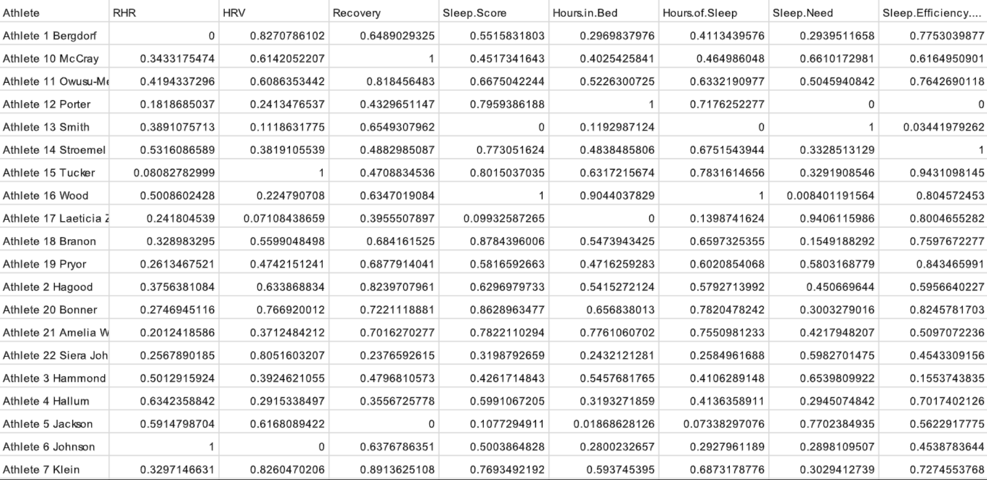
Dataset

Slide 6
Feature Selection
Feature Importance generated using XGBoost
Feature dependence using correlation matrix
Colab Link

Slide 7
Model Selection
Clustering
GMM handles complex cluster structures
Allows clusters of different shapes and sizes
Provides probabilistic cluster assignments
Robust for data points on cluster boundaries
Suitable for data points belonging to multiple clusters

Slide 8
Conclusion
Data preprocessing and imputation
Feature selection
Further Work
The further work to be done is the clustering
Validating the results with other clustering algorithms.
With that employing techniques for Explainable AI
XAI will able to derive the insights based on the clustering results.

Slide 9
References
Taber, C.B., Sharma, S., Raval, M.S. et al. A holistic approach to performance prediction in collegiate athletics: player, team, and conference perspectives. Sci Rep 14, 1162 (2024). https://doi.org/10.1038/s41598-024-51658-8
S. Senbel et al., ”Impact of Sleep and Training on Game Performance and Injury in Division-1 Women’s Basketball Amidst the Pandemic,” in IEEE Access, vol. 10, pp. 15516-15527, 2022, .doi: 10.1109/ACCESS.2022.3145368.
H. Wan, H. Wang, B. Scotney and J. Liu, ”A Novel Gaussian Mixture Model for Classification,” 2019 IEEE International Conference on Systems, Man and Cybernetics (SMC), Bari, Italy, 2019, pp. 3298-3303,doi:10.1109/SMC.2019.8914215.

Slide 10
Thank You

