Slide 1
Lab webserver
web server and browser
Version | 1.5
Author(s) | Lorenzo Ariemma, Tommaso Caiazzi, Giuseppe Di Battista, Maurizio Patrignani, Massimo Rimondini
E-mail | contact@kathara.org
Web | http://www.kathara.org/
Description | A lab showing the operation of a Web server accessed by a browser client – the TCP perspective – kathara version of a corresponding netkit lab vers. 1.2

Slide 2
Copyright notice
All the pages/slides in this presentation, including but not limited to, images, photos, animations, videos, sounds, music, and text (hereby referred to as “material”) are protected by copyright.
This material, with the exception of some multimedia elements licensed by other organizations, is property of the authors and/or organizations appearing in the first slide.
This material, or its parts, can be reproduced and used for didactical purposes within universities and schools, provided that this happens for non-profit purposes.
Information contained in this material cannot be used within network design projects or other products of any kind.
Any other use is prohibited, unless explicitly authorized by the authors on the basis of an explicit agreement.
The authors assume no responsibility about this material and provide this material “as is”, with no implicit or explicit warranty about the correctness and completeness of its contents, which may be subject to changes.
This copyright notice must always be redistributed together with the material, or its portions.

Slide 3
Lab topology
client
2
eth0
10.0.0.0/24
A
1
eth0
server

Slide 4
Lab description
server
runs apache2 (with a default configuration)
client
the user can launch a text-based web browser (links) to check the server operation

Slide 5
The server
the user can check that apache2 is up and running by using the following command:
we put a test html page
located in /var/www/html/index.html
server
root@server:/# systemctl status apache2
apache2.service - The Apache HTTP Server
Loaded: loaded (/usr/lib/systemd/system/apache2.service, enabled) Active: active (running)
<html>
<body>
<h1>Hello!</h1>
</body>
</html>

Slide 6
The client
the user is supposed to start the web browser links on the client
you should get a screen saying “Hello!”
client
root@client:~$ links http://10.0.0.1

Slide 7
let us observe the packets
perform the following command on the host computer to observe the traffic generated by the http protocol
kathara lconfig -n wireshark --add A
what follows is a list of packets observed on the Ethernet link called A

Slide 8
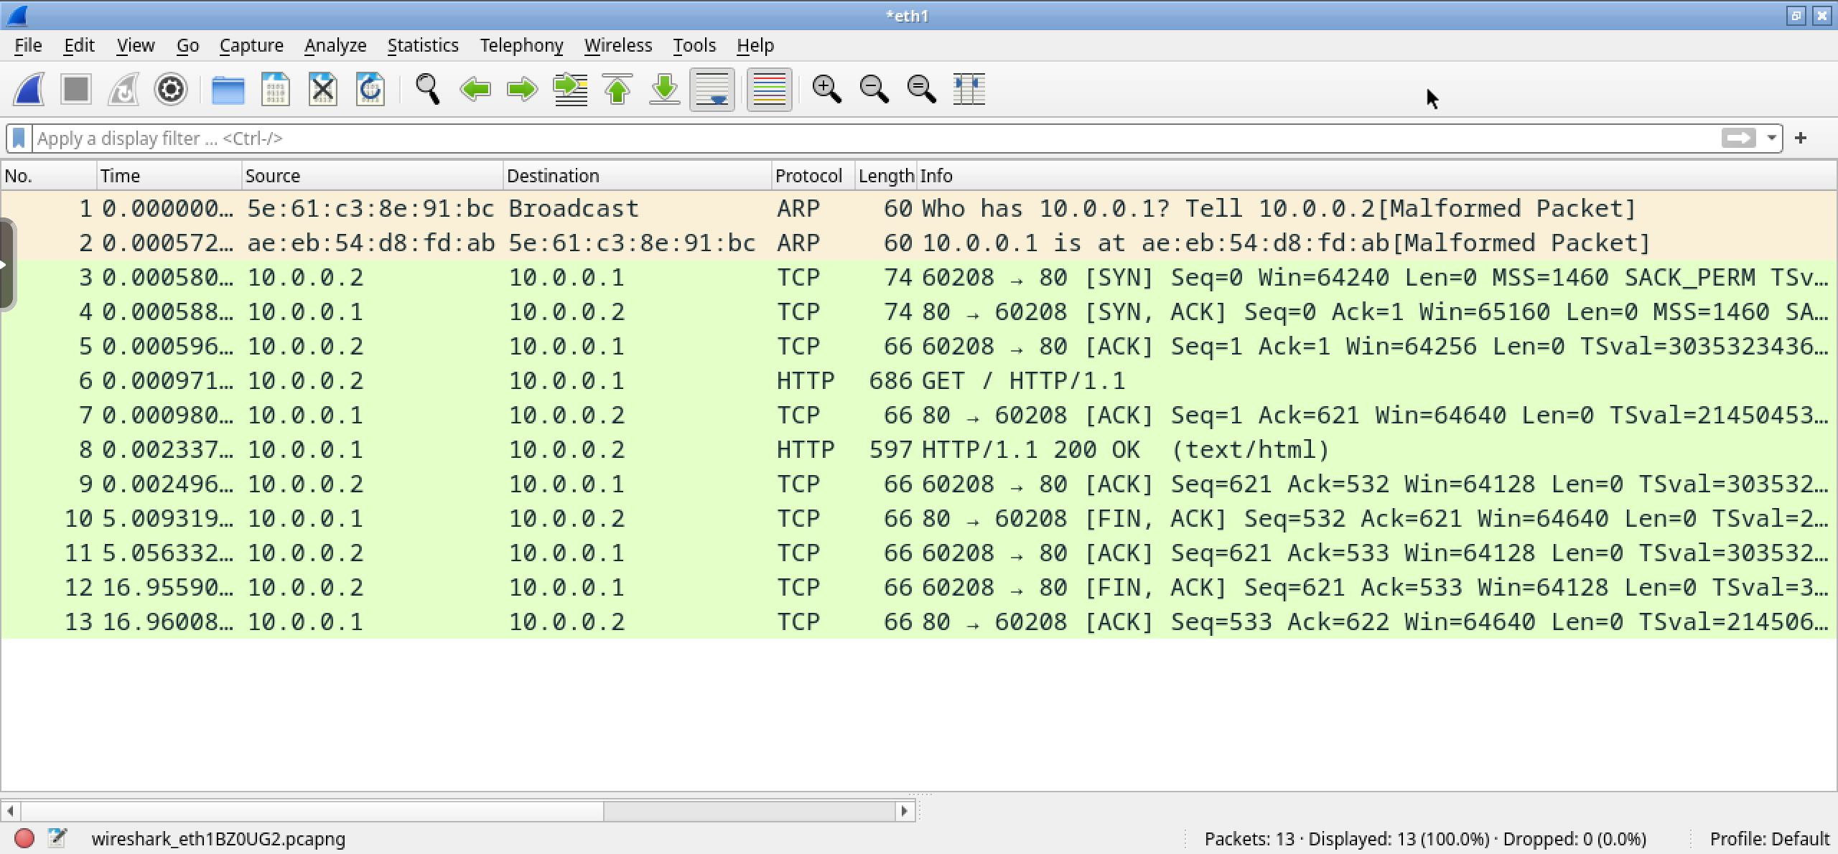
The 13 captured packets

Slide 9
http basic behaviour
Client
Server
SYN
open
SYN+ACK
ACK
Request
Answer
FIN
ACK
close
FIN
ACK

Slide 10
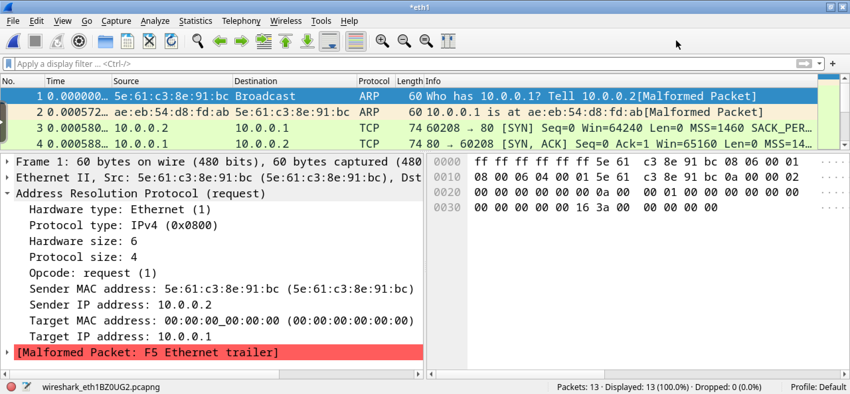
pkt 1 – client→bcast – arp request
arp request: the client looks for the MAC address of the server

Slide 11
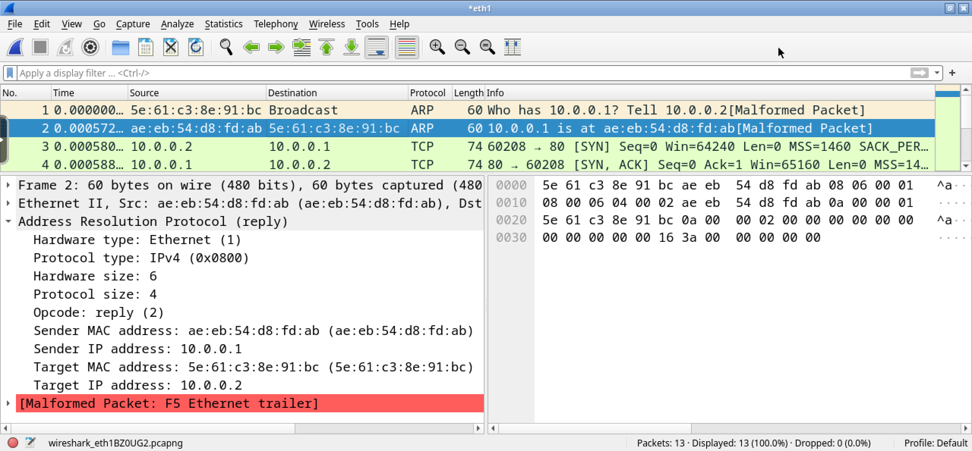
pkt 2 – client←server – arp reply
arp reply: the server provides its MAC address

Slide 12
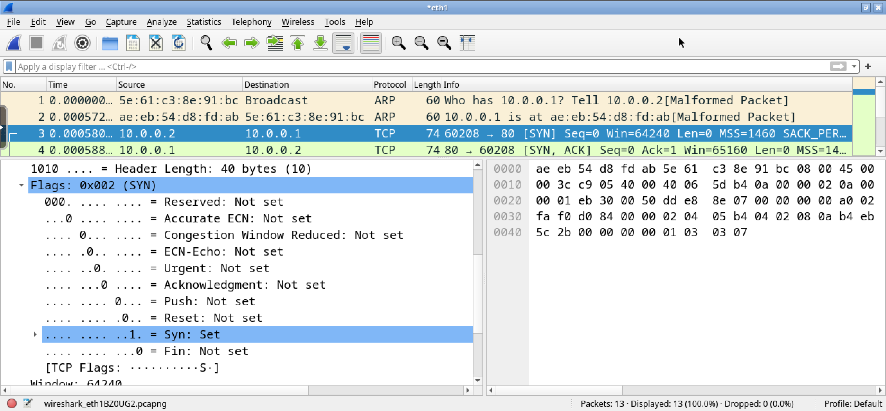
pkt 3 – client→server – syn
the client starts the three-way-handshake
the port the client is “knocking on” is 80
the port the client is using as source port is 60208

Slide 13
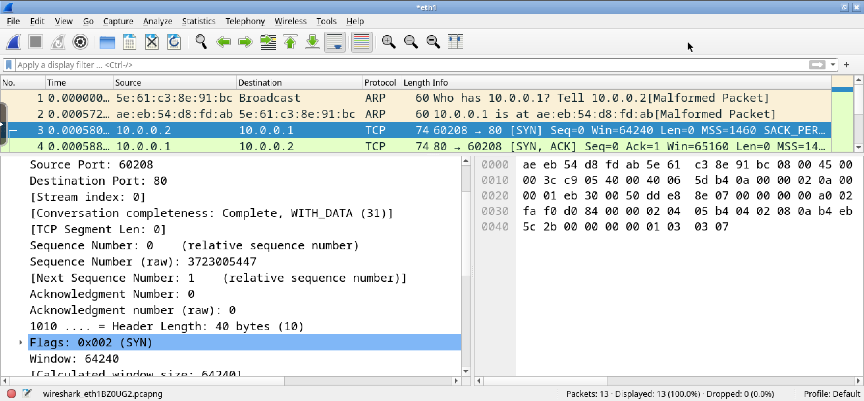
pkt 3 – client→server – initial seq. numb.
the client proposes 3723005447 as its initial sequence number

Slide 14
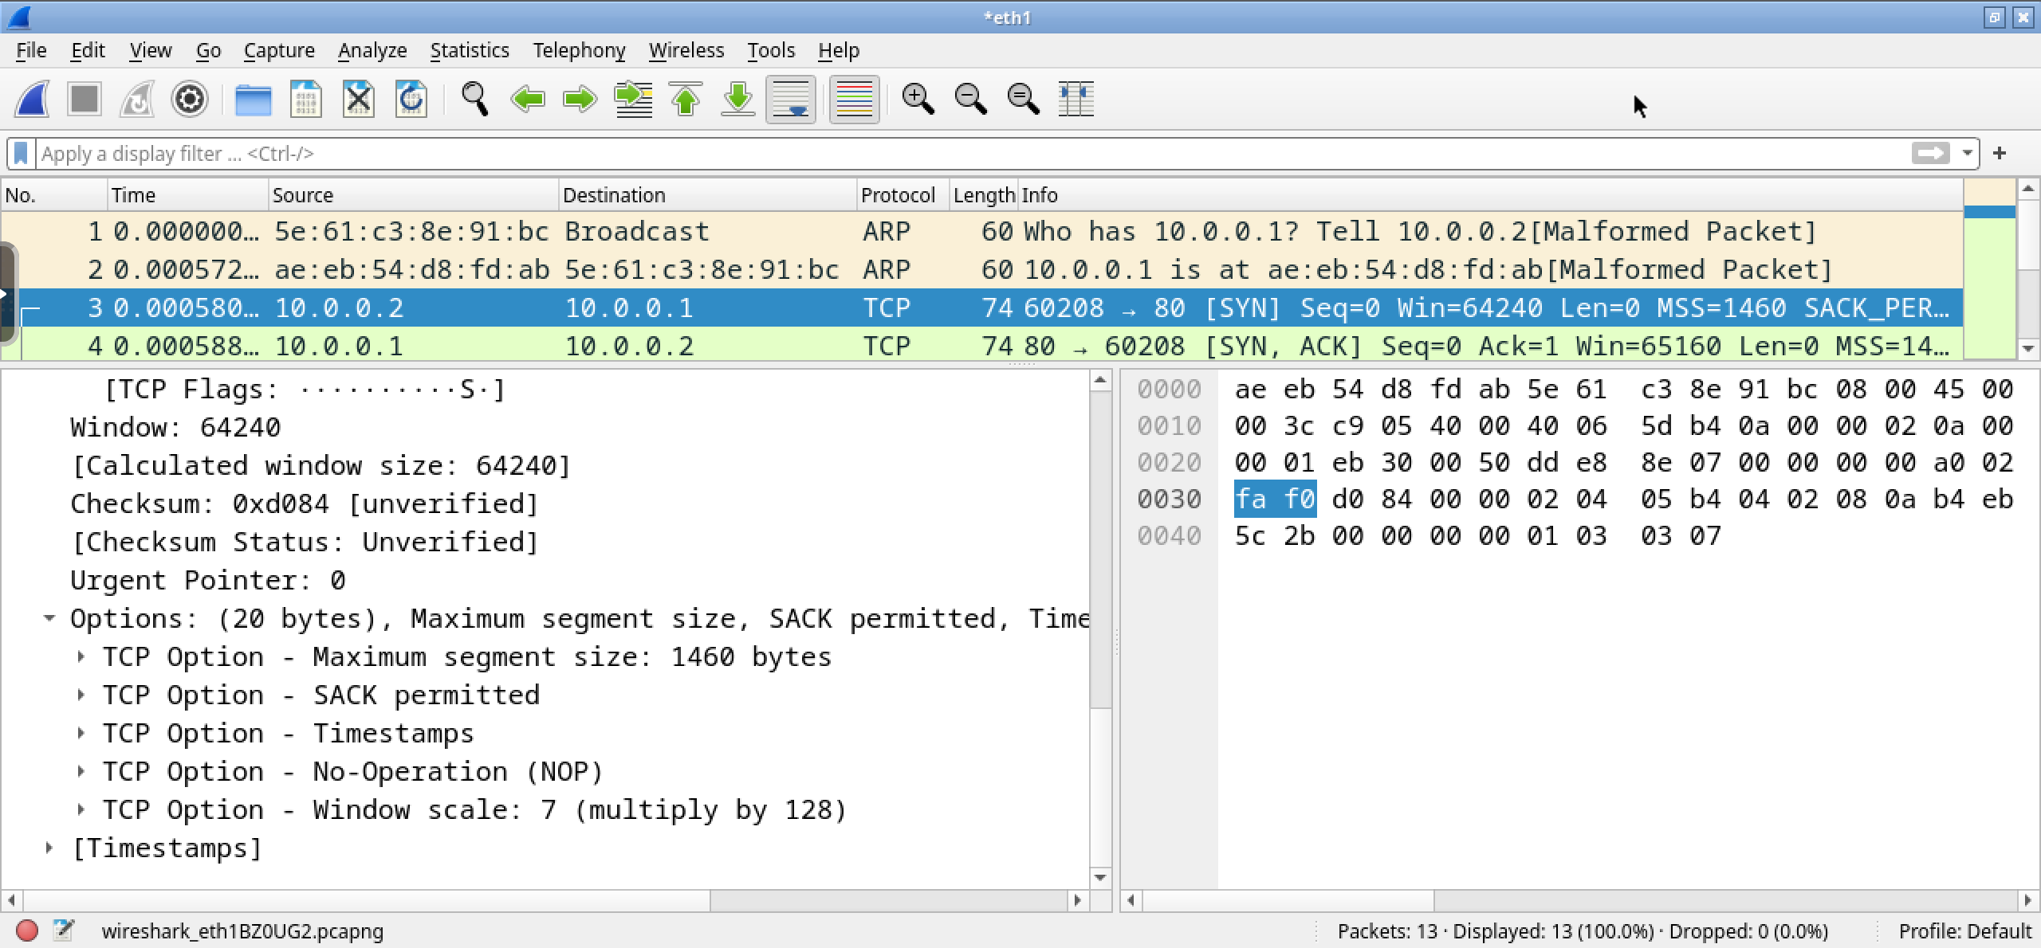
pkt 3 – client→server – MSS option
the client proposes a maximum segment size of 1460 bytes

Slide 15
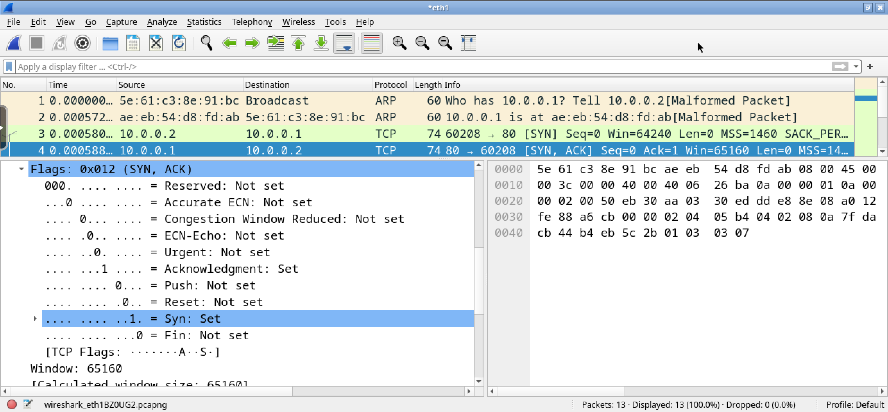
pkt 4 – client←server – syn ack
second packet of the three-way-handshake

Slide 16
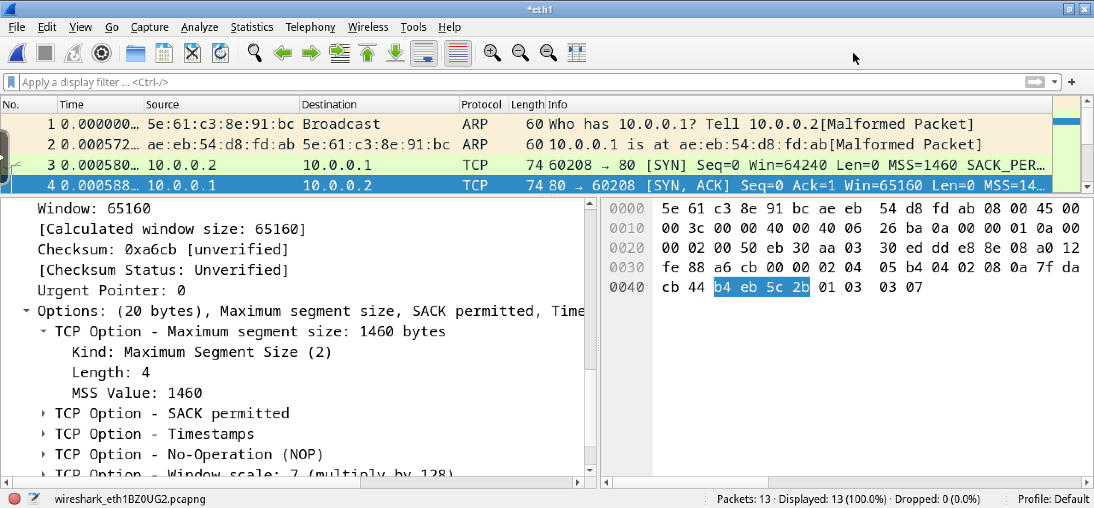
pkt 4 – client←server – MSS option
the server proposes a maximum segment size of 1460 bytes too

Slide 17
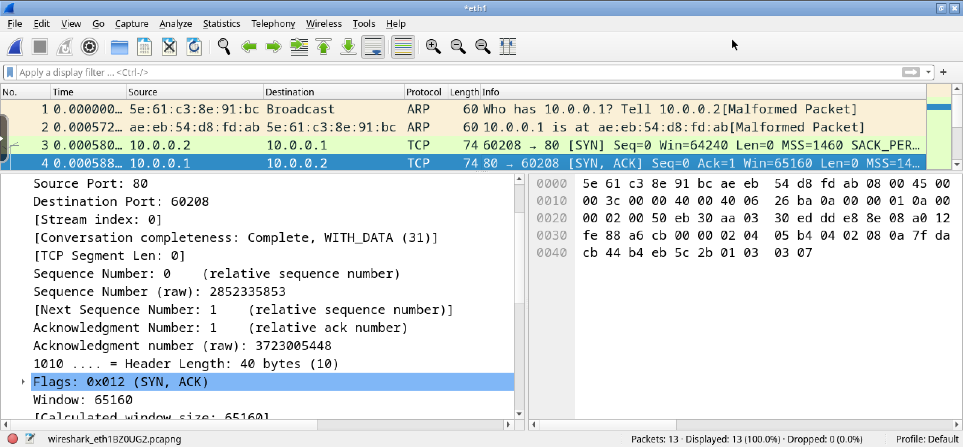
pkt 4 – client←server – initial seq. numb.
the server proposes 2852335853 as initial sequence number
and acks the sequence number proposed by the client

Slide 18
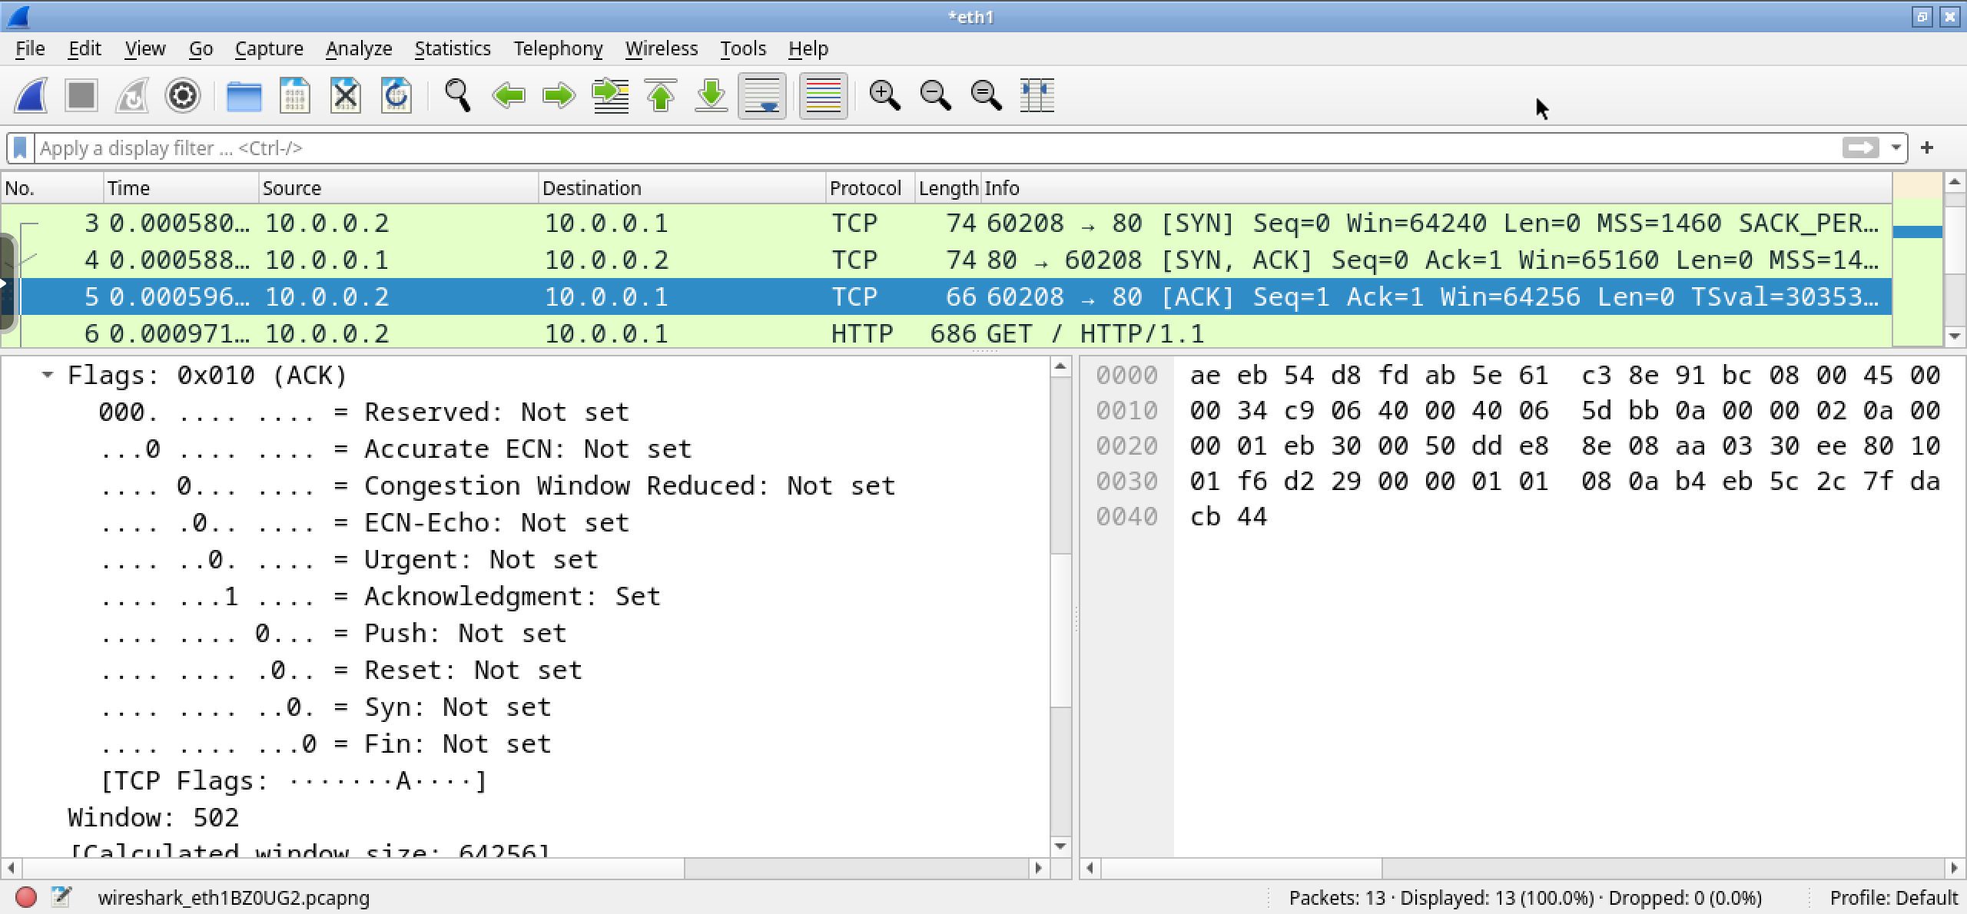
pkt 5 – client→server – ack
third packet of the three-way-handshake

Slide 19
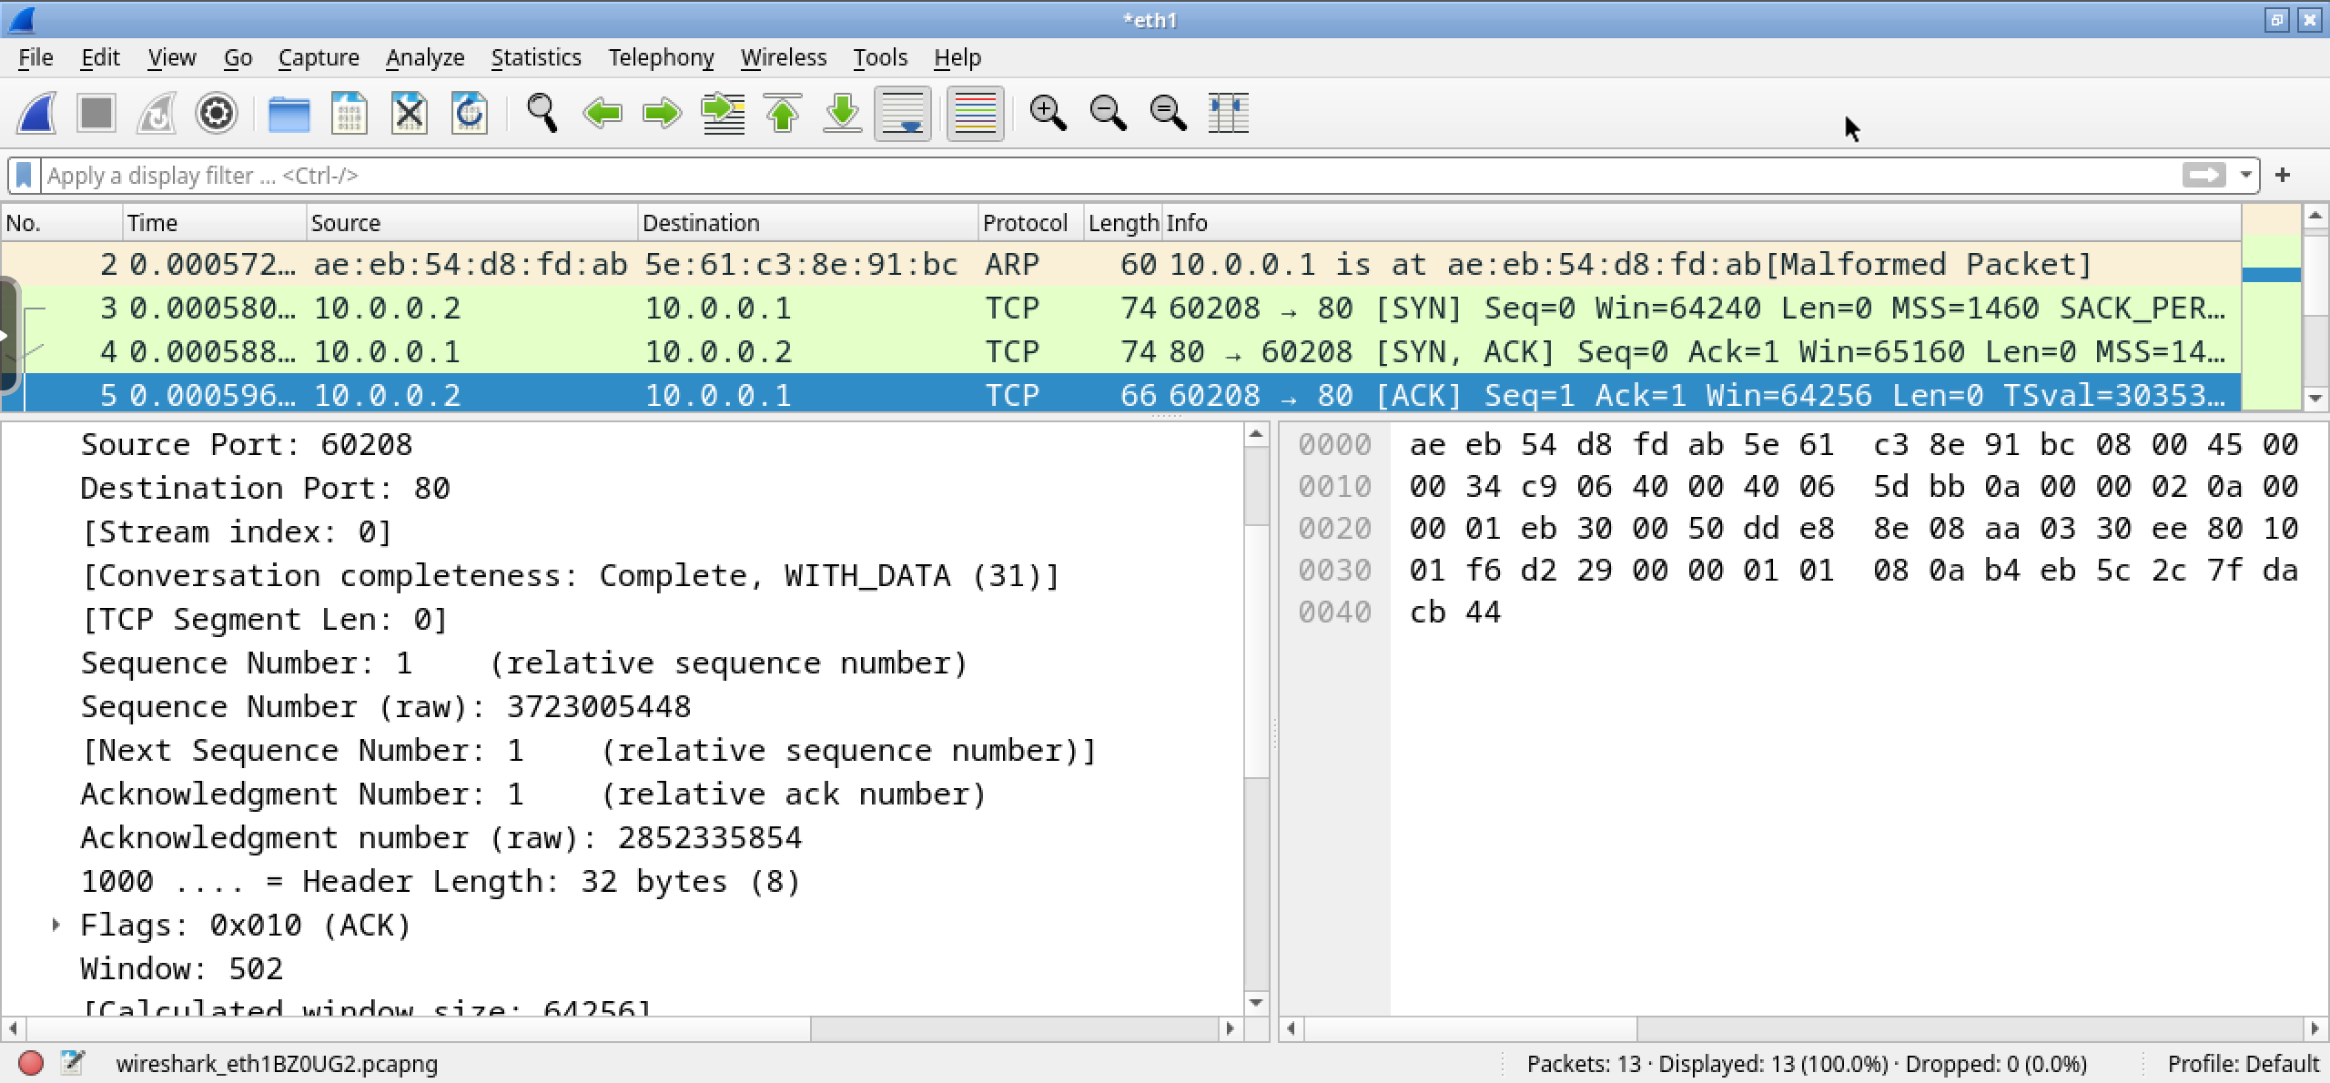
pkt 5 – client→server – ack
the client acks the sequence number proposed by the server

Slide 20
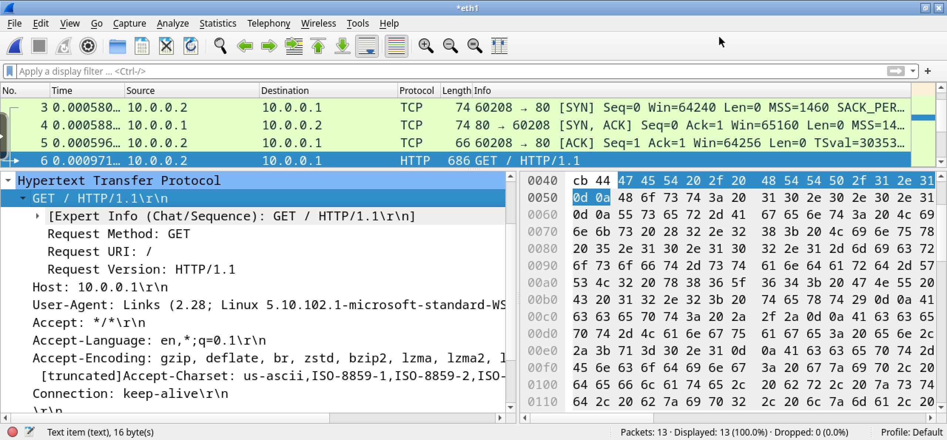
pkt 6 – client→server – http GET
http GET with http version 1.1

Slide 21
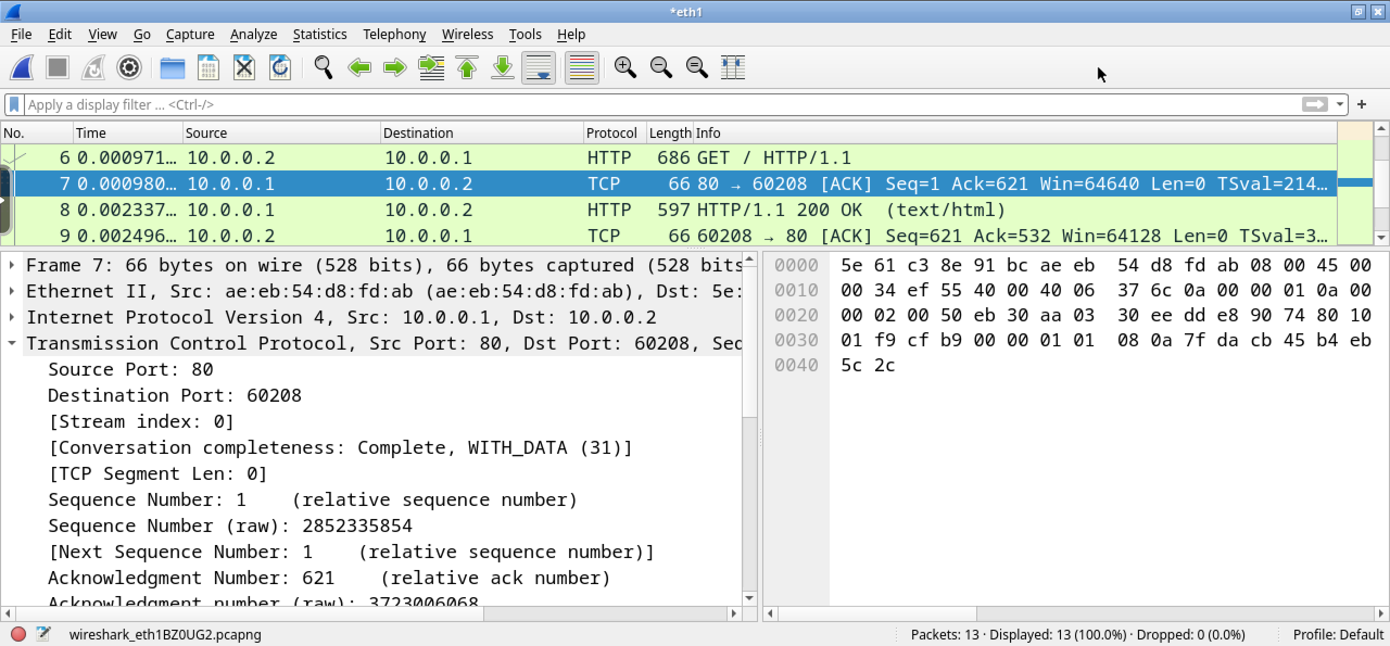
pkt 7 – client←server – bytes received
tcp acks the receipt of the bytes of the GET

Slide 22
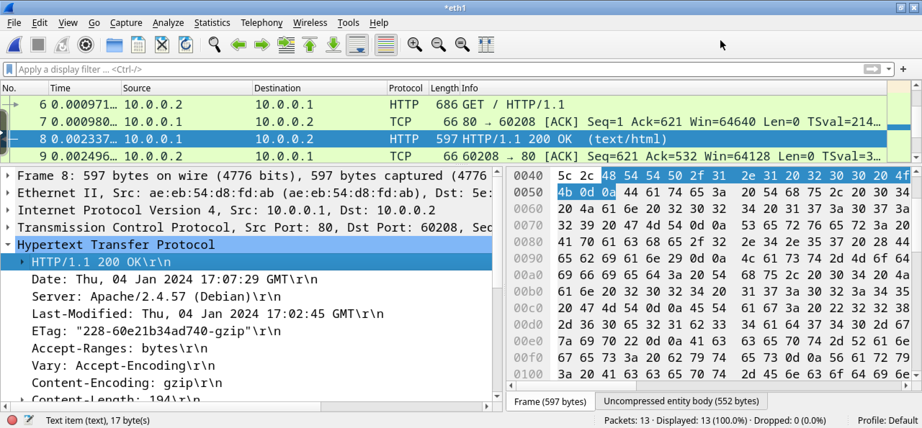
pkt 8 – client←server – resource moves
the requested resource

Slide 23
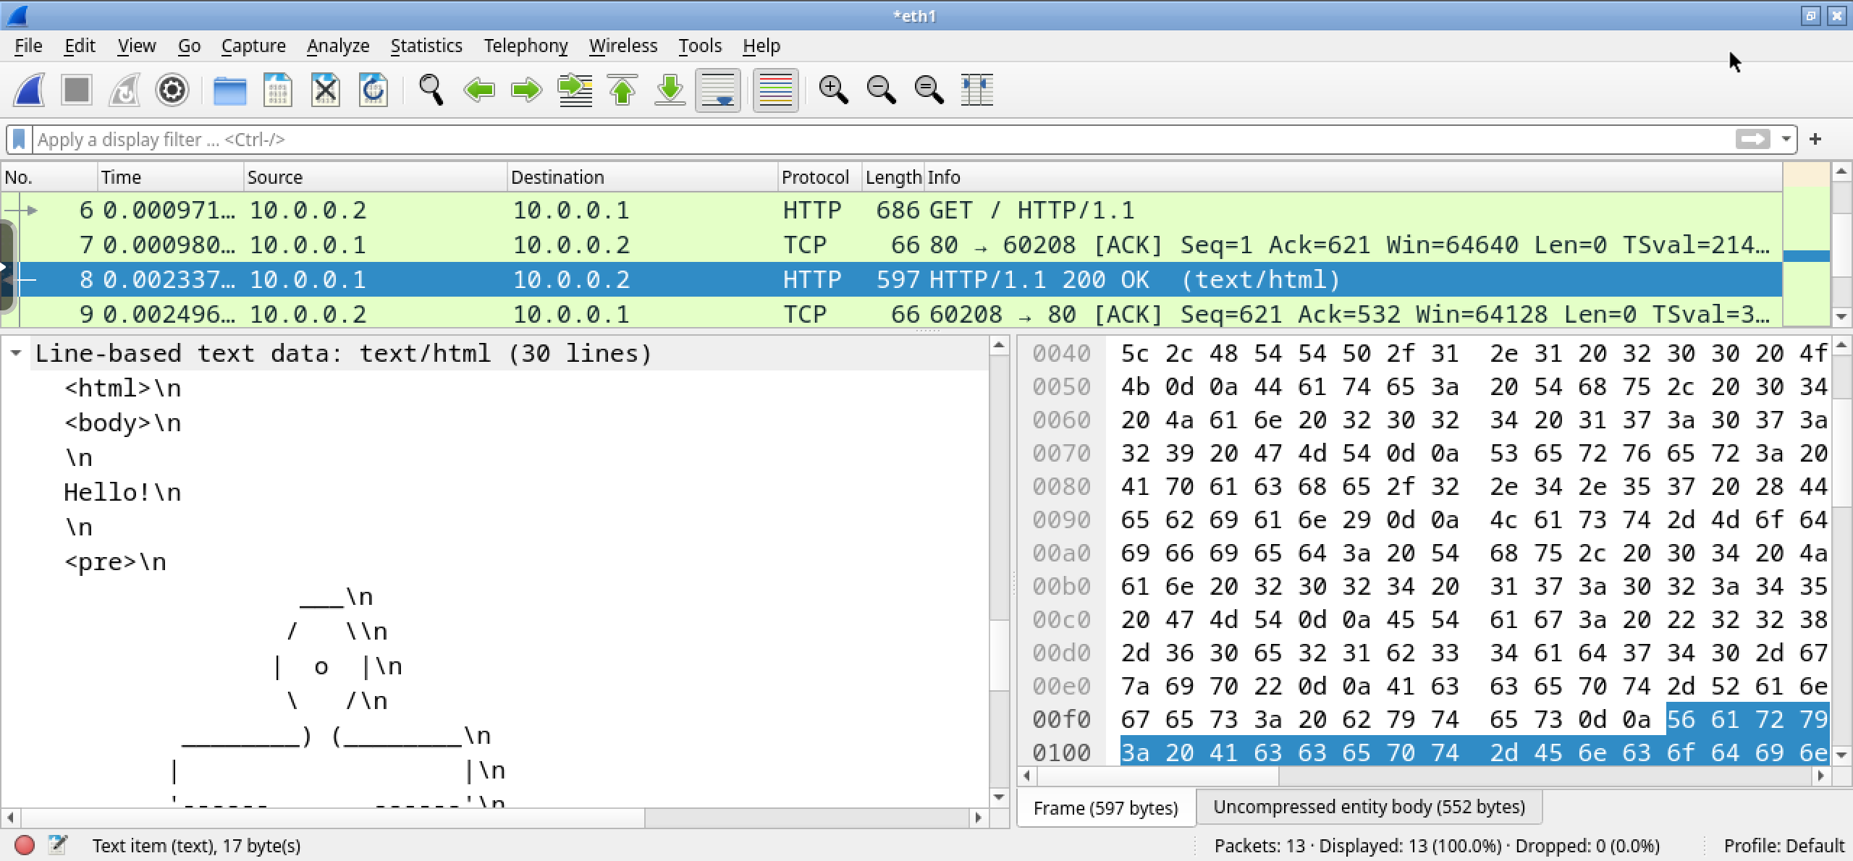
pkt 8 – client←server – resource moves
the requested resource

Slide 24
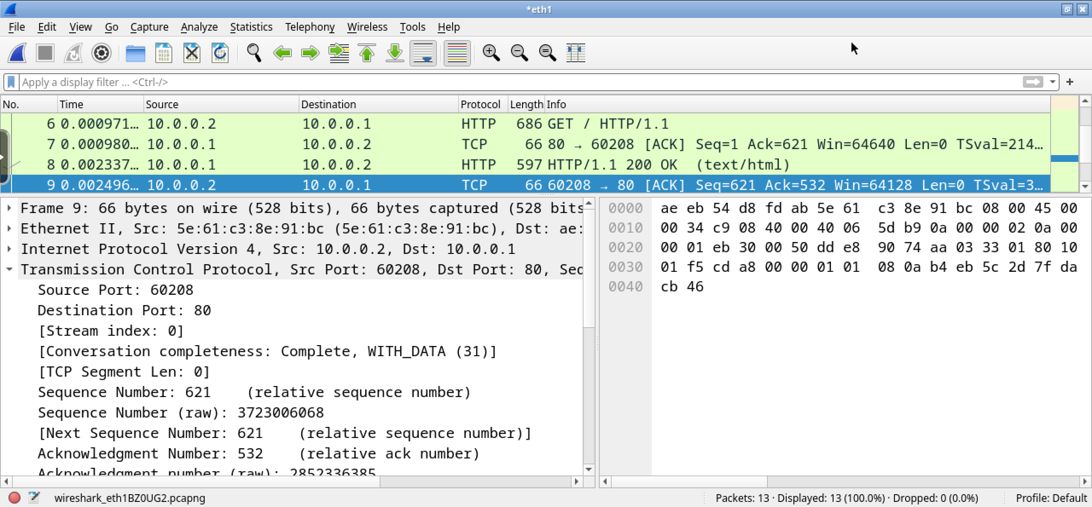
pkt 9 – client→server – bytes received
tcp acks the bytes of the resource

Slide 25
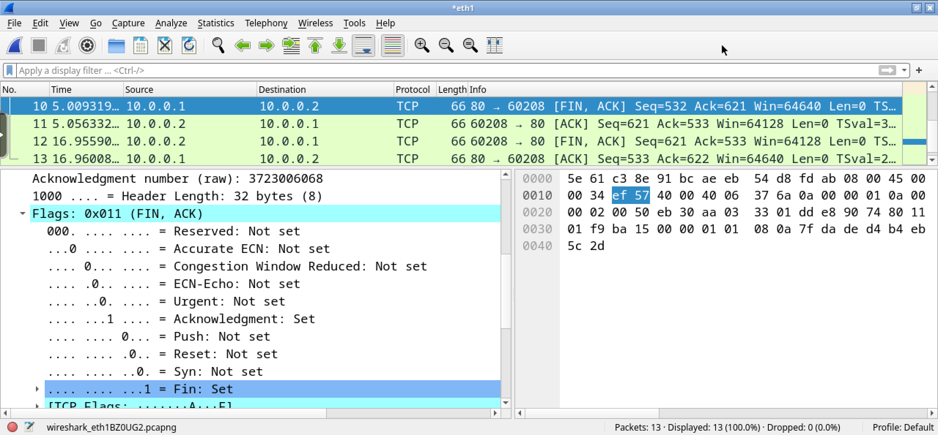
pkt 10 – client←server – fin
request to finish

Slide 26
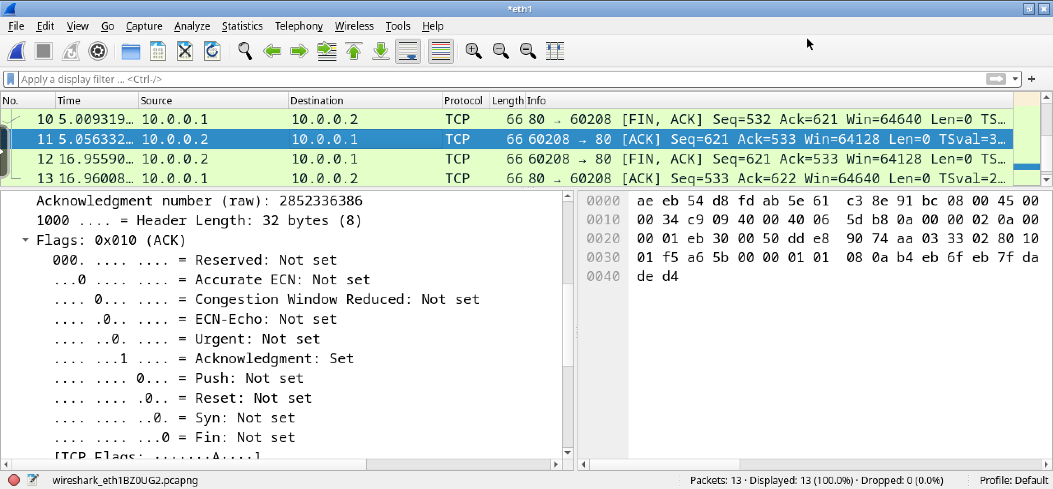
pkt 11 – client→server – ack
ack to finish

Slide 27
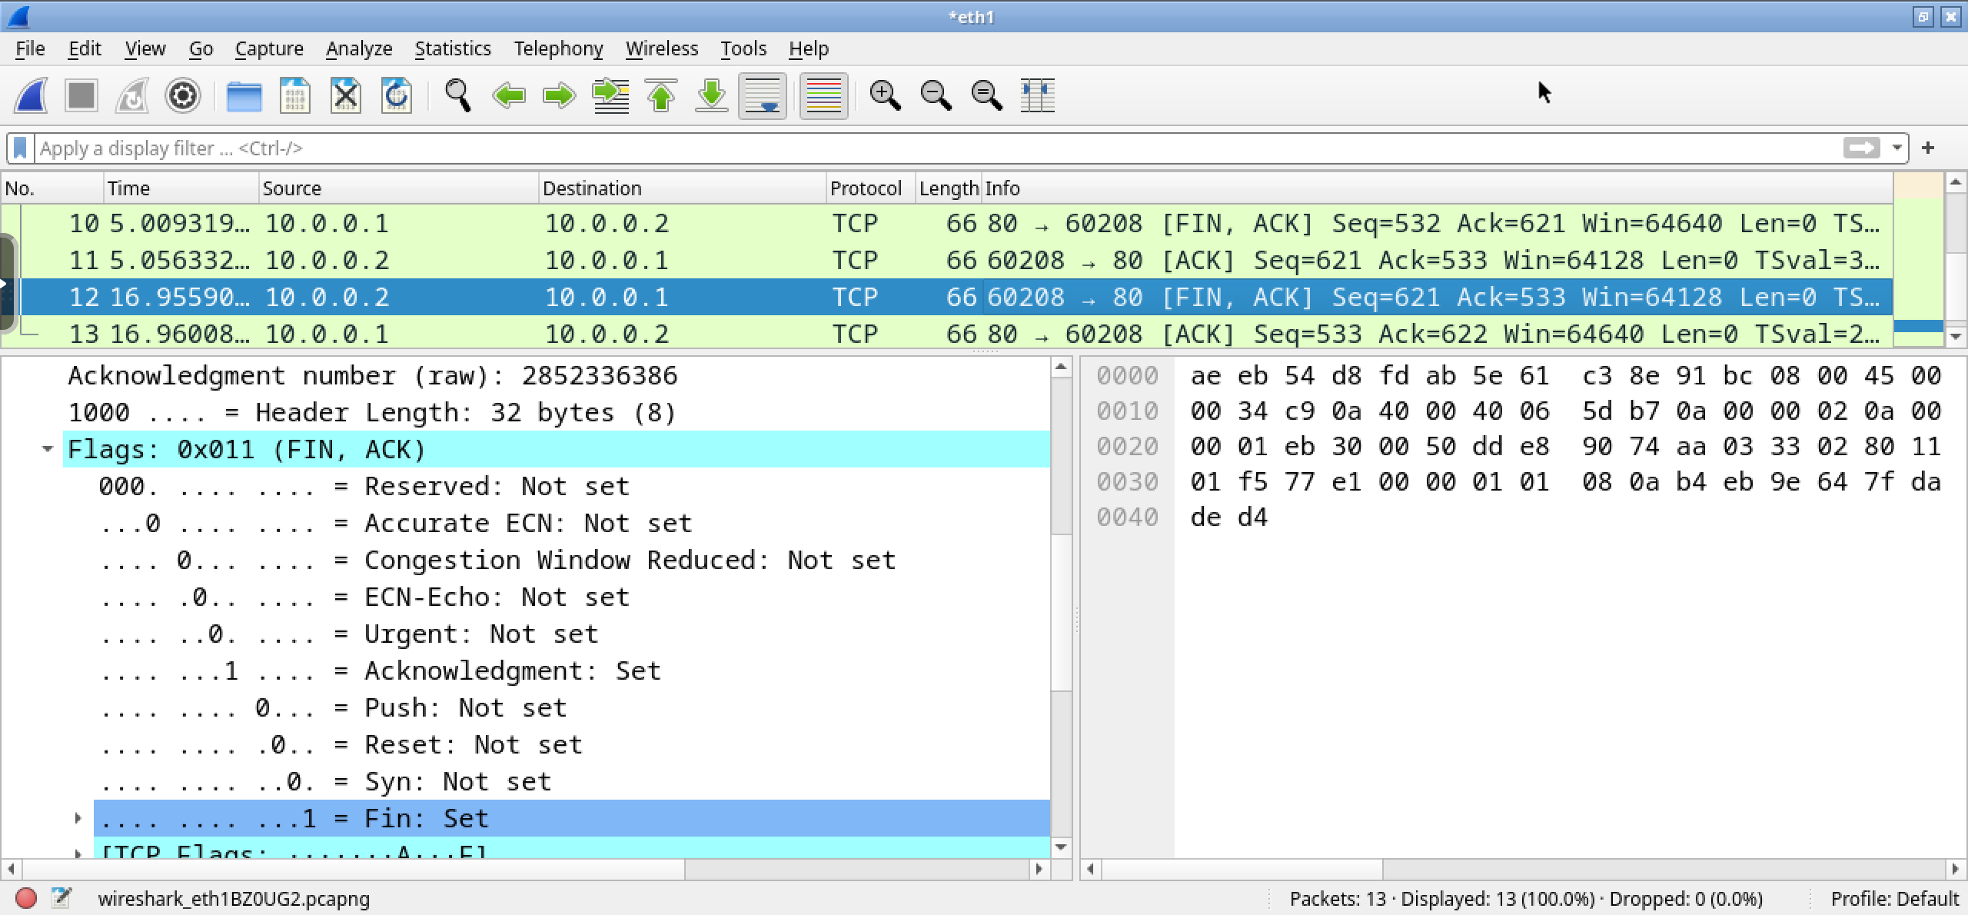
pkt 12 – client→server – fin
request to finish

Slide 28
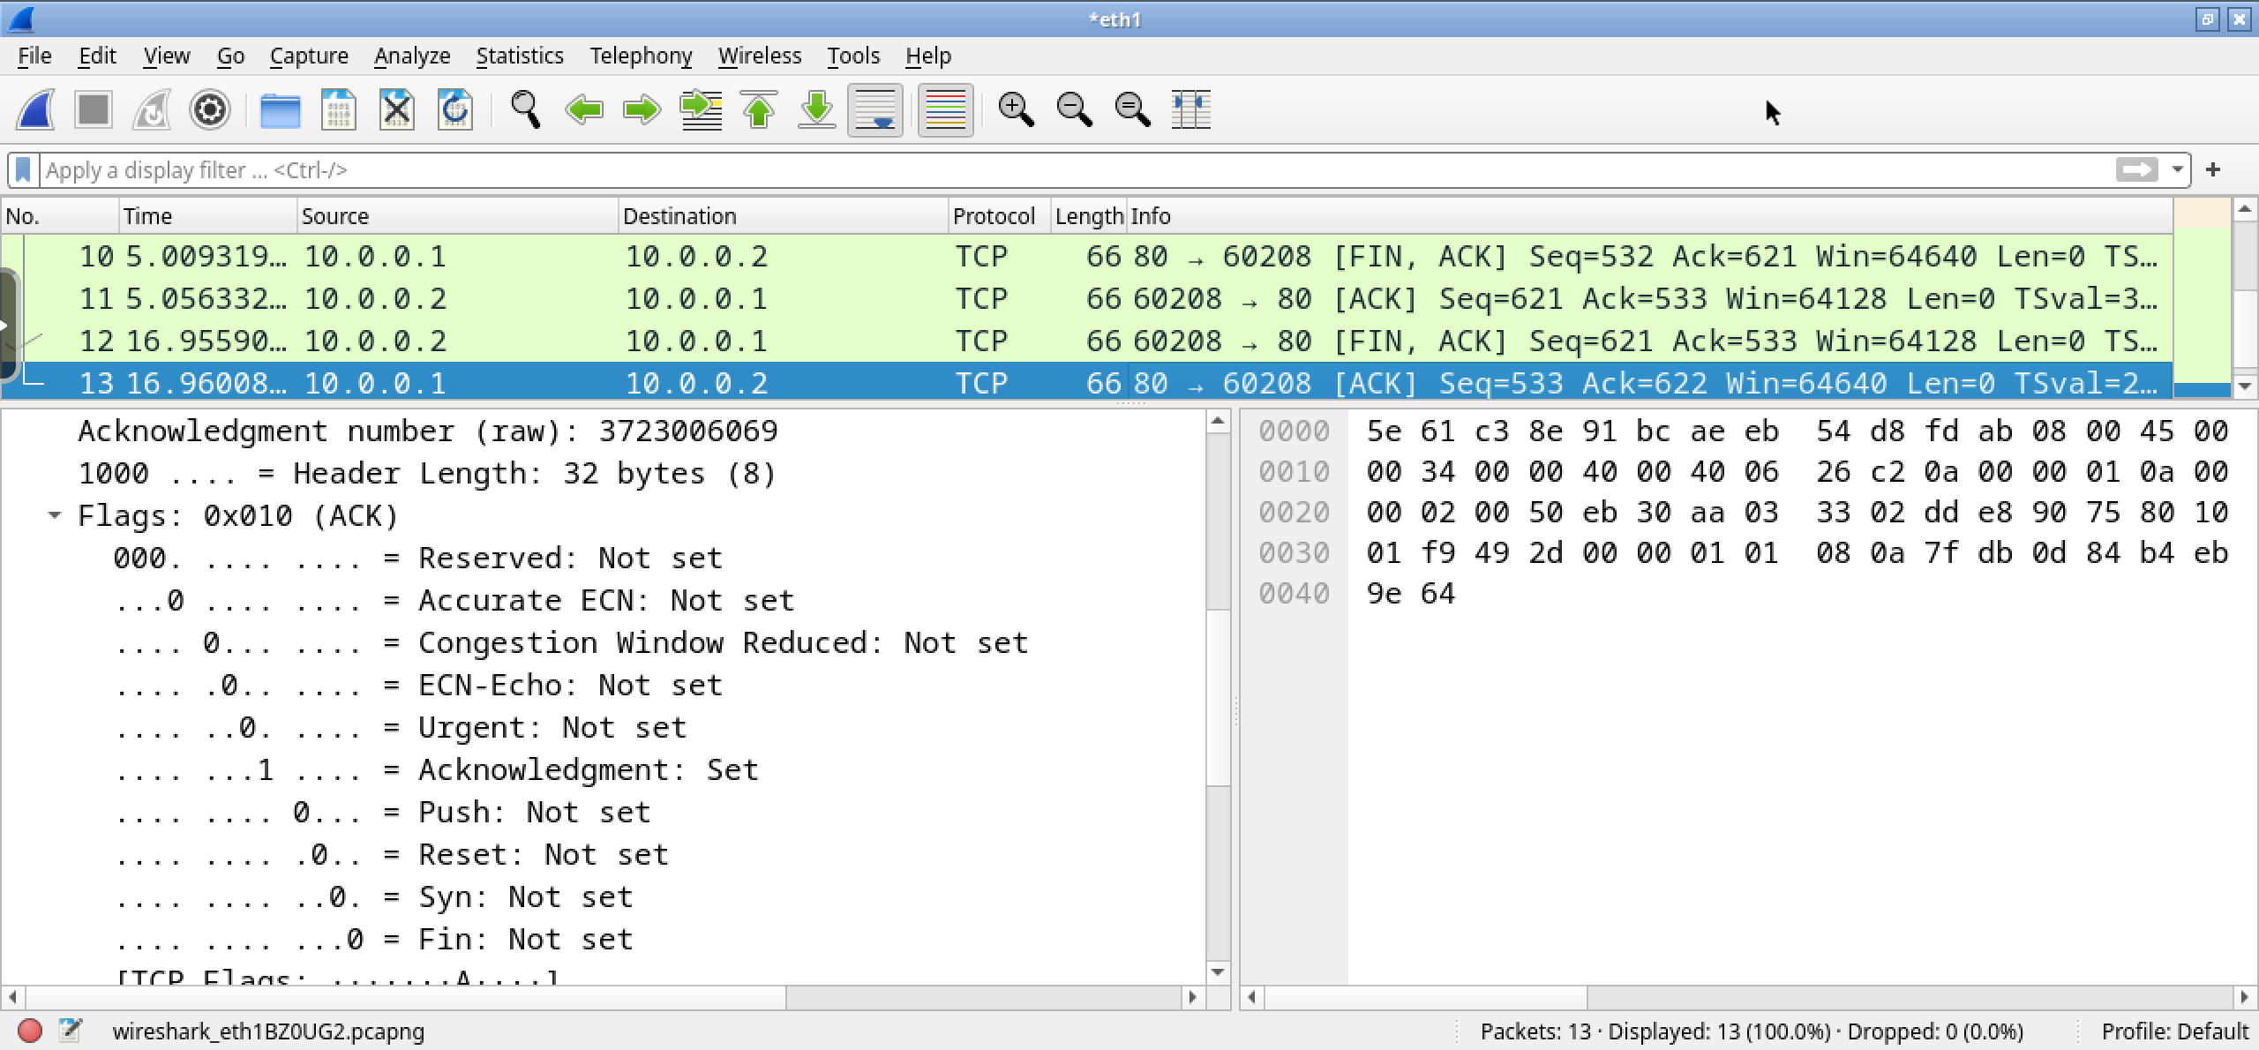
pkt 13 – client←server – ack
ack to finish

Slide 29
extras

Slide 30
The server (again)
to monitor accesses to the web server you can use the following command (on the server):
root@server:~$ tail -f /var/log/apache2/access.log
10.0.0.2 - - [19/Oct/2011:08:04:08 +0000] "GET / HTTP/1.1" 200 56 "-" "Links (2.2; Linux; 80x39)"

Slide 31
The server (again)
to monitor errors on the web server you can use the following command (on the server):
very useful when debugging configurations
root@server:~$ tail -f /var/log/apache2/error.log
[Wed Nov 14 15:57:58 2019] [notice] Apache/2.2.9 (Debian) configured -- resuming normal operations
[Wed Nov 14 16:14:07 2019] [notice] caught SIGTERM, shutting down

Slide 32
Apache modules
most of apache’s functionalities are built-in
retrieve the list using apache2 -l
others can be added by enabling modules
to enable a module:
root@server:~$ a2enmod rewrite
Enabling module rewrite.
To activate the new configuration, you need to run:
service apache2 restart
root@server:~$ █

Slide 33
apache modules
available modules are located in:
/etc/apache2/mods-available
enabled modules are located in:
/etc/apache2/mods-enabled
a2enmod puts a symbolic link from the relevant file(s) in:
/etc/apache2/mods-available to /etc/apache2/mods-enabled
a2dismod removes these symbolic links

Slide 34
some useful apache modules
userdir | enables per-user web sites (this feature does not work with Kathará)
rewrite | implements URL rewriting
proxy | implements a proxy/gateway
cgi/cgid | supports execution of CGI scripts

Slide 35
per-directory configuration
apache allows configuration changes on a per-directory basis
creating a special file /some/path/.htaccess with apache configuration statements applies those statements to all files and subdirectories inside /some/path
.htaccess files can be nested in a directory tree
nested files override their parents

Slide 36
per-directory configuration
sample configuration statements:
restrict access from specific hosts
Deny from example.org test.com 10.0.0 192.168.0.0/24
perform URL rewriting
(transparently) redirect to other sites
restrict access to a specific subdirectory
change name of file containing the default page
DirectoryIndex pippo.html
enable/disable directory indexing
Options -Indexes

Slide 37
Exercise: per-directory configuration
when a resource name is not specified in the URL, apache serves index.html from the requested path
hands-on:
edit file /var/www/html/.htaccess and add the following directive:
DirectoryIndex custom_file.html
rename previously created file /var/www/html/index.html to custom_file.html
try accessing http://10.0.0.1/ from client
rename custom_file.html back to index.html and try accessing the page again

